Slide 1
Long Acting Reversible Contraceptives Lessons from the CHOICE Project
Amna Dermish MD MSc
Associate Medical Director, Planned Parenthood of Greater Texas
Associate Professor OB/GYN, Dell Medical School at UT Austin

Slide 2
Disclosures
Member of Speakers Bureau for:
Merck (Nexplanon®)
Actavis (Liletta®)

Slide 3
Objectives
What are the misconceptions and myths of LARC methods?
Understand the effectiveness of the long-acting reversible contraception methods, and how it differs from other methods
Explain the barriers that hinder the use long–acting reversible contraception methods in women and adolescents

Slide 4
Outline
Background
Unintended Pregnancy
LARC History
Evidence Review
Contraceptive CHOICE Project and other studies
Where we are now
Barriers

Slide 5
Background & History of LARC

Slide 6
Guttmacher.org

Slide 7
Unintended Pregnancy Declined 18%!
Finer et al. NEJM;374(9):843-852
Notes:
45 per 1000
Down from 54 per 1000 women
Which Is also equal to 45% pregnancies being unintended

Slide 8
Notes:
FPL 2015 family 4 - 24K, 200% 48K
2001 - 2008 UIP rate decreased in women at >200% FPL, but increased among women <200% FPL.
Since 2008, UIP rates have decreased among all populations. Wide disparities remain among SES, races, education levels, but we are finally headed in the right direction

Slide 9
Guttmacher.org
Notes:
What is the cause of the changes?
In order to understand that it's important to look at source of UIP.
1/3 of women account for 95% of UIP

Slide 10
LARC use is on the rise
Guttmacher.org
Notes:
But over the last couple decades we've seen a steady increase in % of women using LARC methods.

Slide 11
Changes in use among young women
Kavanaugh et al. Obstet Gynecol;126(5);917-927
Notes:
Use in teens and young women is stable among teens, increasing rapidly among young women
These present more challenging populations

Slide 12
The Intrauterine Device
Notes:
What does the history of the IUD have to tell us about how we ended up here

Slide 13
We’ve come a long way…
Notes:
IUDs have been around for decades, and were fairly popular, up until the Dalkon Shield
- Removed from market in early 1980s
- associated with septic abs & other complications
- multifilament strings

Slide 14
Subdermal Implant
Not without it’s own controversy…
Notes:
Norplant
- taken off market
- concerns re reproductive coercion - promotion of use in African American community
- 6 rods
- removals more difficult

Slide 15
LARC Today
A Review of the Evidence
Notes:
That history had a profound impact in LARC use and led to a long decline, that we have been seeing reverse over the past decade. So where are we today?

Slide 16
Contraceptive CHOICE Project
St Louis, Missouri region
August 2007 – September 2011
9,256 Women aged 14-45
Contraceptive method of their choice at no cost for 3 years
New users or interested in switching
Intended to “promote use of LARC by removing financial and knowledge barriers”
http://www.choiceproject.wustl.edu
Birgisson et al. J Women’s Health. 2015;24(5):349-353
Notes:
Method switching allowed and also covered. STI screening on entry, annually and as needed
Counseling intended to educate about the most effective methods of contraception

Slide 17
CHOICE Participant Demographics
Mean Age – 25
50% African American, 42% White, 5% Hispanic
47% nulliparous
40% had a history of STI
37% received public assistance
63% reported a prior unintended pregnancy
Peipert et al. Obstet Gynecol 2012;120(6):1291-1297

Slide 18
Contraceptive Counseling
Structured counseling intended to increase contraceptive knowledge
Client centered
GATHER method
Greet, Ask, Tell, Help, Explain, Return
Tiered effectiveness approach
Counselors underwent 2hr training
Madden et al. Contraception 2013;88(2):243-249
Notes:
Greet the woman
Ask her about reproductive goals, contraceptive history, etc
Tell her about contraceptive options
Help her make a decision
Explain method in detail, incl effectiveness, side effects
Return for f/u
Contraceptive methods were discussed starting with the most effective methods

Slide 19
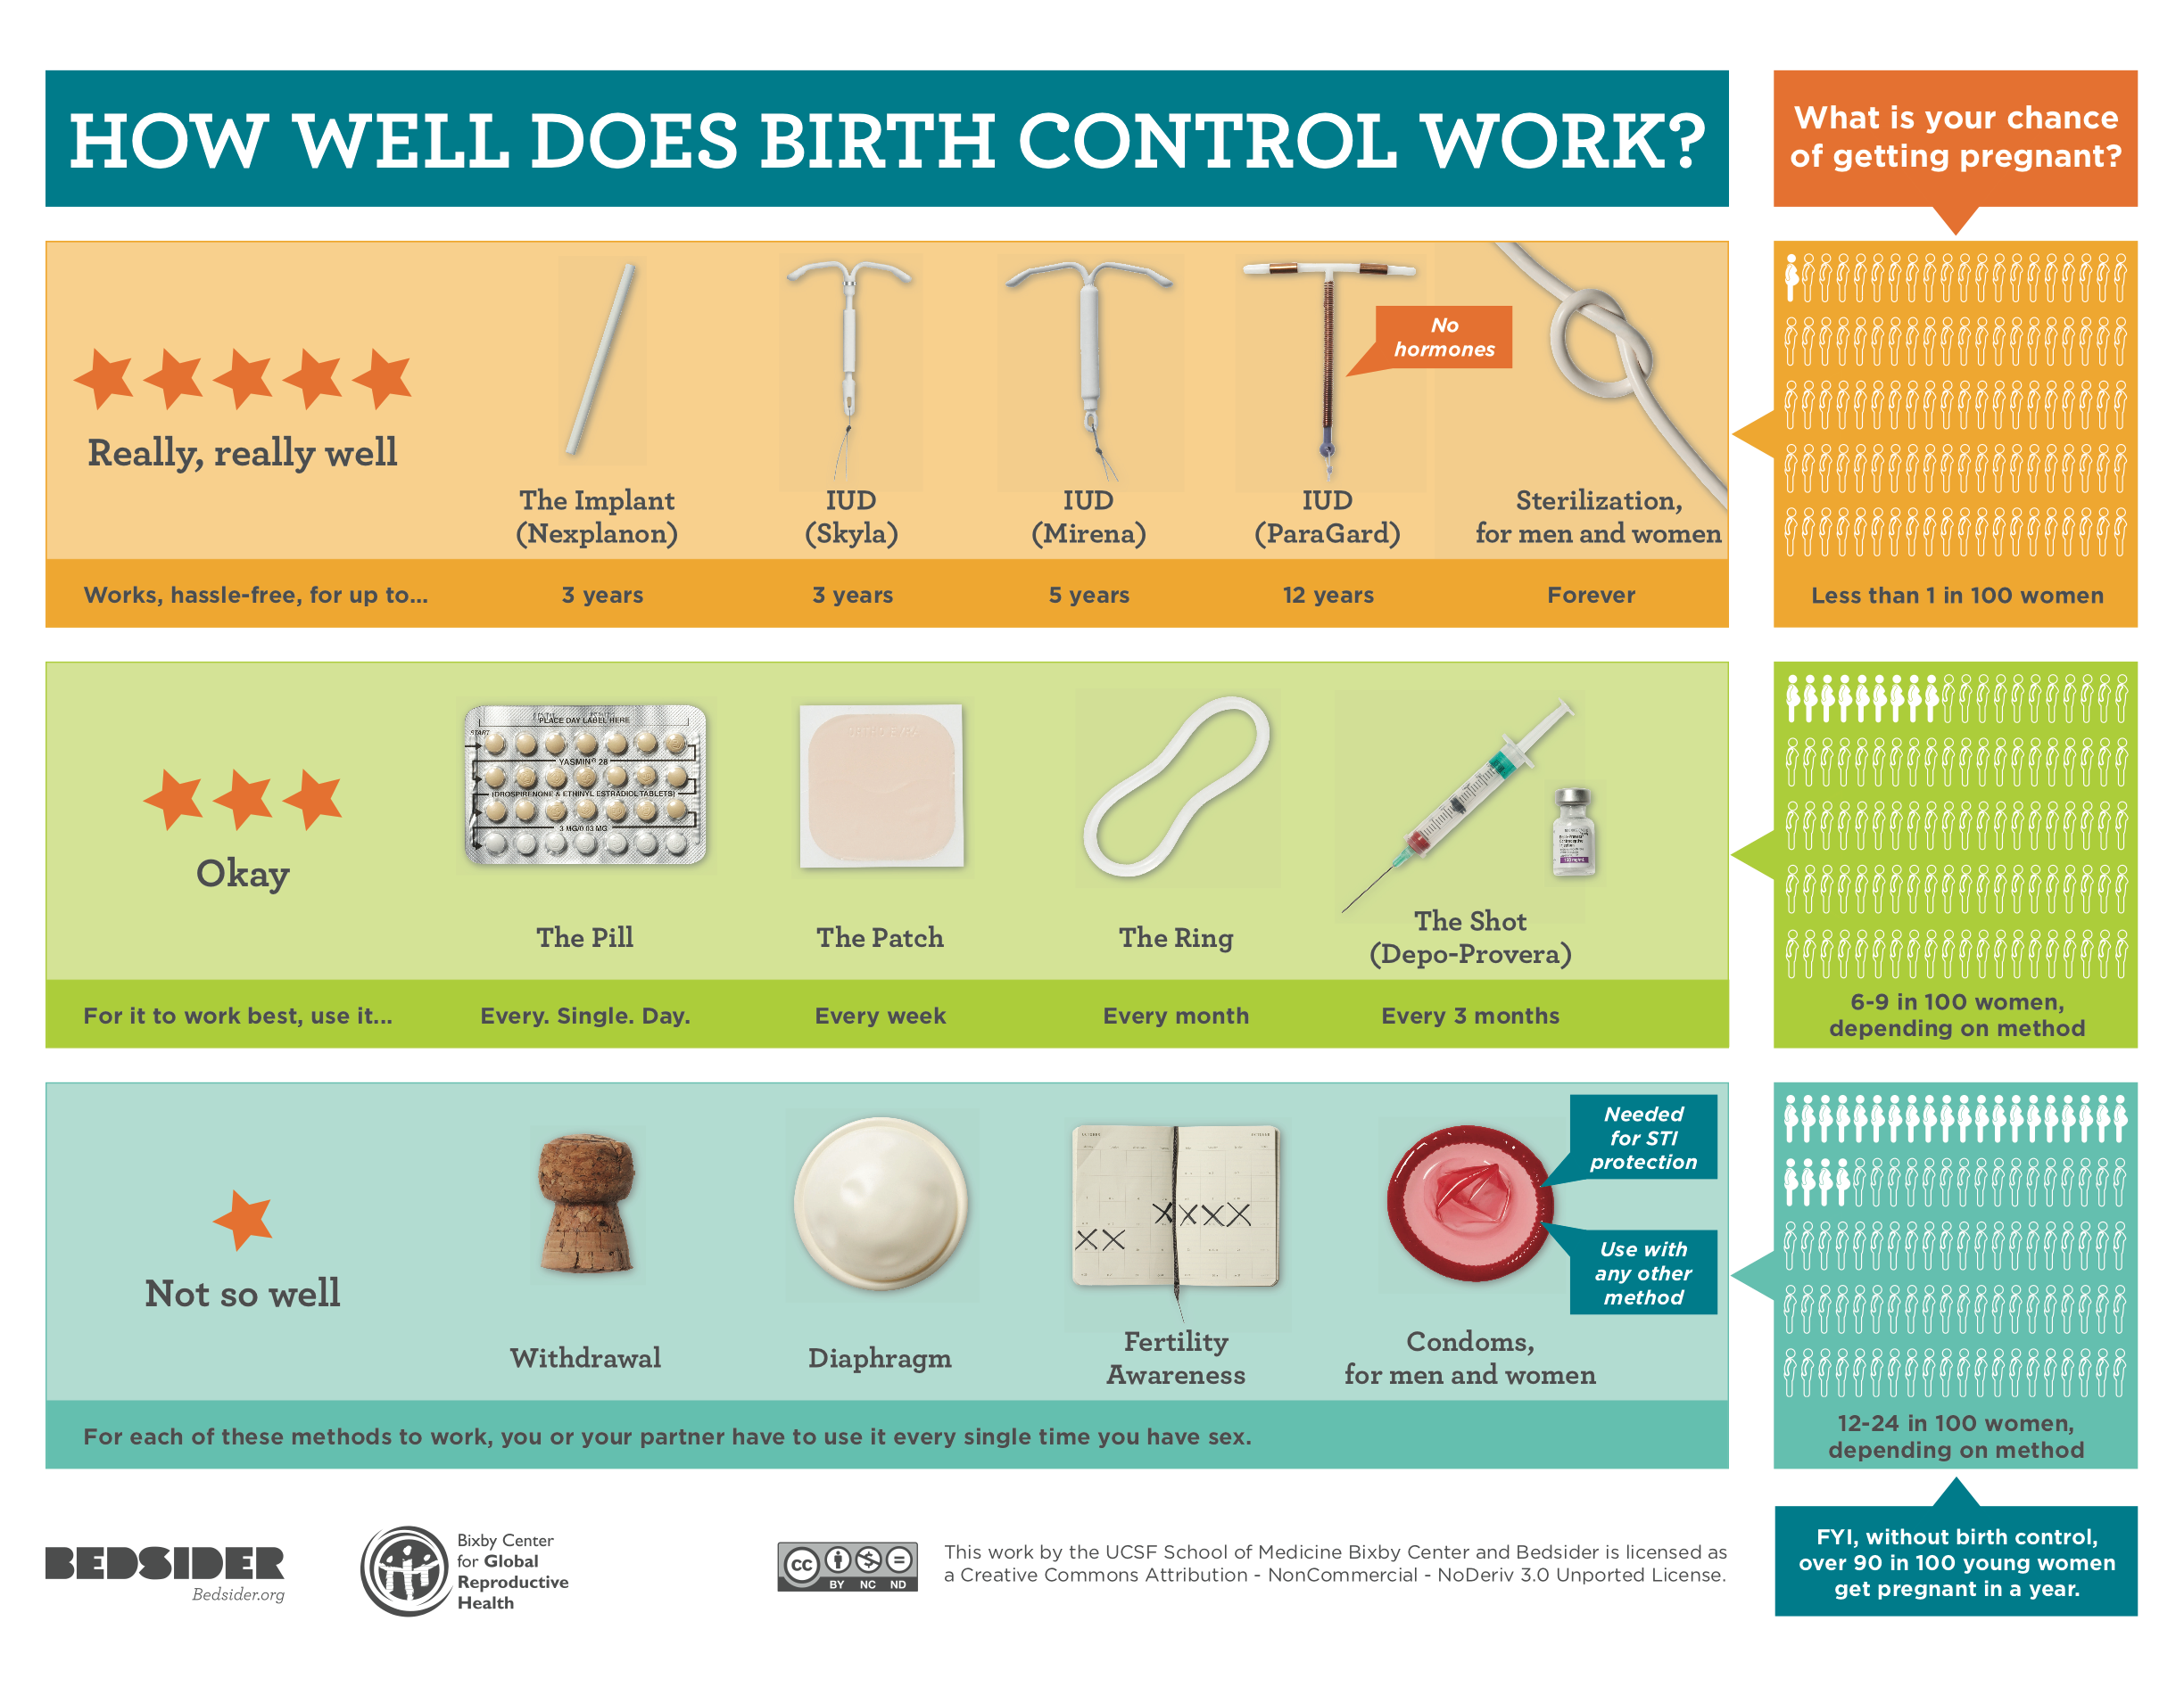
Notes:
Example of tiered effectiveness chart – not exact one used in CHOICE

Slide 20
Method Choice
All methods
Type of LARC
Birgisson et al. J Women’s Health. 2015;24(5):349-353
Notes:
Equal numbers OC, ring and DMPA, fewest chose patch
2/3 of women <20 chose a LARC method
For women <18 2/3 chose Implant over IUD, for women 18-20 this percentage reversed

Slide 21
Continuation Rates
Diedrich et al. AJOG. 2015;213(5):662.e1-662.e8
Notes:
Hazard Ratio for discontinuation of non-LARC vs LARC – 3.08

Slide 22
Continuation rates by age
Diedrich et al. AJOG. 2015;213(5):662.e1-662.e8
Notes:
Younger age also a risk factor for d/c – though overall continuation rates high
Top reasons for d/c – Bleeding, “did not like the way it made me feel”

Slide 23
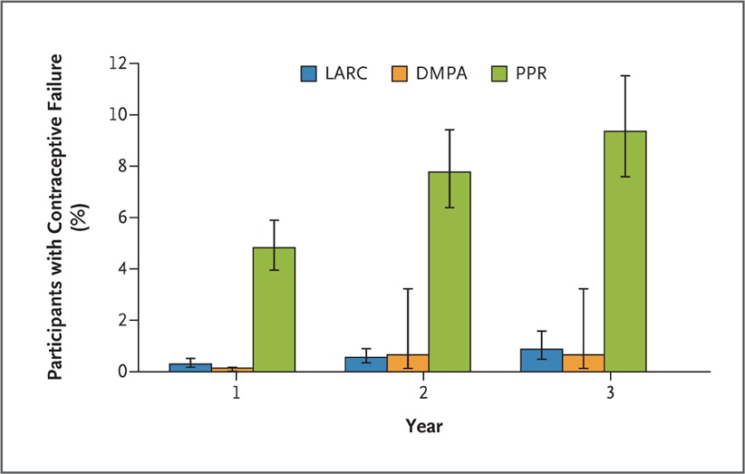
Winner B et al. N Engl J Med 2012;366:1998-2007.
Cumulative Percentage of Participants Who Had a Contraceptive Failure at 1, 2, or 3 Years, According to Contraceptive Method.
LARC Effectiveness
Hazard Ratio (95% CI)
21.8 (13.7 – 34.9)
Risk of contraceptive failure 20 x greater for users of pill, patch, ring
Notes:
One of the most stark and important findings of the CHOICE study
Figure 1. Cumulative Percentage of Participants Who Had a Contraceptive Failure at 1, 2, or 3 Years, According to Contraceptive Method. Bars depict the cumulative percentage of participants who had a contraceptive failure with long-acting reversible contraception (LARC), depot medroxyprogesterone acetate (DMPA), or pill, patch, or ring (PPR) at 1, 2, or 3 years. Participants using PPR had significantly more unintended pregnancies than those using LARC (P<0.001) or DMPA (P<0.001).

Slide 24
Impact on Unintended Pregnancies
Rate is per 1000 sexually experienced teens aged 14-19
Peipert et al. Obstet Gynecol 2012;120(6):1291-1297
Notes:
Teen pregnancy used as proxy for unintended pregnancy rates (>80% pregnancies unintended in this population)

Slide 25
Impact on Abortion Rates
Rate is per 1000 women aged 15-44
Peipert et al. Obstet Gynecol. 2012;120(6):1291-1297
Notes:
20% decline in abortions in St L County, compared to no change among MO

Slide 26
Results from other states
Iowa Initiative
LARC use increased from 1% to 15%
Unintended Pregnancies reduced 5%
Abortion down 19%
Colorado Family Planning Initiative
LARC use increased from 4.5% to 19%
26% decline in teen births
34% decline in teen abortions
Both initiatives similar to the CHOICE Project
Biggs et al. Contraception 2015;91(2):167-173
Ricketts et al. Perspect Sex Reprod Health 2014;46(3):125-132
Notes:
Iowa - Addition of 1 new LARC user per 100 women = 4% decrease in abortion

Slide 27
Nulliparous Women and Adolescents
In CHOICE population
5% 14-17yo
17% 18-20yo
47% Nulliparous
Safe and effective in these populations
High rate of uptake and continuation
IUD Expulsion
Nulliparous women >20yo not at higher risk (1.2% vs 3.2% at 3 mos)
Age <20 is a risk factor (3.5% vs 2.5% at 3 mos)
Mestad et al. Contraception 2011;84(5);493-498
Madden et al. Obstet Gynecol 2014;124(4):718-726
Notes:
>2/3 of all women <20 chose LARC device. Continuation rates were similar to overall rates
<18 more likely to choose impant
Expulsion rates among teens still much lower than discontinuation rates of other short acting methods

Slide 28
Nulliparous Women and Adolescents
American College of Obstetricians and Gynecologists
American Academy of Pediatrics
Both recognize safety of LARC methods and recommend them as first line contraceptives
ACOG Practice Bulletin Number 121 and Number 539
Committee on Adolescence. Pediatrics 2014;134(4):e1244-1256
Notes:
>2/3 of all women <20 chose LARC device. Continuation rates were similar to overall rates
<18 more likely to choose impant

Slide 29
STIs, PID and LARC
No increase in sexual risk taking behavior among LARC users in CHOICE
71% no change in number of partners at 1 year
16% reported increase – majority from 0 to 1
BUT…
Teen LARC users may be less likely to use condoms, compared to OC users
But condom use was similar to Depo, patch, ring users
Less sense of need for “backup”
Highlights need for better counseling
Birgisson et al. J Women’s Health. 2015;24(5):349-353
Steiner et al. JAMA Pediatrics 2016; Epub ahead of print
Notes:
Longer acting methods make women feel more secure in their method
In this study LARC user also had more sexual partners, though that may reflect who is being offered or accepting LARC vs other methods. CHOICE data did not reflect this
Greater LARC uptake in our population did not result in greater sexual risk behavior (i.e., increased number of sexual partners). We found that 71% of study participants reported no change in the number of sexual partners at 12 months compared with baseline, and only 16% reported an increase.17 Of those reporting an increase in sexual partners, more than 80% reported a change from zero partners to one partner.

Slide 30
STIs, PID and IUDs
PID
Slightly increased risk for infection with first 20 days of insertion
After 20 days rate of PID is similar to non IUD users
Biggest risk factor is presence of untreated cervical infection
+GC/CT at baseline = 1.1% risk by 6 mos (vs 0% for non-IUD users)
-GC/CT at baseline = 0.44% risk by 6mos (vs 0.10% for non-IUD users)
No cases PID among LNG IUC users
Screen and treat at time of insertion
Risk based: age <26, multiple partners, inconsistent condom use, prior STI
If PID – treat, but not necessary to remove the IUD if clinically improving
Birgisson et al. J Women’s Health. 2015;24(5):349-353
Grentzer et al. Contraception 2015;92(4):313-318
Notes:
High risk population – 40% report hx of STI in this sub-analysis of 7000 women
Risk based screening >99% sensitivity

Slide 31
Post Abortion LARC - IUDs
Immediate post–procedure insertion is safe & preferred
Medication abortion – insert at follow-up, once uterus confirmed empty
Contraindications – septic AB, heavy bleeding or other complication, untreated GC/CT
No difference in complications for immediate vs interval insertion
Expulsion Rates
1st trimester – 5%
2nd trimester – variable, 7%-19%
Continuation and satisfaction rates similar to interval insertions
Lower repeat pregnancy rates for immediate vs interval insertions
Bednarek et al. NEJM;364:2208-2217 Steenland et al. Contraception;84(5):447-464
McNicholas et al. Womens Health Issues;22(4):e365-369
Notes:
If immediate insertion not available/possible?
Delayed insertion leads to loss to f/u, lower rates of use
Particularly important in states like texas that require multiple clinic visits and place barriers to access

Slide 32
Post Abortion LARC - Implants
1st and 2nd Trimester Surgical Abortion
Insert immediately after procedure
Medical AB
Day 1 – Quickstart Method
Or at follow-up?
Follow up rates are variable – up to 30% no show rates
Does initiation of a progestin only method at time of mifepristone affect effectiveness of the medication abortion?
No difference in efficacy of medication abortion among Quickstart vs Delayed Insertion
Higher Satisfaction rates in Quickstart group
No difference in complication rates or continuation rates
Horning et al. Contraception;85(4):402-7 Gatter et al. Contraception;91(4):269-73
Raymond et al. Obstet Gynecol;127(2):306-312
Notes:
Mifepristone is a potent anti-progestin and a newly inserted implant does not provide enough progestin to overcome its effects
Side Effects
No effect on safety of the abortion
Data lacking on bleeding effects
Continuation & Satisfaction
12 month continuation rates are high & similar to interval insertions of subdermal implants (80+%)

Slide 33
Postpartum LARC
Immediate Postpartum LARC
IUDs : within 10-15 mins following delivery of placenta
Implants: before hospital discharge
IUDs
Can be done at time of vaginal or cesarean delivery
Compared to delayed insertion:
Expulsion rates higher – up to 24%
However 6 mos use is same or higher in immediate group
Immediate postpartum LARC reduces rapid repeat pregnancy rates
Goldthwaite LM et al. Curr Opin Obstet Gynecol 2015;27(6):460-464

Slide 34
Postpartum LARC
Breastfeeding and LARC
Implant not associated with decreased milk supply or shorter duration of breastfeeding
One study showed shorter duration of breastfeeding with immediate postpartum LNG IUD placement – conflicts with other studies
Reimbursement
As of January 1 2016 hospitals are eligible for reimbursement for placement of LARC devices immediately postpartum
Braga et al. Contraception 2015;92(6):536-542 Goldthwaite LM et al. Curr Opin Obstet Gynecol 2015;27(6):460-464
Phillips et al. Contraception 2015;In Press Acog.org

Slide 35
Implants – special considerations
Obesity
No evidence of decreased effectiveness in women who are overweight or obese
Bleeding patterns at 3 mos
Heavy bleeding – 13% Increased Frequency – 35%
Lighter Bleeding – 58% Decreased Frequency – 42%
No Change – 29% No Change – 23%
At 6 mos, the number reporting increased frequency bleeding down to 21%
Discontinuation rates
In CHOICE study rates were similar to IUD users at 1 year, though decreased by years 2 and 3
Xu et al. Obstet Gynecol 2012;120(1):21-26
Diedrich et al. AJOG 2015;212(1):50.e1-50.e8
Notes:
Less of a “loaded” history with implants with both patients and providers. Single rod makes insertion and removal easier. Good option for pts who cannot tolerate a pelvic exam. Popular with teens, more so than IUD.
Self-selection of methods may impact satisfaction and results
1 year continuation - >80%
2 year 68 vs 76
3 year 56 vs 69

Slide 36
Emergency Contraception
Copper IUD
0.09% Failure rate
Efficacy not affected by BMI, timing of LH surge, future acts of unprotected intercourse
At 1 year, IUD for EC users
More likely to be using an effective method of contraception
60% still using an IUD
Less likely to have an unintended pregnancy
Cleland K, et al. Hum Reprod (2012).
Turok et al. Contraception 82(6), 520-525 (2010).

Slide 37
Barriers and Challenges

Slide 38
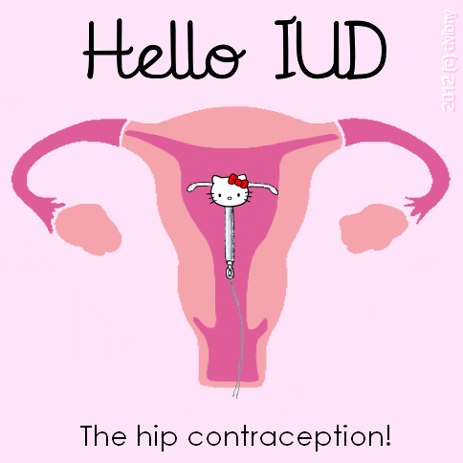

Slide 39
Bustle.com
Youtube.com

Slide 40
Inaccurate information is out there
People increasingly turn to the internet for health information
Misinformation about LARC is a large barrier
One study examining contraceptive websites for information about IUDs:
50% contained at least 1 inaccurate statement about risks or contraindications
Most common inaccuracies related to PID risk and nulliparity or multiple sexual partners
Healthcare providers not exempt
Up to 30% have misconceptions about IUD safety
Madden et al. AJOG 2016;214(4):499.e1-499.e6
Tyler at al. Obstet Gynecol 2012;119(4):762-771

Slide 43
Other Barriers
Cost
Affordable Care Act is improving access
Newer low-cost LNG IUD
Reimbursement for immediate postpartum LARC
Training
Subdermal implant requires special training by manufacturer in order to be able to insert the device
Clinician comfort with more challenging IUD insertions – particularly in young and nulliparous women
Knowledge
Misconceptions persist among health care providers and patients

Slide 44
In Summary
The CHOICE project has contributed greatly to our knowledge and understanding of contraception
www.choiceproject.wustl.edu
IUDs and Implants are the most effective methods of reversible contraception and are safe for nearly all women
Increasing use of these methods has the potential to have a huge public health impact
Barriers remain and need to be addressed at the policy, clinic and clinician level

