Slide 1
Treating Women Transitioning to Menopause: HT or not
Gloria Richard-Davis, MD, FACOG
Professor and Division Director,
Fertility and Reproductive Services
Department of Obstetrics & Gynecology
Notes:
Thank you Dr. Mallet and coordinators of conference for the invitation. Dr. Mallet and I go way back.

Slide 2
Treating Women Transitioning to Menopause and Beyond
Gloria Richard-Davis, MD, FACOG
Professor and Division Director,
Fertility and Reproductive Services
Department of Obstetrics & Gynecology

Slide 3
Disclosure
Pfizer Advisory Board and Consultant

Slide 4
Objectives
Define perimenopause and menopause
Discuss clinical presentation of menopause and impact on quality of life
Be able to manage treatment options for menopausal symptoms
Identify resources to help patients and providers manage menopause
Notes:
For many of you in the audience, much of this will be redundant information. I really want to speak to our residents in training, our future providers.
We have a crisis brewing due to a gap in menopause education and an aging population of women. NAMS and APGO created a set of slides and modules for residency programs to use
In teaching residents.

Slide 5
What is menopause?
Menopause is a normal, natural event, defined as the final menstrual period (FMP), confirmed after 1 year of no menstrual bleeding
Represents the permanent cessation of menses resulting from loss of ovarian follicular function, usually due to aging

Slide 6
When is menopause?
Naturally (spontaneously) average age 51
Prematurely from medical intervention (eg, bilateral oophorectomy, chemotherapy) at any time from impaired ovarian function
Premature ovarian failure or insufficiency (POI)

Slide 7
Menopause Terminology: STRAW* Staging System
Final Menstrual Period
Stages:
-5
-4
-3
-2
-1
+1
+2
Reproductive
Menopausal Transition
Postmenopause
Terminology:
Perimenopause
Menstrual Cycles:
Variable to regular
Regular
Variable cycle length (>7 days different from normal)
≥2 skipped cycles and an interval of amenorrhea (≥60 days)
None
Amen. X 12 mos.
Endocrine:
Normal FSH
↑FSH
↑FSH AMH*
↑FSH AMH*
*STRAW = Stages of Reproductive Aging Workshop.
Soules MR et al. Fertil Steril. 2001;76:875-878. *STRAW+10 Sioban Menopause 2013

Slide 8
Terminology: Postmenopause
The years after the FMP resulting from natural (spontaneous) or premature menopause
With current life expectancy, the postmenopausal years make up 1/3 to 1/2 of the lifespan of most North American women

Slide 9
Impact of Women on Health Care
Women account for:
52% of US population
Up to 90% of health care decisions
2 out of every 3 health care dollars spent (approximately $500 billion annually)
59% of all prescription drugs purchased
In the future, health care providers will spend up to 75% of their time treating women aged 65 years and older.
CareData Reports, Inc. 1999.

Slide 10
Age at Menopause Has Remained Constant While Life Expectancy Has Increased
80
60
Age (years)
40
20
0
1850 1900 1950 2000
Year
Campbell S, ed. The Management of the Menopause and Postmenopausal Years. Baltimore, Md: University Park Press; 1976.

Slide 11
Menopause Demographics
Approximately 4900 US women enter menopause each day.¹
Number of US Women ²
*Estimate.
¹North American Menopause Society.
²US Bureau of the Census.

Slide 12
Ethnicity in the United States
US Census Bureau. Population Projections. Available at: http://www.census.gov/population/www/projections/popproj.html.
Notes:
26
Ethnicity in the United States
The demographic makeup of the United States is constantly changing as a result of immigration and population increases among racially, ethnically, culturally, and linguistically diverse groups. For example, the two largest “minorities” currently make up a quarter of the country’s population. Latinos/Hispanics, who currently represent 14% (41,870,000 people) of the total population, are expected to make up 25% of the United States population by the year 2050. African Americans currently make up more than 12% (34,962,000 people) of the population. This diversity creates an impetus for health-care organizations to become culturally competent in order to address the wide range of health beliefs, practices and access issues.
References:
US Census Bureau. Population Projections. Available at: http://www.census.gov/population/www/projections/popproj.html. Accessed February 26, 2007. US Census Bureau. 2005 American Community Survey. Available at: http://factfinder.census.gov/servlet/STTable?_bm=y&-geo_id=01000US&-qr_name=ACS_2005_EST_G00_S0602&-ds_name=ACS_2005_EST_G00_&_program=. Accessed March 28, 2007.
Henry J Kaiser Family Foundation: Pew Hispanic Center. Key Facts: Race, Ethnicity and Medical Care, 2007 Update. Available at: http://www.kff.org/minorityhealth/6069.cfm. Accessed March 15, 2007.

Slide 13
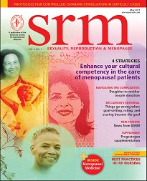
4 strategic steps for clinicians
1. Know cultural difference in menopause
2. Self awareness of CC
3. Adapt CC
4. Know resources available to help
May Issue 2011 Features
Providing culturally competent care for menopausal women
Gloria Richard-Davis, MD, FACOG
Notes:
1. Know the differences in how women experience menopause 2.Know yourself and understand your biases or cultural gap in knowledge, 3. Adapt cultural competency

Slide 14
Life expectancy in years for U.S. Women by race/ethnicity, 2007
Race/ethnicity | Years
Black, non-Hispanic | 76.9
Hispanic* | 82.2
Asian/Pacific Islander | 85.0
American Indian, Eskimo, Aleut | 80.2
White, non-Hispanic | 80.8
*Persons of Hispanic origin may be of any race.
Source: Day, Jennifer Cheeseman. Population projections of the United States by age, sex, race, and Hispanic origin: 1995 to 2050, U.S. Bureau of the Census, Current Population Reports, P25-1130, U.S. Government Printing Office, Washington, DC, 1996. http://www.cdc.gov/nchs/data/hus/hus10.pdf#022 Health U.S. 2010

Slide 15
Menopause Experience in Hispanic Women
4 Themes
Cambio de vida (change of life)
Being silent about menopause
Trying to be optimistic
Getting support
Eun-Ok 2009, Health care Women Internat

Slide 16
Menopause Management- Getting Clinical Care Back on Track
HT declined 80% post WHI
35% menopausal women are using compounding hormones
ACOG, Endocrine Society, NAMS support use of HT in symptomatic recently menopausal women
JoAnn E. Manson, M.D., Dr.P.H., and Andrew M. Kaunitz, M.D.
N ENGL J MED 374;9 NEJM.ORG March 3, 2016
Notes:
Clearly from our changing demographics there is a need for providers knowledgeable about menopause care. What group??

Slide 17
Menopause Management- Getting Clinical Care Back on Track
2009 100 IM residents surveyed
75% considered menopause care important
50% reported low confidence in managing symptoms
33% had no clinical experience managing menopause women in previous 6 months
Primary Care and ObGyn residency are often inadequate in menopause management
JoAnn E. Manson, M.D., Dr.P.H., and Andrew M. Kaunitz, M.D.
N ENGL J MED 374;9 NEJM.ORG March 3, 2016
Notes:
Before obgyns pat ourselves on the back…...we are doing a horrible job of training residents as well.

Slide 18
Serum hormone levels at menopause
Circulating estrogens
Ratio of estrogen to androgen
Sex hormone-binding globulin secretion
Peripheral aromatization of DHEA to estrone
Reversal of estradiol (E₂) to estrone (E₁) ratio
No significant change in testosterone levels
Notes:
Physiological changes in natural menopause

Slide 19
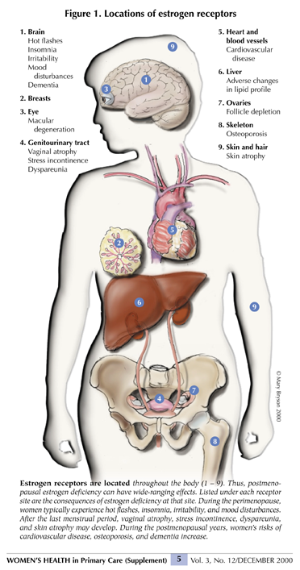
Notes:
The impact of menopause on disease appears to relate to the duration of exposure of organ systems to circulating estrogen and the lack thereof. Because estrogen receptors are located throughout the body, multiple systems are at risk

Slide 20
Estrogen receptor activity
Two estrogen receptors (ERs): ER-α and ER-β
Both are present in the ovary, CNS & many other tissues
Estrogen has many complex beneficial and deleterious effects on the body

Slide 21
Estrogen Loss and Manifestations of Health Risks Over Time
Short-Term Symptoms
Long-Term Diseases
Development of Subclinical Disease
Estrogen Secretion
Hot flushes
Mood, sleep, and/or acute cognitive changes
Urogenital symptoms, skin changes
Cardiovascular disease
Osteoporosis
Cognitive decline (Alzheimer’s disease)
40
45
50
55
60
65
70
75+
Age (years)

Slide 22
Vasomotor symptoms
Recurrent, transient episodes of flushing accompanied by a sensation of warmth to intense heat on the upper body and face
As many as 75% of perimenopausal women in the US have hot flashes
Triggered by small increases in core body temperature acting within a reduced thermoneutral zone
Treatment based on symptom severity and a woman’s risks and personal attitudes about menopause and medication

Slide 23
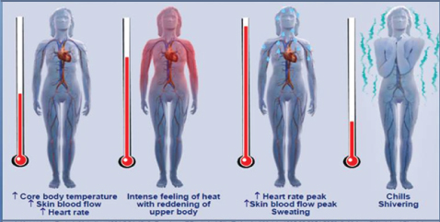
Hot flash physiology illustration

Slide 24
Vaginal symptoms
Symptoms such as vaginal dryness, vulvovaginal irritation/itching, and dyspareunia are experienced by an estimated 10% to 40% of postmenopausal women
Unlike vasomotor symptoms, which abate over time, vaginal atrophy is typically progressive and unlikely to resolve on its own
Treatments include: regular sexual activity, lubricants and moisturizers, and local vaginal estrogen

Slide 25
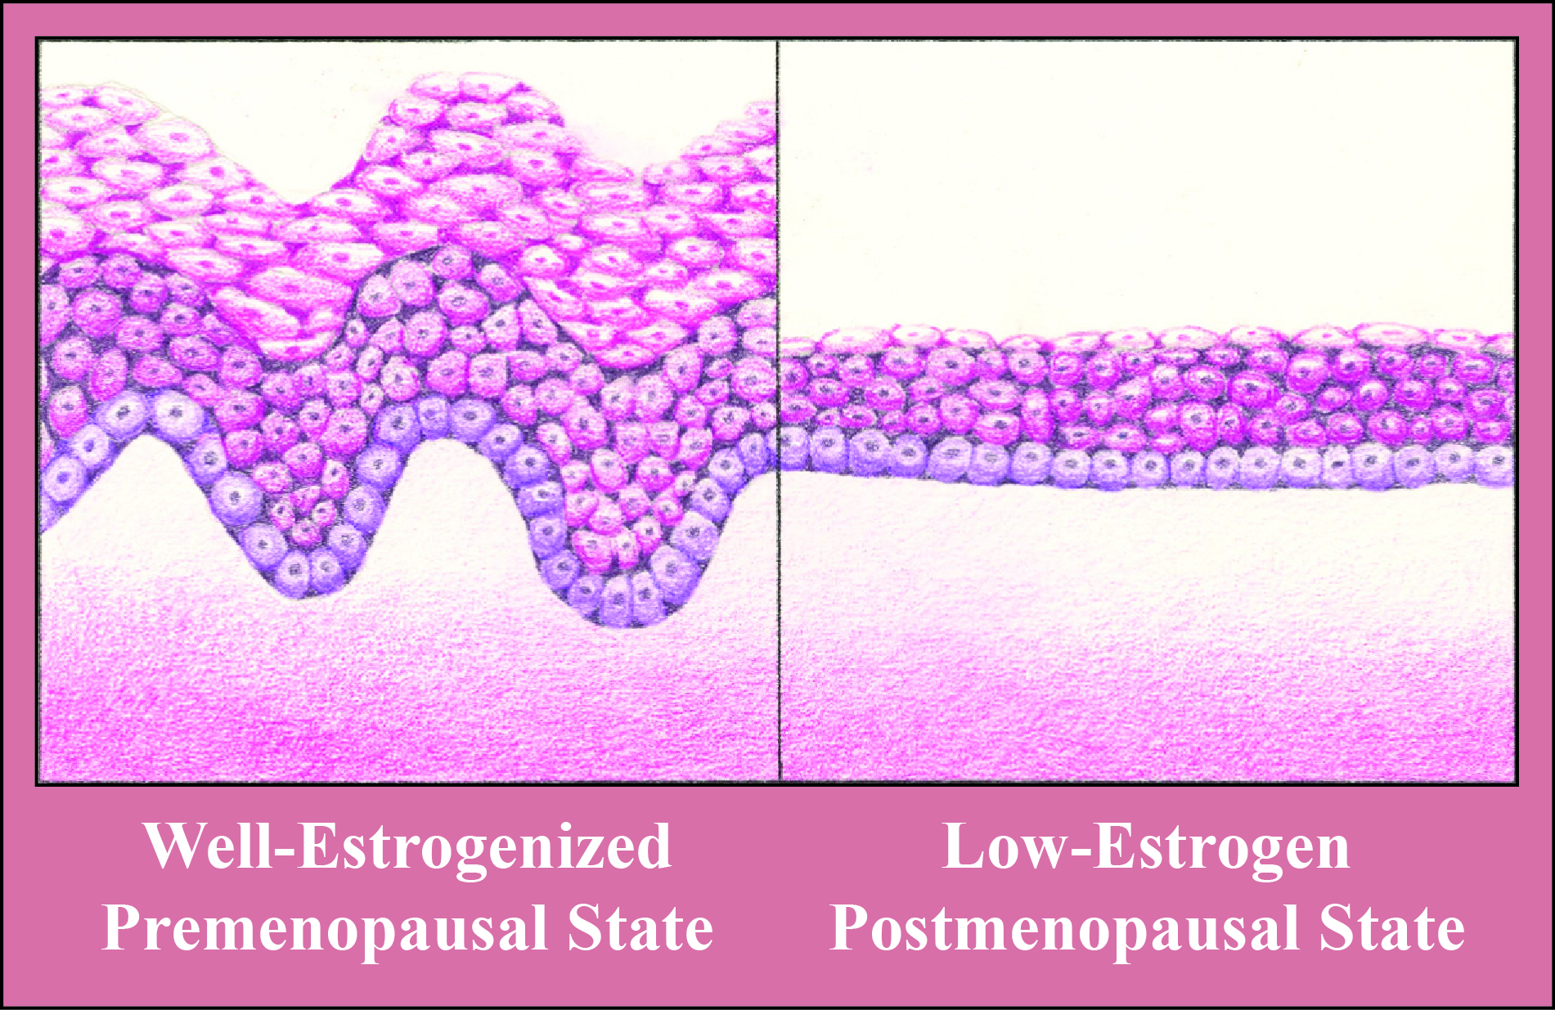
Vaginal atrophy illustration
Vaginal atrophy as illustrated by contrast of vaginal epithelium in a well-estrogenized premenopausal state (left panel) with a low-estrogen postmenopausal state (right panel)

Slide 26
Sexual health
Sexual issues generally increase with aging; distressing sexual complaints peak during midlife (ages 45-64) and are lowest from age 65 onward
Decreased estrogen causes a decline in vaginal lubrication and elasticity
Decreased testosterone may contribute to a decline in sexual desire and sensation
An active sex life, lubricants and moisturizers, and local vaginal estrogen help maintain vaginal health

Slide 27
MANAGEMENT OPTIONS FOR MENOPAUSAL SYMPTOMS

Slide 28
HT & vasomotor symptoms
ET with or without progestogen is most effective treatment of menopause-related vasomotor symptoms
Almost all systemic HT products are FDA approved for vasomotor symptom relief

Slide 29
HT & vaginal symptoms
ET is most effective treatment of moderate to severe symptoms of vulvar and vaginal atrophy
Many systemic HT and local vaginal ET products are available for treating one or both of these symptoms

Slide 30
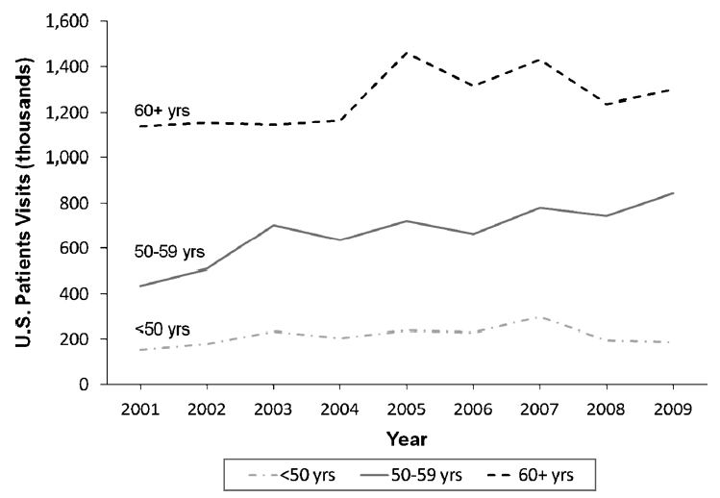
Vaginal Estrogen Use
FIG. 4. US vaginal MHT use by age group, January 2001 through December 2009, IMS Health, National Disease and Therapeutic Index. MHT,
menopausal hormone therapy.
Menopause, Vol. 18, No. 4, 2011 NAMS

Slide 31
Hormone therapy terminology
Hormone therapy (HT)
is the only pharmacologic therapy government approved in US and Canada for treating menopausal symptoms. HT encompasses both estrogen-alone and estrogen-progestogen therapies.
Estrogen therapy (ET):
Unopposed estrogen is prescribed both a) systemically for women who do not have a uterus, and b) locally in very low doses for any woman with vaginal symptoms
Estrogen-progestogen therapy (EPT):
Progestogen is added to ET to protect women with a uterus against endometrial cancer, which can be caused by estrogen alone
Bioidentical hormone therapy (BHT):
Consists of hormones chemically identical or very similar to those made in the body. Available from two sources: 1) FDA-approved and tested; 2) unapproved and untested from compounding pharmacies

Slide 32
Hormone therapy—what we know today
HT formulation, route of administration, and timing of initiation produce different effects (e.g. transdermal route may carry lower risk for thrombosis)
Absolute risks for HT use in healthy women ages 50-59 are low, but can include thrombosis, stroke, and cardiovascular events
HT initiation in older women carries greater risks
Breast cancer risk increases with EPT beyond 3-5 years
ET can be considered for longer duration of use because it carries a lower risk for breast cancer
Consider each woman’s priorities and risk factors prior to initiating HT

Slide 33
North American Menopause Society (NAMS) Updates
KEEPS Trial
NAMS 2012 Position paper on HT/ET
Solidarity statement by NAMS, ASRM, and The Endocrine Society

Slide 34
Kronos Early Estrogen Prevention Study (KEEPS)
727 newly menopausal woman
CCE 0.45 mg; TE 0.5 mg (prometrium 200mg x 12d both); placebo
Both arms Outcome measures-hot flushes, BMD, CVD biomarkers, coronary artery calcium, cognitive function
Outcomes
CE-⬇LDL, ⬆ HDL, TG; TE- neutral; ⬇IR
Cognitive function- NO adverse effect both
⬇hot flushes, ⬆mood & sexual function
⬇ bone loss

Slide 35
KEEPS Trial
Overall beneficial effect when newly diagnosed menopausal patients are treated for VMS or vaginal atrophy.

Slide 36
A Decade After The Women’s Health Initiative— The Experts Do Agree
The statement was published in the journals of The North American Menopause Society (Menopause), the American Society for Reproductive Medicine (Fertility and Sterility), and The Endocrine Society (Journal of Clinical Endocrinology and Metabolism)

Slide 37
By whom?
This solidarity statement was prepared by The North American Menopause Society, the American Society for Reproductive Medicine, and The Endocrine Society
12 other leading organizations in women’s health endorsed the statement

Slide 38
Endorsing organizations
Academy of Women’s Health
American Academy of Physician Assistants
American Academy of Family Physicians
American Association of Clinical Endocrinologists
American Medical Women’s Association
Asociación Mexicana para el Estudio del Climaterio
Association of Reproductive Health Professionals
National Association of Nurse Practitioners in Women’s Health
National Osteoporosis Foundation
Society for the Study of Reproduction
Society of Obstetricians & Gynaecologists of Canada
SIGMA Canadian Menopause Society

Slide 39
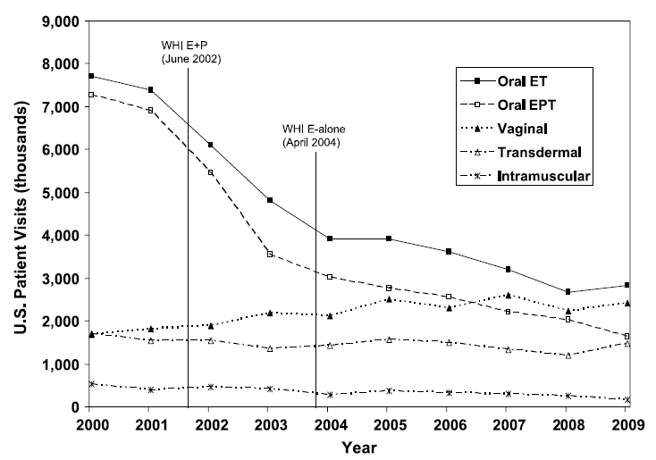
FIG. 1. US reported MHT use by formulation, January 2000 through December 2009, IMS Health, National Disease and Therapeutic Index. MHT, menopausal hormone therapy; WHI, Women’s Health Initiative; E; estrogen; P, progestogen; ET, estrogen therapy; EPT, estrogen + progestogen therapy.
Menopause, Vol. 18, No. 4, 2011
The North American Menopause Society

Slide 40
HR for Clinical Outcomes with CEE-MPA and CEE only
Prentice, R
Seminar Reprod Med
2014

Slide 41
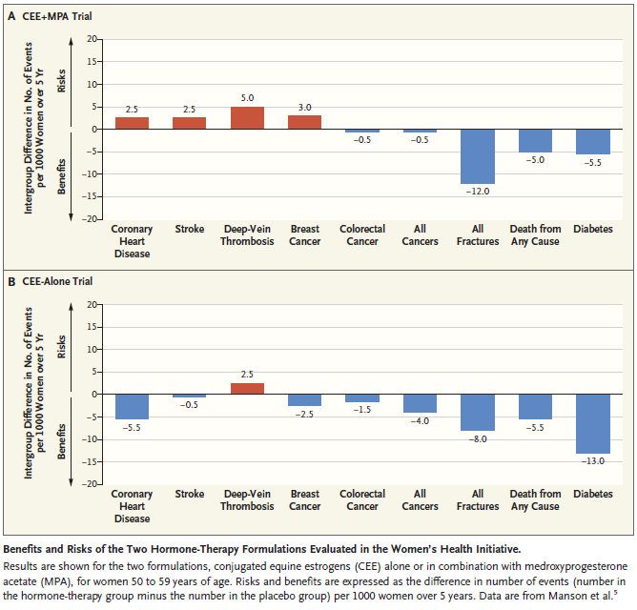
Menopause Management — Getting Clinical Care Back on Track
WHI
50-59 YO
JoAnn E. Manson, M.D., Dr.P.H., and Andrew M. Kaunitz, M.D.
N ENGL J MED 374;9 NEJM.ORG March 3, 2016

Slide 42
Menopause Management — Getting Clinical Care Back on Track
JoAnn E. Manson, M.D., Dr.P.H., and Andrew M. Kaunitz, M.D.
N ENGL J MED 374;9 NEJM.ORG March 3, 2016

Slide 43
HT Decision
Use
Not Use
Mod-severe VMS not relieved by lifestyle changes
NO contraindications
Newly menopause
VMS not bothersome
Symptoms only vaginal- use ET
Contraindication to E2
Late menopause
Contraindications:
Breast or endometrial cancer, DVT/PE, CHD, stroke/TIA,
and other contraindications to HT
,

Slide 44
Treatment for Menopausal Symptoms
Hormone Therapy (HT)
Oral
Patch
Pellets or cream
Gel
Spray
Prescription vaginal estrogen creams
Vaginal estrogen ring or tablet
Osphena (ospemifene)
Nonprescription vaginal lubricants
Alternative treatments black cohosh, soy

Slide 45
ET Drug Delivery
Oral delivery
Requires larger total doses than patch ET*
Undergoes first-pass hepatic metabolism and is rapidly metabolized by the liver¹
Taken once daily
Transdermal patch delivery
Requires smaller total doses than oral ET*
Absorbed through the skin directly into the bloodstream, avoiding first-pass hepatic metabolism¹
Applied once or twice weekly
*Therapeutic levels are achieved with smaller transdermal doses compared to oral therapy. This does not imply differences in safety or efficacy.
1. Vivelle-Dot Prescribing Information. Novartis Pharmaceuticals Corp; 2004.
Notes:
59
Orally administered estrogens go through the gastrointestinal (GI) tract and the liver, where 60% to 90% of the estrogen is metabolized. (Lievertz 1987)
Liver metabolism can substantially impact on the metabolic profile of the drug.
Hepatic metabolism of oral estradiol, for example, results in estrone (E1) and its conjugates estrone glucoronide (E1G) and estrone sulfate (E1S). (Potts 2005) This reduces the bioavailability of estradiol and results in higher circulating levels of E1 than estradiol. (Hossain 2003)
Oral administration of estrogen is also associated with an increased mobilization of hepatic globulins and lipoproteins. (Potts 2005)
In contrast, transdermally administered estradiol is transported directly into the bloodstream via subcutaneous capillaries, avoiding first-pass metabolism by the liver and enzymatic degradation in the GI tract. (Potts 2005)
Because the skin metabolizes estradiol to a lesser extent and delivers estradiol directly into the bloodstream, bypassing the liver, lower doses of transdermally administered estradiol are needed to produce therapeutic serum estradiol levels and a physiological estradiol/estrone ratio. (Hossain 2003)
Transdermal administration of estradiol also provides relatively constant plasma levels of physiological estradiol. (Hossain 2003; Potts 2005)
Lievertz RW. Am J Obstet Gynecol. 1987;156:1289–1293.
Potts RO, et al. Obstet Gynecol. 2005;105:953–961.
Hossain M, et al. Maturitas. 2003;46:173–185.

Slide 46
Regimens for Hormone Replacement Therapy

Slide 47
Table X. Estrogen therapy products approved for postmenopausal use in the United States
Oral products
Composition | Product name(s) | Range of available dose strengths
Conjugated estrogens | Premarin | 0.3-1.25 mg
Synthetic conjugated estrogens, A* | Cenestin | 0.3-1.25 mg
Synthetic conjugated estrogens, B** | Enjuvia | 0.3-1.25 mg
Esterified estrogens | Menest | 0.3-1.25 mg
17β-estradiol | Estrace, various generics | 0.5-2.0 mg
Estradiol acetate | Femtrace | 0.45-1.8 mg
Estropipate | Ortho-Est | 0.625 mg (0.75 mg estropipate, calculated as sodium estrone sulfate 0.625 mg) to 5.0 mg (6.0 mg)
Transdermal products
Composition | Product name(s) | Dose details
17β-estradiol matrix patch | Alora, Climara, Esclim, Fempatch, Menostar, Vivelle, Vivelle-Dot, various generics | 0.014-0.1 mg delivered daily; applied once or twice weekly
17β-estradiol reservoir patch | Estraderm | 0.05-0.1 mg delivered daily; applied twice weekly
17β-estradiol transdermal gel | EstroGel, Elestrin, Divigel | Applied daily via metered pump or packet delivering 0.52-0.75 mg of 17β-estradiol in gel
17β-estradiol topical emulsion | Estrasorb | 2 packets applied daily
17β-estradiol transdermal spray | Evamist | 1 spray/d, up to 2-3/d if needed
* 9 estrogens ** 10 estrogens

Slide 48
Table X. Estrogen therapy products approved for postmenopausal use in US (cont’d)
Vaginal products
Composition | Product name(s) | Dose details
17β-estradiol vaginal cream* | Estrace Vaginal Cream | Initially 2-4 g/d for 1-2 wk, followed by maintenance dose of 1 g/d (0.1 mg active ingredient/g)
Conjugated estrogens cream* | Premarin Vaginal Cream | For vaginal atrophy: 0.5-2 g/d for 21 d then off 7 d For dyspareunia: 0.5 g/d for 21 d then off 7 d , or twice weekly (0.625 mg active ingredient/g)
17β-estradiol vaginal ring | Estring | Device containing 2 mg releases 7.5 µg/d for 90 days (for vulvovaginal atrophy)
Estradiol acetate vaginal ring | Femring | Device containing 12.4 mg or 24. 8 mg estradiol acetate releases 0.05 mg/d or 0.10 mg/d estradiol for 90 days (both doses release systemic levels for treatment of vulvovaginal atrophy and vasomotor symptoms)
Estradiol hemihydrate vaginal tablet | Vagifem | Initially 1 tablet/d for 2 wk, followed by 1 tablet twice weekly (tablet 10 µg of estradiol hemihydrates, equivalent to 10 µg of estradiol; for vulvovaginal atrophy)
*N.B. Higher doses of vaginal estrogen are systemic, meant to relieve hot flashes as well as vaginal atrophy; the lower doses are intended for vaginal symptoms only even though a small amount does get absorbed.

Slide 49
Table XX. Combination EPT products comparing estrogen and progestogen doses
Product name(s) | Standard/low dose | Estrogen | Progestogen
Prempro | Standard Low | 0.625 mg conjugated estrogens 0.3 or 0.45 conjugated estrogens | 2.5 or 5 mg medroxyprogesterone acetate 1.5 mg medroxyprogesterone acetate
Femhrt | Standard Low | 5 µg ethinyl estradiol 2.5 µg ethinyl estradiol | 1 mg norethindrone acetate 0.5 mg norethindrone acetate
Activella | Standard Low | 1 mg 17β-estradiol 0.5 mg 17β-estradiol | 0.5 mg norethindrone acetate 0.1 mg norethindrone acetate
Angeliq | Low Lower | 0.5 mg 17β-estradiol 0.25 mg 17β-estradiol | 1 mg drospirenone 0.5 mg drospirenone

Slide 50
Counseling

Slide 51
Components of counseling
HT formulation, route of administration, and timing of initiation produce different effects (e.g. transdermal route may carry lower risk for thrombosis)
Absolute risks for HT use in healthy women ages 50-59 are low, but can include thrombosis, stroke, and cardiovascular events
HT initiation in older women carries greater risks
Breast cancer risk increases with EPT beyond 3-5 years
ET can be considered for longer duration of use because it carries a lower risk for breast cancer
Consider each woman’s priorities and risk factors prior to initiating HT
Listen
Respect
and validate
Support
Build trust

Slide 52
Alternatives to hormone therapy
Lifestyle changes
Try relaxation techniques (eg, yoga, meditation)
Eat a healthy diet
Get regular exercise
Avoid hot flash triggers (eg, caffeine, alcohol, spicy food)
Keep cool
Dress in layers (eg, light or wicking clothing)
Sleep in cool room (eg, fan, thermoregulating pillow)
Consume cold drinks
Reduce sexual discomfort and increase sensitivity with moisturizers, lubricants, and vibrators

Slide 53
Alternatives to hormone therapy
Non-hormonal prescription drugs (off-label use):
Antidepressant
SSRIs: fluoxetine, paroxetine, escitalopram
SNRIs: venlafaxine and desvenlafaxine
Hypnotic
Eszopiclone
Anticonvulsant
Gabapentin
Antihypertensive
Clonidine
Neuropathic pain drug
Pregabalin

Slide 54
Alternatives to hormone therapy (cont’d)
Complementary & Alternative Medicine
Soy isoflavones
Traditional Chinese medicine
Herbs
Black cohosh
Cranberry
St. John’s wort
Valerian
Vitex
Over-the-counter hormones (dietary supplements)
Topical progesterone
Melatonin

Slide 55
Counseling in Perimenopausal African-American Women
A study of 33 African-American and 35 Caucasian perimenopausal women who had similar serum hormone levels and symptoms
Pham KT et at. J Gen Intern Med. 1997;12:230.
Notes:
And HRT being offered to women at different rates.
Even when reporting similar Prevalence of symptoms was the same in each group, they may or ma ynot be offered HRT
Despite more white women than African-American women discussing their symptoms with physicians (68.6% vs. 36.4%), being asked by physicians about their symptoms (51.4% vs. 21.2%), and being offered HRT (25% vs. 0%), both groups reported equal levels of satisfaction with their care.

Slide 56
Questions???
Reminders:
North American Menopause Society (NAMS)
Nationally Certified Menopause Provider (NCMP)

