Slide 1
Treating Women Transitioning to Menopause and Beyond
Gloria Richard-Davis, MD, FACOG
Professor and Division Director,
Fertility and Reproductive Services
Department of Obstetrics & Gynecology

Slide 3
Disclosure
Pfizer Advisory Board and Consultant

Slide 4
Objectives
- To define perimenopause and menopause
- Discuss the clinical presentation of menopause and impact on quality of life
- Be able to manage treatment options for menopausal symptoms
- Identify resources to help patients and providers manage menopause

Slide 5
Menopause Management- Getting Clinical Care Back on Track
-Over 50 million menopausal women by 2020 in US
-2009 survey of IM resident revealed 75% feel uncomfortable treating menopausal women due to lack of training in residency
-Ob Gyn residency also lacks sufficient training
Manson & Kauntiz, NEJM 2016 374(9), 803

Slide 6
What is menopause?
Menopause is a normal, natural event, defined as the final menstrual period (FMP), confirmed after 1 year of no menstrual bleeding
Represents the permanent cessation of menses resulting from loss of ovarian follicular function, usually due to aging

Slide 7
When is menopause?
Naturally (spontaneously) average age 51
Prematurely from medical intervention (eg, bilateral oophorectomy, chemotherapy) at any time from impaired ovarian function

Slide 8
Terminology: Postmenopause
The years after the FMP resulting from natural (spontaneous) or premature menopause
With current life expectancy, the postmenopausal years make up 1/3 to 1/2 of the lifespan of most North American women

Slide 9
Impact of Women on Health Care
Women account for:
52% of US population
Up to 90% of health care decisions
2 out of every 3 health care dollars spent (approximately $500 billion annually)
59% of all prescription drugs purchased
In the future, health care providers will spend up to 75% of their time treating women aged 65 years and older.
CareData Reports, Inc. 1999.

Slide 10
Age at Menopause Has Remained Constant While Life Expectancy Has Increased
80
60
Age (years)
40
20
0
1850 1900 1950 2000
Year
Campbell S, ed. The Management of the Menopause and Postmenopausal Years. Baltimore, Md: University Park Press; 1976.

Slide 11
Menopause Demographics
Approximately 4900 US women enter menopause each day.¹
Number of US Women ²
*Estimate.
¹North American Menopause Society.
²US Bureau of the Census.

Slide 12
Ethnicity in the United States
US Census Bureau. Population Projections. Available at: http://www.census.gov/population/www/projections/popproj.html.
Notes:
12
Ethnicity in the United States
The demographic makeup of the United States is constantly changing as a result of immigration and population increases among racially, ethnically, culturally, and linguistically diverse groups. For example, the two largest “minorities” currently make up a quarter of the country’s population. Latinos/Hispanics, who currently represent 14% (41,870,000 people) of the total population, are expected to make up 25% of the United States population by the year 2050. African Americans currently make up more than 12% (34,962,000 people) of the population. This diversity creates an impetus for health-care organizations to become culturally competent in order to address the wide range of health beliefs, practices and access issues.
References:
US Census Bureau. Population Projections. Available at: http://www.census.gov/population/www/projections/popproj.html. Accessed February 26, 2007. US Census Bureau. 2005 American Community Survey. Available at: http://factfinder.census.gov/servlet/STTable?_bm=y&-geo_id=01000US&-qr_name=ACS_2005_EST_G00_S0602&-ds_name=ACS_2005_EST_G00_&_program=. Accessed March 28, 2007.
Henry J Kaiser Family Foundation: Pew Hispanic Center. Key Facts: Race, Ethnicity and Medical Care, 2007 Update. Available at: http://www.kff.org/minorityhealth/6069.cfm. Accessed March 15, 2007.

Slide 13
Life expectancy in years for U.S. Women by race/ethnicity, 2007
Race/ethnicity | Years
Black, non-Hispanic | 76.9
Hispanic* | 82.2
Asian/Pacific Islander | 85.0
American Indian, Eskimo, Aleut | 80.2
White, non-Hispanic | 80.8
*Persons of Hispanic origin may be of any race.
Source: Day, Jennifer Cheeseman. Population projections of the United States by age, sex, race, and Hispanic origin: 1995 to 2050, U.S. Bureau of the Census, Current Population Reports, P25-1130, U.S. Government Printing Office, Washington, DC, 1996. http://www.cdc.gov/nchs/data/hus/hus10.pdf#022 Health U.S. 2010

Slide 14
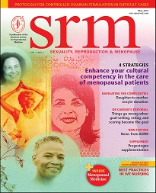
4 strategic steps for clinicians
1. Know cultural difference in menopause
2. Self awareness of CC
3. Adapt CC
4. Know resources available to help
May Issue 2011 Features
Providing culturally competent care for menopausal women
Gloria Richard-Davis, MD, FACOG
Notes:
1. Know the differences in how women experience menopause 2.Know yourself and understand your biases or cultural gap in knowledge, 3. Adapt cultural competency

Slide 15
Serum hormone levels at menopause
Circulating estrogens
Ratio of estrogen to androgen
Sex hormone-binding globulin secretion
Peripheral aromatization of DHEA to estrone
Reversal of estradiol (E₂) to estrone (E₁) ratio
No significant change in testosterone levels

Slide 16
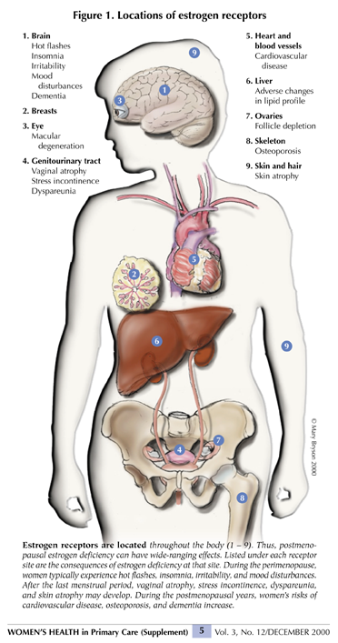
Notes:
The impact of menopause on disease appears to relate to the duration of exposure of organ systems to circulating estrogen and the lack thereof. Because estrogen receptors are located throughout the body, multiple systems are at risk

Slide 17
Estrogen receptor activity
Two estrogen receptors (ERs): ER-α and ER-β
Both are present in the ovary, CNS & many other tissues
Estrogen has many complex beneficial and deleterious effects on the body

Slide 18
Estrogen Loss and Manifestations of Health Risks Over Time
Short-Term Symptoms
Long-Term Diseases
Development of Subclinical Disease
Estrogen Secretion
Hot flushes
Mood, sleep, and/or acute cognitive changes
Urogenital symptoms, skin changes
Cardiovascular disease
Osteoporosis
Cognitive decline (Alzheimer’s disease)
40
45
50
55
60
65
70
75+
Age (years)

Slide 19
MANAGEMENT OPTIONS FOR MENOPAUSAL SYMPTOMS

Slide 20
Oral Contraceptives

Slide 21
Why would perimenopausal women use hormonal contraception?
Hormonal contraception offers a viable option for both symptomatic perimenopausal women and those who wish to avoid pregnancy
Combination estrogen progestin contraceptives (pills, patch, ring) only appropriate for healthy, lean, nonsmoking perimenopausal women
Contraindicated in women over age 35 who smoke
Other potential contraindications include hypertension, diabetes, obesity, and other comorbidities

Slide 22
Noncontraceptive benefits of OCs
Suppress vasomotor symptoms
Restore predictable bleeding
Decrease dysmenorrhea
Enhance BMD
Lower risk of endometrial and ovarian cancer

Slide 23
When to stop OCs
Individualization is required
Consider stopping in early 50s, typical age of menopause
Can transition from OCs to HT if still symptomatic
As low-dose OCs have higher hormone levels than HT, hot flashes may reappear transiently

Slide 24
Menopausal Hormone Therapy

Slide 25
Terminology
Estrogen therapy (ET): Unopposed estrogen is prescribed both a) systemically for women who do not have a uterus, and b) locally in very low doses for any woman with vaginal symptoms
Estrogen-progestogen therapy (EPT): Progestogen is added to ET to protect women with a uterus against endometrial cancer, which can be caused by estrogen alone
Bioidentical hormone therapy (BHT): Consists of hormones chemically identical or very similar to those made in the body. Available from two sources: 1) FDA-approved and tested; 2) unapproved and untested from compounding pharmacies

Slide 26
FDA-approved indications for HT
All oral estrogens, most transdermal estrogen, and one vaginal estrogen are approved for moderate to severe vasomotor symptoms
Some oral and transdermal products are approved for prevention of postmenopausal osteoporosis, but not for treatment

Slide 27
FDA-approved indications for vaginal HT
Local vaginal estrogen is approved for atrophic vaginitis
No vaginal product is approved for osteoporosis
Two vaginal products are approved for dyspareunia as a symptom of vulvar and vaginal atrophy due to menopause
One vaginal product is indicated for urinary urgency and dysuria

Slide 28
Black Box warning for HT
Subsequent to the WHI trial in 2002, the US FDA and Health Canada require all estrogen-containing prescription therapies to carry a “black box” warning about the adverse HT risks which include cardiovascular disorders, endometrial cancer, breast cancer, and probable dementia
Although only two products were studied in the WHI, all HT products—including “natural” bioidentical and compounded hormones—are assumed to have similar risks until proven otherwise

Slide 29
Hormone therapy terminology
Hormone therapy (HT) is the only pharmacologic therapy government approved in US and Canada for treating menopausal symptoms. HT encompasses both estrogen-alone and estrogen-progestogen therapies.
Estrogen therapy (ET): Unopposed estrogen is prescribed both a) systemically for women who do not have a uterus, and b) locally in very low doses for any woman with vaginal symptoms
Estrogen-progestogen therapy (EPT): Progestogen is added to ET to protect women with a uterus against endometrial cancer, which can be caused by estrogen alone
Bioidentical hormone therapy (BHT): Consists of hormones chemically identical or very similar to those made in the body. Available from two sources: 1) FDA-approved and tested; 2) unapproved and untested from compounding pharmacies

Slide 30
Hormone therapy—what we know today
HT formulation, route of administration, and timing of initiation produce different effects (e.g. transdermal route may carry lower risk for thrombosis)
Absolute risks for HT use in healthy women ages 50-59 are low, but can include thrombosis, stroke, and cardiovascular events
HT initiation in older women carries greater risks
Breast cancer risk increases with EPT beyond 3-5 years
ET can be considered for longer duration of use because it carries a lower risk for breast cancer
Consider each woman’s priorities and risk factors prior to initiating HT

Slide 31
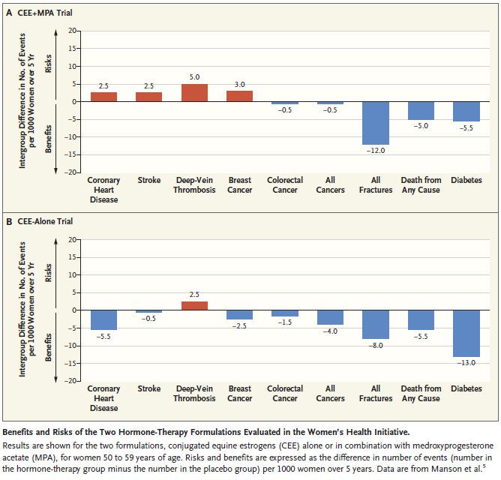
Menopause Management — Getting Clinical Care Back on Track
JoAnn E. Manson, M.D., Dr.P.H., and Andrew M. Kaunitz, M.D.
N ENGL J MED 374;9 NEJM.ORG March 3, 2016

Slide 32
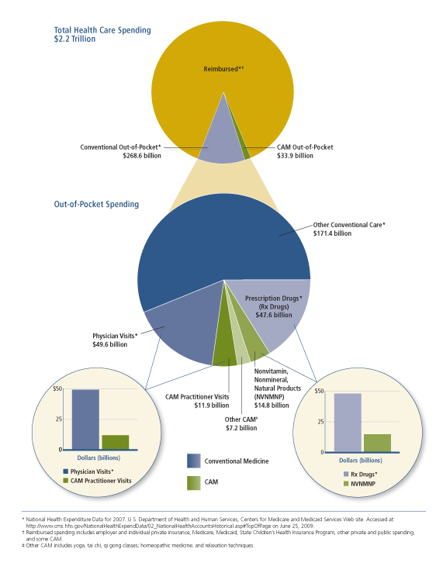
Total Health Care Spending
- About quarter of all visits are CAM practitioner
- About third of drug cost is CAM
Notes:
About quarter of all visits are CAM practitioner. About third of drug cost is CAM.

Slide 33
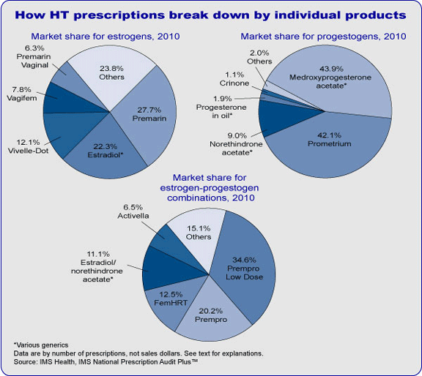
HT market by product

Slide 34
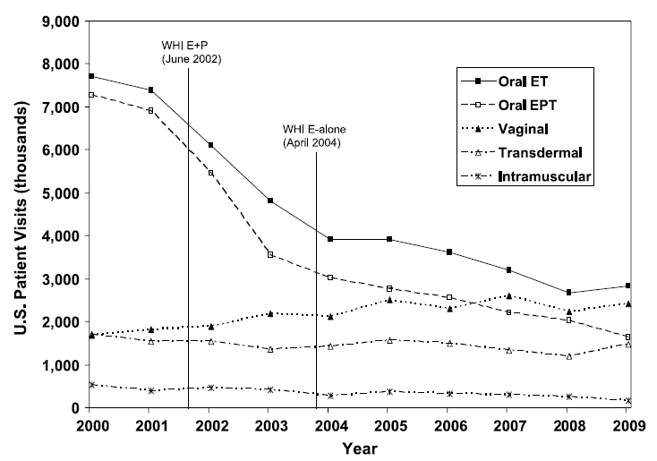
FIG. 1. US reported MHT use by formulation, January 2000 through December 2009, IMS Health, National Disease and Therapeutic Index. MHT, menopausal hormone therapy; WHI, Women’s Health Initiative; E; estrogen; P, progestogen; ET, estrogen therapy; EPT, estrogen + progestogen therapy.
Menopause, Vol. 18, No. 4, 2011
The North American Menopause Society

Slide 35
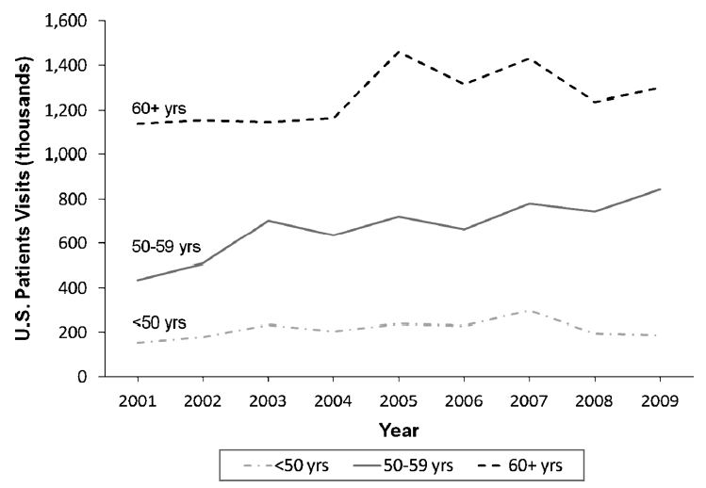
Vaginal Estrogen Use
FIG. 4. US vaginal MHT use by age group, January 2001 through December 2009, IMS Health, National Disease and Therapeutic Index. MHT,
menopausal hormone therapy.
Menopause, Vol. 18, No. 4, 2011 NAMS

Slide 36
Table X. Estrogen therapy products approved for postmenopausal use in the United States
Oral products
Composition | Product name(s) | Range of available dose strengths
Conjugated estrogens | Premarin | 0.3-1.25 mg
Synthetic conjugated estrogens, A* | Cenestin | 0.3-1.25 mg
Synthetic conjugated estrogens, B** | Enjuvia | 0.3-1.25 mg
Esterified estrogens | Menest | 0.3-1.25 mg
17β-estradiol | Estrace, various generics | 0.5-2.0 mg
Estradiol acetate | Femtrace | 0.45-1.8 mg
Estropipate | Ortho-Est | 0.625 mg (0.75 mg estropipate, calculated as sodium estrone sulfate 0.625 mg) to 5.0 mg (6.0 mg)
Transdermal products
Composition | Product name(s) | Dose details
17β-estradiol matrix patch | Alora, Climara, Esclim, Fempatch, Menostar, Vivelle, Vivelle-Dot, various generics | 0.014-0.1 mg delivered daily; applied once or twice weekly
17β-estradiol reservoir patch | Estraderm | 0.05-0.1 mg delivered daily; applied twice weekly
17β-estradiol transdermal gel | EstroGel, Elestrin, Divigel | Applied daily via metered pump or packet delivering 0.52-0.75 mg of 17β-estradiol in gel
17β-estradiol topical emulsion | Estrasorb | 2 packets applied daily
17β-estradiol transdermal spray | Evamist | 1 spray/d, up to 2-3/d if needed
* 9 estrogens ** 10 estrogens

Slide 37
Table X. Estrogen therapy products approved for postmenopausal use in US (cont’d)
Vaginal products
Composition | Product name(s) | Dose details
17β-estradiol vaginal cream* | Estrace Vaginal Cream | Initially 2-4 g/d for 1-2 wk, followed by maintenance dose of 1 g/d (0.1 mg active ingredient/g)
Conjugated estrogens cream* | Premarin Vaginal Cream | For vaginal atrophy: 0.5-2 g/d for 21 d then off 7 d For dyspareunia: 0.5 g/d for 21 d then off 7 d , or twice weekly (0.625 mg active ingredient/g)
17β-estradiol vaginal ring | Estring | Device containing 2 mg releases 7.5 µg/d for 90 days (for vulvovaginal atrophy)
Estradiol acetate vaginal ring | Femring | Device containing 12.4 mg or 24. 8 mg estradiol acetate releases 0.05 mg/d or 0.10 mg/d estradiol for 90 days (both doses release systemic levels for treatment of vulvovaginal atrophy and vasomotor symptoms)
Estradiol hemihydrate vaginal tablet | Vagifem | Initially 1 tablet/d for 2 wk, followed by 1 tablet twice weekly (tablet 10 µg of estradiol hemihydrates, equivalent to 10 µg of estradiol; for vulvovaginal atrophy)
*N.B. Higher doses of vaginal estrogen are systemic, meant to relieve hot flashes as well as vaginal atrophy; the lower doses are intended for vaginal symptoms only even though a small amount does get absorbed.

Slide 38
Table XX. Combination EPT products comparing estrogen and progestogen doses
Product name(s) | Standard/low dose | Estrogen | Progestogen
Prempro | Standard Low | 0.625 mg conjugated estrogens 0.3 or 0.45 conjugated estrogens | 2.5 or 5 mg medroxyprogesterone acetate 1.5 mg medroxyprogesterone acetate
Femhrt | Standard Low | 5 µg ethinyl estradiol 2.5 µg ethinyl estradiol | 1 mg norethindrone acetate 0.5 mg norethindrone acetate
Activella | Standard Low | 1 mg 17β-estradiol 0.5 mg 17β-estradiol | 0.5 mg norethindrone acetate 0.1 mg norethindrone acetate
Angeliq | Low Lower | 0.5 mg 17β-estradiol 0.25 mg 17β-estradiol | 1 mg drospirenone 0.5 mg drospirenone

Slide 39
Counseling and Addressing Concerns

Slide 40
EPT & breast cancer
Diagnosis of breast cancer increases with EPT use beyond 3-5 years
Unclear whether EPT risk differs between continuous and sequential progestogen
EPT and to a lesser extent ET increase breast cell proliferation, breast pain, mammographic density, repeat mammograms, and breast biopsies
EPT may impede diagnostic interpretation of mammograms
Increased breast cancer diagnosis declined 3 years post EPT cessation

Slide 41
EPT & breast cancer (continued)
Breast cancer mortality was higher in women assigned to EPT than in those assigned to placebo
Women starting EPT shortly after menopause experienced increased breast cancer risk, but those with a gap time greater than 5 years did not

Slide 42
ET & breast cancer
ET arm of the WHI showed no increased cancer risk after mean 7.1 years on study
There was a significantly decreased risk of breast cancer after 7.1 years, which persisted after discontinuation
ET and EPT use in breast cancer survivors may increase recurrence risk

Slide 43
HT & premature menopause/POI
Data regarding HT in women over age 50 should not be extrapolated to younger postmenopausal women
Likely that risks attributable to HT are smaller and benefits greater in these younger women
Use of HT or oral contraceptives until median age of menopause is recommended, at which time decision can be reevaluated

Slide 44
Progestogen indication
Primary menopause-related indication for protestogen use is endometrial protection from systemic ET
Adequate progestogen recommended for women with an intact uterus using systemic ET
Progestogen generally not indicated with low-dose local ET for vaginal atrophy

Slide 45
Bioidentical hormones
Many well-tested, government-approved HT products contain bioidentical hormones
Usually refers to compounded formulations
Compounded preparations and salivary hormone testing not recommended
Compounded HT not tested for efficacy, safety, batch standardization, or purity
Some compounders make unsubstantiated claims about safety and effectiveness
Compounded HT should include patient information

Slide 46
Duration of use
With EPT, increased risk of breast cancer incidence and mortality with 3-5 years of use
With ET, no increase of breast cancer with early postmenopausal use; a decrease was found after hiatus in estrogen exposure
With ET, potential CAD and CHD benefits with early use
Initial increase in CHD risk when EPT is initiated further from menopause

Slide 47
Duration of use (continued)
Extending EPT use is acceptable for:
Women who request it and are aware of its risks
Prevention of osteoporosis for women at high risk of osteoporotic fracture when alternate therapies are not appropriate

Slide 48
Discontinuation
3 years after EPT discontinuation:
Rate of CVD, fractures, and colon cancer same as placebo
Increase in all cancers and mortality from breast cancer
3 years after ET discontinuation:
No increase in CHD, DVT, stroke, hip fracture, colorectal cancer, or total mortality
Decrease in breast cancer persisted

Slide 49
Discontinuation (continued)
HRs for all-cause mortality neutral for ET and EPT
50% chance of vasomotor symptoms recurring
Symptom recurrence similar whether tapered or abrupt
Decision to continue HT should be individualized

Slide 50
HT summary
HT formulation, route of administration, and timing of initiation produce different effects
Individual benefit-risk profiles are essential
Absolute risks in healthy women ages 50-59 are low
Long-term use or HT initiation in older women, however, has greater risks
Breast cancer risk increases with EPT beyond 3-5 years
ET can be considered for longer duration of use due to its more favorable safety profile

Slide 51
Screening tests for women ages 50-64
Test | How Often
Blood pressure | At least every 2 years if normal (below 120/80)
Bone mineral density | Discuss with healthcare provider if at risk
Cholesterol | Regularly if at risk for heart disease
Colonoscopy, fecal occult blood test, or sigmoidoscopy | Beginning at age 50
Fasting blood glucose | Regularly if overweight with additional risk factors
Mammogram | Every 2 years at age 50
Pap test | Every 3 years or every 5 years if combined with HPV test
Pelvic exam | Yearly
Sexually transmitted infection | Both partners, including HIV, before initiating sexual intercourse

Slide 52
How women view menopause
Midlife women do not consider menopause a time of health complaints, increased disease risk or a time for medical care, but rather a normal developmental phase
51% in early postmenopause said they were happier and more fulfilled than in their 20s, 30s, or 40s
About 75% of women surveyed reported making some kind of lifestyle change at menopause
Women with negative attitudes toward menopause report more menopausal symptoms

Slide 53
Components of counseling
Listen
Respect
and validate
Support
Build trust

Slide 54
Counseling multiethnic women
According to the Study of Women’s Health Across the Nation (SWAN) differences in menopausal symptoms exist across ethnic groups compared to Caucasian women
Healthcare providers must consider each woman as a unique individual, including any cultural beliefs that might affect a woman’s view of menopause or various treatment options

Slide 55
Multiethnic population
40 million postmenopausal women in US
Nearly 1/3 of adult women in racial and ethnic minorities (3.5M African-American, 1-2M Hispanic, 1M Asian)
Almost 10% of the US population foreign born
Nearly 15% speak a foreign language at home
Make an effort to understand cultural differences among midlife women

Slide 56
Counseling in Perimenopausal African-American Women
A study of 33 African-American and 35 Caucasian perimenopausal women who had similar serum hormone levels and symptoms
Pham KT et at. J Gen Intern Med. 1997;12:230.
Notes:
And HRT being offered to women at different rates.
Even when reporting similar Prevalence of symptoms was the same in each group, they may or ma ynot be offered HRT
Despite more white women than African-American women discussing their symptoms with physicians (68.6% vs. 36.4%), being asked by physicians about their symptoms (51.4% vs. 21.2%), and being offered HRT (25% vs. 0%), both groups reported equal levels of satisfaction with their care.

Slide 57
Alternatives to hormone therapy
Non-hormonal prescription drugs (off-label use):
Antidepressant
SSRIs: fluoxetine, paroxetine, escitalopram
SNRIs: venlafaxine and desvenlafaxine
Hypnotic
Eszopiclone
Anticonvulsant
Gabapentin
Antihypertensive
Clonidine
Neuropathic pain drug
Pregabalin

Slide 58
Alternatives to hormone therapy (cont’d)
Complementary & Alternative Medicine
Soy isoflavones
Traditional Chinese medicine
Herbs
Black cohosh
Cranberry
St. John’s wort
Valerian
Vitex
Over-the-counter hormones (dietary supplements)
Topical progesterone
Melatonin

Slide 59
Alternatives to hormone therapy (cont’d)
Lifestyle changes
Try relaxation techniques (eg, yoga, meditation)
Eat a healthy diet
Get regular exercise
Avoid hot flash triggers (eg, caffeine, alcohol, spicy food)
Keep cool
Dress in layers (eg, light or wicking clothing)
Sleep in cool room (eg, fan, thermoregulating pillow)
Consume cold drinks
Reduce sexual discomfort and increase sensitivity with moisturizers, lubricants, and vibrators

Slide 60
Tools for Practice

Slide 61
Menopause health questionnaire

Slide 62
Using validated, menopause-specific tools
Greene Climacteric Scale
Menopause Rating Scale
Menopausal Symptom List
Utian Quality of Life Score
Women’s Health Questionnaire

Slide 63
A free mobile app for menopause symptom management from The North American Menopause Society
Clinical decision-support tool
Available for iPhones and iPads
Dual mode for Clinicians and Women/Patients
Learn more at: Menopause 2015; 22(3):[e-pub 10/13/14] or at www.menopause.org

Slide 64
Moderate-to-severe hot flashes and/or night sweats? (and inadequate response to behavioral/lifestyle modifications)
No
Yes
GSM symptoms such as vaginal dryness or pain with intercourse/sexual activity?
Interested in HT and free of contraindications?
Yes
No
Yes
No
Assess CVD risk and time since menopause onset
Free of contraindications to SSRIs/SNRIs?
Free of contraindications?
Avoid HT
 | Years Since Menopause Onset
 | <5 | 6 to 10 | >10
Low (<5%) | HT OK | HT OK | Avoid HT
Moderate (5% to 10%) | HT OK (choose transdermal) | HT OK (choose transdermal) | Avoid HT
High (>10%) | Avoid HT | Avoid HT | Avoid HT
Yes
No
Yes
No
CVD Risk Over 10 Years (ACC/AHA Risk prediction score)
Consider low-dose paroxetine or other well-studied SSRIs/ SNRIs
Consider gabapentin, pregabalin, clonidine
Consider low-dose vaginal estrogen. Ospemifene also may be an option
Vaginal lubricants and/or moisturizers
Prior Hysterectomy?
Yes = ET options (see tables)
No = EPT options (see tables) (CE/bazedoxifene also may be an option)
Adequate control of hot flashes?
Yes
No
Continue
Adjust dose or consider gabapentin, pregabalin, clonidine
DECISION ABOUT DURATION OF USE: continued moderate-to-severe symptoms; patient preference; weigh baseline risks of breast cancer, CVD, and osteoporosis.
Source: Manson JE, et al. Menopause 2014.

Slide 65
Moderate-to-severe hot flashes and/or night sweats? (and inadequate response to behavioral/lifestyle modifications)
Yes
Interested in HT and free of breast cancer, endometrial cancer, DVT/PE, CHD, stroke/TIA, and other contraindications to HT?
Yes
No
Assess CVD risk and time since menopause onset
 | Years Since Menopause Onset
 | <5 | 6 to 10 | >10
Low (<5%) | HT OK | HT OK | Avoid HT
Moderate (5% to 10%) | HT OK (choose transdermal) | HT OK (choose transdermal) | Avoid HT
High (>10%) | Avoid HT | Avoid HT | Avoid HT
Consider non-hormonal therapy
CVD Risk Over 10 Years (ACC/AHA Risk prediction score)
Prior Hysterectomy?
Yes = ET options (see tables)
No = EPT options (see tables) (CE/bazedoxifene also may be an option)
DECISION ABOUT DURATION OF USE: continued moderate-to-severe symptoms; patient preference; weigh baseline risks of breast cancer, CVD, and osteoporosis.
Source: Manson JE, et al. Menopause 2014.

Slide 66
Moderate-to-severe hot flashes and/or night sweats? (and inadequate response to behavioral/lifestyle modifications)
Yes
No
See HT algorithm
Genitourinary symptoms such as vaginal dryness or pain with intercourse/sexual activity?
Yes
No
Free of breast cancer, endometrial cancer, and other hormone-sensitive cancers?
Avoid hormonal therapy
Yes
No
Vaginal lubricants and/or moisturizers. Consider low-dose vaginal estrogen if response is inadequate. Ospemifene may be an option for women who prefer a non-estrogen oral treatment, if no contraindications.
Vaginal lubricants and/or moisturizers
Source: Manson JE, et al. Menopause 2014.

Slide 67
Moderate-to-severe hot flashes and/or night sweats? (and inadequate response to behavioral/lifestyle modifications)
Yes
Interested in HT and free of breast cancer, endometrial cancer, DVT/PE, CHD, stroke/TIA, and other contraindications to HT?
Yes
No
See HT algorithm
Interested in non-hormonal therapy and free of contraindications to SSRIs/SNRIs?
Yes
No
Consider low-dose paroxetine or other well-studied SSRIs/ SNRIs (venlafaxine, escitalopram, others), if no contraindications.
Avoid SSRIs/SNRIs. Consider gabapentin, pregabalin, or clonidine, if no contraindications.
Adequate control of hot flashes?
Yes
No
Continue low-dose paroxetine or other SSRIs/SNRIs.
Adjust dose or consider gabapentin, pregabalin, or clonidine.
Source: Manson JE, et al. Menopause 2014.

Slide 68
QUESTIONS?????????

