Slide 1
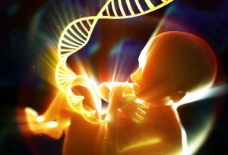
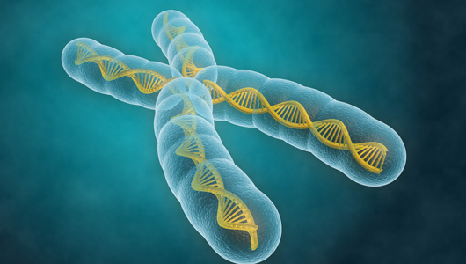
Cell free fetal DNA
For the Busy Clinician
Carla Ann Martinez, MD
Maternal Fetal Medicine

Slide 2
I have no financial conflicts of interest to declare

Slide 3
Objectives
What is cell free fetal DNA?
Review technologies employed to evaluate cell free fetal DNA
Review positive predictive value
Explain differences between different aneuploidies and test outcomes

Slide 4

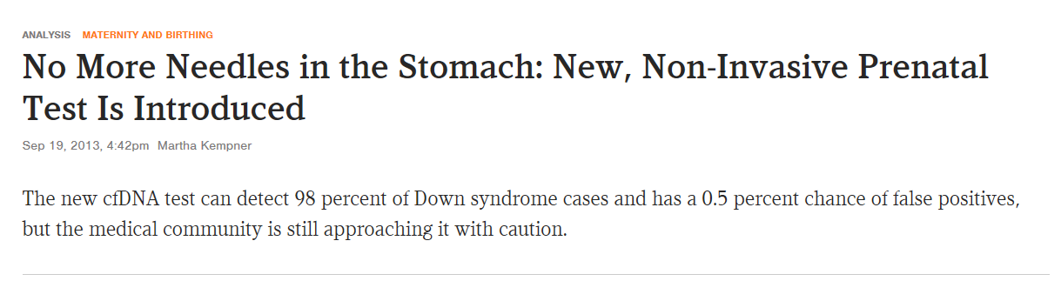

Slide 5
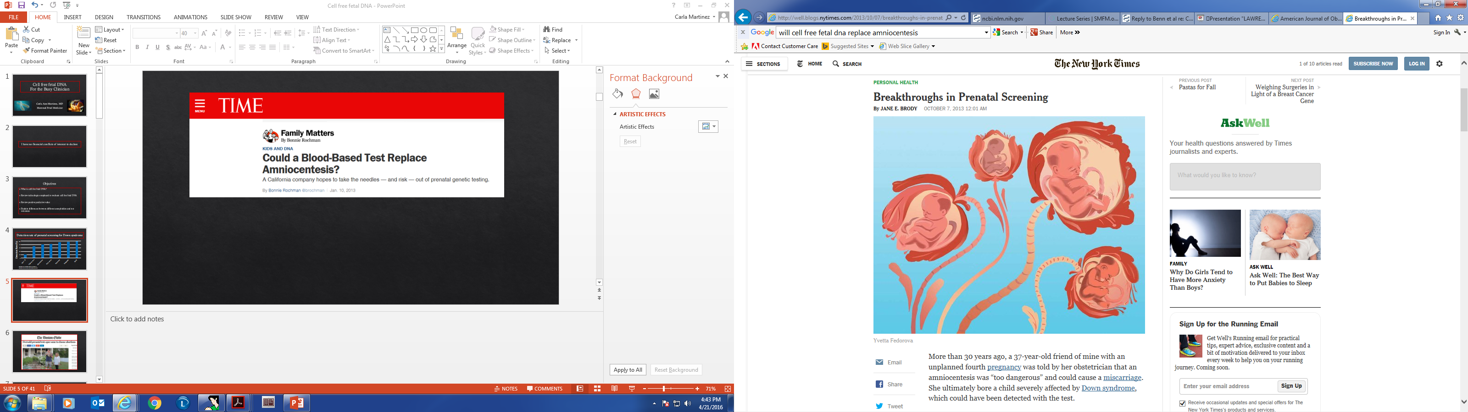

Slide 6

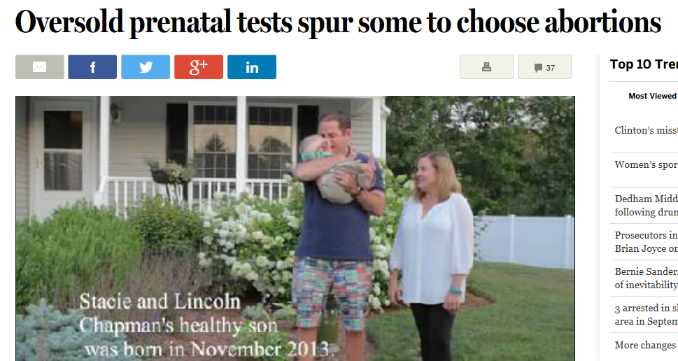

Slide 7
Prenatal Prevalence of Reported Chromosome Abnormalities
Wellesley D, et al. Eur J of Hum Gen 2012
Notes:
Although chromosomal abnormalities occur in approximately 1 in 150 live births, the prevalence is greater earlier in gestation because aneuploidy accounts for a large proportion of early pregnancy loss. While it increases with increasing maternal age, it can affect any woman regardless of age and is not related to race or ethnicity.
Autosomal trisomies are the most common that are not related to sex chromosome disorders. Down syndrome is the most common with a prevalence of 1 in 800 live births. Screening is really designed around Down syndrome

Slide 8
Detection rate of prenatal screening for Down syndrome
Detection Rate (%)
Malone, et al. NEJM 2005;353:2001-11
ACOG PB 163, May 2016 ahead of print
Notes:
An observational study of more than 38,000 women demonstrated that if all women aged 35 years an older had had diagnostic testing, the detection rate for Down syndrome would have been only 21.6%

Slide 9
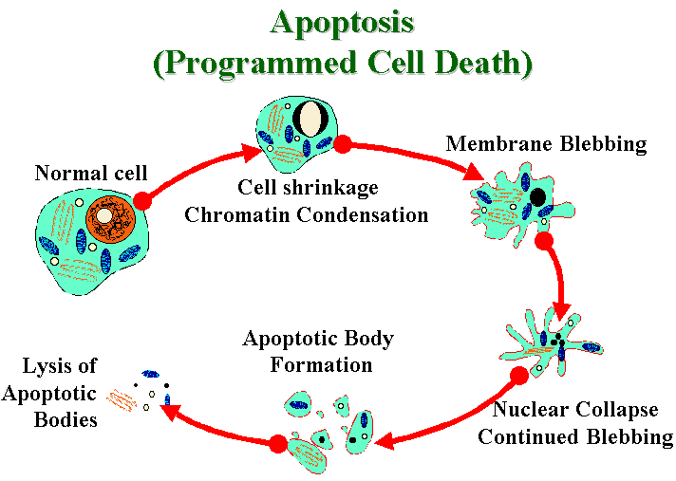
What is cell free fetal DNA?
Short segments (<200 base pairs) of fetal DNA circulates in maternal plasma
Origin is primarily placenta
Placental cells undergoing apoptosis

Slide 10
Cell free fetal DNA Characteristics
Comprises 3-13% of total DNA in maternal DNA plasma
Reliably detected >7 weeks
Increases throughout pregnancy (10-22 weeks constant)
Cleared within hours of birth
  Short half life (16 min), undetectable by 2 hours postpartum
Ashoor, etc al. Ultrasound Obstet Gyn 2013:41:26-32
Lo et al. Am J Hum Genet 1999;64:218-224

Slide 11
Cell free DNA Clinical Applications
Sex Determination
Single gene disorders
  Detect paternally inherited allele
Isoimmunization: noninvasively determine fetal Rh type
Aneuploidy: detect abnormal ratio of a particular chromosome;
Does not detect nontargeted aneuploidies

Slide 12
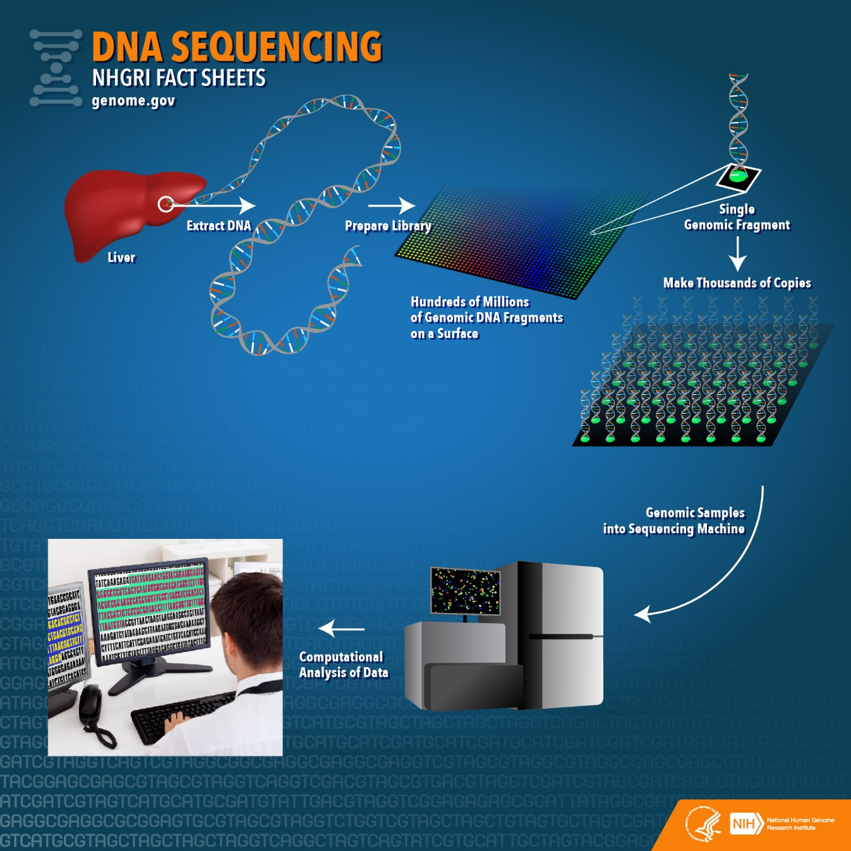
Methodology
Next generation sequencing
Many platforms and methods
Overall theme
  Rapidly improving methods
  Decreased costs

Slide 13
Massive Parallel Sequencing or Shotgun Sequencing
Many companies use this approach
Massive: tons of DNA sequencing data
Parallel: many pieces of DNA sequenced at the same time
Shotgun: sequenced randomly

Slide 15
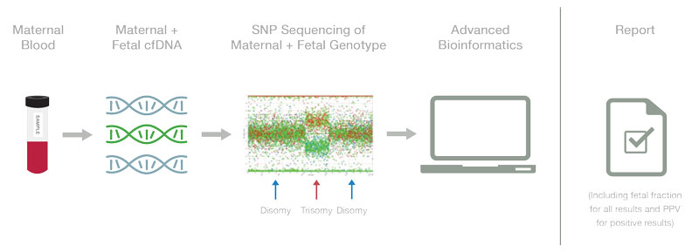

Slide 16
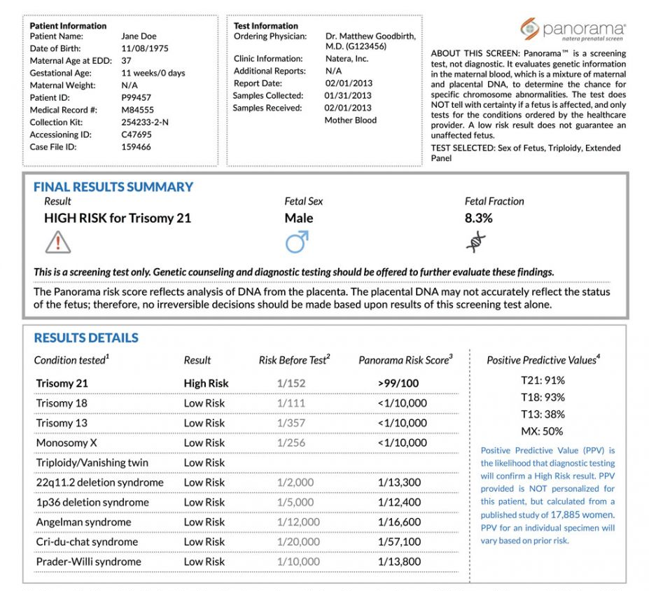
Panorama
Company: Natera
High risk result

Slide 17
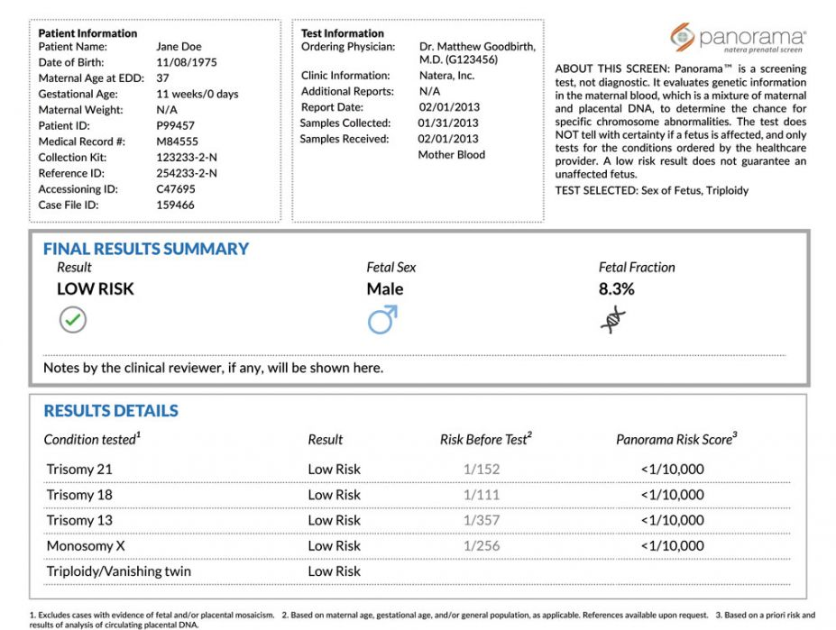
Panorama
Company: Natera
Low risk results

Slide 18
2014 study cffdna terminations without confirmation

Slide 19
Sensitivity, Specificity & Predictive Values
Sensitivity: if the disease is present, the test is positive
Specificity: if the disease is absent, the test is negative
Characteristics inherent to the TEST
Independent of the prevalence of the disease
PPV: probability that if the test is positive the patient has disease
NPV: probability that if the test is negative the patient DOES NOT have disease
Dependent on the prevalence of the disease in the population tested
Notes:
Some laboratories report the probability of aneuploidy; most commonly, this is stated to be >99% in patients who are at increased risk and <1/10,000 in patients who are at low risk. Such results
suggest a degree of certainty that is near diagnostic; however, this is a population statistic and applies only to the entire population of women who were screened and not to an individual’s result. It is
important for providers to recognize that a positive result for any of these aneuploidies confers a chance that the fetus is affected, which is usually far <99%, particularly in lower risk patients.

Slide 20
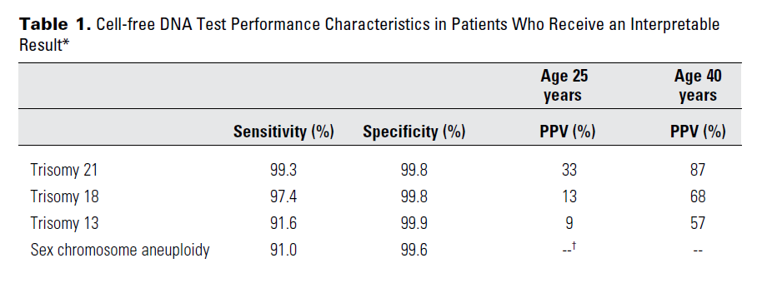

Slide 22
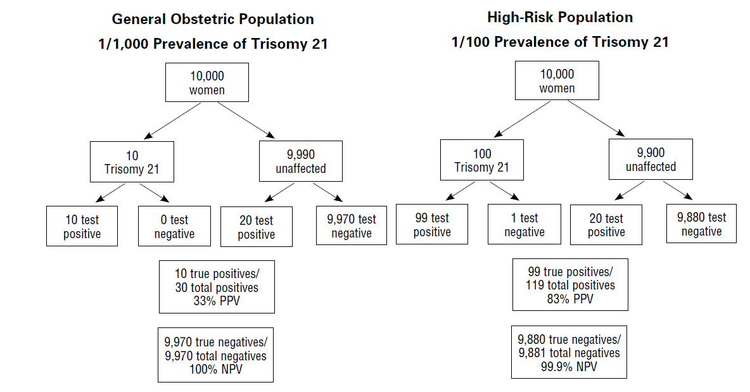

Slide 23
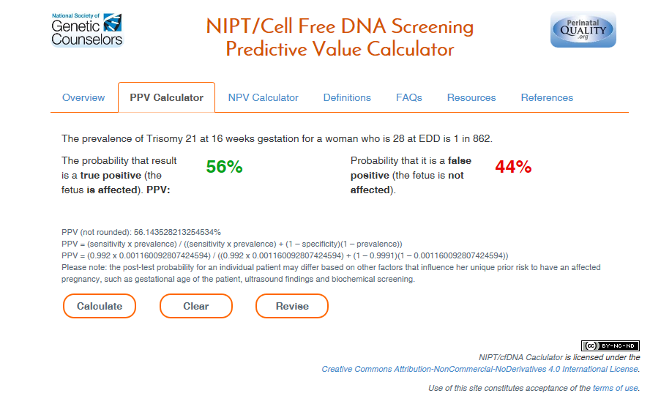

Slide 24
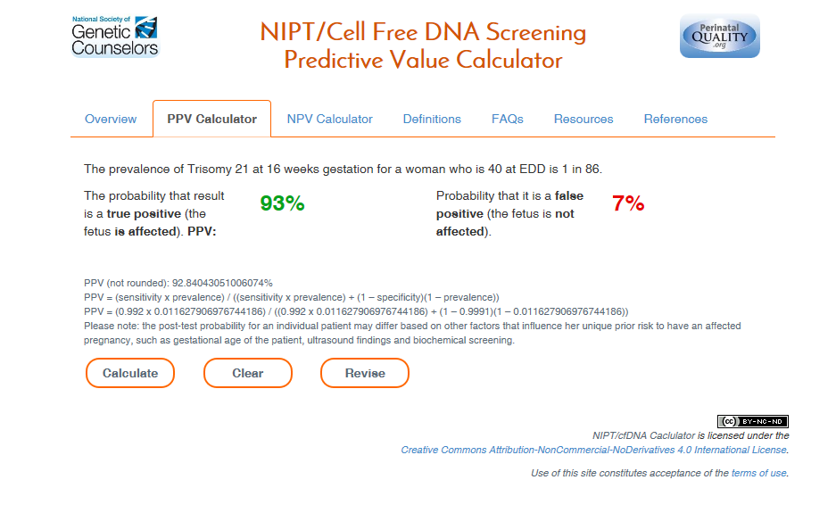

Slide 25

http://mombaby.org/nips_calculator.html

Slide 26
Some tests fail to provide a result
  These patients are at HIGH RISK of aneuploidy
  Importance of fetal fraction
The PPV depends on maternal age
Not all abnormalities are detectable

Slide 27
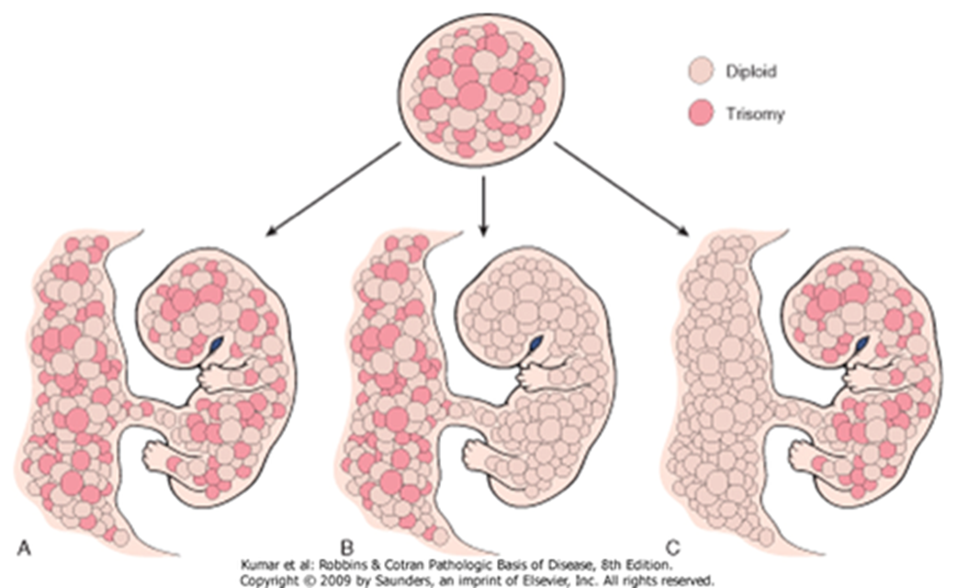
Why cell free fetal DNA fails?
Occurs in 3% samples
Confined placental mosaicism
BMI
Maternal malignancy
Notes:
In most pregnancies the chromosomal complement detected in the fetus is also present in the placenta. The detection of an identical chromosomal complement in both the fetus and its placenta has always been expected as both develop from the same zygote. However, in approximately 2% of viable pregnancies studied by chorionic villus sampling (CVS) at 9 to 11 weeks of gestation, the cytogenetic abnormality, most often trisomy, is confined to the placenta. This phenomenon is known as confined placental mosaicism (CPM). It was first described by Kalousek and Dill in term placentas of infants born with unexplained intrauterine growth restriction (IUGR). Contrary to generalized mosaicism, which is characterised by the presence of two or more karyotypically different cell lines within both the fetus and its placenta, CPM represents tissue specific chromosomal mosaicism affecting the placenta only. The diagnosis of CPM is most commonly made when, after the diagnosis of chromosomal mosaicism in a CVS sample, the second prenatal testing (amniotic fluid culture or fetal blood culture analysis) shows a normal diploid karyotype

Slide 28
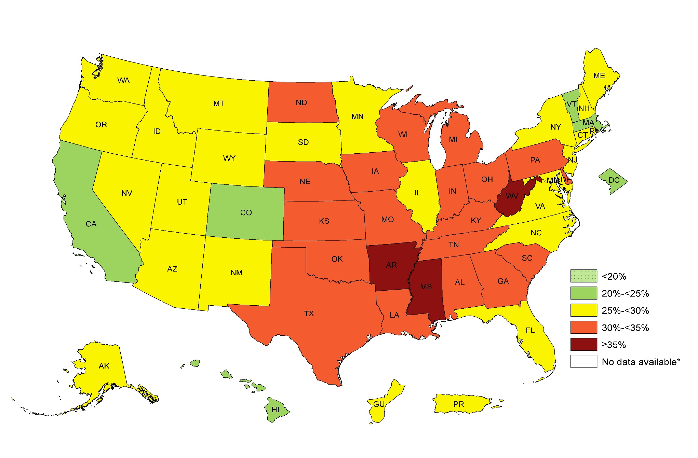

Prevalence of Self-Reported Obesity Among U.S. Adults by State and Territory, BRFSS, 2014
¶ Prevalence estimates reflect BRFSS methodological changes started in 2011. These estimates should not be
compared to prevalence estimates before 2011.
*Sample size <50 or the relative standard error (dividing the standard error by the prevalence) ≥ 30%.

Slide 29

Obesity in US Adults
CDC 2014 Percent of adults aged 18 years and older who are obese

Slide 30
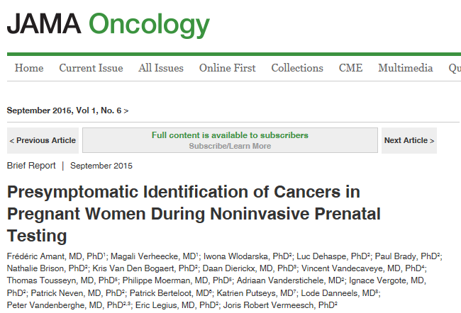
Maternal Malignancy
Notes:
Noninvasive prenatal testing (NIPT) for fetal aneuploidy by scanning cell-free fetal DNA in maternal plasma is rapidly becoming a major prenatal genetic test. Similar to placental DNA, tumor DNA can be detected in the plasma, and analysis of cell-free tumor DNA can be used to characterize and monitor cancers. We show that plasma DNA profiling allows for presymptomatic detection of tumors in pregnant women undergoing routine NIPT.
Observations During NIPT in over 4000 prospective pregnancies by parallel sequencing of maternal plasma cell-free DNA, 3 aberrant genome representation (GR) profiles were observed that could not be attributed to the maternal or fetal genomic constitution. A maternal cancer was suspected, and those 3 patients were referred for whole-body diffusion-weighted magnetic resonance imaging, which uncovered an ovarian carcinoma, a follicular lymphoma, and a Hodgkin lymphoma, each confirmed by subsequent pathologic and genetic investigations. The copy number variations in the subsequent tumor biopsies were concordant with the NIPT plasma GR profiles.
Conclusions and Relevance We show that maternal plasma cell-free DNA sequencing for noninvasive prenatal testing also may enable accurate presymptomatic detection of maternal tumors and treatment during pregnancy.

Slide 31
Vanishing Twin

Slide 32
Norton NEJM study

Slide 33
Microdeletions

Slide 36
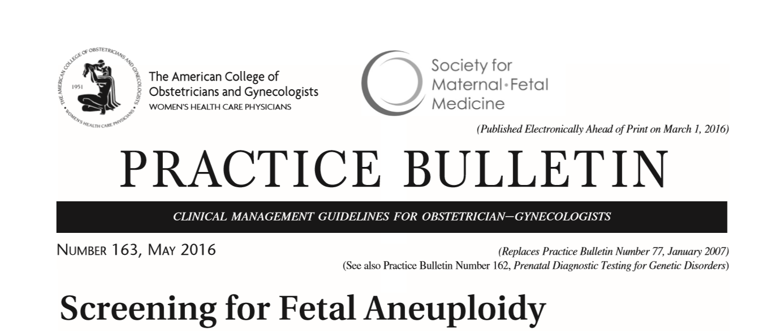

Slide 37
452,901 women had sequential screening between 2009-2012 in California
Compare Sequential screening to cfDNA general prenatal cohort
AJOG 2016

Slide 38
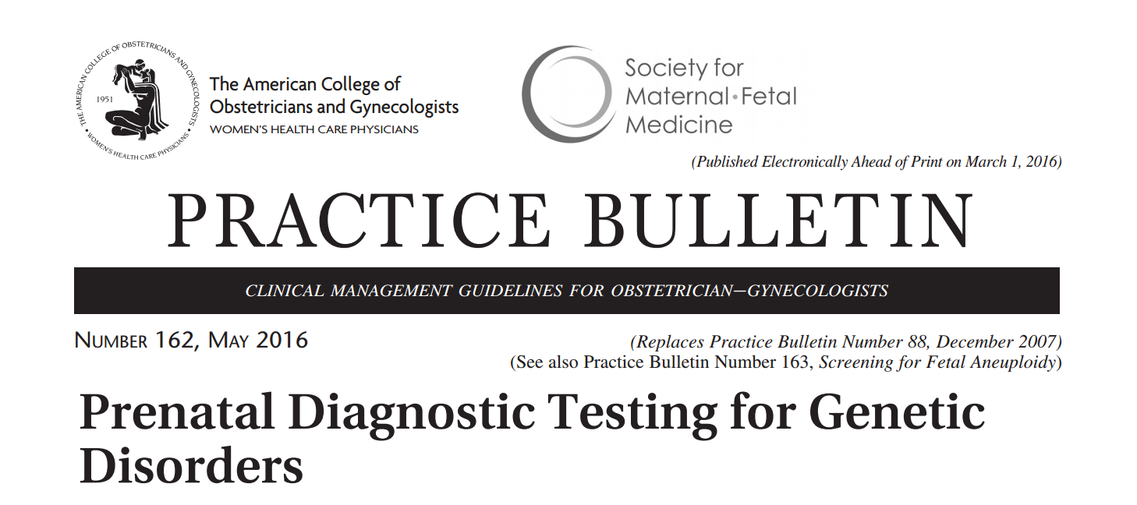

Slide 39
https://www.geneticsupportfoundation.org/providers/nipt-for-providers

Slide 43
