Slide 1
Disclosures
Patti Parsons has no relevant financial and/or non-financial relationships to disclose

Slide 2
Breastfeeding: New Core Measures and Cultural Tendencies
Patti Parsons, RN, MSN, IBCLC
May 8, 2015

Slide 3
Objectives
Review the Joint Commission’s core measure on breastfeeding
Share strategies that protect, promote, and support breastfeeding
Describe cultural tendencies related to breastfeeding

Slide 4
Joint Commission Core Measures
PC-01: Elective delivery
PC-02: Cesarean section
PC-03: Antenatal steroids
PC-04: Health care associated bloodstream infections in newborns
PC-05: Exclusive breast milk feeding

Slide 5
PC-05: Exclusive breastfeeding
Effective January 1, 2014
Ten steps to exclusive breastfeeding
Use multidisciplinary team to prepare “infant feeding” policy
Educate everyone: doctors, nurses, staff, community and women (pre-conception and prenatally)
Recommend breastfeeding to mothers as a health decision rather than lifestyle choice

Slide 6
PC-05: Exclusive breastfeeding
Ten steps to exclusive breastfeeding (cont.)
Implement skin-to-skin breastfeeding in first half hour
Emphasize supply and demand, early hours/days most crucial
Use formula only for medical indication
Keep mom and baby together

Slide 7
PC-05: Exclusive breastfeeding
Ten steps to exclusive breastfeeding (cont.)
Teach feeding cues, breast massage, and hand expression
Teach and normalize infant behavior, set realistic expectations, teach and model calming techniques (no artificial teats or pacifiers)
Support moms before, during and especially after the hospital

Slide 8
Documentation Perinatal Core Measure: Exclusive Breastfeeding
THIS PATIENT’S MOTHER HAS BEEN COUNSELED ON THE BENEFITS OF BREASTFEEDING
VERSUS FORMULA FEEDING HER INFANT. THE PATIENT HAS CHOSEN THE FOLLOWING:
❑ BREASTFEEDING  FORMULA FEEDING
OTHER: ____________________________________________________________
COUNSELING DATE: ____________________COUNSELING TIME: __________________
NURSE’S NAME (PRINT): _____________________________________________________
NURSE’S SIGNATURE: _______________________________________________________
Date/Time______________________________
I AGREE THAT THE NEWBORN’S MOTHER HAS BEEN COUNSELED ON BREASTFEEDING
AND ACKNOWLEDGE THE MOTHER’S CHOICE ABOVE.
PEDIATRIC RESIDENT NAME (PRINT): __________________________________________
PEDIATRIC RESIDENT SIGNATURE: ____________________________________________
Date/Time______________________________
PEDIATRIC ATTENDING (PRINT): ______________________________________________
PEDIATRIC ATTENDING SIGNATURE: __________________________________________
Date/Time______________________________
Place in UMC Newborn Medical Record
Interdisciplinary Newborn Feeding Method Record 750-017-15 | PATIENT IDENTIFICATION LABEL

Slide 9
Step 10: Support moms before, during and especially after the hospital

Slide 10
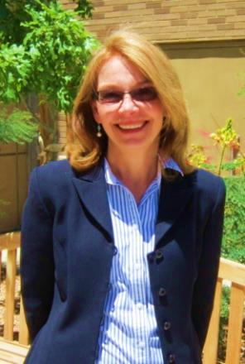
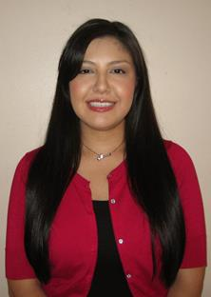
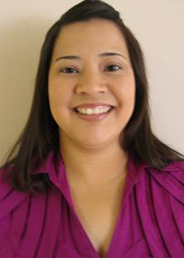
Community Education and Support
Facts:
90.2% Client breastfeeding initiation
Highest rate in Texas
(915) 521-7162

Slide 11
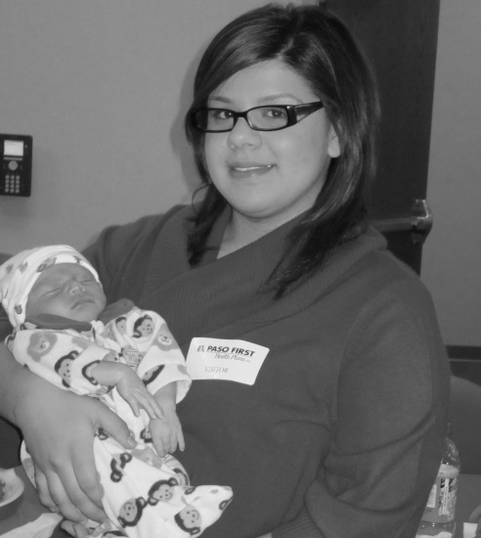
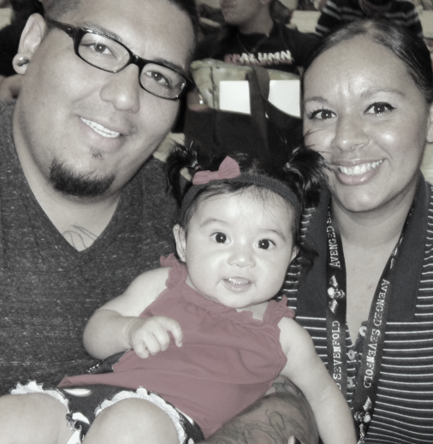
Cultural Awareness

Slide 12
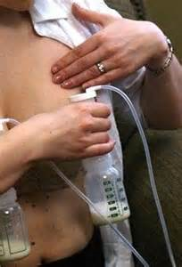
Affordable Care Act Provisions for Breastfeeding
Employers with 50+ employees required to provide nursing employees with:
Reasonable break time to express breast milk
A place, other than a bathroom, that may be used to express milk
For up to one year after the child’s birth

Slide 13
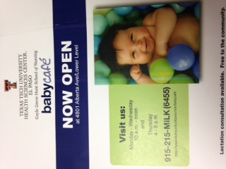
Chapter 165, Texas Health and Safety Code
A mother is entitled to breastfeed her baby in any location in which the mother is authorized to be.
-grocery stores
-parks
-restaurants
-hospitals

Slide 14
References
American Academy of Pediatrics (2013).Time to prepare for the new joint commission perinatal care core measures on breastfeeding.
El Paso County Hospital (2014). Department of nursing lactation management promotion of breastfeeding through implementation of ten steps to successful breastfeeding: Policy: NC-LM-1
Mitchell, P.H. (2015). How to teach for a culturally competent world; 4th Annual Cultural Competence Conference at Texas Tech University
Rumay, A.G. (2013). Patient centered care equals culturally competent care: Nurse-Family Partnership National Education Symposium
Texas Tech University Health Science Center at El Paso (2011). Lactation at the workplace, Policy: EP.9.4
The Joint Commission (2013). Benchmark improving performance on perinatal care measures; volume II, Issue 7
UMC of El Paso (2015). Interdisciplinary newborn feeding method record; Chart form 750-017-15

