Slide 1
Surgical Principles in a Difficult Vaginal Hysterectomy
T. Ignacio Montoya, M.D., F.A.C.O.G.
Female Pelvic Medicine & Reconstructive Surgery

Slide 2
Vaginal Hysterectomy, Where art thou?
T. Ignacio Montoya, M.D., F.A.C.O.G.
Female Pelvic Medicine & Reconstructive Surgery

Slide 3
No disclosures

Slide 4
Lecture Objectives
1. Understand reasons why vaginal hysterectomy is performed less often
2. Understand surgical principles that facilitate performance of vaginal hysterectomy
3. Understand techniques that may be applied in difficult vaginal hysterectomy cases

Slide 5
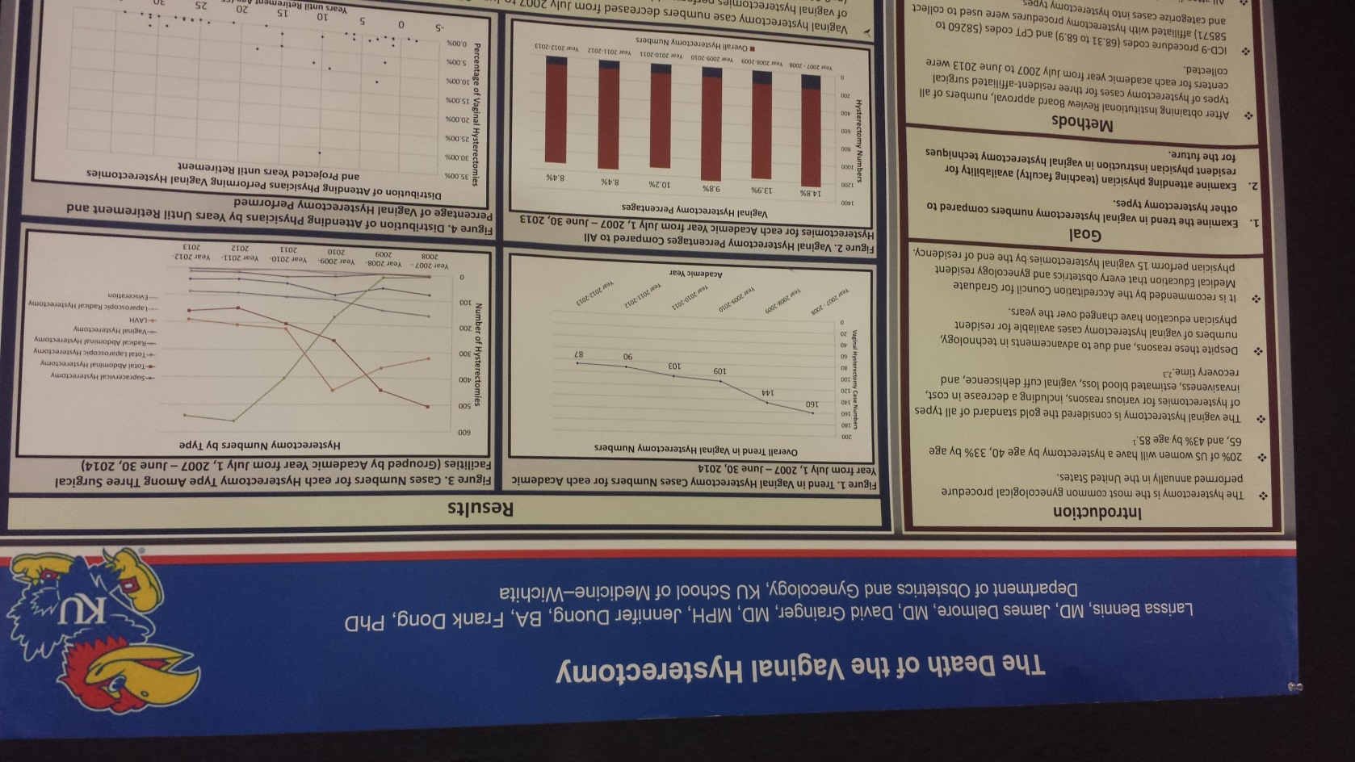
Is vaginal hysterectomy dying?
Notes:
I attended the CREOG meeting earlier this year and saw this poster. First, I wish I’d taken a better picture of the poster

Slide 6
www.augs.org
Notes:
Threatening to bundle suspension procedure along with vaginal hysterectomy– ie., unable to bill as separate procedures.

Slide 7
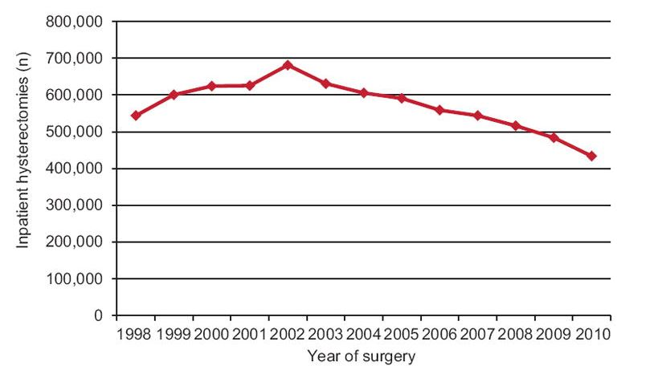
Hysterectomy Trends in USA-- Numbers
Currently ~400,000/year
Wright et al. Obstet Gynecol 2013
Notes:
Wright. Trends in Use of Inpatient hysterectomy. Obstet Gynecol 2013

Slide 8
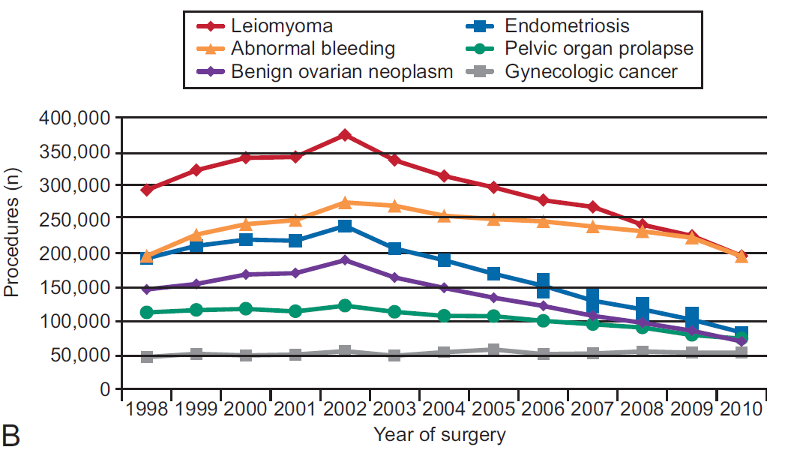
Hysterectomy Trends in USA-- Indications
Wright et al. Obstet Gynecol 2013

Slide 9
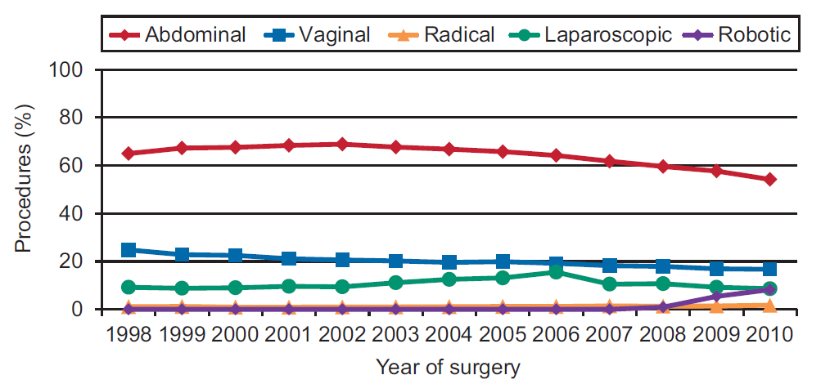
Hysterectomy Trends in USA-- Approach
Wright
=
=
Wright et al. Obstet Gynecol 2013
Notes:
Should come to no surprise that only approach that seems to be increasing in popularity is the robotic approach.

Slide 10
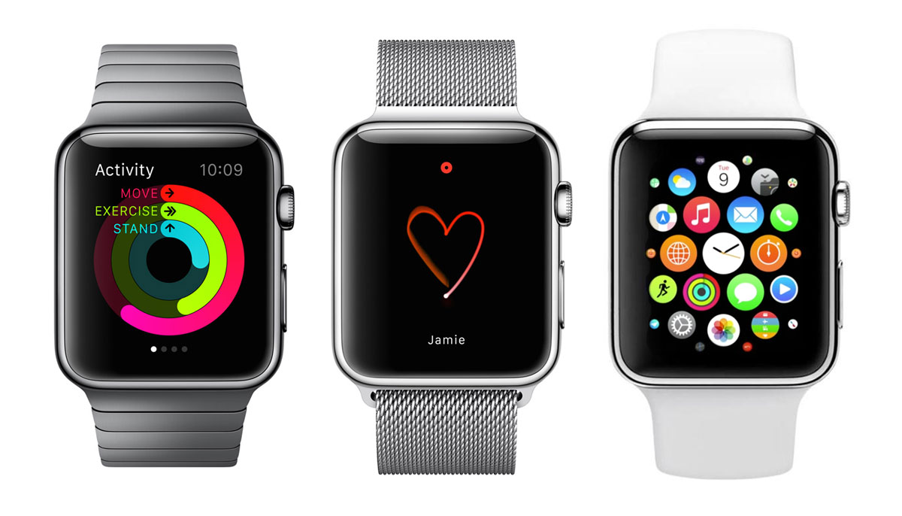
Everyday Technology
Notes:
We are enamored with technology. How many of us have placed preorders for an Apple Watch? Show of hands. I’m not sure if it tells time or not, but it sure looks cool.

Slide 11
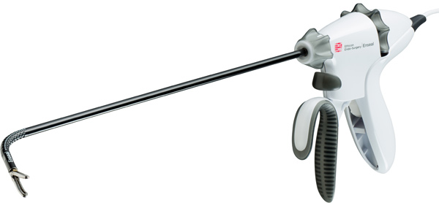
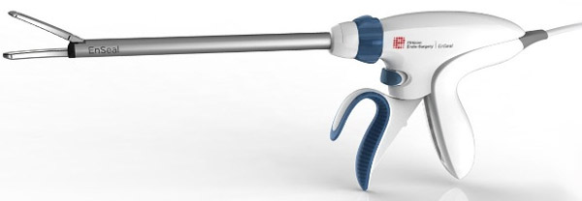
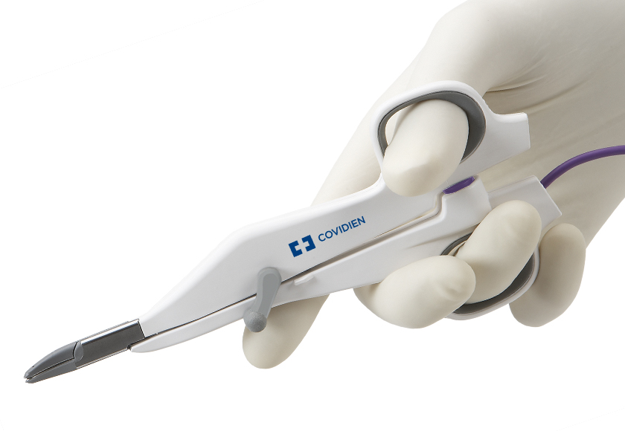
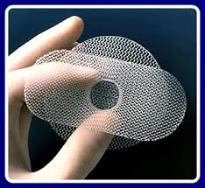
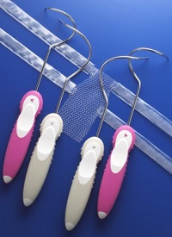
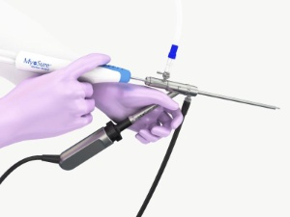
Technology in Gynecologic Surgery
?
Notes:
We love technology. We love gadgets. Some of these are great and make our lives easier in the OR, and help perform safer surgery. Sometimes products are great and facilitate our work as surgeons, and sometimes the products seem like a good idea… but are not as great.

Slide 12
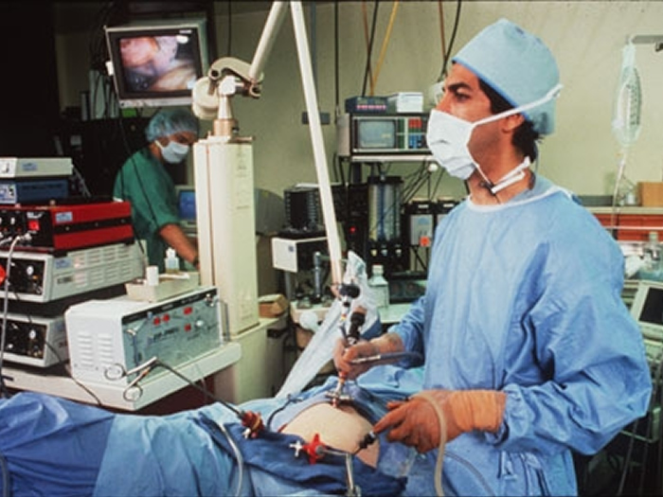
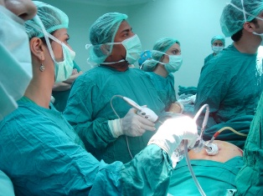
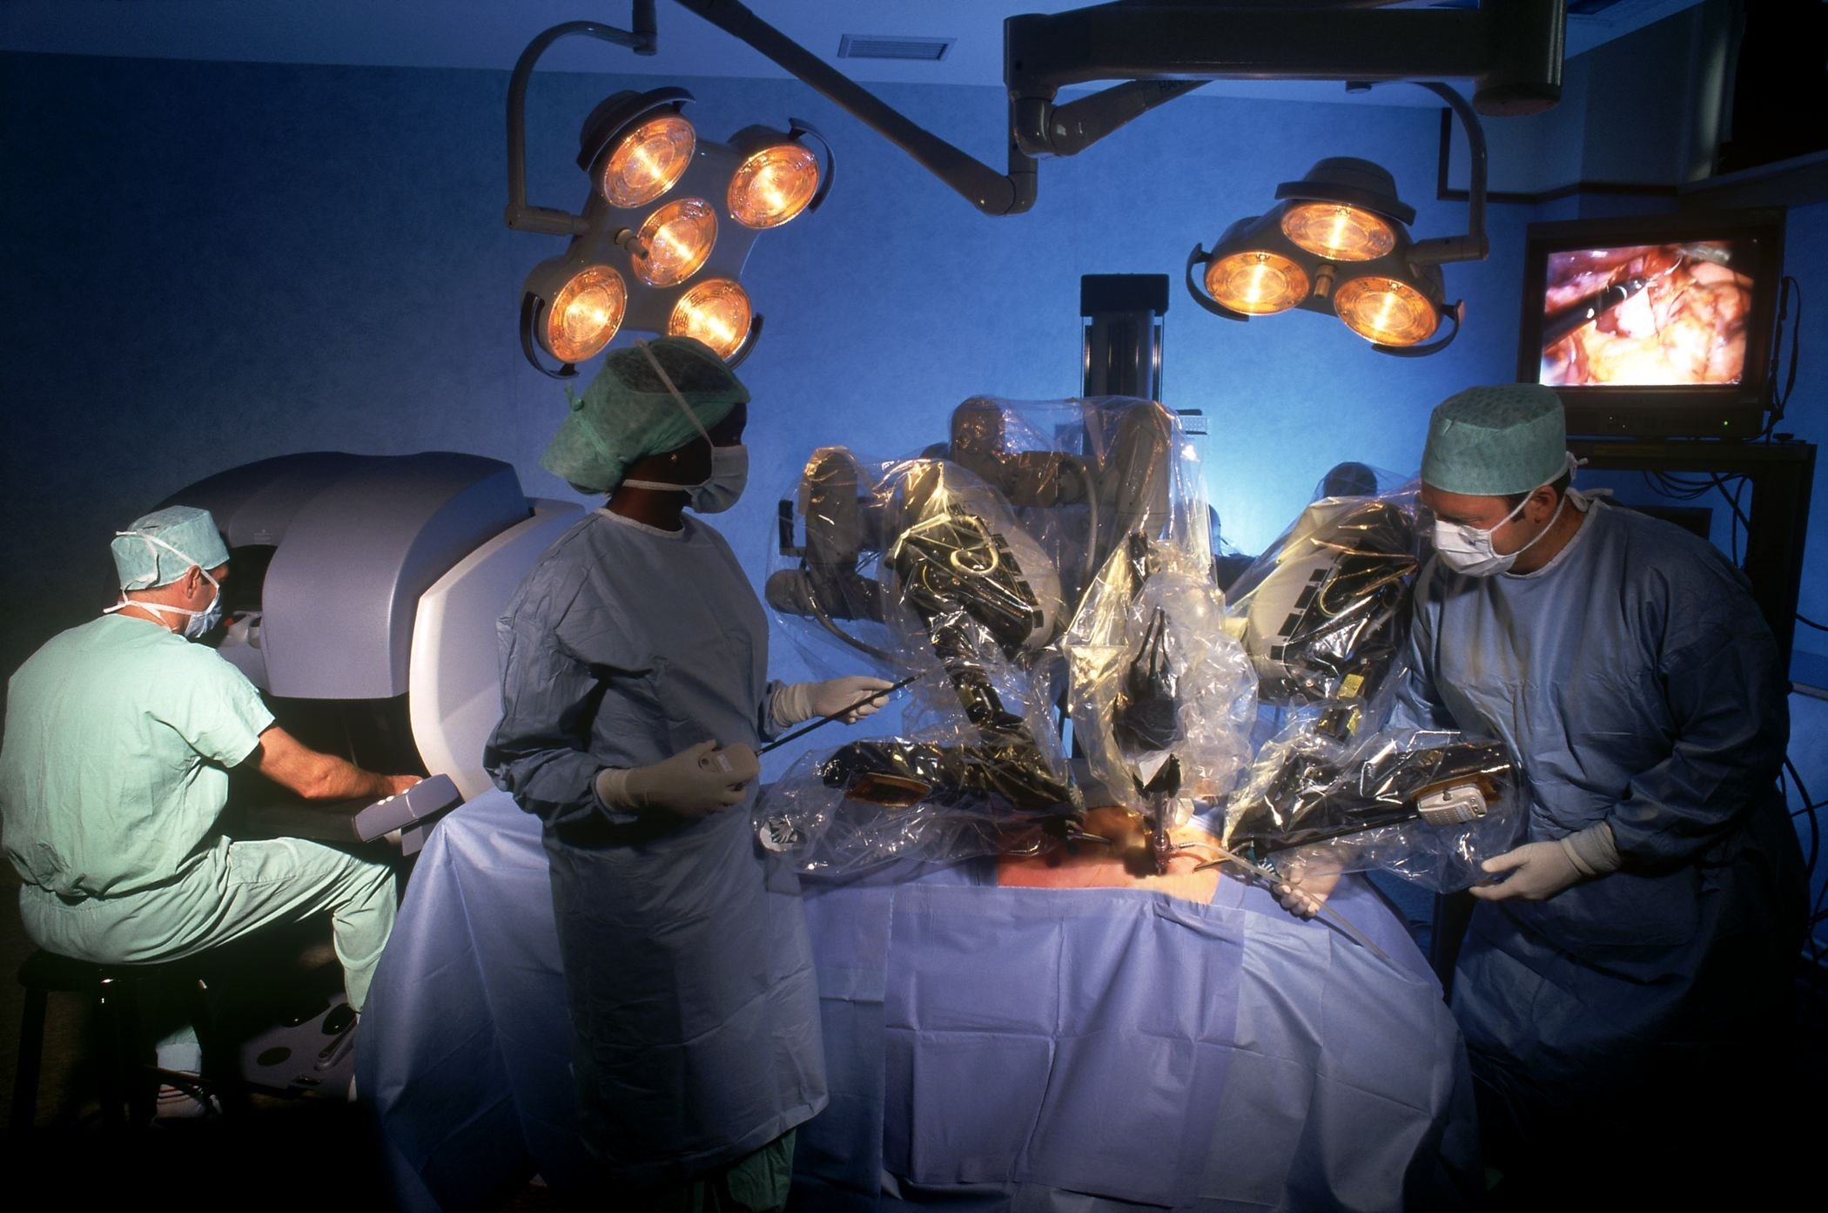
Evolution of Hysterectomy
Notes:
It’s natural for procedures to evolve with advances in technology. Hysterectomy has not been safe from the influence of technology.

Slide 13
“Single-Site” Hysterectomy
Notes:
We certainly have new options on how to approach a hysterectomy

Slide 14
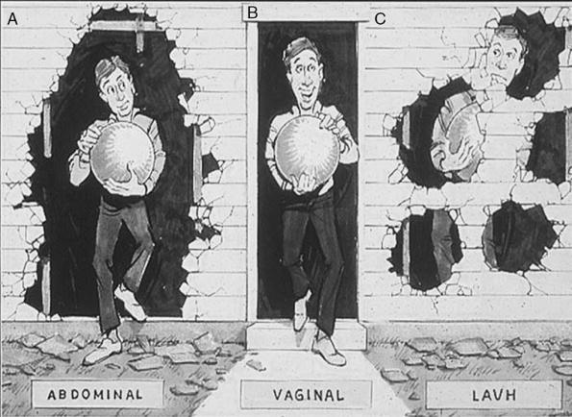
Vaginal Hysterectomy
The original single-site hysterectomy!
Most “minimally invasive” approach
ABDOMINAL
VAGINAL
LAPAROSCOPIC
Kovac S Clin Obstet Gynecol 2014
Notes:
So… where does Vaginal Hysterectomy fall into this seemingly new way of doing things?
After all… TVH is the original single-site hysterectomy!

Slide 15
ACOG Committee Opinion #444
Notes:
So… where does Vaginal Hysterectomy fall into this seemingly new way of doing things?
After all… TVH is the original single-site hysterectomy!

Slide 16
Preferred Mode of Hysterectomy
Least invasive approach
Shorter recovery
Fewer complications
Most cost-effective
Better cosmetic result
Nieboer et al, Cochrane Database Syst Rev 2009
ACOG Committee Opinion #444
Dayaratna et al. Am J Obstet Gynecol 2014
Notes:
Preferred Mode of Hysterectomy (when feasible)

Slide 17
Hysterectomy in the US
Wu et al, Obstet Gynecol 2007
Erekson et al, Obstet Gynecol 2011
Notes:
30 day all-inclusive “major” complication rate; TAH; TVH; TLH

Slide 18
Vaginal Hysterectomy
Most common indication: Uterine Prolapse
AUB
Leiomyoma
Cervical dysplasia
Endometrial hyperplasia
May be performed as Outpatient (*)

Slide 19
Why are we not performing more vaginal hysterectomies?
Training in residency
Maintenance of skills in practice
Marketing/awareness of alternative hysterectomy techniques
Notes:
3 key factors associated with underutilization of VH

Slide 20
Maintenance of Surgical Skill
TAH predominance
Lack of comfort/experience with minimally
invasive techniques
Most practicing OB/GYN in USA perform 4 or less hysterectomies/year
Moen MD, Richter HE Int Urogyn J 2014
Einarsson JI, et al. J Minim Invasive Gynecol 2010
Boyd LR, et al. Obstet Gynecol 2010

Slide 21
Hysterectomy OBGYN Resident Experience
Washburn et al. J Minim Invasive Gynecol 2014

Slide 22
TVH Proficiency
Minimum number needed for proficiency:
21-27
Minimum number of TVH required, ACGME:
15
2014
Jelovsek JE, et al. Am J Obstet Gynecol 2010
www.acgme.org

Slide 23
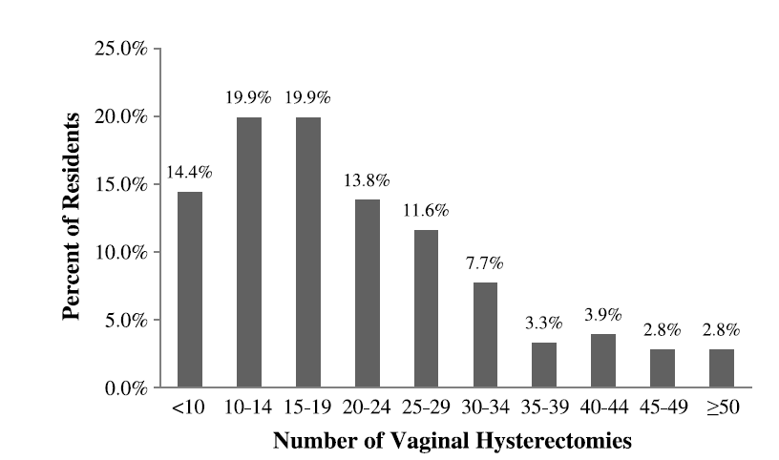
OBGYN residents
How many TVH have you performed as primary surgeon during residency?
Antosh DD, et al Female Pelvic Med Reconstr Surg 2011

Slide 24
Are you comfortable/competent to perform VH independently? (Graduating PGY4’s)
“Yes”
2007: 79%
2010: 27.8%
2015: ???
Kenton K, et al Am J Obstet Gynecol 2008
Burkett D, et al Female Pelvic Med Reconstr Surg 2011

Slide 25
Graduating residents TVH experience
www.acgme.org
ACGME PGY4 Case logs for Vaginal Hysterectomy as Primary Surgeon
Notes:
TTUHSC EL Paso AVG 37.2; MEAN for 2014=23

Slide 27
Notes:
Simulation consortium online toolkit; surgical skills module to help educate residents on vaginal hysterectomy techniques

Slide 28
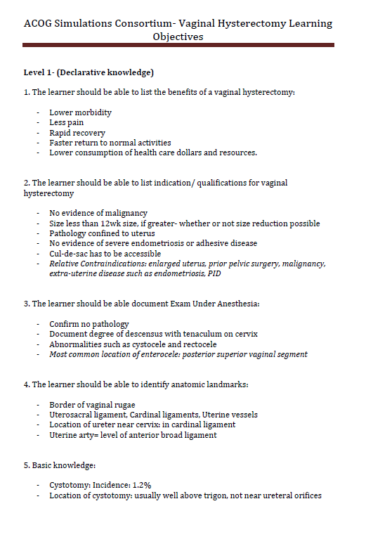
www.acog.org

Slide 29
Simulation

Slide 30
Simulation
APGO/CREOG Annual Meeting, 2015

Slide 31
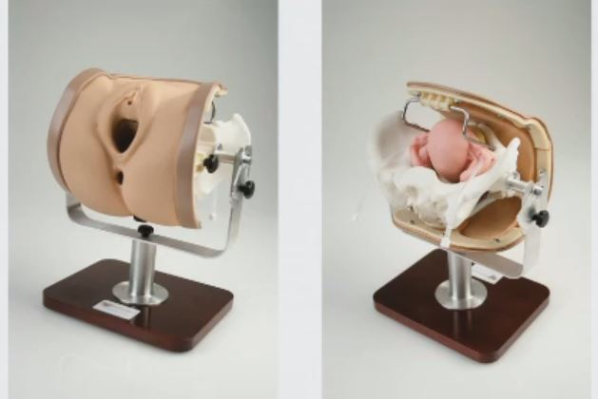
Simulation
Miya Model Vaginal Hysterectomy Simulator

Slide 32
What is the most difficult part of a TVH?
Removing ovaries vaginally
Anterior cul-de-sac entry
Securing utero-ovarian ligament
Securing uterine vessels
Posterior cul-de-sac entry
(HARDEST)
(EASIEST)
Antosh DD, et al Female Pelvic Med Reconstr Surg 2011

Slide 33
“Classic” contraindications (*)
* Not really; depending on surgeon experience/skill
Prior pelvic surgery/cesarean delivery
Suspected adhesive disease
Nulliparity
Adnexal pathology
Need for BSO
Uterine enlargement
Advanced prolapse
(Remember your FPMRS friends)

Slide 34
Prior Cesarean
Unger: No increase in complications
Rooney, Agostini: No significant increase in cystotomy
Kovac: 3,447 vaginal hysterectomies
Cystotomy:
0.7% (C-Section) VS. 0.5 % (No C-section)
Unger JB and Meeks GR Am J Obstet Gynecol 1998
Rooney CM, et al Am J Obstet Gynecol 2005
Agostini A, et al J Reprod Med 2005
Notes:
Agostini: metaanalysis

Slide 35
“Real” contraindications
Severe endometriosis
“Frozen” pelvis
Distorted anatomy
Uterine size >16-18 wks
Safe access to uterine vessels
Extensive morcellation
Pelvic malignancy

Slide 36
TVH: Keys to Success
1. Mobility (or the ability to create it)
2. Access/control of uterine vessels
3. Operator experience/skill

Slide 37
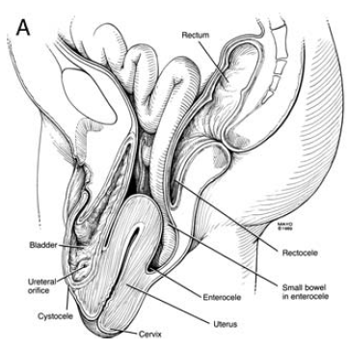
Word of caution-- Mobility
Mobility-- too much may be problematic
"...the less the prolapse, the easier the hysterectomy; the greater the prolapse, the more difficult the hysterectomy“
- David Nichols
Occhino, JA Clin Obstet Gynecol 2010

Slide 38
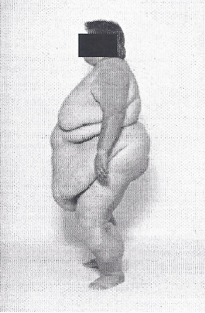
Difficult vaginal hysterectomy
Problem:
Prominent Buttocks
Solution:
Exposure/Assistance

Slide 39
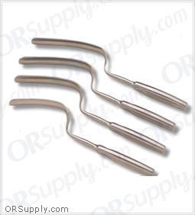
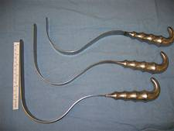
Exposure
Deep Deaver retractors
Breisky-Navratil retractors

Slide 40
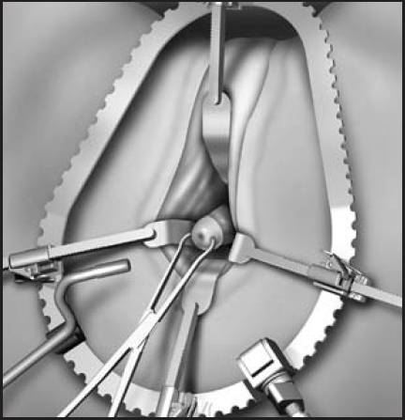
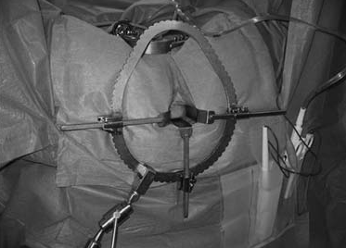
Exposure
Magrina-Bookwalter vaginal retractor

Slide 41
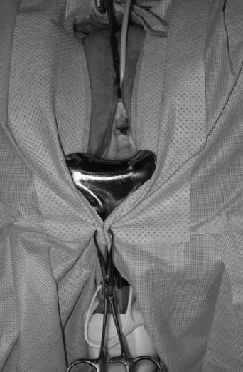
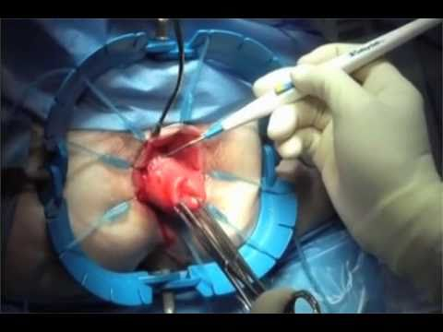
Exposure
Lone Star retractor
Weighted Speculum

Slide 42
Difficult Vaginal Hysterectomy
Problem:
Narrow pubic arch/Narrow vagina

Slide 43
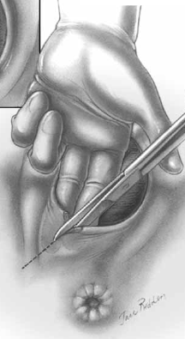
Narrow pubic arch/vagina
Solution:
Episiotomy (Midline/Mediolateral)
Notes:
33,316 practicing ob/gyns in USA

Slide 44
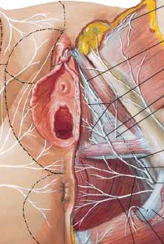
Mediolateral Episiotomy
Bulbocavernosus m.
Superficial transverse
perineal m.
Levator ani m.
(Puborectalis/
Pubococcygeus)
Notes:
33,316 practicing ob/gyns in USA

Slide 45
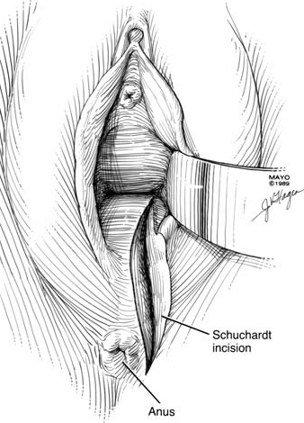
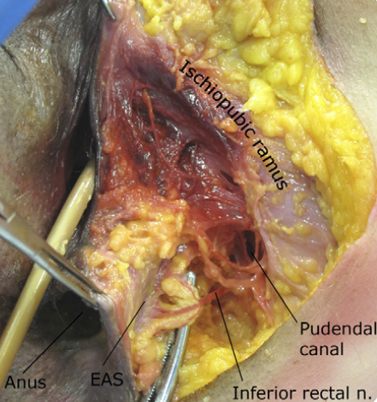
Narrow pubic arch/vagina
Solution:
Schuchardt incision (*)
* Know your anatomy
Montoya TI, et al. Am J Obstet Gynecol 2011
Notes:
33,316 practicing ob/gyns in USA

Slide 46
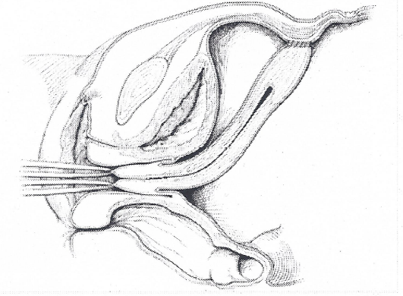
Difficult Vaginal Hysterectomy
Problem:
Abdominal fixation
OOPS!!!

Slide 47
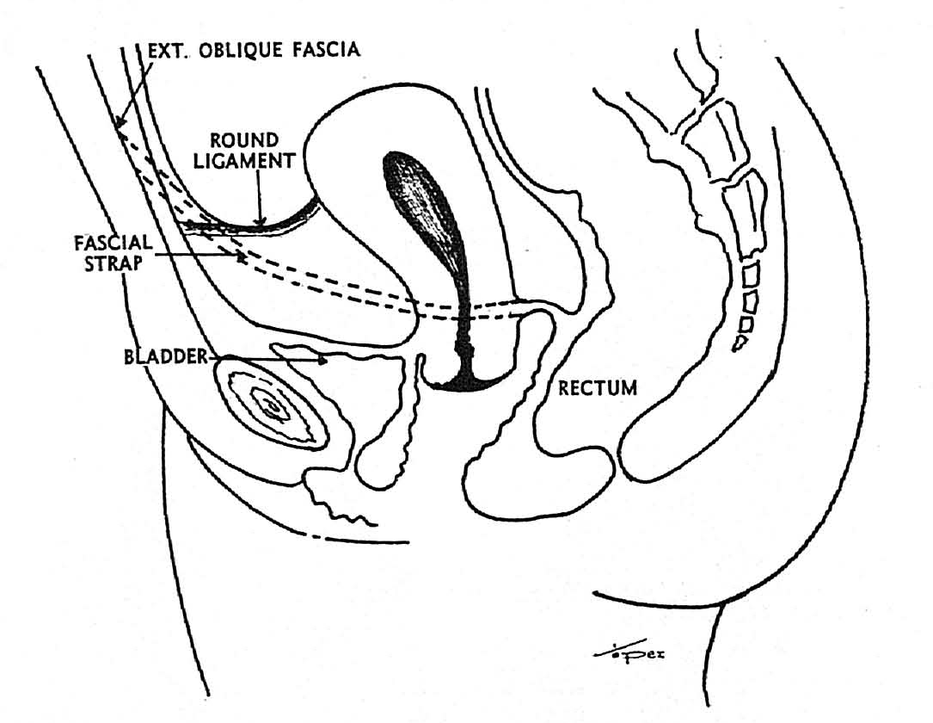
Previous Suspension
Watch out for: Ventral suspension/fixation procedures
Williams-Richardson Operation for Uterine Prolapse
Nassar GF Obstet Gynecol 1967

Slide 48
Abdominal Fixation of Uterus
Solution:
Be aware of past surgical history
Physical exam/abdominal scars
Start case laparoscopically

Slide 49
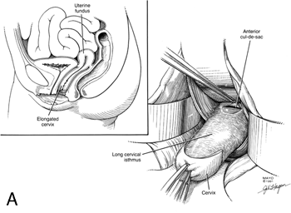
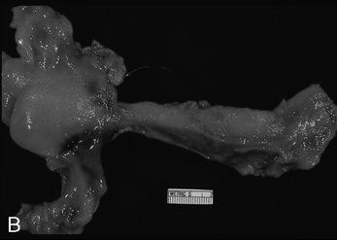
Difficult Vaginal Hysterectomy
Problem:
Cervical Elongation
Occhino, JA Clin Obstet Gynecol 2010
Notes:
Usually discovered intraoperatively
You will not reach VU fold until level of internal cervical os is reached

Slide 50
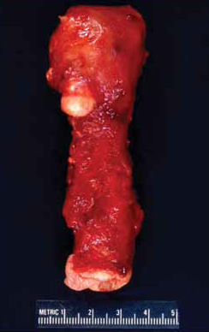
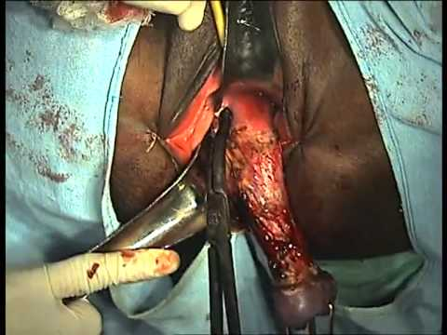
Cervical Elongation
Solution:
Remember-- Patience is a virtue

Slide 51
Difficult Vaginal Hysterectomy
Problem:
Large uterus; large fibroids
Solution:
Morcellation
Bivalving
Intramyometrial Coring
Deliver uterine fundus

Slide 52
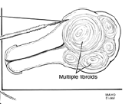
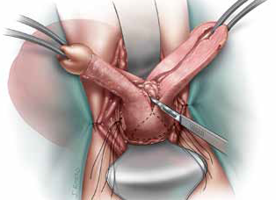
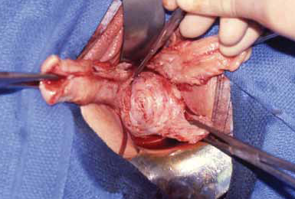
Large uterus/leiomyoma
Bivalving/Morcellation
Notes:
Prior to morcellation– control uterine vessels

Slide 53
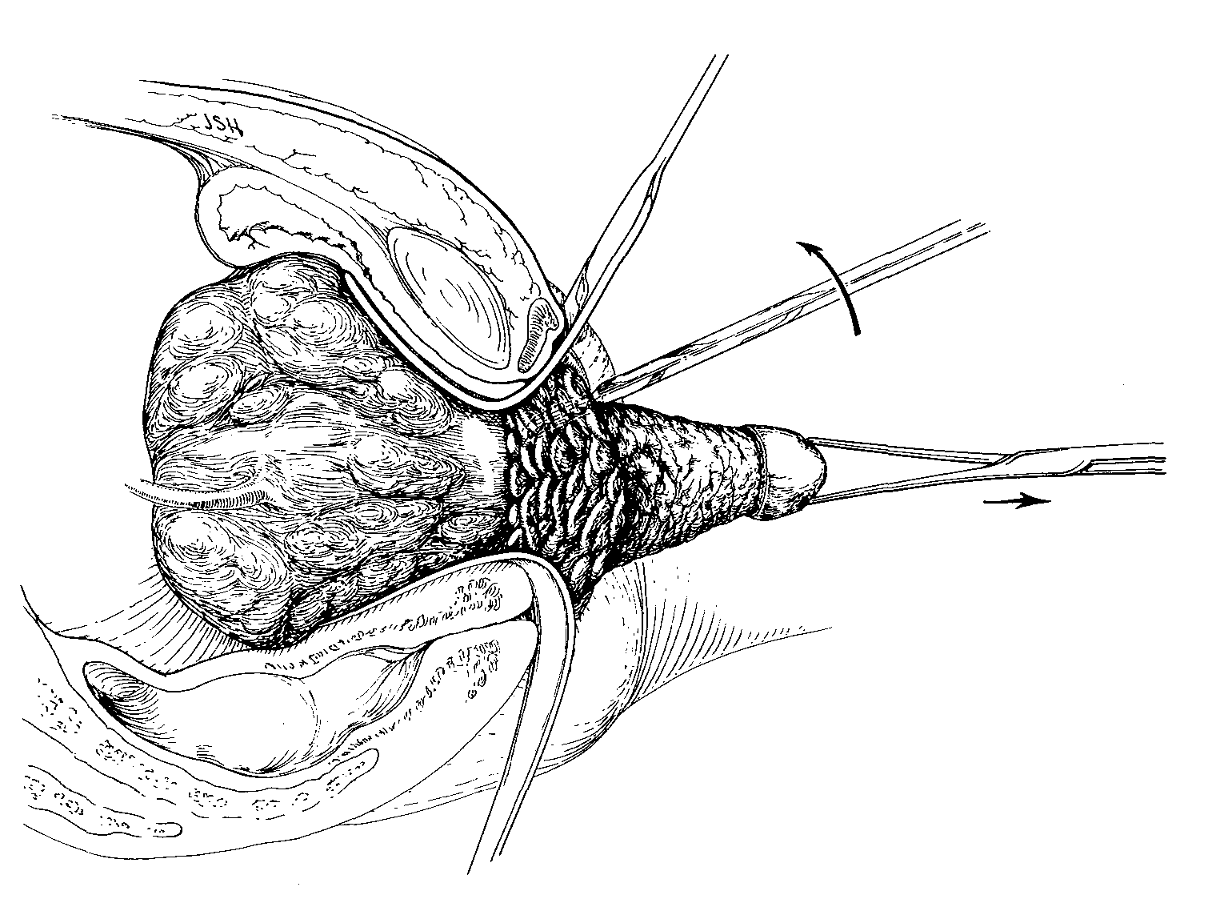
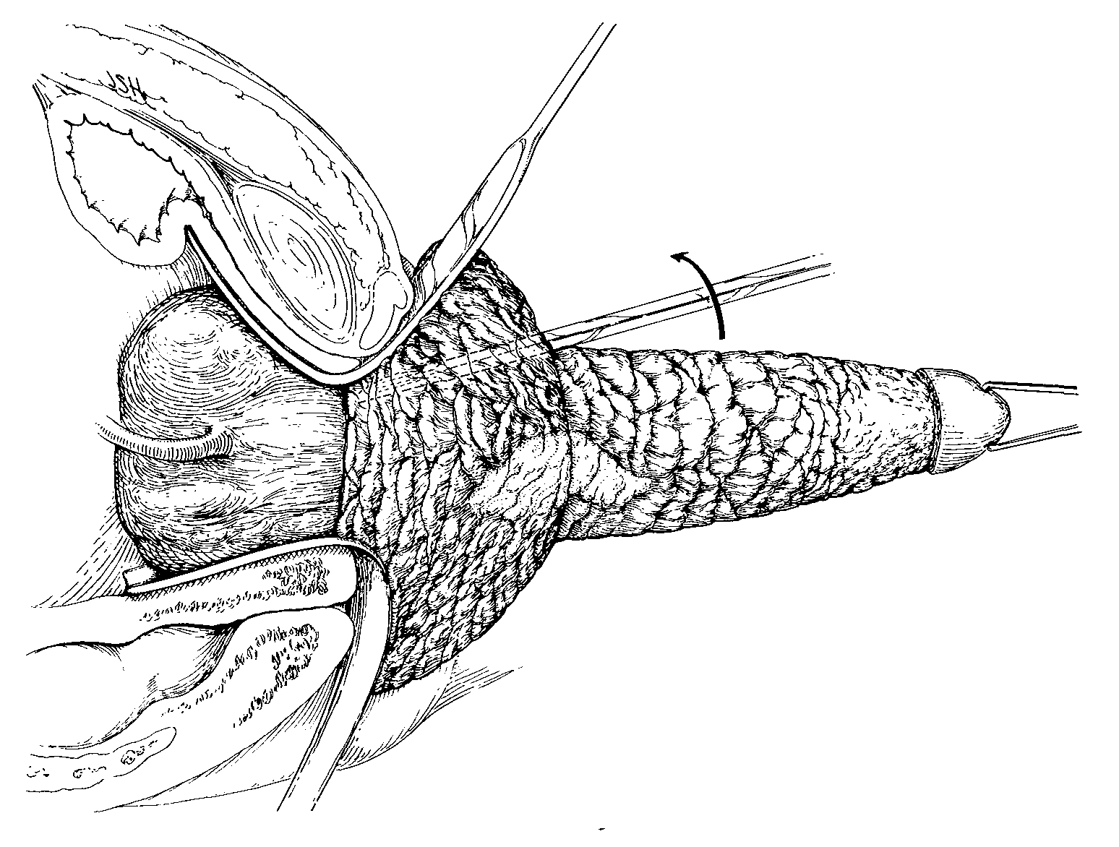
Large uterus/leiomyoma
Coring Technique
Kovac SR, Obstet Gynecol 1986
Notes:
Prior to morcellation– control uterine vessels
Knife underneath serosa– myometrium along with undisturbed endometrial cavity is delivered/excised

Slide 54
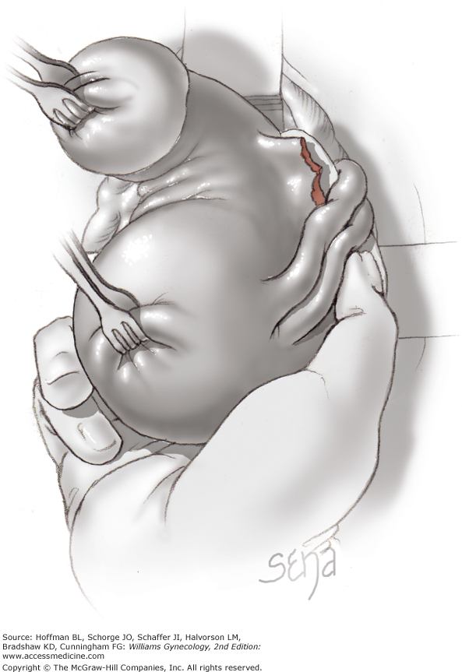
Large uterus/leiomyoma
Deliver uterine fundus
Hoffman et al. Williams Gynecology 2nd edition
Notes:
Prior to morcellation– control uterine vessels

Slide 55
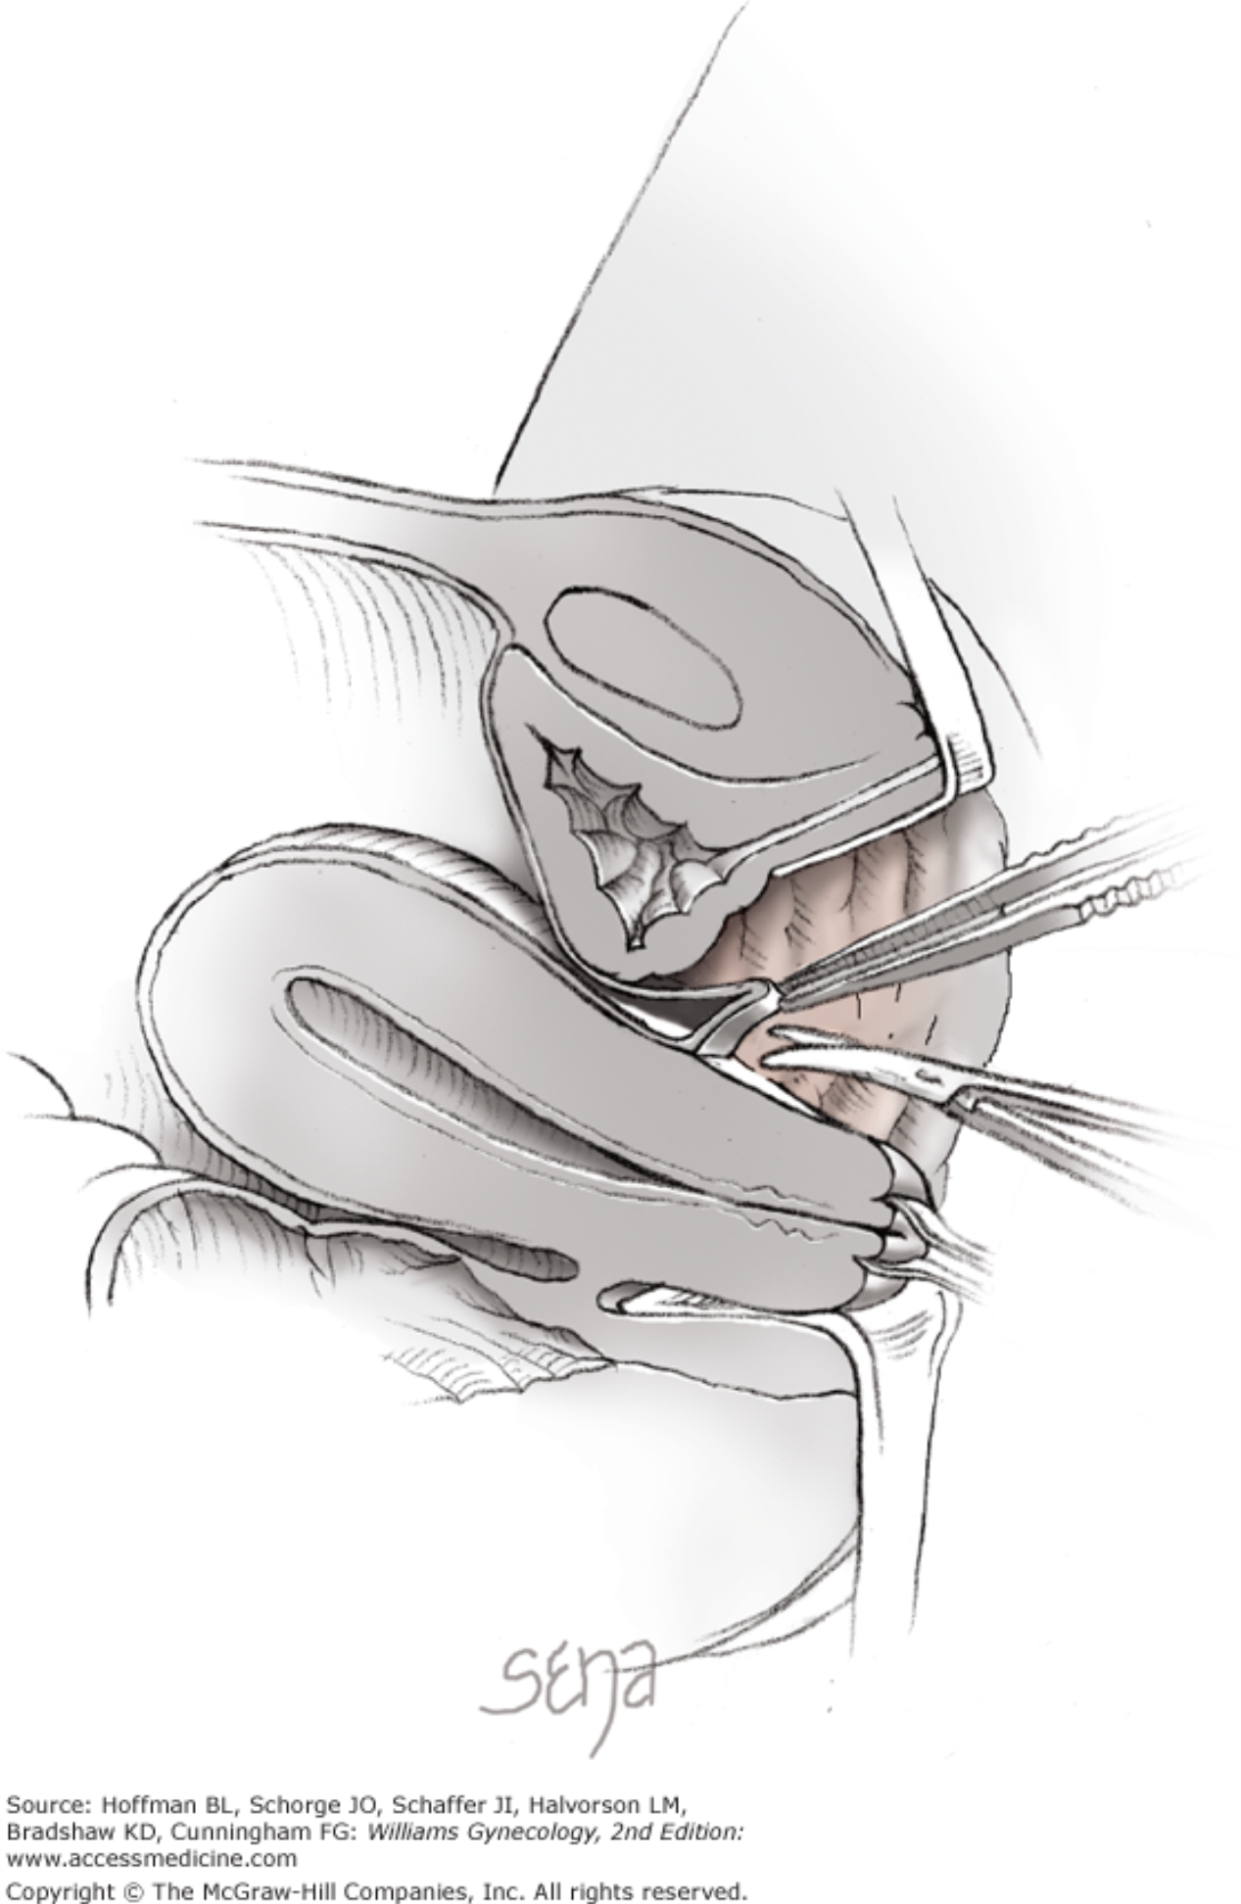
Difficult Vaginal Hysterectomy
Problem:
Anterior entry
Hoffman et al. Williams Gynecology 2nd edition

Slide 56
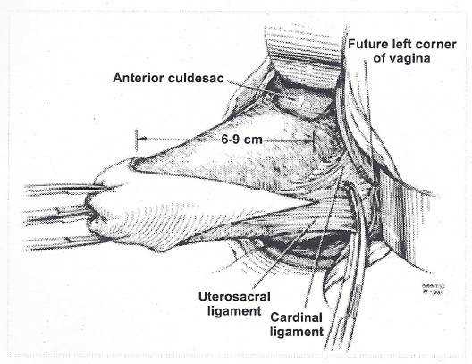
Anterior cul-de-sac entry
Patience
Take USL and cardinals first
VU peritoneal fold is always higher
2.5- 4.5 cm
Balgobin S, Montoya TI. Female Pelvic Med Reconstr Surg 2011
Notes:
Entry should be delayed until better descensus of uterus obtained, to adequately reach level of the VU fold

Slide 57
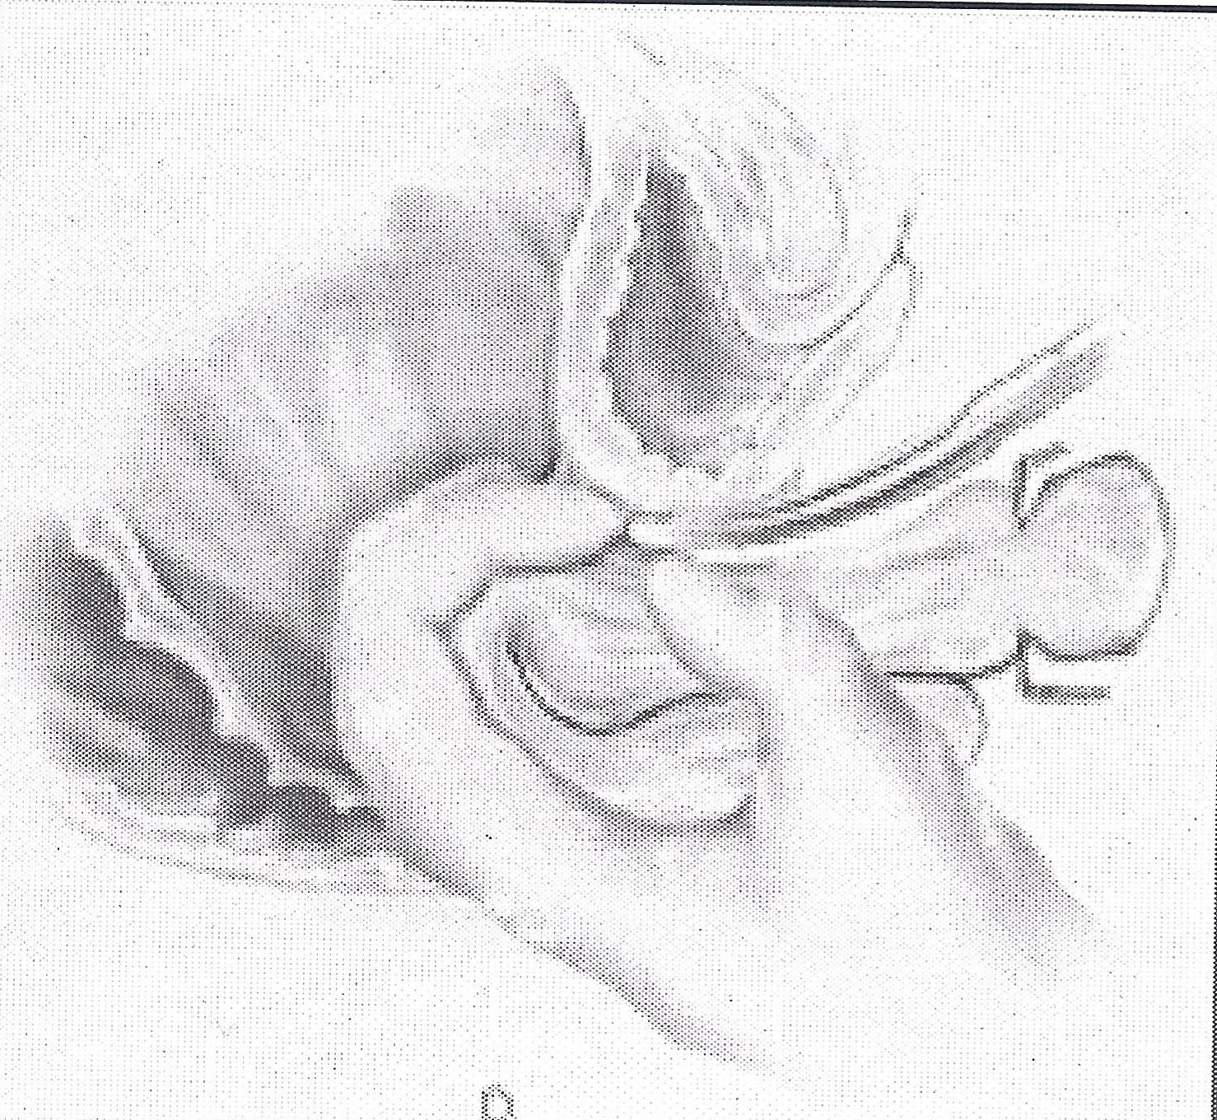
Anterior cul-de-sac entry
Reach-around
fundus
Notes:
Entry should be delayed until better descensus of uterus obtained, to adequately reach level of the VU fold

Slide 58
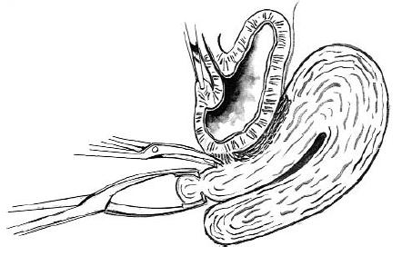
Prior Cesarean
Careful Sharp dissection-- KEY
Methylene-Blue dye in bladder
Unger JB and Meeks GR Am J Obstet Gynecol 1998
Notes:
In patients with prior cesarean; fill bladder with metylene blue-stained fluid. Use careful sharp dissection. In Most cases, the part closest to the initial vaginal disection is UNAFFECTED by the previous operation on the lower uterine segment. Once you get in correct surgical plane, continue dissection along cervix/uterus until vesicouterine peritoneum is reached.

Slide 59
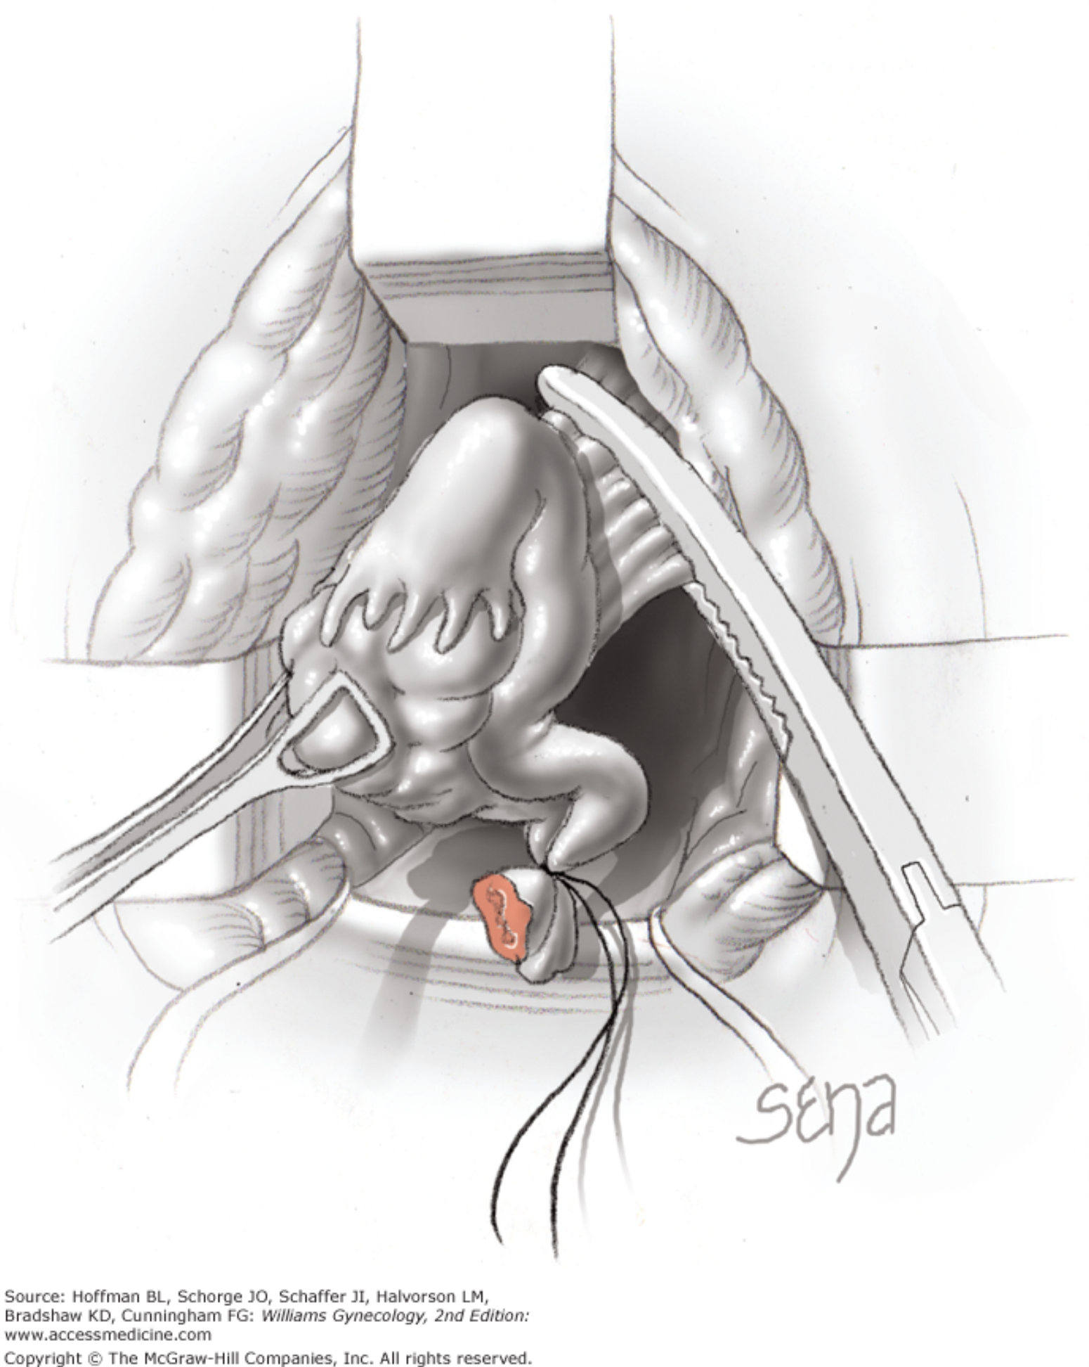
Vaginal Hysterectomy
Problem:
Removal of adnexa

Slide 60
Vaginal Hysterectomy
Solution:
Pack bowel
Use retractors
Babcock clamps
Patience
Consider laparoscopic assistance (*)

Slide 61
* Laparoscopic assistance for BSO
Success of removing adnexa vaginally 65 - 97.5%
RCT: VH/BSO vs LAVH/BSO
Longer duration and more complications in LAVH group
Better to approach vaginally IF NO endometriosis, adhesions or adnexal anomalies
Ballard LA and Walters MD Obstet Gynecol 1996
Davies A, et al Am J Obstet Gynecol 1998
Agostini A, et al Am J Obstet Gynecol 2006

Slide 62
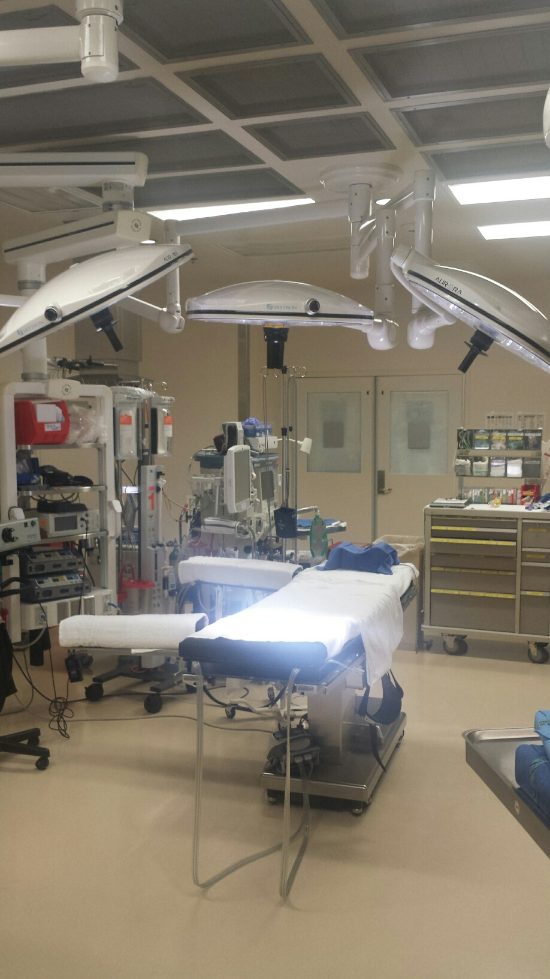
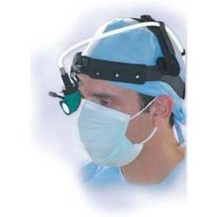
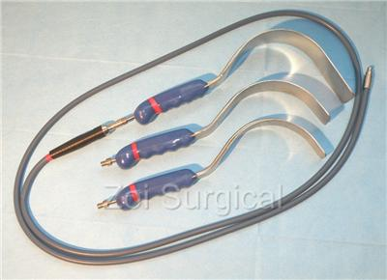
Lighting
Optimize BEFORE scrubbing

Slide 63
Foley or No Foley?
No Foley: Helps visualize cystotomy (?)
Foley: Lowers risk for cystotomy (?)
Available evidence: Level 3 (expert opinion)
Bottomline: Up to you!

Slide 64
Final thoughts
TVH should be preferred approach to hysterectomy
Most minimally invasive approach

Slide 65
Final thoughts
TVH should be performed when feasible–
However…
Approach of surgery should fit the patient, her specific complaints, her anatomy, and the surgeon’s skill level.

Slide 66
“May the vaginal hysterectomy never be to gynecologic surgery what the breech delivery has become to obstetrics”
George Morley
FORCEPS
Notes:
Vesicovaginal space→ vesicouterine peritoneum

