Slide 1
Diabetes in Pregnancy:
Diagnosis and Management
Lisa E. Moore, MD,MS, FACOG,RDMS
Texas Tech Health Sciences Center
Division of Maternal-Fetal Medicine

Slide 2
Objectives
To review current trends in the diagnosis and management of gestational diabetes
To understand current controversies in the diagnosis and management of gestational diabetes.
To review the use of insulin and oral agents in gestational diabetes.

Slide 3

How big is the problem?

Slide 4
Statistics About Diabetes Data from the National Diabetes Statistics Report, 2014 (released June 10, 2014)
In 2012, 29.1 million Americans, or 9.3% of the population, had diabetes.
Of the 29.1 million, 8.1 million were undiagnosed –
In 2012, 86 million Americans age 20 and older had prediabetes
Diabetes remains the 7th leading cause of death in the United States in 2010,

Slide 5
The rates of diagnosed diabetes by race/ethnic background are:
7.6% of non-Hispanic whites
9.0% of Asian Americans
12.8% of Hispanics
13.2% of non-Hispanic blacks
15.9% of American Indians/Alaskan Natives

Slide 6
Incidence of Diabetes in Pregnancy
Incidence in all pregnancies in the US: 5-14%
Canada 8-18%
China 7-10%
India – possibly as high as 27%
80% of patients with diabetes complicating pregnancy have gestational diabetes
10-20% of patients with diabetes complicating pregnancy have pre-existing diabetes (Type 1 and Type 2)

Slide 7
Gestational Diabetes
(definition)
Carbohydrate intolerance that begins or is first recognized during pregnancy
Diagnostic Categories: GDM A1 and A2
15% of GDM remain diabetic (Type 2)
50-60% of GDM will become diabetic in 5-10 yrs

Slide 8
Type 2 diabetes
Encompasses insulin resistance and relative insulin deficiency.
Associated with obesity – or increased percentage of body fat.
May go undiagnosed for many years

Slide 9
Both GDM and Type 2 are heterogeneous disorders
Pathophysiology is characterized by
- peripheral insulin resistance
- impaired regulation of hepatic glucose
production
-decreased insulin production
* Today both clinical entities are viewed as the same disease with different names

Slide 10
Pre-Diabetes
In 2010 the ADA committee on diagnosis and classification recognized an intermediate group
Blood glucose not high enough to have diabetes but also not normal.
IFG (impaired fasting glucose) fasting 100mg/dl – 125 mg/dl
IGT (impaired glucose tolerance) 2 hr value on the OGTT of 140mg/dl – 199 mg/dl

Slide 11
Pre-Diabetes
This is considered an intermediate stage
IFG and IGT are not diseases in their own right but are risk factors for diabetes and cardiovascular disease.

Slide 12
Hgb A1C
A1C of 5.5-6.0% have a 5 year cumulative incidence of diabetes from 12% to 25%
NHANES data indicate that A1C of 5.5 -6.0% identifies people with IFG and IGT.

Slide 13
Hgb A1C
Compared to a fasting glucose of 100 mg/dl – using A1C 5.7% or above is 66% sensitive and 88% specific for the development of diabetes in 6 years.
Individuals with A1C 5.7-6.4 should be informed of the risk and receive counseling regarding changes in lifestyle
.

Slide 14
Categories of increased risk
Fasting 100mg/dl – 125 mg/dl
2h values on the 75gOGTT 140mg/dl-199 mg/dl
A1C of 5.7-6.4
.

Slide 15

Why do we care about diabetes in pRegnancy?

Slide 16
Adverse effects in offspring
Conception to 8th week
Malformations:
Caudal regression (3wk)
NTD (4 wk)
Cardiac (5 wks)
Renal (5 wks)
GI (6 wks)
ACOG Tech Bulletin Dec 1994
8th week to delivery
Chronic hypoxia
Intrauterine death
Hyperinsulinism
Macrosomia
Organomegaly
Polyhydraminos

Slide 17
Birth Defects
Most important FACTOR: glycemic control during embryogenesis
If Gestational diabetes begins after first trimester;no increase in birth defects
In women with pre-existing diabetes:8.5% increase in cardiac defects,5.3% in CNS defects,and 3.5% in GI and GU defects
HGA1c levels prior to embryogenesis determine the risks for birth defects. A1c greater than 7 increase the risks

Slide 18
Neonatal Morbidity
Hypoglycemia
Polycythemia
Hyperbilirubinemia
Hypocalcemia
Cardiomyopathy
Respiratory Distress
Birth Trauma

Slide 19
Diabetes Effect on the Pregnancy
Dystocia
Preeclampsia
Pyelonephritis
Pelvic trauma

Slide 20

TESTING /SCREENING

Slide 21
Screening
2 step testing
Universal vs High risk
24 –28 wks
Step 1. 1 hr 50 gram – no fasting necessary
Venous plasma (<140 mg/dl) identifies 80% of women with GDM. A value >130mg/dl identifies 90% of women with GDM
Step 2. 3 hour 100g after an overnight fast

Slide 22
Diagnostic Criteria for GDM
Status | Carpenter and Coustan | National Diabetes Group
Fasting | 95 | 105
One hour | 180 | 190
Two hour | 155 | 165
Three hour | 140 | 145

Slide 23
Screening
1 step testing
75 g glucose load after overnight fast
Fasting 95 mg/dl
1 h 180 mg/dl
2 h 155 mg/dl

Slide 24
When to Screen
Assess risk at the first prenatal visit
Marked obesity
Family or personal history
glycosuria

Slide 25
When is it outright diabetes?
1. A1C ≥ 6.5%
2. Fasting glucose ≥ 126 mg/dl (8 hr fast)
3. 2h value ≥ 200mg/dl after 75g load
4. Symptomatic pt with random glucose ≥ 200 mg/dl
(1-3 should be confirmed with repeat testing)

Slide 26
A few details
Hgb A1C ≥ 6.5% identifies one third fewer patients than a fasting ≥ 126 mg/dl
Certain hemoglobinopathies or anemias may affect the A1C (Sickle cell, iron deficiency)
There may be discordance between tests.

Slide 27
Screening
Hgb A1C at first prenatal visit. (< 20 weeks)
≥ 6.5% dx of diabetes in pregnancy
counseling on diet
daily SMBG
medication as needed
5.7-6.4% Impaired glucose tolerance
counseling on diet
monitor BG

Slide 28
Screening
<5.7% Test for GDM at 24-28 weeks

Slide 29

Which method is best?

Slide 30
World Health Organization (WHO)
Australasian Diabetes in pregnancy society
Diabetes in pregnancy study group of India
International Association of Diabetes and Pregnancy study group (IADPSG)
American Diabetes Association (ADA)
ALL SUPPORT 75G ONE STEP TESTING AND THE USE OF THE A1C AT THE FIRST VISIT

Slide 31
Americal Congress of Obstetricians and Gynecologists (ACOG)
Supports 2 step testing
It is estimated that if 75g single step testing is implemented the prevalence of GDM is expected to increase to 20% or higher.

Slide 32

PART 2: Management

Slide 33
All diabetes is not the same
Diabetes in pregnancy ≠ Diabetes outside of pregnancy
Outside of pregnancy goals are :
To prevent complications of cardiovascular disease
blindness
neuropathy
renal failure

Slide 34
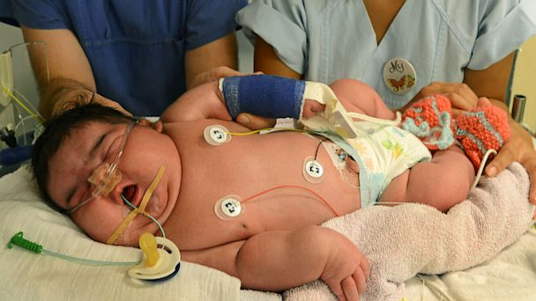
Newborn 13.4pounds (NSVD !!!)

Slide 35
All diabetes is not the same
During pregnancy – goals are:
Prevent macrosomia
Prevent fetal death
Prevent other fetal complications

Slide 36
This means you cant treat them the same
During pregnancy
more frequent visits when not controlled
stricter glycemic goals

Slide 37
Control of Maternal Glycemia
(Target plasma glucose levels)
Fasting
Preprandial
1 hr after meals
2 hr after meals
60-90 mg/dl
60-105 mg/dl
<140 mg/dl
<120 mg/dl;

Slide 38
Glucose Monitoring
Daily SMBG superior to intermittent monitoring
Fasting blood sugar
Post prandial sugars most predictive of macrosomia . The most difficult glucose to control- post breakfast(dawn phenomenon) most predictive of fetal demise
Verify glucometer with your facility’s lab

Slide 39
Medical Nutrition Therapy(MNT)
Goal: to provide calories and nutrients to sustain pregnancy, but does not cause post-prandial hyperglycemia

Slide 40
Dietary recommendations
3 meals and 3 snacks
Composition: CHO-30%-prot-20%;fat-30-40%
Wt gain: 25-35 lb;if overwt(15-25);underwt (30-40)
Caloric distribution;10%-breakfast,20-30 % for lunch,30-40 % for dinner,30% for snacks
Exercise is also very important in the management of all women with diabetes

Slide 41
Carbohydrate Budget
Breakfast 1-2 carbohydrate choices
Lunch 3-4 carbohydrate choices
Supper 3-4 carbohydrate choices
Snacks (1-3 ) 1-2 carbohydrate choices
Amount of CHO typically found in a 2200 calorie diet

Slide 42
Nutrition Guidelines
Carbohydrate counting/label reading
CHO restriction at breakfast
Avoid sugar, concentrated sweets, refined/processed starches
Eliminate liquid CHO (juices), test milk
Ok to use aspartame(Equal), sucralose (Splenda).
saccharine (Sweet n Low)
Increase high fiber foods (25-30 grams)

Slide 43
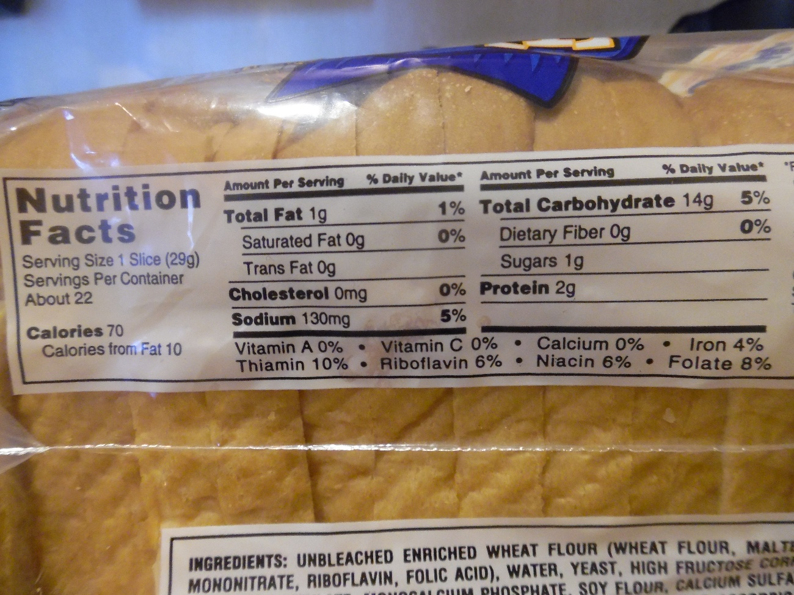

Slide 44


Slide 45
After a meal
Peak glucose levels approximately 1 hour
Preprandial levels 2-3 hours
Should you check 1 hour or 2 hour postprandial?

Slide 46
When to initiate pharmacotherapy
GDM A1 to A2
>2 values exceed goal in 1 to 2 weeks
FBS >95
2 hour PP>120
Fetal abdominal circumference >70% at 29-33 wks
(Buchanan diabetes care 1998)

Slide 47
Insulin Therapy Lispro(Humalog)
Rapid Acting-good for pre-meals!
Onset-15min
Peak-30-90min
Duration-3-5 hours
Little antibody formation; more effective than regular insulin
Disadvantages: expensive , once thought to increase risk for proliferative retinopathy
Notes:
Regular insulin onset 30min peak 2-4 hrs and duration 6-8 hrs

Slide 48
Insulin Therapy
NPH
Intermediate Acting Insulin
Onset 1-2 hours
Peak 4-8 hours
Duration 12 hours
Good for HS to Fasting window
May add in Am to cover midday

Slide 49
Insulin Therapy
Ultralente
Long Acting
Onset 4-6hr
Duration 24-36 hours
Peaks 16-18 hours
Large day to day variability
Not recommended

Slide 50
LANTUS(glargine-DNA origin)
Long acting
Once a day insulin injection
No peak
Steady release of insulin
Acidic pH 4. After SQ injection it is neutralized forming micro precipitates.
Cannot be mixed with any other insulin
Category C

Slide 51
Insulin Total Daily Dose Regimen
1st trimester .7 u/kg
2nd trimester .8u/kg
3rd trimester 1.0u/kg
Dose range .25u/kg to 1.0u/kg

Slide 52
********Insulin Therapy –Daily Breakdown
Lispro Coverage
TDD x 40% Pre Breakfast
TDD x 30% Pre Lunch
TDD x 20 % Pre Dinner
TDD x 10% Bedtime
NPH is added for coverage at bedtime

Slide 53
BEWARE OF VICIOUS CYCLE
BG
Appetite
Wt Gain
Insulin resistance
Insulin

Slide 54
Management of GDM/Type 2 oral agents
First line glyburide ( not used in Type 1)
Max dose 20mg/day
Usual dose 5-10mg targeted for time when glucose abnormal ( there is a 2.5mg dose)
It’s a sulfonylurea - don’t use in patients with sulfa allergy
Long tail –most common side effect is hypoglycemia

Slide 55
Oral Hypoglycemic Agents
Glyburide
An effective alternative to insulin in the treatment of gestational diabetes (Langer NJMED,2000)
30 –40 % failure rate in some series of studies
Patients prefer oral agents rather than injections!
Other agents Metformin( biguanide)
Precose?
Notes:
Metfomin glucaphage insulin resistance reducer increase hypoglycemia and crosses the placenta

Slide 56
Management of GDM/type 2 oral agents
Metformin – insulin sensitizer
Maximum dose studied 2000mg/day but have seen patients on up to 2500.
Crosses the placenta in appreciable amounts
Doesn’t cause hypoglycemia
Can be combined with glyburide
Most common side effect is GI upset

Slide 57
Management of GDM/type 2 medication
When to add medication
Goals : fasting ≤ 95mg/dl
2 hr postprandial ≤ 120mg/dl
Check 4 x day = 28 values/week
15-20% abnormal values consistently indicates a need for medication.

Slide 58
Medication Management
Rules of the Road
1. There must always be a combination of medicine and diet.
2. Starting medication is just that. A start. Patient will not be controlled immediately after you start medication. It will have to be adjusted. This is particularly true of insulin
3. Exercise makes everything better
4. Oral agents wont work if blood glucose consistently ≥ 170mg/dl

Slide 59
Fetal Surveillance
Ultrasound
Early dating and viability scan
Every 4 weeks for growth
Quad screen marker at 15-20 weeks or Free fetal DNA > 10 weeks
Kick count at 28 weeks (+/-)
Pre-existing diabetes,GDM A-2, NST twice/week starting at 30-32 weeks, or BPP once/week starting at 32-34 weeks

Slide 60
Delivery
Induce at 38-39 6/7wks (pre-existing DM and GDM A-2)
ADA (2004)
NICE (2008)
Amniocentesis for fetal lung maturity if there is uncertainty in gestational age (especially in the borderlands)
Keep BG at 70-90 mg/dl during labor
Most important determinant of risk for early neonatal hypoglycemia is intrapartum control

Slide 61
Post Partum Care
Breastfeeding is encouraged
2 hour 75 –gm glucola at 6 weeks post-partum)
Euglycemia, IFG, IGT, Overt Type 2
50-60% of GDM will develop Type 2 diabetes in 5-10 years

Slide 62
Major Goals
Manage all diabetes patients with a team approach
Major Goals:To prevent Macrosomia,hyperbilirubenemia,birth trauma,neonatal hypoglycemia in the baby
To prevent: operative deliveries(including –vacuum extraction,forceps delivery,and cesarean deliveries),genital trauma,and prevent preeclampsia in the mother

Slide 63

questions
Interesting facts about SUMO
Eat 20,000 calories a day
Ideal weight is 400-600 lbs
They never eat breakfast
Each meal 5-10 bowls of rice and up to 6 pints of beer
Surprisingly low incidence of diabetes (5%)

