Slide 1
MANAGING FATIGUE During Treatment
Zeina Nahleh, MD, F.A.C.P.
Associate Professor of Medicine and Biomedical Sciences
Chief, Division of Hematology-Oncology
Department of Internal Medicine
TTUHSC - Paul L. Foster School of Medicine
4800 Alberta Ave
El Paso, TX 79905
(915) 545-6618 (office)
(915) 545-6634 (fax)
zeina.nahleh@ttuhsc.edu

Slide 2
Fatigue
Since fatigue is the most common symptom in people receiving chemotherapy, patients should learn ways to manage the fatigue.
Patients should be informed about the following:
Possible medical causes (anemia, not enough fluids, breathing problems etc..)
To observe their rest and activity routines
To identify environmental or activity changes that may help decrease fatigue
The importance of eating enough food and drinking enough fluids

Slide 3
Fatigue (Continuation)
To schedule important daily activities during times of less fatigue, and cancel unimportant activities that cause stress
To avoid or change a situation that causes stress
To engage in attention-restoring activities
To observe whether treatments being used to help fatigue are working

Slide 4
Managing Fatigue During Treatment
Fatigue is the most common complaint of people with cancer, especially those receiving treatment for their cancer.
People with cancer may express it in different ways, such as saying they feel tired, weak, exhausted, weary, worn-out, fatigued, heavy, or slow.
Fatigue may affect how the person feels about him-or herself, his or her daily activities and relationships with others, and whether, he or she continues with cancer treatment.

Slide 5
Managing Fatigue During Treatment (Continuation)
Patients receiving some cancer treatments may miss work, withdraw from friends, need more sleep, and, in some cases, may not be able to perform any physical activities because of fatigue.
Fatigue is complex , and has biological, psychological, and behavioral causes
Patients should tell their doctors when they are experiencing fatigue and ask for information about fatigue related to underlying causes and treatment side effects.

Slide 6
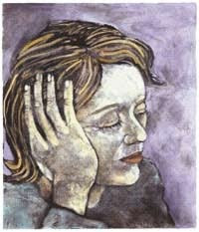
Causes of Cancer Fatigue
The causes of fatigue in people with cancer are not always known. Fatigue can occur for many reasons.
The extreme stress that people with cancer experience may be all that is needed to trigger Fatigue.
However, there may be other reasons. Patients should be educated that Fatigue is a common side effects of cancer treatment: cancer treatment like radiation therapy or chemotherapy commonly causes fatigue due to collection of toxic substances produced by cells or the increased energy needed to repair damaged skin tissue.
Medications to treat pain, depression, vomiting and other conditions are also common causes of fatigue in patients with cancer.

Slide 7
Treatment of Cancer Fatigue
To determine the cause and best treatment for fatigue, the person’s fatigue pattern must be determined, and
all of the factors causing the fatigue must be identified.
The following factors must be evaluated
Fatigue pattern, including how and when it started, how long it has lasted, and its severity, plus any factors that make fatigue worse or better.
Type and degree of disease and of treatment-related symptoms and/or side effects.
Treatment history.
Current medications

Slide 8
Treatment of Cancer Fatigue (Continuation)
Sleep and/or rest patterns and relaxation habits.
Eating habits and appetite or weight changes.
Effect of fatigue on activities of daily living and lifestyle.
Psychological profile, including an evaluation for depression.
Complete physical examination
Other factors (for example, anemia, breathing problems, decreased muscle strength).

Slide 9
Treating The Common Causes of Cancer Fatigue
Nutrition factors
Fatigue often occurs when the body needs more energy than the amount being supplied from the patient’s diet.
In people with cancer, 3 major factors may be involved: a change in the body’s ability to process food normally, an increased need by the body for energy (due to tumor growth, infection, fever, or problems with breathing), and a decrease in the amount of food eaten (due to lack of appetite, nausea, vomiting, diarrhea, or bowel obstruction).
Special attention to nutrition is necessary.

Slide 10
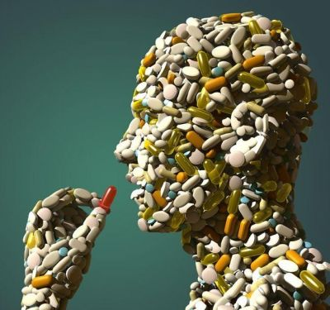
Nutrition Factors
Diet supplementation with iron, vitamins and proteins may be needed
Anemia.- Anemia may be a major factor in cancer-related fatigue and quality of life in people with cancer. Anemia may be caused by the cancer, cancer treatment, or may be related to other medical causes.

Slide 11
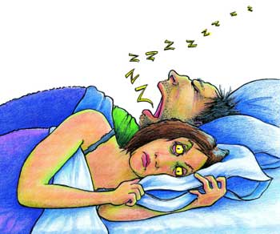
Treating The Common Causes of Cancer Fatigue (Continuation)
Sleep disorder and inactivity
Disrupted sleep, poor sleep habits, less sleep at night, sleeping a lot during the day, or no activity during the day may contribute to cancer-related fatigue.
Patients who are less active during the daytime and awaken frequently during the night report higher levels of cancer-related fatigue.

Slide 12
Sleep disorder and inactivity
Sleep disorder and insomnia should be addressed and may require medications.
Exercise , including light walking helps many people with cancer, leading to more energy, better appetite, and improved quality of life

Slide 13
Activity and Rest
Activity and Rest People with cancer should set priorities and keep a reasonable schedule. Any changes in daily routine require the body to use more energy.
An activity and rest program should be discussed with the health professionals to make the most of a patient’s energy.
Practicing sleep habits such as not lying down at times other than for sleep, taking short naps no longer than one hour, and limiting distracting noise during sleep may improve sleep and allow more activity during the day.

Slide 14
Addressing the Psychological Factors
Addressing the Psychological Factors: Anxiety and depression are the most common psychological disorders that cause fatigue.
Depression may be a disabling illness that affects approximately 15% to 25% of people who have cancer.
Patients experiencing depression may have loss of interest, difficulty concentrating, mental and physical tiredness, and feelings of hopelessness.
The fatigue from physical causes can become worse and last longer than usual, even after the physical causes are gone. Antidepressants might be needed.

Slide 15
Addressing the Psychological Factors (Continuation)
Decreased attention span and difficulty understanding and thinking are often associated with fatigue.
Attention problems are common during and after cancer treatment. Attention may be restored by activities that encourage relaxation like gardening, meditation, prayers. In addition, sleep is also necessary.

