Slide 1



On behalf of the Texas Medical Association Insurance Trust (TMAIT) and Texas Tech University Health Sciences Center
Welcome to TMAIT’s insurance program
for residents and fellows.
1

Slide 2

COVID Courses
We are here through each stage of your career.
Coverage while you are an active
resident/fellow
Coverage you can keep after your residency is complete
TMAIT pays both your County and
State medical society dues while you
are enrolled in this residency program
10/31/2022

Slide 3

Resident Insurance Program
Coverage provided to you at no cost while you are an active resident/fellow:
Group Long Term Disability (LTD)
Group Term Life Insurance
Group Dental
10/31/2022

Slide 4

Resident Insurance Program
Long Term Disability
Own Occupation
As long as you meet the definition of disability, this plan pays your benefits to your normal retirement age under the Social Security Act.
Benefit Amount
$1,500 per month, 30-day waiting period.
Catastrophic Benefit
Receive an additional 20% if you cannot perform 2 or more Activities of Daily Living, such as bathing or feeding yourself.
Survivor Benefit
Should you pass away while receiving disability benefits, your beneficiary would receive 3X the monthly benefit.
Student Loan Reimbursement
Applies to your coverage if you are 40 and under on the date your first enrolled.
An additional 25% will be added to your monthly payment with a maximum benefit up to $250,000.
10/31/2022

Slide 5

Resident Insurance Program
Term Life Insurance
Benefit Amount
Physician $100,000
Spouse/Domestic Partner $10,000
Per child benefit $5,000
10/31/2022

Slide 6

Resident Insurance Program
Dental Insurance
Coverage Highlights
Dependent Spouse & Children are eligible to enroll.
Deductible: $50 Individual / $150 Family
Diagnostic and Preventative Care: 100% - deductible waived.
Restorative and General Services: 80%
Maximum Calendar Year Benefit: $1,000
Orthodontic Benefits (under age 30): $750 Maximum benefit
10/31/2022

Slide 7
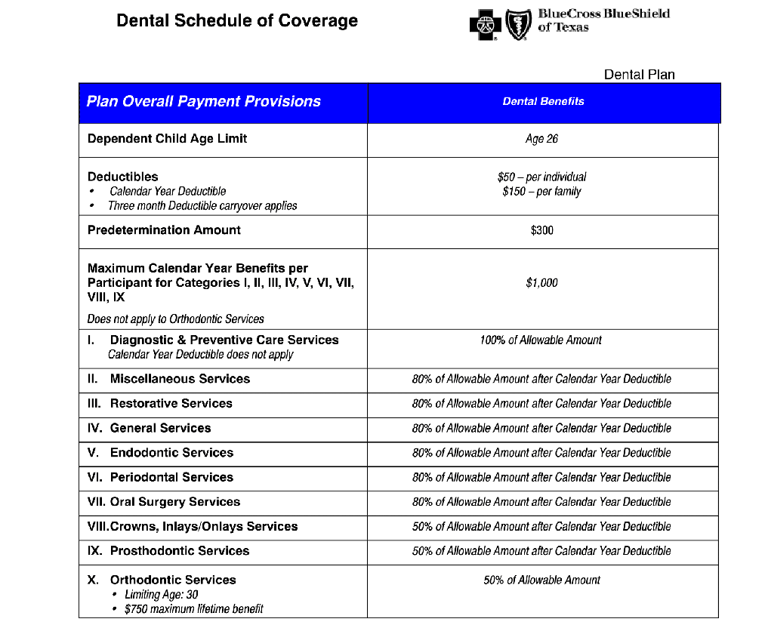
Resident Insurance Program
Dental Insurance
10/31/2022

Slide 8
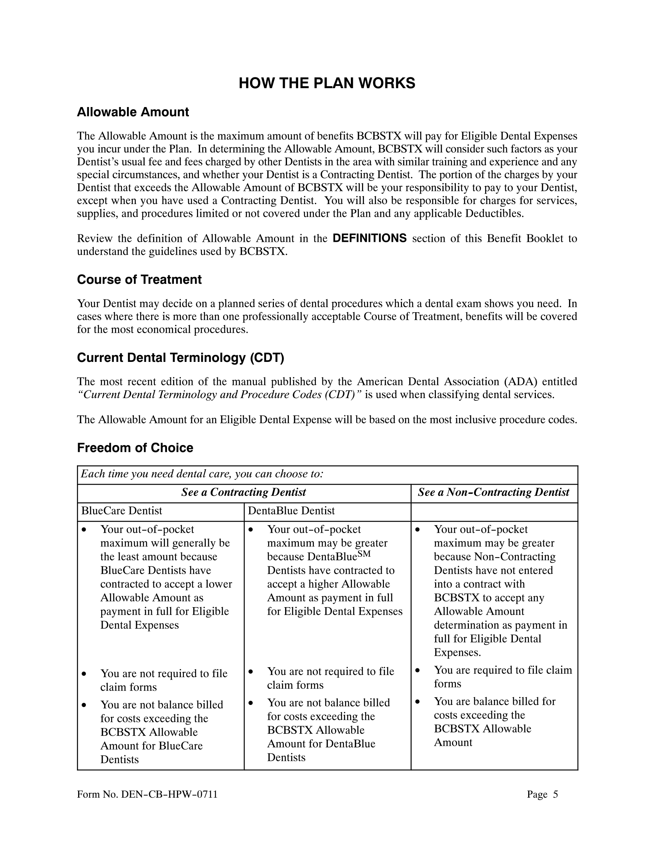
Resident Insurance Program
Dental Insurance
10/31/2022

Slide 9

Important benefit information for orientation
Your benefits start on your date of hire.
TMAIT will pay 100% of the fellow/resident’s annual TMA and County Medical Society dues while enrolled in this program.
Texas Tech will pay 100% of the premiums for the resident and enrolled dependents.
Eligible dependents are spouse/domestic partner and children (including adopted or step-children). Dependents child age limits: Dental to age 26 and Life to age 25.
If you get married or acquire a child while covered under these benefit plans, it is best to add them within 31 days from the date acquired.
10/31/2022

Slide 10
Important benefit information for orientation
If you do not add at the time acquired:
Children who are less than 5 years of age may be added to the dental plan at any time, and it will become effective the first of the month following receipt of the application.
Children over 5 years of age not added within 31 days may NOT be enrolled in the dental plan until the next open enrollment. The request to add should be submitted June 1 – June 30 for a July 1st effective date.
You may add an eligible child of any age to the life insurance policy at any time.
The effective date would be the first of the month following receipt of the application.
It is your responsibility to inform the GME/HR department of your new spouse and/or any newly acquired dependents.
10/31/2022

Slide 11
A program with value throughout your career
Benefits you can keep, increase and add without proving insurability
(medical exams) when you complete your residency.
➢ TMA Member Long Term Disability Insurance
$5,000 a month at no cost to you for 12 months if you maintain TMA membership.
An option for an additional $5,000 Future Increase Option prior to age 45 as your salary increases.
➢ TMA Member Term Life Insurance
$200,000 with no medical exam and the option to apply for up to $2 million with underwriting.
➢TMA Member Business Overhead Expense Insurance
$5,000 monthly benefit.
10/31/2022

Slide 12
A program with value throughout your career
Medical Insurance
If you need help securing an individual health insurance plan for you and/or your dependents when you graduate, please contact our office.
Your loss of the Texas Tech group coverage qualifies you for a Special Enrollment Period. You have 60 days from the qualifying event to exercise your right to enroll in a new individual ACA plan. TMAIT can help you review your options.
To make sure you are able to secure coverage and guarantee you do not have a period of time without medical coverage, it is best to consider your options and enroll in a new plan 30 days before your current coverage expires.
We can also help you apply for a Short-Term Medical plan if you only need coverage for a short period of time between employment.
10/31/2022

Slide 13
A program with value throughout your career
Additional Coverage Offered
Our focus is to help protect what’s important- your health, family, and assets – at every stage of your life, from this residency program all the way to retirement. Generations of Texas physicians have relied on TMAIT.
In addition to the previously mentioned coverage, we can you assist with:
Auto, Homeowners, and Renters Insurance
Umbrella Liability Insurance
AD&D Insurance
Hospital Indemnity Insurance
Group Employer Benefits
Critical Illness Insurance
10/31/2022

Slide 14
Contact information
Edward VanWisse
TMA Insurance Trust Resident Coordinator
& Insurance Advisor
Edward.vanwisse@tmait.org
800.880.8181 ext. 1729
512.370-1799 Fax
512.370.1729 direct line
Please contact Edward if you have any issues or questions regarding your dental, disability, or life insurance benefits. You may request replacement dental ID cards, report address changes, or request beneficiary change forms.
BlueCross BlueShield of Texas – www.bcbstx.com
Once on the BCBSTX website, click on the “Log in” arrow at the top right corner of the website. This will open a window to BlueAccess for members. Register as a new user. This will allow you to access a wide variety of resources, including the ability to review your dental coverage details, print dental ID cards, review dental claims, find network providers, and estimate costs of dental care.
BlueCross BlueShield of Texas Dental Customer Service: 1.800.521.2227
10/31/2022

Slide 15



Thank you for your valuable time!
Let’s connect!
tmait.org
10/31/2022

