Slide 1
Optimization of qPCR Using TaqMan Probes to Differentiate HTLV-1 & 2 for Purposes of Organ Transplantation
Timothy Bullock MS2
Mentor: Debra Bramblett, PhD
Texas Tech University HSC
Paul L. Foster SOM

Slide 2
The Problem
Transplant tissues are not prospectively screened for HTLV.
Experimental Approach
Use quantitative (real time) PCR to detect and differentiate between HTLV-1 and HTLV-2.

Slide 3
Distinguishing Properties of HTLV-1&2
Human T-Cell Lymphotropic Virus (HTLV): RNA Retrovirus containing gag, pol, env and pX region: ORF III, IV encode Tax, Rex
HTLV-Type 1 (HTLV-1)
Adult T Cell Leukemia
HTLV-Associated Myelopathy (HAM) / Tropical Spastic Paraparesis
HTLV-Type 2 (HTLV-2)
No associated diseases
Therefore, it is important to distinguish between these two serotypes.

Slide 4
Prevalence of HTLV-1,2
<1%
10-15%
Japan: 5%
Okinawa:
37%
IV drug
users & Amerindians: 5-15%
Caribbean,
S. Amer:
1-5%
Pygmy
5%
Aboriginals: 14%
HTLV-2
HTLV-1

Slide 5
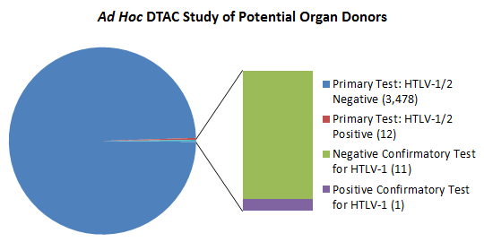
OPTN Policy
November 2009: Eliminated mandatory prospective testing of organ donors for HTLV 1&2.
False positive screening tests → organ wastage
Low prevalence of HTLV-1 in US
Lack of FDA-licensed HTLV-1 screening test.
ELISA: cannot distinguish HTLV-1 from HTLV-2.

Slide 6
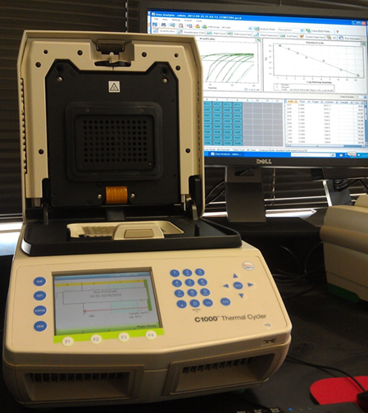
Real-Time PCR
Amplification→ High Sensitivity
Rapid; available in many Hospital/OPO labs
Possible to test for multiple viruses in one run

Slide 7
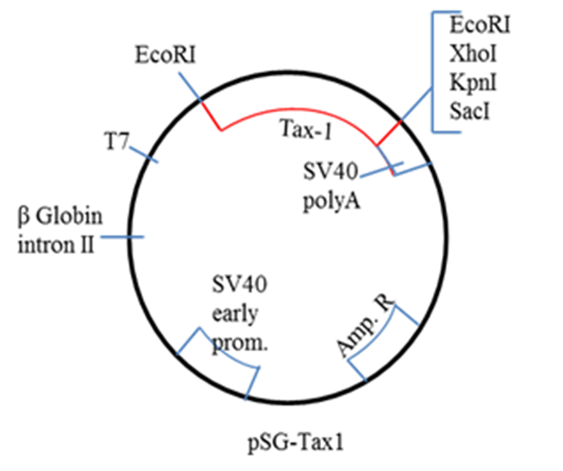
Present Research
It is possible to detect physiological levels of HTLV-1 and 2 proviral DNA in genomic DNA samples using qPCR technology.

Slide 8
qPCR for HTLV-1&2 Detection
Began with SYBR Green Technology
Using pSG-Tax 1 as plasmid DNA template
Primers:
HTLV-1F CTCCTTCCCCACCCAGAGA
HTLV-1R GGGTGGGTTCCATGTATCCATT
Progressed to TaqMan Technology
Using HTLV-1 Tax Probe
5’-/56-JOEN/AG GAG GGT G /ZEN/ G AAT GTT GGG GGT TGT ATG /3IABkFQ/ -3’
Notes:
To develop the assay, started with plasmid DNA template (contained a viral sequence)

Slide 9
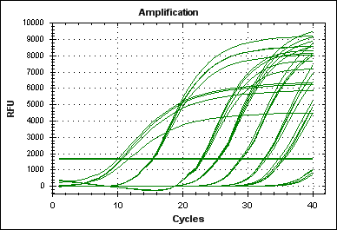
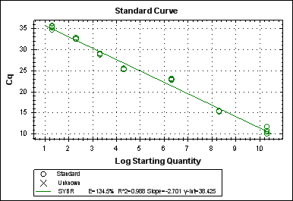
SsoFast EvaGreen qPCR
Titration of DNA template: HTLV-1 plasmid DNA and Primers effective
Detected significant amplification of 200 copies/μl sample at 36 cycles.

Slide 10
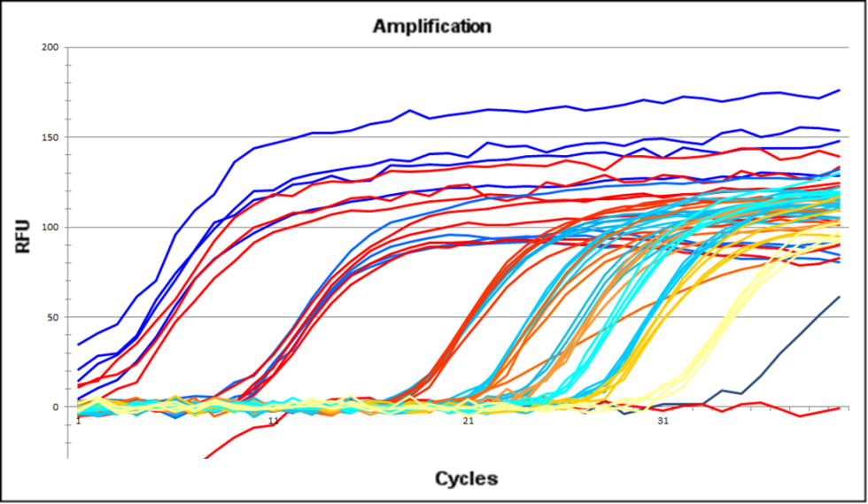
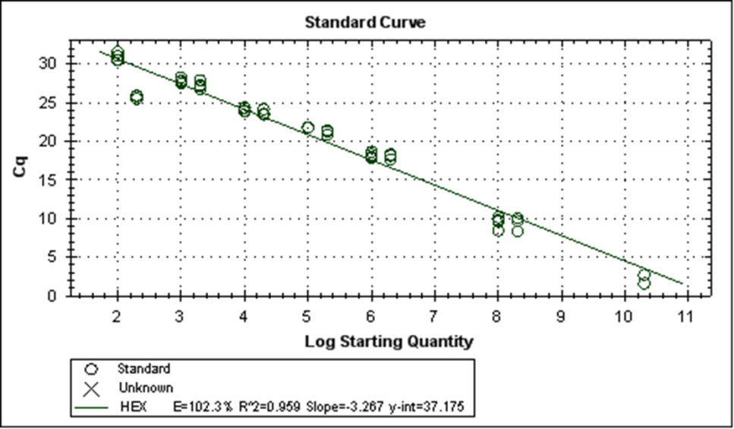
TaqMan qPCR, HTLV-1 pDNA
Titration of DNA template with Human Genomic DNA comparison: HTLV-1 plasmid DNA and Primers effective with TaqMan probe.
Taq Man qPCR effective w/ Human genomic DNA.

Slide 11
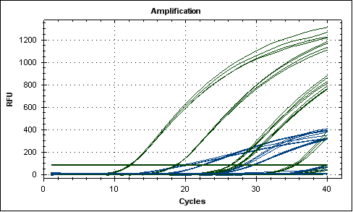
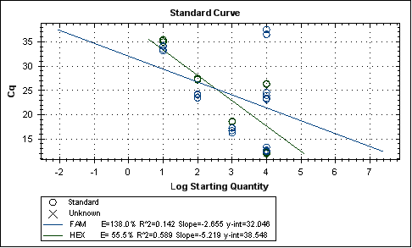
Multiplex: Simultaneous Detection of HTLV-1& 2.
Able to detect both, and distinguish between the two.

Slide 12
Current Progress
Optimization of Multiplex, HTLV-1 and 2.
Seeking IRB Approval: Blood samples
Possible other viruses for donor testing (CMV)

Slide 13
Acknowledgements
Texas Tech University Paul L. Foster SOM
Debra Bramblett, PhD
Curt Pfarr, PhD
Alan Tyroch, MD, FACS
Mark Hall, BA
University of Leige, Gemblious, Belgium
Jean Claude Twizere, PhD

Slide 14
References
Abbas, Abul K. Basic Immunology: Functions and Disorders of the Immune System, 3rd (Updated) ed. W.B. Saunders Company, 2010.
Goncalves, Denise Utsch, et al, “Epidemiology, Treatment, and Prevention of Human T-Cell Leukemia Virus Type 1-Associated Diseases,” in Clinical Microbiology Reviews, vol 23, No.3, p 577-89, Jul 2010.
Haller, Kerstin, et al, “Physical Interaction of Human T-Cell Leukemia Virus Type 1 Tax with Cyclin-Dependent Kinase 4 Stimulates the Phosphorylation of Retinoblastoma Protein,” in Molecular Cell Biology, vol 22, no 10: 3327-3338; May 2002.
Health Resources and Services Administration (HRSA) and Organ Procurement and Transplantation Network (OPTN) of the U.S. Department of Health and Human Services, “Policy Management/ Policies.” Resource Online, available at http://optn.transplant.hrsa.gov/policiesAndBylaws/policies.asp.
Ison, Michael G., MD, MS, Chair, and Michael Nalesnik, MD, Vice Chair, UNOS Ad Hoc Disease Transmission Advisory Committee (DTAC). “Report to the Board of Directors,” June 23-24, 2009, Richmond, Virginia. Available online at http://optn.transplant.hrsa.gov/CommitteeReports/board_main_AdHocDiseaseTransmissionAdvisoryCommittee_7_7_2009_15_25.pdf
Kaul, D.R., “Donor Screening for Human T-Cell Lymphotropic Virus ½: Changing Paradigms for Changing Testing Capacity,” in American Journal of Transplantation 2010; 10:207-213.

Slide 15
References
Longo, Dan L. and Anthony S. Fauci, “Infections Due to Human Immunodeficiency Virus and Other Human Retroviruses.” Article in Fauci, Anthony S. et al, Harrison’s Principles of Internal Medicine, 17th Ed. New York: McGraw Hill Medical, 2008.
Murphy, Edward L and Hope H. Biswas. “Human T-Cell Lymphotropic Virus Types I and II,” in Mandell, Gerald L et al’s Principles and Practice of Infectious Diseases, 7th ed. Elselvier: Philadelphia, 2010.
OPTN, “Guidance for HTLV-1 Screening and Confirmation in Potential Donors and Reporting Potential HTLV-1 Infection,” 29 June 2011.
Phillips, Adrienne A, “A Critical Analysis of Prognostic Factors in North American Patients with Human T-Cell Lymphotropic Virus Type-1 Associated Adult T-Cell Leukemia/Lymphoma,” in Cancer 2010; 116:3438-46.
Qu, Zhaoxia and Gutian Xiao. “Human T-Cell Lymphotropic Virus: A Model of NF-κB-Associated Tumorigenesis.” Viruses, 2011 June 1;3(6):714-749.
Sambrook, Joseph and David W. Russell. Molecular Cloning: A Laboratory Manual, 3rd ed. Cold Spring Harbor: Cold Spring Harbor Laboratory Press, 2001.
The Foreign Born From Latin America and the Caribbean: 2010. Available at http://www.census.gov/population/foreign/

