Slide 1
The Nature and Incidence of Musculoskeletal Combat Wounds in Iraq and Afghanistan (2005-2009)
CPT Brendan J. McCriskin, M.D.
LTC (P) Philip J. Belmont, M.D.
CPT Mark S. Hsiao, M.D.
COL Robert Burks, Ph. D.
MAJ Kenneth J. Nelson, M.D.
MAJ Andrew J. Schoenfeld, M.D.
William Beaumont Army Medical Center
Texas Tech University Health Sciences Center
Department of Orthopaedic Surgery
11 May 2012

Slide 2
Disclosure can be found in the AAOS database.
All authors are employees of the U.S. Federal Government and the United States Army. The opinions or assertions contained herein are the private views of the authors and are not to be construed as official or reflecting the views of William Beaumont Army Medical Center, the Department of Defense or United States Government. Data presented in this investigation is derived from the Joint Theater Trauma Registry (JTTR). The JTTR is not responsible for any claims arising from works based on the original data.

Slide 3
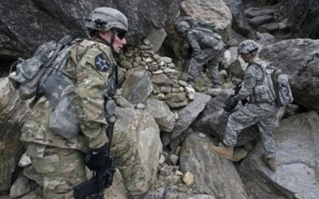
Background
Iraq and Afghanistan wars: longest in US history, two distinct fronts
Advancements in medical and protective technology
Widespread irregular enemy tactics
Paucity of musculoskeletal injury
descriptive data
Characterize musculoskeletal injury wounding patterns and injury mechanisms incidence and epidemiology
Notes:
The US is currently engaged in the longest continuous military conflict in US history. There have been more than two million servicemember deployment years in Iraq or Afghanistan, and nearly 54,000 casualties have resulted from these conflicts with nearly 5,000 combat deaths. The military casualties derived from these wars are the largest since the Vietnam era and eclipse the numbers from all intermediary conflicts combined.
There are two distinct fonts being fought in Iraq and Afghanistan, both of which have presented novel military engagement tactics and injury mechanisms. We are seeing widespread use of the most advanced protective and medical equipment, ever fielded in combat. These advances, as well as unprecedented military medical responsiveness have enhanced survivability, despite increasing wound severity and disability.
These facts have culminated in a large cohort of injured personnel who have survived devastating injuries and are left with challenging musculoskeletal issues that must be addressed by the orthopaedic community, as a whole.
A recent analysis regarding orthopaedic war injuries and their impact on long-term disability revealed that 64% of soldiers with a primary diagnosis of extremity wound were ultimately found unfit for continued service.
5) To our knowledge, no large cohort studies have been published examining the musculoskeletal wounding mechanisms and patterns, and injury specific incidence, that could be used to predict casualty burden and resource utilization in both in the military setting and those organizations that will care for injured military personnel following their separation from the service.
6) The goal of this study is to characterize the incidence and nature of musculoskeletal combat-wounds for the Iraq and Afghanistan Wars from 2005-2009, as well as the influence of demographic factors, combat theater and year, and precipitating mechanism on the risk of injury.

Slide 4
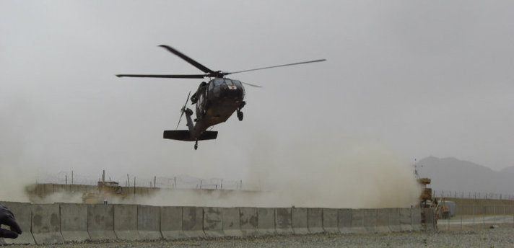
Background
Study seeks to describe the nature and magnitude of that burden, both presently and in the future
64% of separations from military service attributable to extremity injuries*
Years under study encompass most intensive period of combat in both Iraq and Afghanistan, including the Iraq War Troop Surge
First study to develop a model capable of predicting need for musculoskeletal medical resources among a large body of servicemembers deployed in a modern military conflict
* Masini et al. Resource utilization and disability outcome assessment of combat casualties from OIF and OEF. JOT 2009; 23: 261-266.
Notes:
1) To our knowledge, this study is the most complete effort to date, at describing musculoskeletal combat injuries in the Iraq and Afghanistan wars. As such, this study seeks to describe the magnitude and nature of the burden on the orthopaedic community, both presently and in the years and decades to come.
2) When one takes into account that combat related extremity injuries have been found to be responsible for 64% of medical separations from service, the tremendous potential for war wounds to ultimately be cared for by civilian orthopaedic providers becomes apparent.
3) It should be recognized that the years under study encompass the most intensive period of combat in both Iraq and Afghanistan, including the Iraq War Troop Surge.
4) To the best of our knowledge, this is the first study of its kind to develop a model capable of predicting the need for musculoskeletal medical resources among a large body of servicemembers deployed in a modern military conflict.

Slide 5
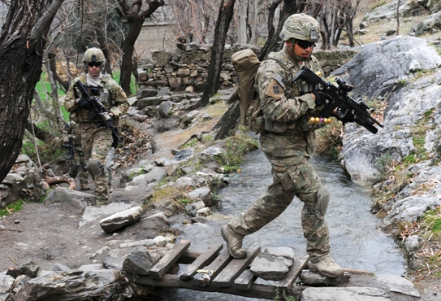
Methods
Joint Theater Trauma Registry (JTTR) queried to identify musculoskeletal combat casualties from 2005-2009
Analysis of casualty demographics, mechanism injury and musculoskeletal wounding patterns was performed
KIA and non-battle injuries and illness excluded
Deployment statistics obtained
from the DOD Defense Manpower Data Center
Notes:
The Joint Theater Trauma Registry, or JTTR, is a database of medical information for patients treated at US military medical facilities, in theater, from POI through all echelons of care to MTFs in US
The JTTR was queried by ICD9 code to identify all individuals sustaining musculoskeletal injuries as a result of combat in both Iraq and Afghanistan from January 1, 2005 – December 31, 2009.
MSK casualty was defined as a servicemember sustaining a combat wound to the upper or lower extremities, spine, or pelvis.
For those identified, demographic information such as age, sex, rank, branch of military service, and theater was assessed. Mechanism of injury and the nature of wounding, including the presence of fractures, soft tissue injury, joint dislocation, neurologic injury, and traumatic amputation were also determined.
Servicemembers that were killed in action (KIA) and disease and non-battle injuries (DNBI) were excluded from this analysis.

Slide 6
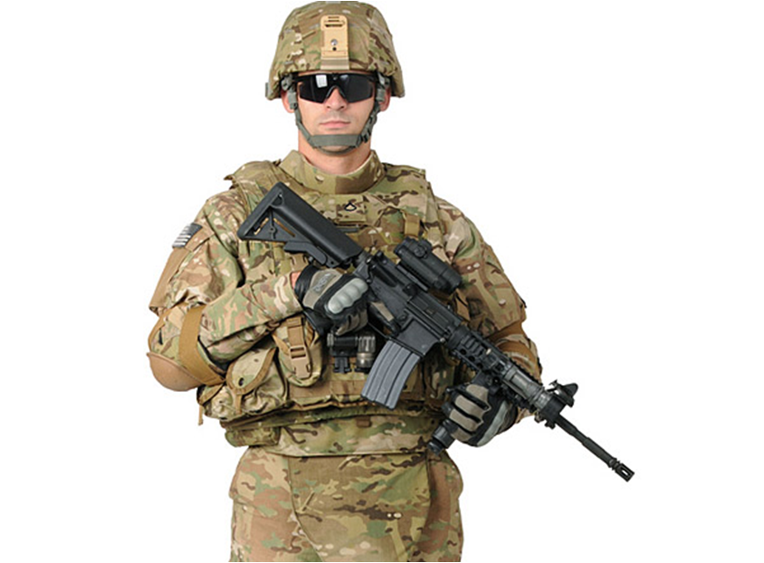
Results
1,992,232 military servicemembers deployed
59,736 ICD9 codes reviewed
29,624 distinct combat wounds in 7,877 combat casualties identified
77.33% (n=6,092) casualties sustained at least one musculoskeletal injury
17,177 distinct musculoskeletal combat wounds were identified in those 6,092 combat casualties
Combat casualty incidence = 3.06 per 1,000 deployed servicemember per year
Head and Neck 28.1%
Thorax
9.9%
Abdomen 10.1 %
Extremities 51.9%
Notes:
For our study period from 2005-2009, 1,992,232 military servicemembers deployed, 59,736 ICD9 codes, 29,624 distinct combat wounds in 7,877 combat casualties.
77.33% (6,092 / 7,877) of the casualties in this cohort sustained at least one injury involving the musculoskeletal system, with a combat casualty incidence of 3.06 per 1,000 deployed servicemember per year
17,177 distinct musculoskeletal combat wounds were identified in those 6,092 combat casualties.
Combat injury distribution by body region was previously reported at 52% Extremity Injuries, 28% Head and Neck, 10% Abdomen, and 10% Thoracic injuries.
Mean age of musculoskeletal casualty Cohort: 25.8 years, musculoskeletal combat casualties predominantly: Male (98.5%), Army Soldiers (77.8%), Junior enlisted (58.8%)
The occurrence of musculoskeletal injuries peaked in 2007 at 1,685, accounting for 28% of all musculoskeletal combat casualties for the five-year study period.
The highest incidence; however, occurred in 2005 at 4.48 musculoskeletal casualties per deployed servicemember per year.

Slide 7
Results
Mean age of musculoskeletal casualty cohort: 25.8 years
Musculoskeletal combat casualties found to be predominantly:
Male (98.5%)
Army Soldiers (77.8%)
Junior enlisted (58.8%)
Occurrence of musculoskeletal casualties peaked in 2007 at 1,685, accounting for 28% of all musculoskeletal combat casualties.
Notes:
Mean age of musculoskeletal casualty Cohort: 25.8 years, musculoskeletal combat casualties predominantly: Male (98.5%), Army Soldiers (77.8%), Junior enlisted (58.8%)
The occurrence of musculoskeletal injuries peaked in 2007 at 1,685, accounting for 28% of all musculoskeletal combat casualties for the five-year study period.
The highest incidence; however, occurred in 2005 at 4.48 musculoskeletal casualties per deployed servicemember per year.

Slide 8
Musculoskeletal Injury Distribution
Soft Tissue Injuries: 47% (n=8056)
Fractures: 40% (n=6794)
Amputations, Joint Dislocations, Neurologic Injuries < 7% each
Notes:
Among the 17,177 musculoskeletal combat injuries identified, 8,056 were soft tissue injuries, comprising a total of 46.9% of all musculoskeletal injuries.
A total of 6,794 fractures were identified, comprising 39.55% of all musculoskeletal injuries.
A total of 1,039 amputations were identified, comprising 6.05% of all musculoskeletal injuries.
A total of 927 neurologic injuries were identified, comprising 5.4% of all musculoskeletal injuries.

Slide 9
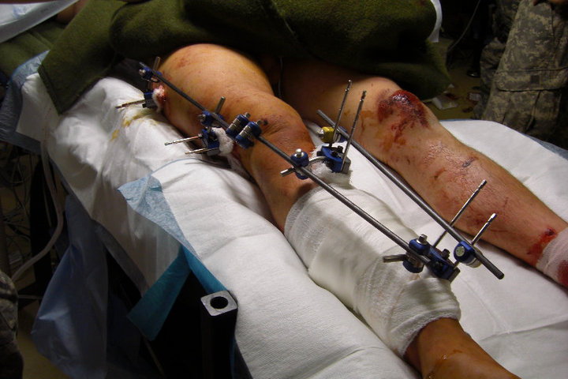
Musculoskeletal Injury Distribution
Fractures
Tibia/Fibula: 17.5%
Spine: 11.8%
Radius/Ulna: 10.9%
Femur: 9%
Fractures: 57.8% Open (n=3,930), 41.5% Closed (2,864)
Notes:
Of the 6,794 fractures identified 3,930 or 58% were open fractures, while 2,864 or 42% were closed fractures.
Lower extremity fractures accounted 47% (n=3,182) of all fractures with upper extremity fractures accounted for 36% (2,470), and Spine and Pelvis fractures accounting for the remaining 17% of all combat fractures.

Slide 10
Fracture Distribution
Lower Extremity: 47% (n=3,182)
Upper Extremity: 36% (n=2,470)
Spine/Pelvis: 17% (n=1,142)
Notes:
Lower extremity fractures accounted 47% (n=3,182) of all fractures with upper extremity fractures accounted for 36% (2,470), and Spine and Pelvis fractures accounting for the remaining 17% of all combat fractures.

Slide 11
Musculoskeletal Injury Distribution
Amputations
Leg: 52.7%
Arm: 12.8%
Toe/Finger: 25.2%
Foot: 9.2%
Amputations: 65.5% Major (n=681), 34.5% Minor (n=358), 119 Bilateral amputations
Fractures: 57.8% Open (n=3,930), 41.5% Closed (2,864)
Notes:
Of the of 1,039 amputations identified, 681 or 66% were major amputations, involving an arm or leg, while 358 or 35% were minor amputations involving a foot, finger, or toe. 119 bilateral amputations were identified.

Slide 12
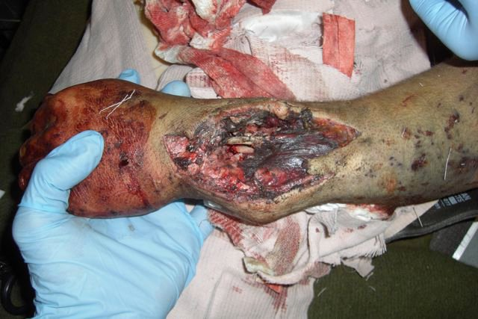
Musculoskeletal Injury Distribution
Soft Tissue Injuries
Upper Extremity: 45%
Lower Extremity: 50.6%
Soft Tissue Injuries: 50.6% Lower Extremity (n=4,080), 45% Upper Extremity (n=3,628)
Notes:
Soft Tissue were the musculoskeletal combat wounds with the highest incidence, at 4.04 per 1,000 deployed servicemembers per year.
Of the 8,056 soft tissue injuries identified, 4,080 or 51% involved the lower extremities and 3,628 or 45% involved the upper extremities.
Of the 927 neurologic injuries identified, 813 or 88% involved a peripheral nerve, 96 or 10% involved the spinal cord, and 18 or 2% involved a nerve root.

Slide 13
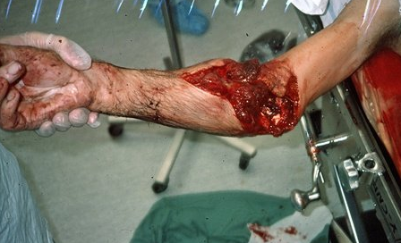
Musculoskeletal Injury Distribution
Neurologic Injuries
Peripheral Nerve: 87.7%
Spinal Cord: 10.4%
Nerve Root: 2%
Neurologic Injuries: 87.7% Peripheral Nerve (n=813), 10.4 % Spinal Cord (n=96), 2% Nerve Root (n=18)
Notes:
Soft Tissue were the musculoskeletal combat wounds with the highest incidence, at 4.04 per 1,000 deployed servicemembers per year.
Of the 8,056 soft tissue injuries identified, 4,080 or 51% involved the lower extremities and 3,628 or 45% involved the upper extremities.
Of the 927 neurologic injuries identified, 813 or 88% involved a peripheral nerve, 96 or 10% involved the spinal cord, and 18 or 2% involved a nerve root.

Slide 14
Musculoskeletal Injury Rate per 1,000 Deployed Servicemembers per Year
Total Musculoskeletal Injury | Total |  | Rate
Axial Skeleton Fractures | 1,142 |  | 0.57
Upper Extremity Fractures | 2,470 |  | 1.24
Lower Extremity Fractures | 3,182 |  | 1.60
Total Fractures | 6,794 |  | 3.41
Major Amputations | 681 |  | 0.34
Minor Amputations | 358 |  | 0.18
Total Amputations | 1,039 |  | 0.52
Neurological Injuries | 927 |  | 0.47
Joint Dislocations | 361 |  | 0.18
Soft Tissue Injuries | 8,056 |  | 4.04
Total Musculoskeletal Injuries | 17,177 |  | 8.62
Rates are reported per 1,000 deployed servicemembers per year.

Slide 15
Mechanism of Injury Distribution 2005-2009
Significantly more combat casualties resulted from explosive mechanisms (74.4%) than from gunshot wounds (19.9%)
* p < .001
Casualty %
Mechanism of Injury
Notes:
1) When considering all 7,877 combat casualties, significantly more injuries were caused by explosive mechanisms than from gunshot wounds, during all years studies, in both Iraq and Afghanistan.

Slide 16
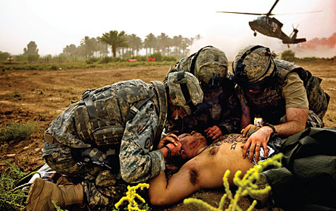
Musculoskeletal Injury Cohort Mechanism of Injury Comparison
Explosive Mechanism:
- 74.9% of casualties (n=4,563)
- 82.4% of wounds (n=14,158)
Gunshot Wounds:
- 19.8% of casualties (n=1,209)
- 13.9% of wounds (n=2,392)
Notes:
This trend was seen in the musculoskeletal casualty cohort, as well. Explosive mechanisms caused more musculoskeletal injuries, than did gunshot wounds, during all years studied among servicemembers sustaining musculoskeletal injuries.
Explosive mechanisms accounted for 75% (4563/6092) of all musculoskeletal casualties and 82% (14,158/17,177) of all musculoskeletal wounds.
Gunshot wounds accounted for 20% (1209/6092) of all musculoskeletal casualties and 14% (2,392/17,177) of all musculoskeletal wounds.

Slide 17
Combat Casualty Rates by Branch of Service
All Musculoskeletal Casualty Rates (casualty/number deployed)
Rate of casualties calculated using estimated deployment statistics obtained from DOD Defense Manpower
Notes:
You can see the trends in distribution of combat casualties by branch of service in these two graphs, Tan representing Army, Yellow USN, Blue USAF, and Green the USMC.
The distribution of casualties by branch of service within the two theaters of operation varied from year to year, however, Army Soldiers (.45%) and Marines (.99%) sustained significantly higher percentages of combat casualties per deployed SM than Navy and USAF servicemembers, across all years studied.

Slide 18
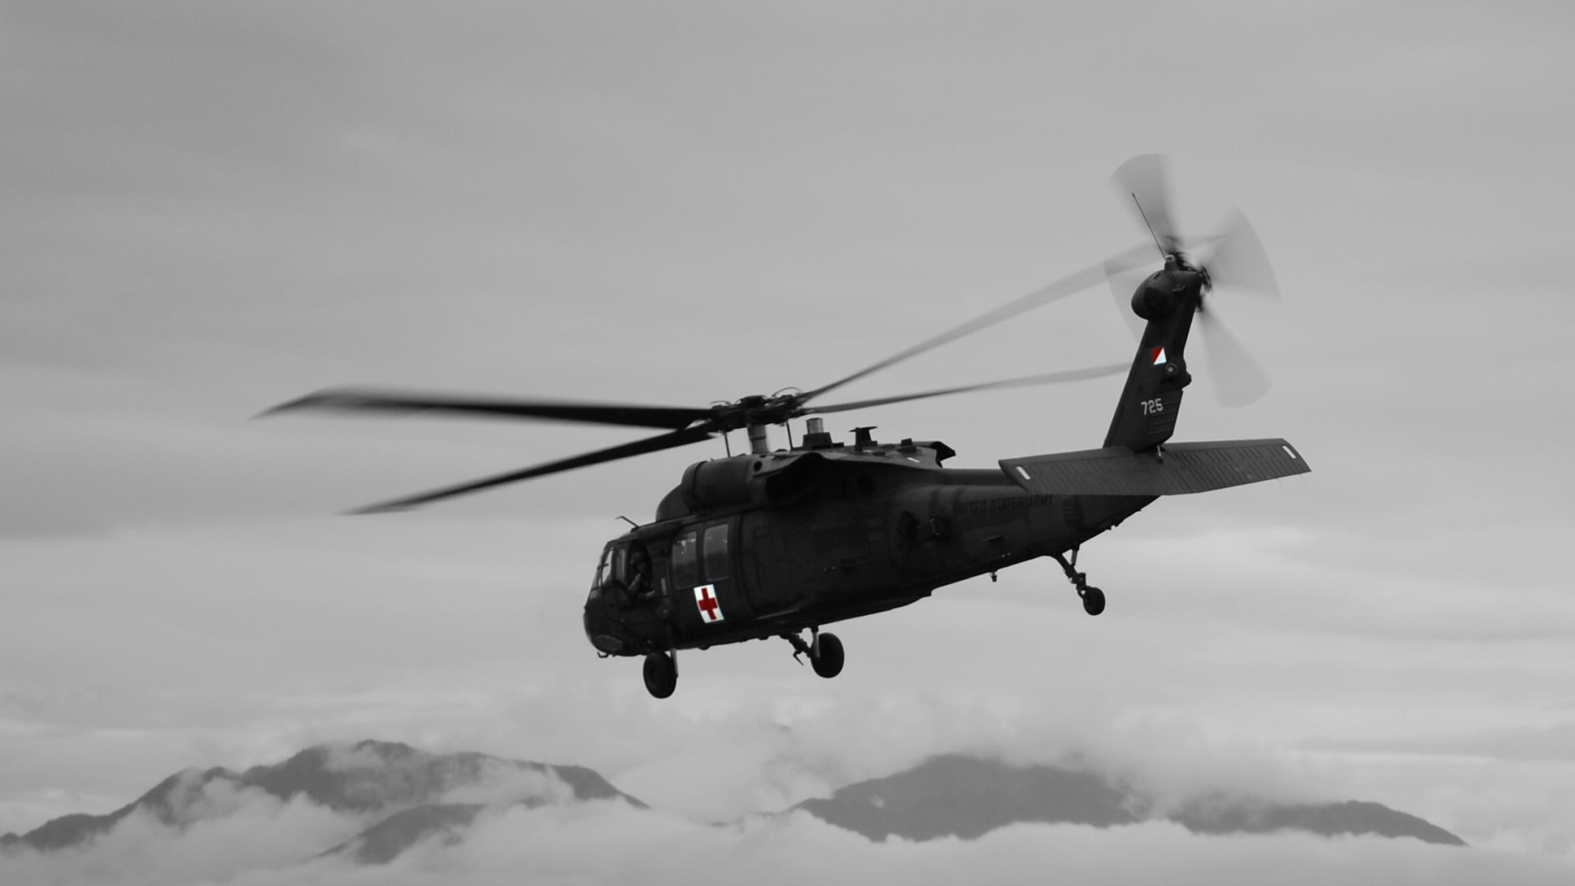
Conclusions
Majority of servicemembers found unfit for continued military service have a primary diagnosis of a musculoskeletal injury.
Much of the long term orthopaedic care will be assumed by civilian orthopaedic providers.
Describes a large cohort of injured personnel who have survived devastating injuries and are left with challenging musculoskeletal issues that must be addressed by the orthopaedic community, as a whole.
Notes:
In summary, the majority of musculoskeletal injuries sustained in combat during this study period involve soft tissue injuries and fractures, with open fractures being more common that closed fractures. Explosive mechanisms such as IED and RPG blasts are the causative mechanism for the majority of these musculoskeletal injuries.
The results of this analysis indicate that many combat-related musculoskeletal injuries sustained during the current conflicts are varied and less debilitating than multi-limb amputation or severe lumbo-pelvic trauma. Moreover, while military orthopaedic surgeons will provide acute care and intermediate-term management for the majority of combat casualties, long-term care in most instances will be addressed by civilian orthopaedic providers in the Veterans Administration or in private practice.
It is important to recognize that, overwhelmingly, injured personnel in these studies are young in age and mostly enlisted in rank. Such individuals may have limited coping resources and social support systems, and frequently derive from lower socio-economic strata. As they face recovery from severe combat injury, and separation from the military, these servicemembers may be at risk for problems such as unemployment, substance abuse, and an increased risk of infectious disease already identified as a burgeoning public health problem.
The majority of servicemembers found unfit for continued military service have a primary diagnosis of a musculoskeletal injury. In light of these considerations, we maintain that the present analysis represents the most complete evaluation of the nature of orthopaedic wounds in Iraq and Afghanistan. We also believe that ours is the only study of its kind to present information, such as injury specific incidence, that could be used to predict casualty burden and resource utilization in the military setting and among the Veterans Administration and civilian orthopaedic organizations who will care for injured personnel following their separation from the service.
These facts have culminated in a large cohort of injured personnel who have survived devastating injuries and are left with challenging musculoskeletal issues that must be addressed by the orthopaedic community, as a whole.

Slide 19
References
Schoenfeld AJ. The history of combat orthopaedic surgery. In: Owens BD, Belmont PJ Jr (Eds.). Combat Orthopaedic Surgery: Lessons Learned in Iraq and Afghanistan. Thorofare, NJ: SLACK Incorporated, 2011, pp 3-12.
Covey DC. From the frontlines to the home front: The crucial role of military orthopaedic surgeons. J Bone Joint Surg Am 2009;91: 998-1006.
Dougherty PJ, Carter PR, Seligson D, Benson DR, Purvis JM. Orthopaedic surgery advances resulting from World War II. J Bone Joint Surg Am 2004;86: 176-181.
Dougherty PJ. Transtibial amputees from the Vietnam War. J Bone Joint Surg Am 2001;83: 383-389.
Schoenfeld AJ. The combat experience of military surgical assets in Iraq and Afghanistan: A historical review. Am J Surg 2012 (In press).
Belmont PJ Jr, Goodman GP. The combat environment and epidemiology of musculoskeletal combat casualties. In: Owens BD, Belmont PJ Jr (Eds.). Combat Orthopaedic Surgery: Lessons Learned in Iraq and Afghanistan. Thorofare, NJ: SLACK Incorporated, 2011, pp 13-22.
Belmont. PJ Jr, Thomas D, Goodman GP, Schoenfeld AJ, Zacchilli MA, Burks R, Owens BD. Combat musculoskeletal wounds in a US Army Brigade Combat Team during Operation Iraqi Freedom. J Trauma 2011;71: E1-E7.
Blair JA, Patzkowski JC, Schoenfeld AJ, Cross JD, Grenier ES, Lehman RA Jr, Hsu JR, Skeletal Trauma Research Consortium (STReC). Are spine injuries sustained in battle truly different? Spine J 2012 (In press).
Cross JD, Ficke JR, Hsu JR, Masini BD, Wenke JC. Battlefield Orthopaedic Injuries Cause the Majority of Long Term Disabilities. J Am Acad Orthop Surg 2011;19:S1-S7.
Goodman GP, Schoenfeld AJ, Owens BD, Dutton JR, Burks R, Belmont PJ Jr. Non-emergent orthopaedic injuries sustained by soldiers in Operation Iraqi Freedom. J Bone Joint Surg Am 2012 (In press).
Lin DL, Kirk KL, Murphy KP, McHale KA, Doukas WC. Orthopaedic injuries during Operation Enduring Freedom. Mil Med 2004;169: 807-809.

Slide 20
References
Owens BD, Kragh JF Jr, Macaitis J, Svoboda SJ, Wenke JC. Characterization of extremity wounds in Operation Iraqi Freedom and Operation Enduring Freedom. J Orthop Trauma 2007;21: 254-257.
Schoenfeld AJ, Goodman G, Belmont PJ Jr. Characterization of combat related spinal injuries sustained by a U.S. Army Brigade Combat Team during Operation Iraqi Freedom. Spine J 2012 (In press).
Stansbury LG, Lalliss SJ, Branstetter JG, Bagg MR, Holcomb JB. Amputations in U.S. military personnel in the current conflicts in Afghanistan and Iraq. J Orthop Trauma 2008;22: 43-46.
Helgeson MD, Lehman RA Jr, Cooper P, Frisch M, Andersen RC, Bellabarba C. Retrospective review of lumbosacral dissociations in blast injuries. Spine 2011;36: E469-E475.
Masini BD, Waterman SM, Wenke JC, Owens BD, Hsu JR, Ficke JR. Resource utilization and disability outcome assessment of combat casualties from Operation Iraqi Freedom and Operation Enduring Freedom. J Orthop Trauma 2009; 23:261-266.
Directorate for Information Operations and Reports. Department of Defense. Available at: http://siadpp.dmdc.osd.mil/personnel/CASUALTY/castop.htm Accessed January 19, 2012.
Uhorchak JM, Rodkey WG, Hunt MM, Hoxie SW. Institute report #469: Casualty data assessment team Operation Desert Storm. San Francisco, CA: Letterman Army Institute of Research; 1992.
Potter BK, Burns TC, Lacap AP, Granville RR, Gajewski DA. Heterotopic ossification following traumatic and combat-related amputations. Prevalence, risk factors, and preliminary results of excision. J Bone Joint Surg Am 2007;89: 476-486.
Beebe GW, DeBakey ME. Location of hits and wounds. In: Battle Casualties. Springfield, IL: Charles C. Thomas, 1952, pp 165-205.
Sakuta H, Suzuki T. Rank in self-defense forces and risk factors for atherosclerotic disease. Mil Med 2005;170: 820-823.
Nurutdinova D, Chrusciel T, Zeringue A, Scherrer JF, Al-Aly Z, McDonald JR, Overton ET. Mental health disorders and the risk of AIDS-defining illness and death in HIV-infected veterans. AIDS 2012;26: 229-234.
Mody RM, Zapor M, Hartzell JD, Robben PM, Waterman P, Wood-Morris R, Trotta R, Andersen RC, Wortmann G. Infectious complications of damage control orthopedics in war trauma. J Trauma 2009;67: 758-761.

Slide 21
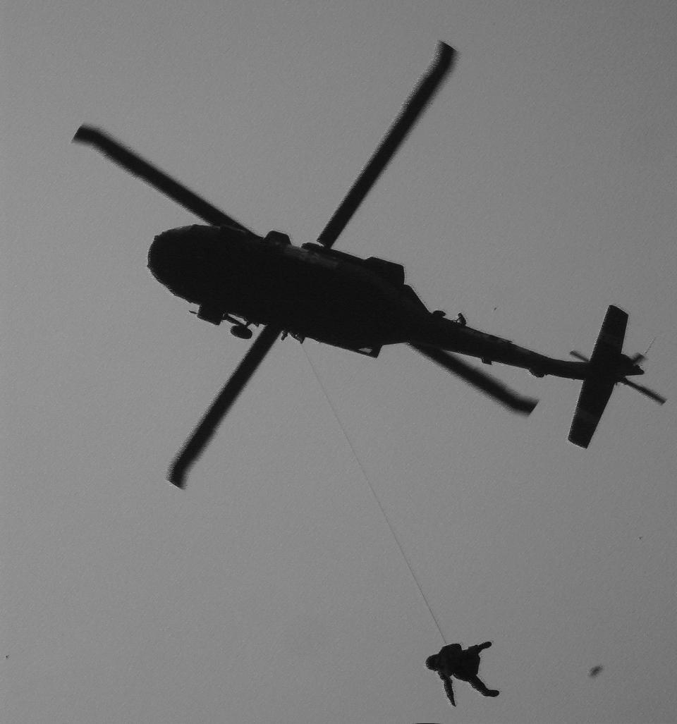
Thank You

