Slide 1
Kidney Injury and Liver Disease in the ICU
German T. Hernandez, MD, FASN, FACP
Associate Professor of Medicine
Division of Nephrology & Hypertension
Paul L. Foster School of Medicine
TTUHSC at El Paso

Slide 2
Learning Objectives
1. Define the Hepatorenal Syndrome
2. Discuss the use of emerging medical therapies in Hepatorenal Syndrome
2. Recognize the abdominal compartment syndrome as cause of acute kidney injury

Slide 3
Acute Kidney Injury
Many Definitions:
Increase in serum creatinine ≥1.5x baseline within 7 days (RIFLE)
  or
Increase in serum creatinine by 0.3 mg/dL or ≥1.5x baseline with 48 hrs (AKIN)
Crit Care 2004; 8:B204
Crit Care 2001; 11:R31

Slide 4
Acute Kidney Injury: Classification
Prerenal AKI
Intrinsic AKI
  Acute Tubular Necrosis (ATN)
  Interstitial Nephritis
  Glomerulonephritis
  Vascular syndromes
  Intra-tubular obstruction (crystals, myeloma casts)
Post-renal AKI

Slide 5
Acute Kidney Injury in Liver Disease
Caveat:
  Renal dysfunction in liver disease may go unrecognized
  Decreased creatinine and urea production
  A normal serum creatinine (1.0-1.3) may represent a low glomerular filtration rate (eGFR)
Am J Med 1987; 82:945

Slide 6
Acute Kidney Injury in Liver Disease
Prerenal AKI
ATN
Hepatorenal Syndrome
Interstitial Nephritis
Glomerular Diseases
  MPGN (Hep C)
  IgA nephritis
  Membranous nephropathy (Hep B)
  Cryoglobulinemia (Hep C)

Slide 7
Hepatorenal Syndrome
Functional renal failure caused by intrarenal vasoconstriction in patients with ESLD
Splanchnic vasodilatation
Relatively low cardiac output
Effective circulatory hypovolemia
Gut 2007; 56:1310-1318

Slide 8
Hepatorenal Syndrome
HRS typically presents with:
  Oliguria
  Benign urine sediment
  Very low urine Na excretion
  Progressive rise in serum creatinine
    (may have periods of stabilization)
Gut 2007; 56:1310-1318

Slide 9
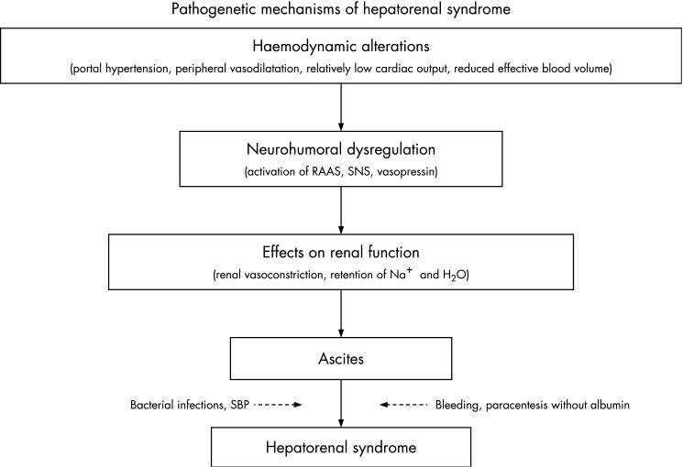
Pathophysiology

Slide 10
HRS Diagnostic Criteria
HRS is a diagnosis of exclusion
  Cirrhosis with ascites
  Serum Creatinine > 1.5 mg/dL
  No improvement in SCr (<1.5 mg/dL) after at least 2 days of diuretic withdrawal and IV albumin (1g/kg/day, max 100g/day)
  Absence of shock
  No intrinsic renal disease: proteinuria >500mg/day, >50 RBC/HPF, or abnormal renal US
Gut 2007; 56:1310-1318

Slide 11
Hepatorenal Syndrome
Type-1 HRS
  Rapid progression of kidney injury with a rise in SCr >2x baseline in less than 2 weeks
  Can develop spontaneously, but commonly follows:
    SBP or other infection
    GI bleeding
Gut 2007; 56:1310-1318

Slide 12
Hepatorenal Syndrome
Type-2 HRS
  Associated with diuretic-resistant ascites and less renal insufficiency than type-1 HRS
Gut 2007; 56:1310-1318

Slide 13
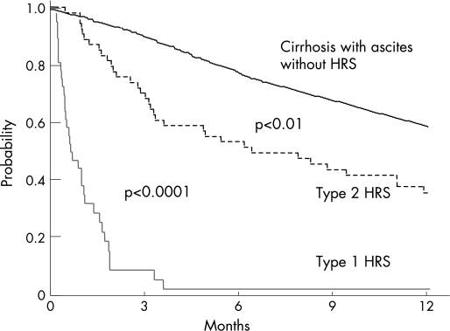
Outcomes in HRS
Gut 2007; 56:1310-1318

Slide 14
HRS: Treatment
Liver transplantation for both type 1 and 2 HRS
Vasoconstrictors for type 1 HRS
  Terlipressin
  Norepinephrine
  Midodrine/octreotide
TIPS

Slide 15
HRS Type 1: Terlipressin & Albumin
Terlipressin: vasopressin analog, reduces splanchnic vasodilatation
Dosing: 1-2 mg IV every 4hrs
Given with IV Albumin 1g/kg, then 20-40g/day
Significant improvement in renal function
Not available in the USA
No difference in survival at 3 months vs. albumin alone
Survival benefit for renal responders
Gastroenterology 2008; 134:1352-9

Slide 16
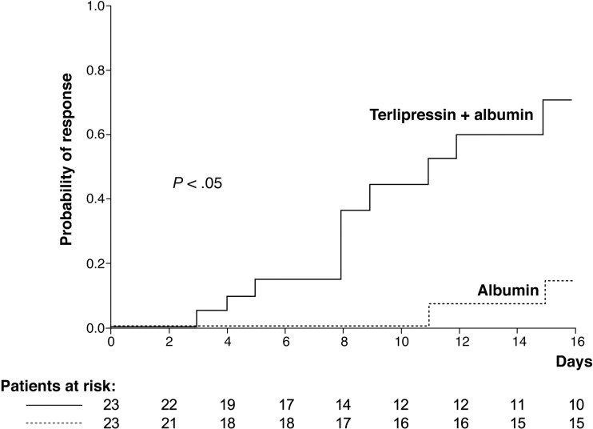
Renal Response: Terlipression+Albumin vs Albumin alone
Gastroenterology 2008; 134:1352-9

Slide 17
HRS-1: Norepinephrine
Uncontrolled pilot study, n=12
Norepinephrine 0.5-3mg/hr with IV albumin and furosemide
Hepatology 2002; 36:374-380

Slide 18
HRS-1: Midodrine & Octreotide
Midodrine- selective alpha-1 adrenergic agonist
  Causes increase in peripheral vascular resistance
Octreotide-analogue of somatostatin
  Inhibits endogenous vasodilator release, thereby reducing splanchnic vasodilatation
The combination is thought to improve renal and systemic hemodynamics

Slide 19
HRS-1: Midodrine & Octreotide
Group A: 8 subjects treated with
  Dopamine 2-4mcg/kg/min
Group B: 5 subjects treated with
  Midodrine 7.5-12.g mg po TID
  Octreotide 100-200 mcg subq TID
  Both meds titrated to an increase in MAP of ≥ 15 mmHg
Both groups also received IV Albumin
Hepatology 1999; 29:1690-7

Slide 20
Dopamine vs. Midodrine+Octreotide
Hepatology 1999; 29:1690-7

Slide 21
Dopamine vs. Midodrine+Octreotide:
Survival
Hepatology 1999; 29:1690-7

Slide 22
Abdominal Compartment Syndrome
Intra-abdominal hypertension
  Intra-abdominal pressure ≥ 12 mmHg; (normal 5-7 mmHg) or
  Abdominal perfusion pressure <60 mmHg
    APP=MAP-IAP
  Abdominal compartment syndrome
    IAP ≥ 20 mmHg and new organ dysfunction
Intensive Care Med 2006; 32:1722

Slide 23
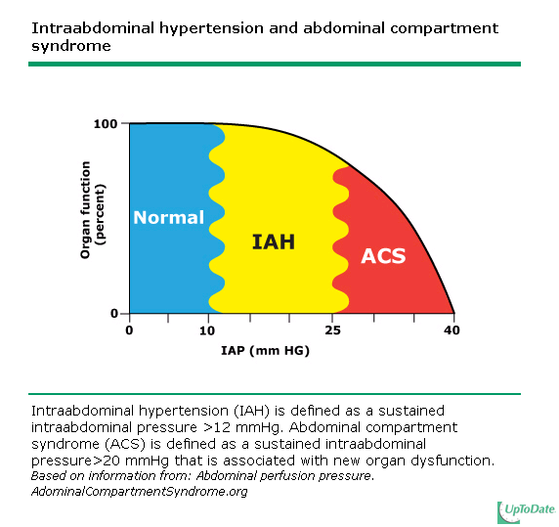

Slide 24
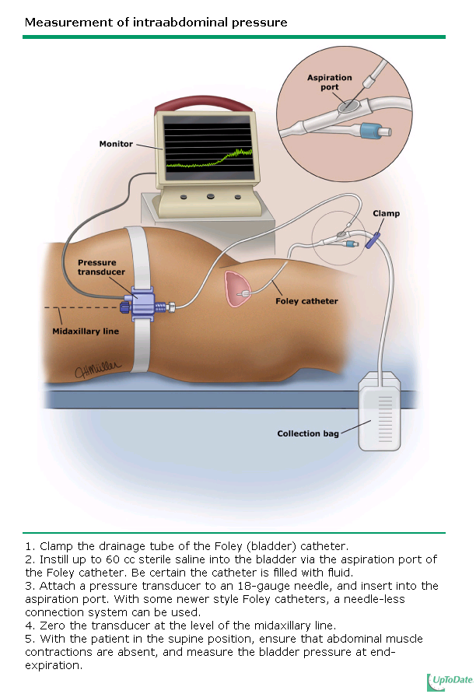

Slide 25
Abdominal Compartment Syndrome
Systemic effects
  Impaired cardiac function (from compression due to elevation of diaphragm); reduced venous return
  Increased intra-thoracic pressures, risk of barotrauma, etc.
  Decreased splanchnic perfusion
  Decreased hepatic ability to metabolize lactic acid
  Increase in ICP
Intensive Care Med 2006; 32:1722

Slide 26
Abdominal Compartment Syndrome
Renal effects
  Acute kidney injury due to:
    Renal vein compression with higher venous resistance and impaired venous drainage
    Renal artery vasoconstriction via overactive sympathetic drive and renin-angiotensin axis
  Drop in GFR
  Drop in urine output: Oliguria with IAP 15 mmHg, anuria with IAP 30 mmHg
  Decreased urine sodium and chloride
Trauma 2000; 48:874

Slide 27
Abdominal Compartment Syndrome
Clinical settings in which to keep ACS in mind
  Trauma patients following aggressive volume resuscitation
  Burn patients >30% BSA
  Post liver transplant
  Massive ascites, bowel distention, abdominal surgery, intraperitoneal bleeding
  Ruptured AAA, pelvic fx with bleeding, pancreatitis
Crit Care Med 2005; 33:315
Crit Care Med 2004; 30:822

Slide 28
Abdominal Compartment Syndrome
Diagnosis
  First of all think of the diagnosis
  Measure IAP
Treatment
  Abdominal Decompression
Renal dysfunction is generally reversible if decompression is done in a timely manner
Trauma 2000; 48:874
Arch Intern Med 1985; 145:553

Slide 29
The End
Thank you for your attention

