Slide 1
Thrombophilia in the Pediatric Trauma Patient
Gemmie Devera, MS, MPH
Brittany Jarvis
Bert Johansson, MD,PhD, FAAP

Slide 2
Objectives
Increase awareness of thrombophilia in children
Propose that a Level 1 thrombophilic work up be done in a selected group of children involved in trauma
Propose that thrombophilia and other metabolic errors (eg glutaric acidosis Type 2) be considered in the work up of non-accidental head trauma.

Slide 3
Case 1
9-month-old female with no PMH or FHX s/p fall from bed ~ 3 feet with subdural hematoma
PE: abrasion L frontal area, bilateral retinal hemorrhages
Tests: nl. PT, PTT, INR

Slide 4
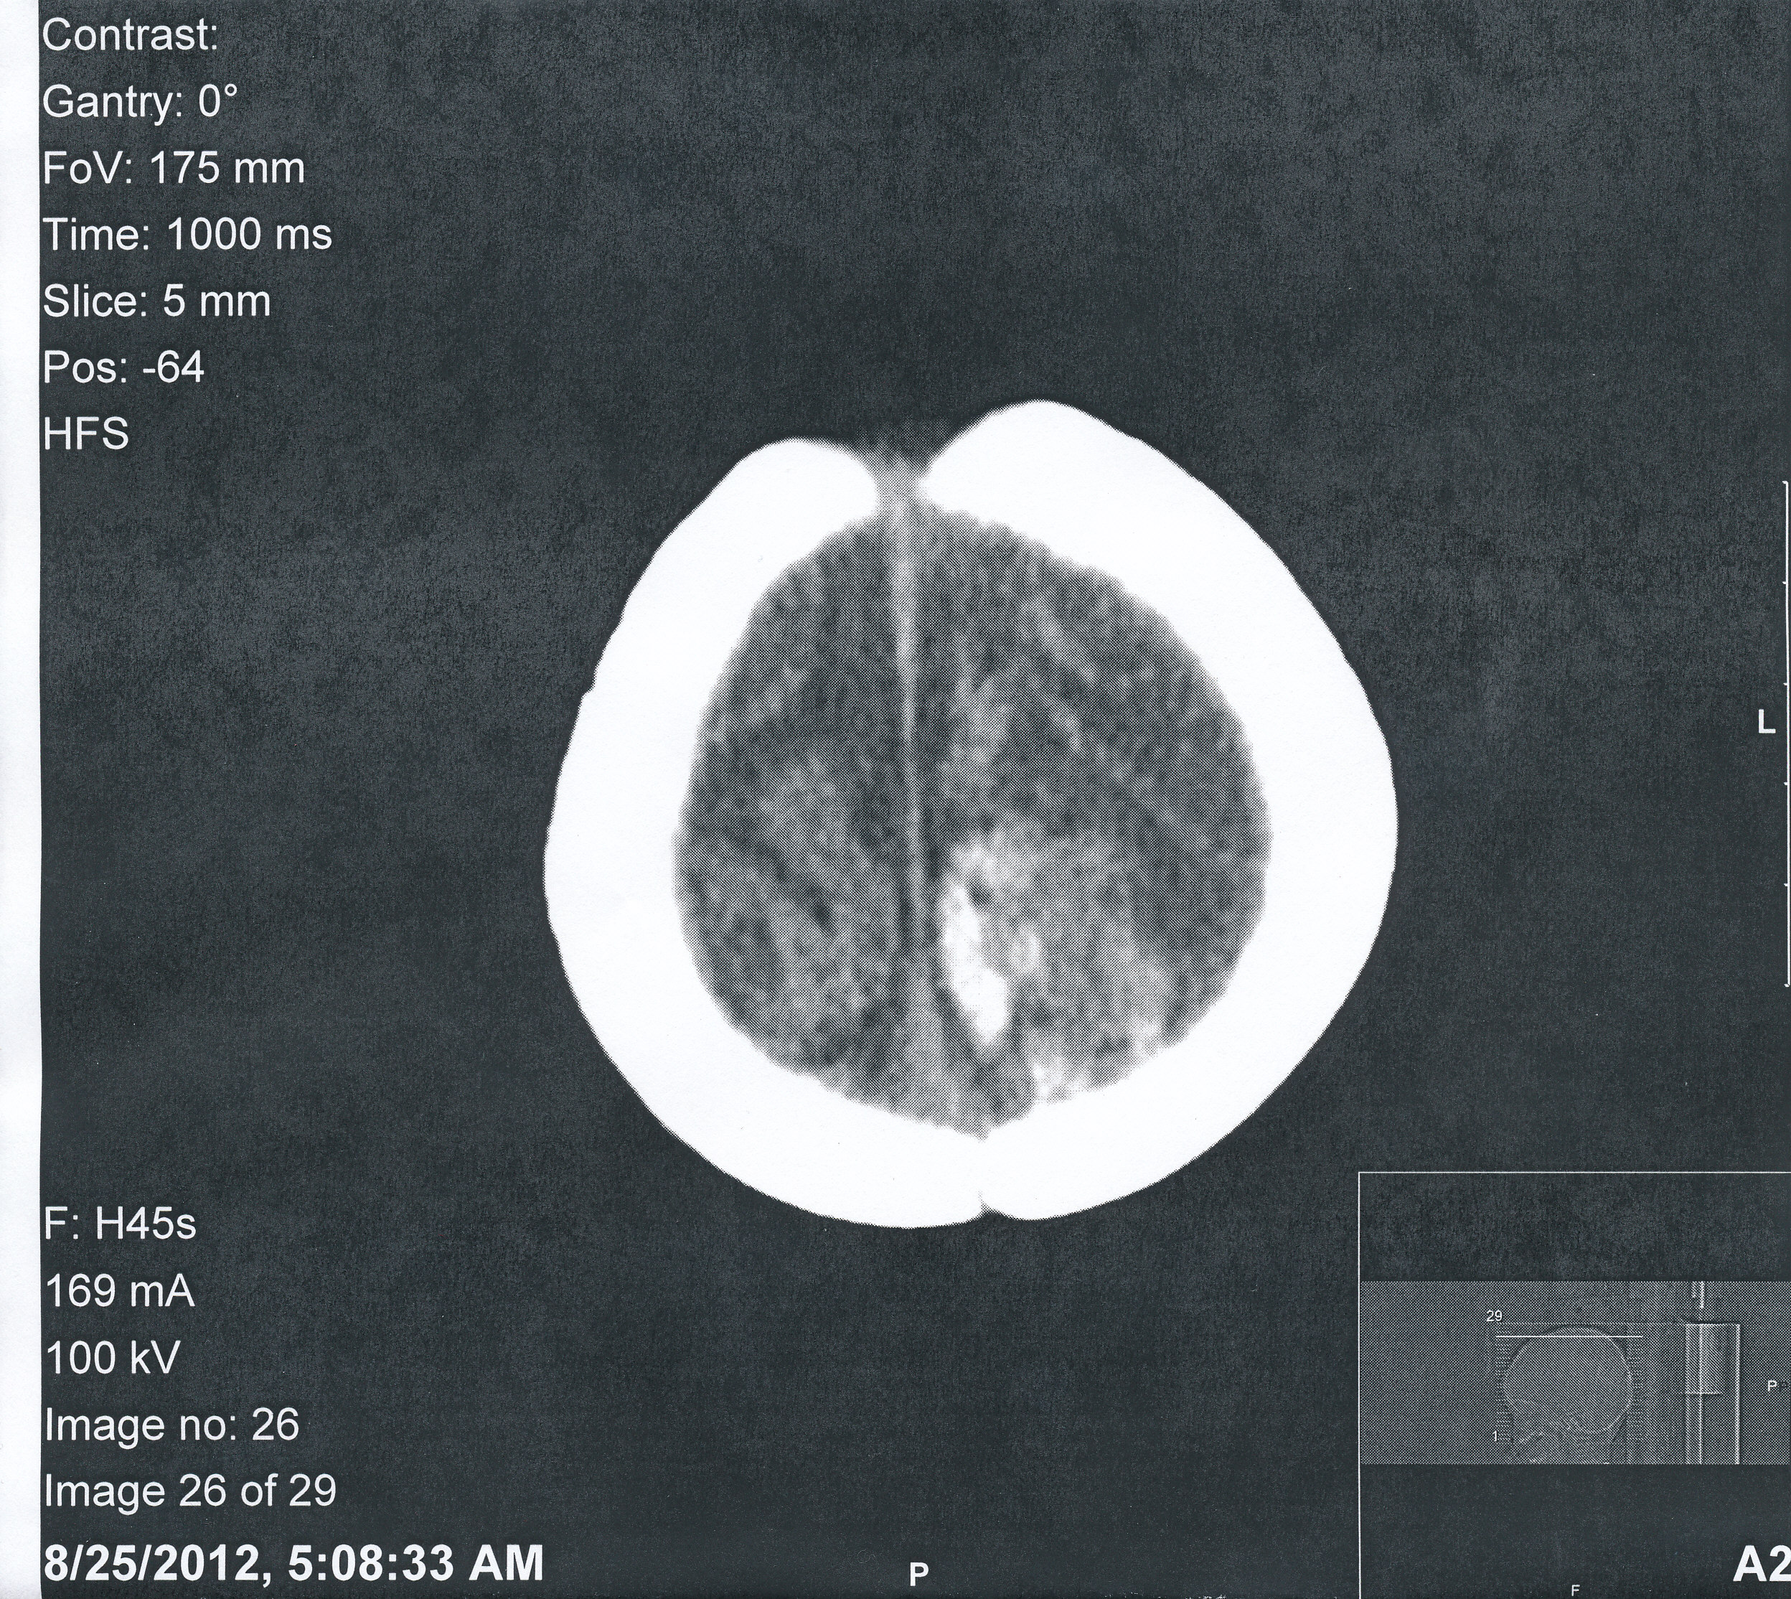
Case 1: Head CT
Subdural hematoma
Mixed acute & subacute hemorrhage
Non-accidental trauma?

Slide 5
Case 1: Thrombophilia Workup
+ MTHFR C677t mutation
  Found in patients with congenital thrombophilia, esp. hyperhomocystinemia
↑ levels of aspartic acid, glycine, ornithine, valine, cystine
inborn errors of metabolism v. non-accidental trauma

Slide 6
Case 2
Previously healthy five-week-old male in status epilepticus
Head CT: acute, large right epidural hematoma & older, smaller L subdural hematoma
High index of suspicion for non-accidental trauma

Slide 7
Case 2: Thrombophilia workup
Normal PT, PTT, INR
Partial thrombophilia workup: Normal factor VIII, factor XIII, vWF
Further testing: + for Factor V Leiden

Slide 8
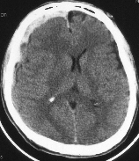

Slide 9
SUBDURAL HEMATOMA
Collection of blood on the surface of the brain cortex, beneath the dura
Great amount of force
Profound and progressive neurologic deterioration
Initially medical management of ICP
Large subdurals need surgical evacuation
Less favorable outcome than epidurals
Consider glutaric acid deficiency Type 2, bleeding disorders, thrombophilia etc

Slide 10
Risk Factors For A Less Severe Head Injury in Children Resulting In A Subdural Hematoma.
  Inborn errors of metabolism
  Previous history of brain surgery
  Having a condition that makes you bleed more easily, such as hemophilia,
  Having a condition that makes your blood more prone to clotting, such as thrombophilia
  Taking anticoagulant medication to prevent blood clots, such as warfarin or aspirin

Slide 11
Case 3
15-year-old male who sustained intracranial bleed after fall while skateboarding with craniotomy presents with L arm pain at IV site two days after discharge…
PMH: none.
FHX: brother – nosebleeds. No bleeding disorders.

Slide 12
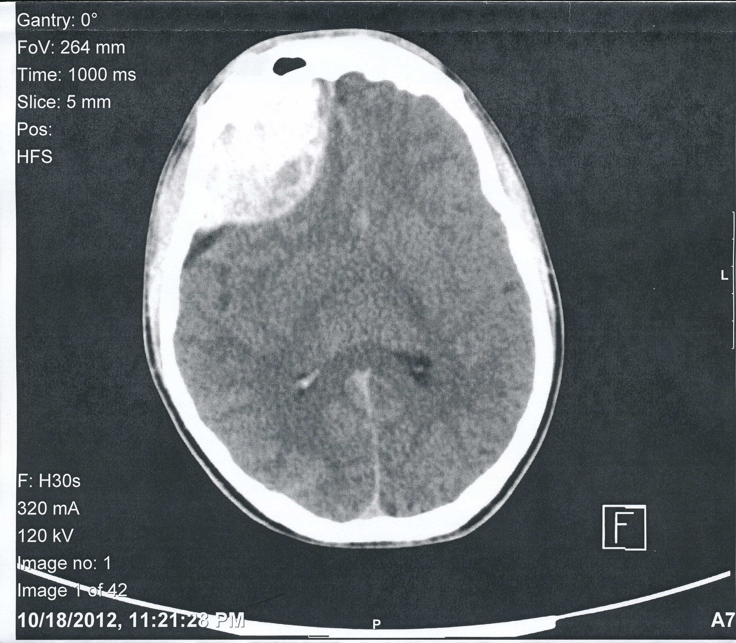
Case 3: Head CT
Epidural Hematoma
R frontal intracranial extradural hemorrhage and hematoma with mass effect

Slide 13
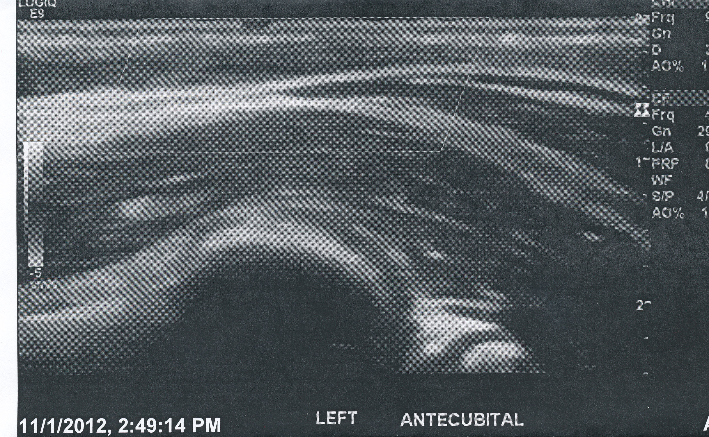
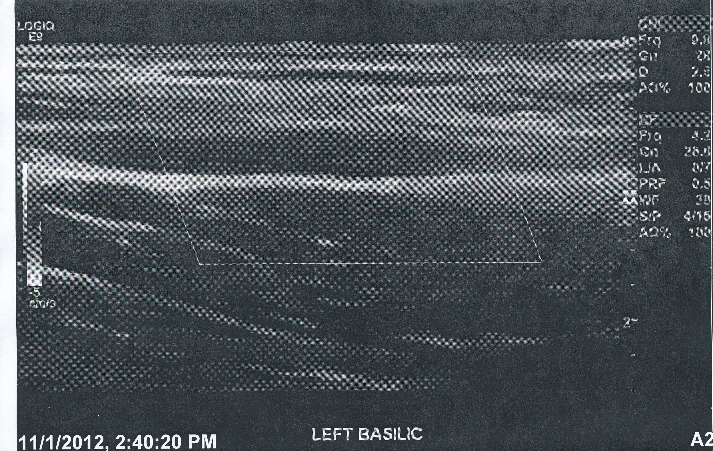
Case 3: Doppler Venous US
Non-compressible veins show
thrombophlebitis.

Slide 14
Case 3: Thrombophilic Workup
Initial labs: nl. PT, PTT, INR
Positive for MTHFR A1298C mutation
Possible hypercoagulable state

Slide 15
BASIC EVALUATION
Basic coagulation studies (PT, PTT) and platelets
CBC, ESR
Iron, folate, Hb electrophoresis
Protein S, protein C

Slide 16
What To Consider In A Thrombophilic Work Up:
AT III, heparin cofactor II, plasminogen, vWF Ag, factor VIII, factor XII, lupus anticoagulant
Anticardiolipin antibodies
Factor V Leiden & activated protein C resistance
Prothrombin 20210 gene
Total homocysteine & thermolabile MTHFR gene, serum folate, B6, B12
Fasting cholesterol, triglycerides, Lp(a) lipoprotein

Slide 17
Conditions Associated With Acquired
Thrombophilic Lab Abnormalities.
Acute thrombosis
Low protein S
Low protein C
Low antithrombin
Infection
Antiphospholipid antibodies
Inflammation
Elevated factor VIII
Low free protein S
Elevated Lp(a)
Nephrotic syndrome
Low protein C
Low protein S
Elevated Lp(a)
Nutritional deficiency
Elevated homocysteine
Complex congenital heart disease
(single ventricle)
Low protein S
Low protein C
Low antithrombin
Asparaginase
(acute lymphoblastic leukemia)
Low antithrombin
Liver disease
Low protein S
Low protein C
Low antithrombin
Warfarin therapy
Low protein S
Low protein C
Heparin therapy: Low antithrombin

Slide 18
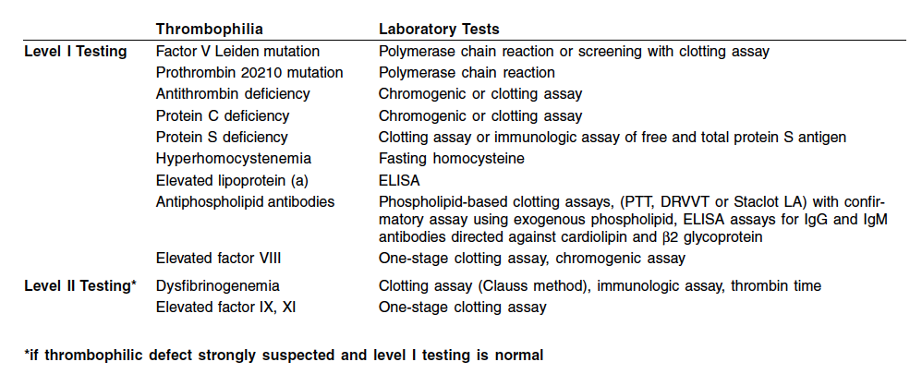
Testing For Thrombophilia In Kids

Slide 19

NEUROIMAGING
Imaging of the brain
Ischemic infarct or hemorrhage?
Where is it?
How large is it?
How old is it?
Imaging of the vessels
Blockage?
Where?
How severe?
Pathology?
Other vascular lesions?

Slide 20
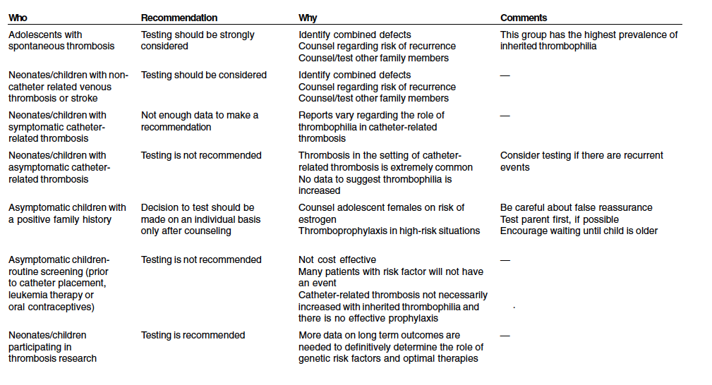
Who to Test for Thrombophilias

Slide 21
Summary & Future Directions:
Maintain a high index of suspicion for congenital or acquired thrombophilia
Thrombophilia may have nl. PT, PTT, INR
Thrombophilia mimic for non-accidental trauma
More research needed to describe hypercoagulable states in kids & raise awareness of these conditions

Slide 22
References:
Lawrence PF, Bell RM, et al. Essentials of General Surgery, Fourth ed. Philadelphia: Lippincott Williams & Wilkins, 2006.
Raffini L. 2008. Thrombophilia in Children: Who to Test, How, When and Why? Hematology Am Soc Educ Program, 228-235.
Tormene, D., Gavasso, S., et al., 2006. Thrombosis and Thrombophilia in Children: A Systematic Review. Semin Thrombo Hemostat Oct 32 (7) 724-8.
Kenet, G., et al., 2010 Impact of Thrombophilia on the risk of arterial ischemic stroke or cerebral sinovenus thrombosis in neonates and children. Circulation Apr 27: 121(16) 1838-47.

