Slide 1
Radiation Exposure in Pediatric Trauma
        Nilda M. Garcia, MD
Trauma Medical Director
Dell Children Medical Center-Austin
Associate Professor of Pediatric Surgery
UT Southwestern -Austin

Slide 2
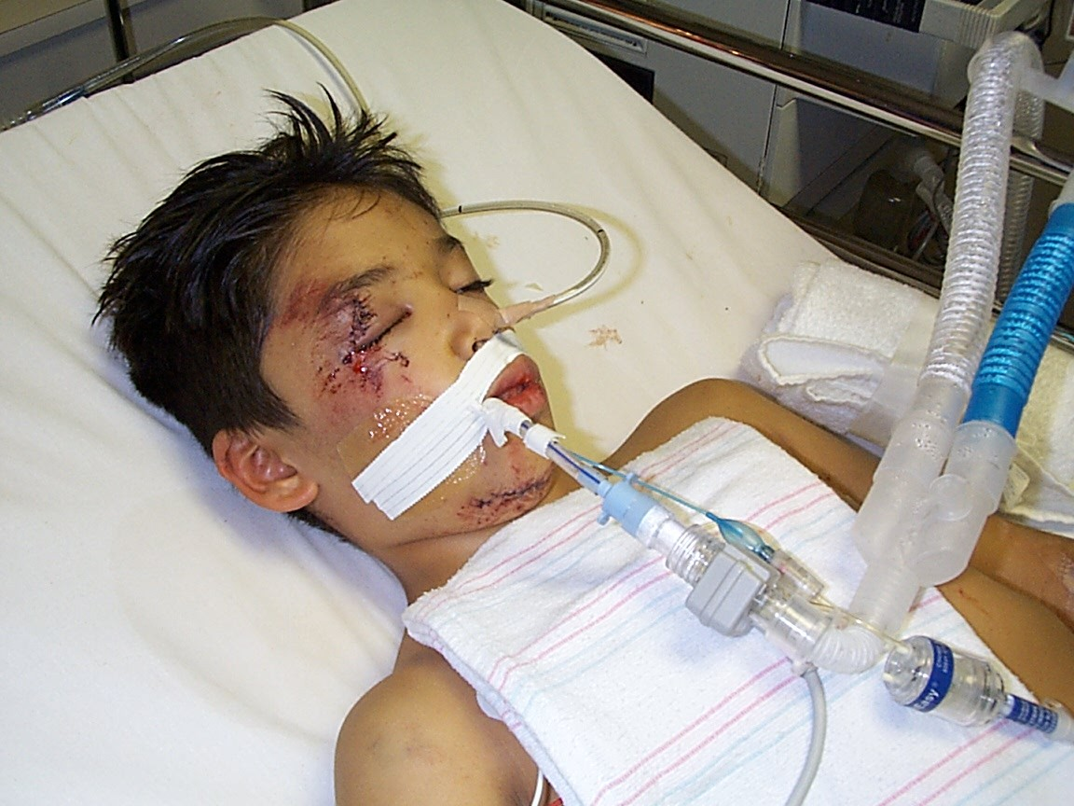
Nuke ‘em Till They Glow

Slide 3
OVERVIEW
Why do we scan?
BEIR Report
  Facts
  Physiology/definitions/doses
Trauma patient ‘s exposure to radiation
  Current
  CXR, Pelvis, Brain CT
  Screening labs
ACR
  ALARA-concept

Slide 4
We scan out of:
Necessity (variable)
Ignorance
CYA**
Laziness**

Slide 5
Diagnostic CT in the USA
1980 3 million scans
2006 62 million scans
2006 4 million scans pediatric population

Slide 6
Radiation Exposure
1987 85% from environment and 15% from CT
2006 50% from environment and 50% from CT

Slide 7

Lay Press
Too Much of a Good Thing?; The Growing Use of CT Scans Fuels Medical Concerns About Radiation Exposure
From: The Washington Post | Date: January 15, 2008| Author: Rob Stein - Washington Post
 | Weighing the risks of CT scans Newspaper article from: Oakland Tribune ; ...of all medical radiation exposure to the U.S. population...the 62 million CT scans given annually...tissue trauma. CT scans, he added, "revolutionized...controversial study on radiation exposure from CT scans...diagnostic benefit of CT ...

Slide 8
MORE LAY PRESS
“Hundreds of fatal cases of cancer are being induced in children every year by hospital scans…”
  www.nature.com/nature/journal
“F.D.A. to Increase Oversight of Medical Radiation “
  New York Times- Feb 2010

Slide 9
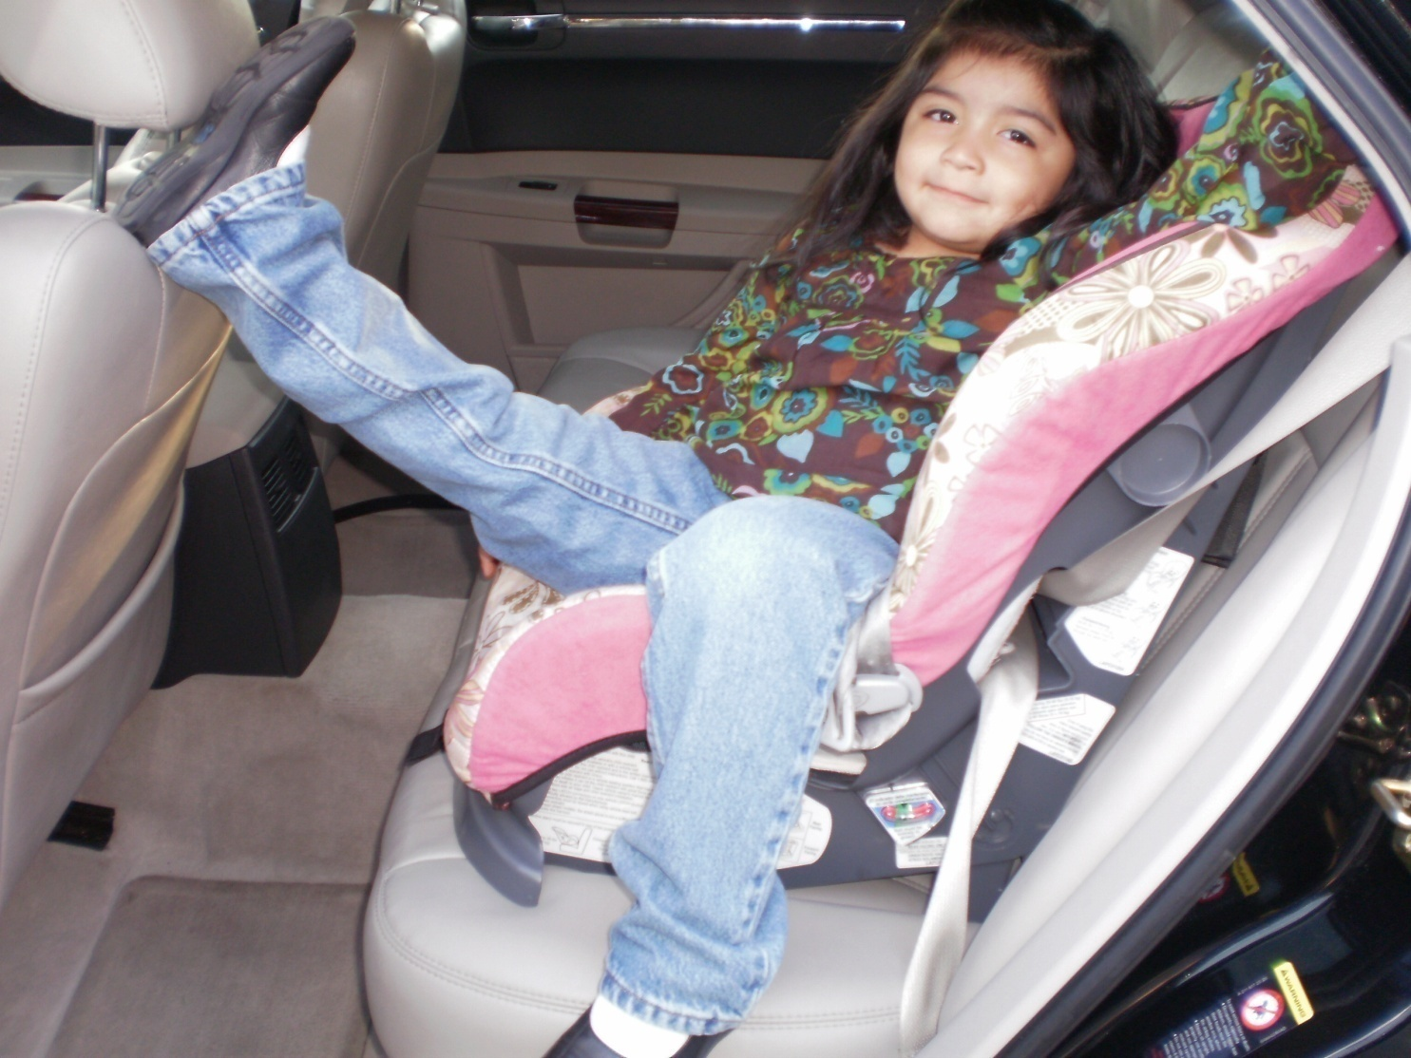
What is the risk?

Slide 10
NATIONAL RESEARCH COUNCIL OF THE NATIONAL ACADEMIES -THE NATIONAL ACADEMIES PRESS
Washington , D.C.
Committee to Assess Health Risks from Exposure to Low Levels of Ionizing Radiation
BEIR- Biological Effects of Ionizing Radiation
BEIR’s series of reports are the most authoritative basis for radiation risk estimation. The report estimates risks for cancer incidence rates as well as mortality and also provides detailed risk figures according to age of exposure for males and females by cancer type.

Slide 11
Biological Effects of Ionizing Radiation (BEIR)
Methodology to estimate lifetime attributable risk of cancer induction associated with low level radiation exposure.
Evidence based on long term follow-up of Hiroshima, Nagasaki and Chernobly survivors.
25,000 Japanese survivors received 5 to 150 mSv with a mean of 40 mSv.
BEIR VII Phase 2 (2006)
National Academy of Science

Slide 12
Physiology of Radiation Injury to Biological Tissue
Ionizing radiation. Free electrons.
Free radicals. Hydroxyl radicals from water
Hydroxyl interaction with DNA. Strand breaks damages base pairs and damages repair enzymes
Mis-repairs lead to point mutations, chromosomal translocations and gene fusions
Interferes with programmed cell death
Mutagenesis and carcinogenesis.

Slide 13
Physiology
Long lag time from acute exposure and development of malignancy (20 – 25% background incidence)
Age, gender and target organ factor. Females more susceptible than males
Young more susceptible than old – more actively dividing cells, more dose per gm. tissue and longer lag time
Breast, bone, thyroid and lung more susceptible than skin or brain.

Slide 14
BEIR VII Phase 2
Risk of cancer induction proceeds in linear fashion down to a low dose, low energy exposure
Risk of cancer induction linear down to ~50mSv.
Probably no “safe” threshold
No information on X-ray

Slide 15
Definitions
Roentgen-beam energy (coulomb/kg)
Gray-energy absorbed per unit mass (joule/kg). Useful unit for targeted therapeutic radiation.
Sievert-energy absorbed in non-homogeneous tissue. Useful measure for diagnostic imaging or environmental sources.
Dose estimate-beam energy X target factors (age, gender, body size, target organs) Measured in Sieverts

Slide 16
Dose Estimates
Average from environment 3mSv
Cosmic source at sea level .26mSv
Cosmic source in Denver .63mSv
Food and water .40mSv
Air (Radon) 2mSv
Airport security .00002mSv
TV 0mSv

Slide 17
Dose Estimates continued
Hand x-ray 0.01mSv
Chest x-ray 0.06mSv
VQ scan 0.14mSv
UGI 2.5mSv
Abdominal CT adult 10 - 20mSv Abdominal CT child 15 - 30mSv

Slide 18
Dose Estimates continued
CTCA or PE protocol 64 slice
  50 to 90 mSv
“Triple rule out” (Coronary Art, Aorta, Pulm artery)
  100 to 180 mSv

Slide 19
In a few decades, estimated that 2% of all cancers will be due to radiation from CT scans performed now.

Slide 21
Shock room films:
Chest X-ray 0.02mSv
Lateral C-spine 0.02mSv
Pelvic film 0.03mSv
Trauma Panel:
Head CT 2mSv
Cervical Spine Ct 2mSv
Chest CT 8mSv
Abd/pelvic CT 10mSv
Next morning
Repeat CT - head 2mSv
T&L spine films 0.1mSv
Chest Xray 0.02mSv
Total (first 18 hours) 24.2mSv

Slide 22
Radiation Exposure for Trauma
100 consecutive trauma patients
Blunt trauma at a Level I Center
Median effective dose of radiation 40.2 mSv
Equivalent to 1,005 chest X-rays
Winslow et al,
Ann Emerg. Med
Aug. 2008

Slide 23
We expose patients :
Out of necessity
  Variably
Is there a difference in:
  3 pts. Present simultaneously after being ejected in a high speed crash – busy trauma center
  Single patient, properly restrained in a low speed crash – smaller center

Slide 24
We expose patients out of:
Lack of Knowledge
  Not understanding the real risk assessment for a patient
    Example – C-spine
  Not understanding alternative ways to obtain information
    Non or minimally radiating tools
      Plain films
      Ultrasound
      MRI
      Labs

Slide 25
Utility of Routine CXR in the Trauma Room
In stable trauma patients with a normal chest physical exam, CXR appears to be unnecessary in their initial evaluation. CXR should be relegated to a role similar to cervical spine and pelvis radiographs in the initial evaluation of hemodynamically stable trauma patients with a normal physical examination, and should be limited to use only for clear clinical indications.
Wisbach GG, Sise MJ et al; What is the role of chest X-ray I the initial assessment of stable trauma patients? J Trauma. 2007 Jan;62(1):74-8

Slide 26
Utility of the Pelvic film in the Trauma room
We conclude that the screening PPF appears to be an unnecessary exam in multiple trauma patients about to be imaged by APCT scan.
Stewart BG, Rhea JT, et al: Is the screening portable pelvis film clinically useful in multiple trauma patients who will be examined by abdominopelvic CT? Experience with 397 patients. Emerg Radiology; 2002 Nov;9(5):266-71.

Slide 27
Decision rule for CT scanning of the brain
Patients with specific mechanism and exam characteristics can be safely observed without CT scanning of the brain.
Smits M, Dippel DW et al External validation of the Canadian CT Head Rule and the New Orleans Criteria for CT scanning in patients with minor head injury. JAMA, 2005 Sep 28;294(12):1519-25.

Slide 28
Utility of Screening Labs
Physical examination combined with selected laboratory studies can be used to predict the risk of IAI accurately among children who sustain blunt trauma. Application of these findings may be useful in reducing costs and improving the accuracy of diagnosing IAI among children.
Cotton BA, Beckert BW, Smith MK, Burd RS; The utility of clinical and laboratory data for predicting intraabdominal injury among children. J Trauma,2004 May; 56(5):1068-74.

Slide 29
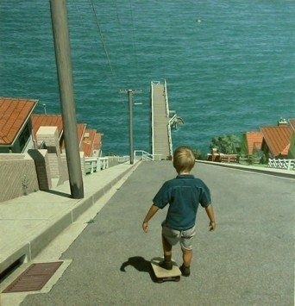
Now you know the risks (sort of)
Is it worth it?
Yes & No

Slide 30
American College of Radiology
Supports development of national database for radiation dose estimates
Establish benchmarks
Encourage vendors to automatically calculate, display and record patient dose
Encourage Joint Commission to review

Slide 31
ACR CT Accreditation
Mandate recording and routine preventative maintenance. Annual inspection
Mandate benchmarks for specific equipment and patient population
Enforce Pass/Fail criteria
Set protocols to optimize risk benefit.
Sufficient image quality for a given clinical indication can be achieved at lower dose (mAs, kVp) settings.
mAs-milliamperage-volume
kVp-voltage-

Slide 32
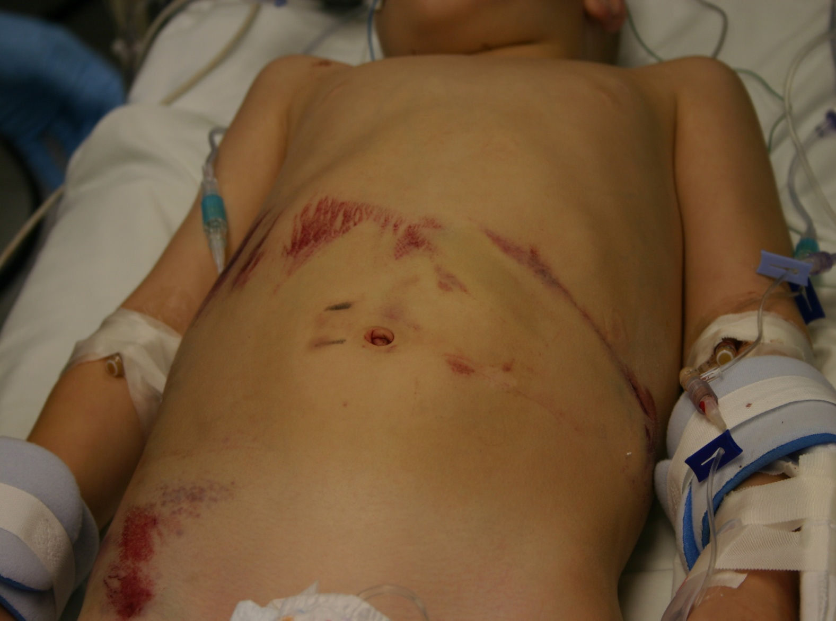
Improperly Restrained
32
Notes:
32

Slide 33
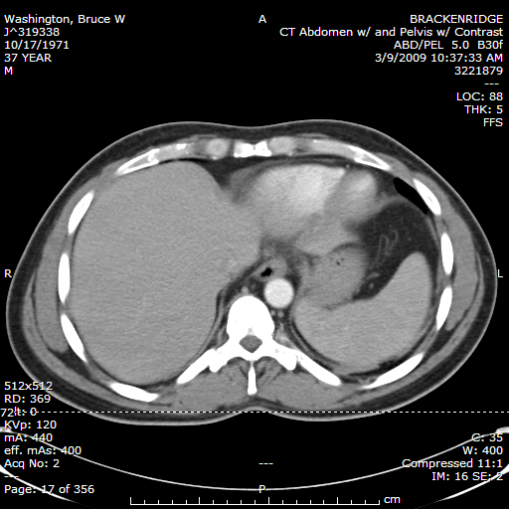

Slide 34
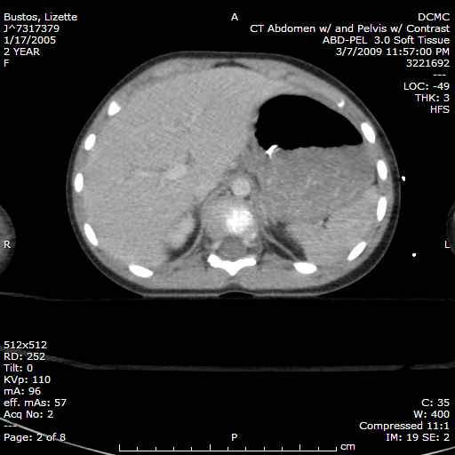

Slide 35
ALARA
ALARA, "As Low As Reasonably Achievable",
  -Radiation safety principle for minimizing radiation doses by employing all reasonable methods.
  any amount of radiation exposure, no matter how small, can increase the chance of negative biological effects such as cancer
  the probability of the occurrence of negative effects of radiation exposure increases with cumulative lifetime dose.

Slide 36

Society of Pediatric Radiology

Slide 37
Recommendations
Scan when the data desired will be obtained.
Scan when the data will change management.
Scan at the lowest possible settings to obtain adequate images. Child size the kVp ( Kilovolt Peak- Quality ) and mAs (Milliamp second-Quantity)

Slide 38
Recommendations
Consider the “benefit” of repeat scanning.
Work with radiologists, techs, and med physicist to optimize the scanning protocols by study intent and age.
Scan only needed area and shield other areas.

Slide 39
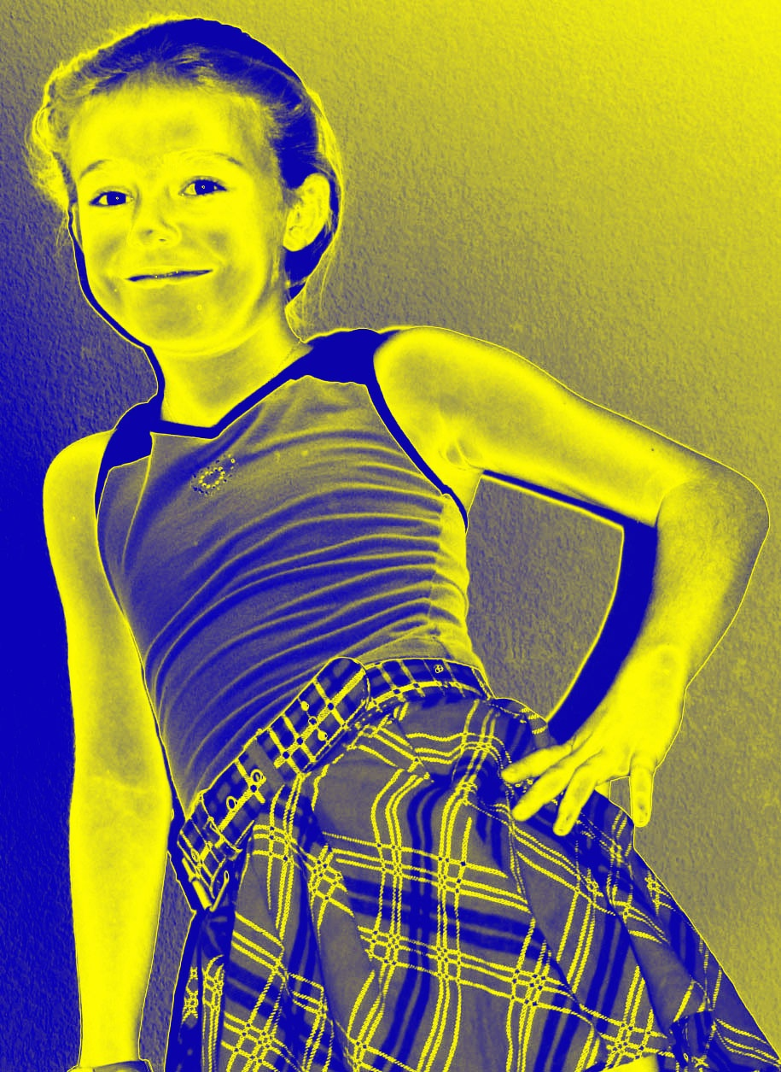
Glowing Children

Slide 40
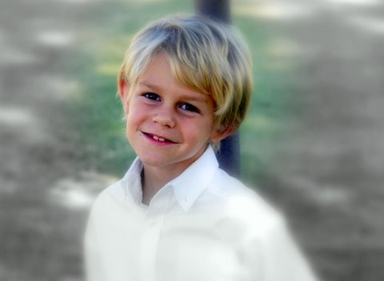
Glowing children

Slide 41
Thank You

