Slide 1
Clearing the Pediatric Cervical Spine
Nilda M Garcia, MD, FACS
Trauma Medical Director
Dell Children’s Hospital
Associate Professor Pediatric Surgery
UT Southwestern-Austin

Slide 2
Objectives
Discuss the significance of the problem
Review evidence for assessment of the pediatric cervical spine
Discuss the approach to clearing the pediatric cervical spine
Why, Who, When, How

Slide 3
Retrospective Review of NTDB Patients <3yo, 2001-2005
Any C-spine (cord and/or column) Injury- 1.59%
Any spinal cord injury (with or without column injury)- 0.38%
Isolated spinal cord injury- 0.19%
Polk-Williams et al, JPS, 2008

Slide 4
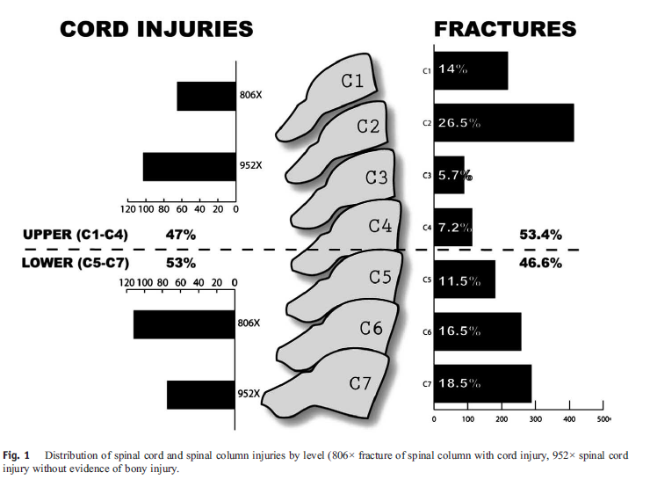
Polk-Williams et al, JPS, 2008

Slide 5
Stratification of injury by Age of patient
Infants
Injuries to the upper cervical spine
Mostly ligamentous
In between (6-12 years)
Variable position of injury
Variable likelihood of boney vs. ligamentous injury
Adolescents (13 years and over)
Pattern of injury similar to adults

Slide 6
Who needs cervical spine clearance?
All trauma patients need spinal clearance!

Slide 7
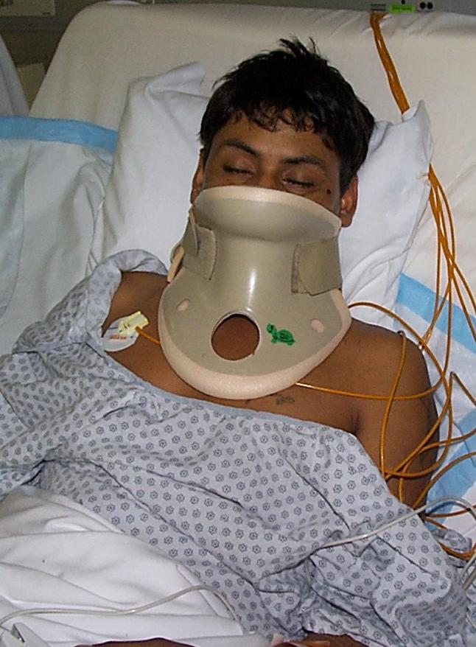
Immobilization
Size matters
Children are rarely calm in the ED
Prolonged immobilization in the absence of injury is Not Good

Slide 8
When should the cervical spine be cleared?
As soon as clinically feasible!

Slide 9
National Emergency X-Radiography Utilization Study (NEXUS)
Low risk criteria included absence of: midline cervical tenderness, intoxication, altered MS, focal deficit, distracting injury
Stratified by age:
Pre-verbal ( 0-2)
Immature spine (2-8)
Older child (9-17)
A Prospective Multicenter Study of Cervical Spine Injury in Children, Viccellio et al, Pediatrics, 2001

Slide 10
NEXUS Study
34,069 patients including 3,065 children
30 (0.98%) spinal injuries, 3.7% of all SCI
19.7% low risk
Number of low risk patients with an injury was zero.
100% sensitive; 100% NPV; 1.2% PPV
But- very few infants or toddlers –so use caution applying NEXUS rules
Viccellio et al, Pediatrics, 2001

Slide 11
Masiakos, et al. , J Trauma, 2009
Can simple clinical criteria be used
to safely rule out CSI in <3 yo.-
Multi-Center Study of the AAST
Data from 22 Pediatric Trauma Centers
12,537 children (age< 3 yo)
83 cervical spine injuries (0.66%)
Independent predictors of risk:
GCS<14
Age>2
MVC
GCS (eye)=1
If none present, no imaging necessary (69.7%)

Slide 12
Weighted Score
If weighted score 0 or 1, no imaging necessary (69.7%)
If weighted score 2 or greater, clinical judgment
Masiakos, et al. , J Trauma, 2009

Slide 13
Taking the collar off
First exam is “relatively normal”
X-rays normal
REPEAT EXAM IS NORMAL
Take the collar off

Slide 14
Patients with pain
Screening x-rays
Flexion/Extension views
MRI shows ligamentous damage but not fractures well
CT scans also useful
Getting a head CT
Plain films were not good enough
High risk

Slide 15
Trauma Association of Canada Pediatric Subcommittee National Pediatric Cervical Spine Evaluation Pathway: Consensus Guidelines
Review of the literature
Create an evidence based, pediatric, c-spine clearance guideline
Chung et al., J Trauma, 2011

Slide 17
Able clinically clear the C-spine
YES
• C-Spine clear
• D/C collar
Trauma Association of Canada National Pediatric C-Spine Evaluation Pathway: Reliable Clinical Exam
NO
Cooperative: AP/lat/odont x-rays
Uncooperative: AP/lat x-rays
Neurologic Exam
Abnormal
• Leave collar on
• MRI
• Consider CT
• Spine svc consult
Normal
Abnormal
CT C-spine
Abnormal
Normal and Adequate X-ray
Normal
• Leave collar on
• Spine svc consult
Normal
Age >8 yrs
Age ≤8 yrs
NO
Planning Head CT
Normal
Re-examine
YES
• C-Spine clear
• D/C collar
Normal
Abnormal
• Leave collar on
• Spine svc consult
CT Head and C1-3
Abnl Neurologic Exam
Abnl Exam: C-sp tenderness
• Consider Flex/Ext x-rays
• Consider Spine svc consult
Normal and
adequate x-rays
• Leave collar on
• MRI
• Consider CT
• Spine svc consult
Abnormal or
inadequate x-rays
• May D/C with close follow up and consider removal of collar
• Leave collar on
• Consider MRI

Slide 18
Trauma Association of Canada National Pediatric C-Spine Evaluation Pathway: Unreliable Clinical Exam
• Leave collar on
• MRI
• Consider CT
• Spine svc consult
Neurologic Exam
Abnormal
Normal
AP/lat x-rays
Consider CT C-spine
Leave collar on
Abnormal
• Leave collar on
• Spine svc consult
Normal
LOC
NOT
improving
Frequent reassessment of LOC during first 24-72 hrs
• Leave collar on
• Spine svc consult
Normal
Patient alert and cooperative
Consider MRI C-Spine
LOC improving
Follow reliable/conscious clinical exam pathway

Slide 19
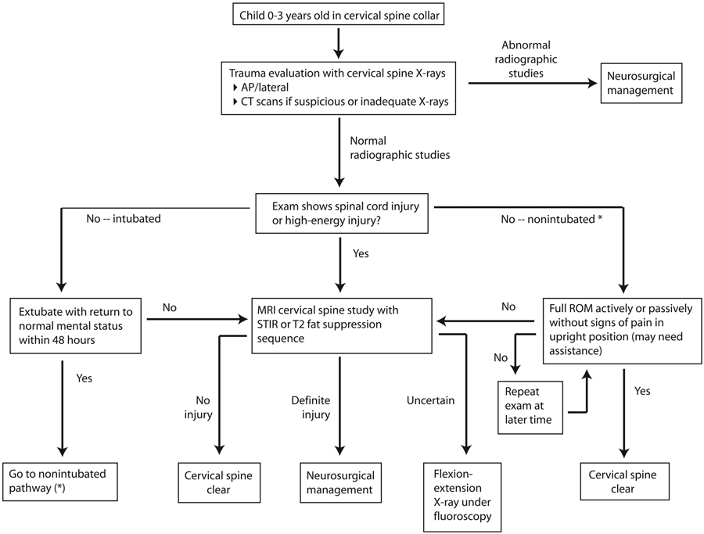
J Neurosurg: Pediatrics/Volume 5/March 2010

Slide 20
Local biases
Clear c-spine clinically (w/o any imaging) when appropriate
May limit C spine imaging to lateral view if unstable
Very strong bias to leave in collar and re-examine later
Use MRI (within 72 hrs) if unable to clear

Slide 21
Summary
Pattern of injury is variable by age
Clinical clearance is practical and safe in most settings
Radiographs should be used for defined purposes and judiciously

