Slide 1
Pre-hospital tourniquet use considerations
Kenneth Berumen, RN, MD, FACEP
Medical Director – El Paso Fire Department
Regional Medical Director – EmCare Western Division

Slide 2
Historical Perspective
1st reported use: 1674 by French Army surgeon Etienne Morel
Term originates from the French term “tourner” meaning “to turn”
Tight bandages proximal to wounds were being used by surgeons in amputations as early as 1517
1874 Lister described civilian use to obtain a bloodless field for the excision of a tuberculous wrist joint

Slide 3
Historical Overview Continued
In 1873, Friedrich von Esmarch developed a rubber bandage that would control bleeding
This device is known as Esmarch's bandage for surgical haemostasis or Esc\hmarch's Tourniquet
In 1881, Richard von Volkmann showed that limb paralysis can occur from the use of the Esmarch tourniquet.

Slide 4
Positive Reasons for Use
Recent military data have estimated that 10% of all battlefield deaths are caused by extremity hemorrhage
This accounts for 60% of preventable deaths
Vietnam data analysis found that 7% of combat deaths may have been prevented by the use of a tourniquet
In a 4 year period of tourniquet use by the Israeli Defense Force there were no reported deaths from uncontrolled limb hemorrhage among 550 injured patients

Slide 5
Goals of Use
Hemorrhage control
Shock prevention
Improved survival rates
Lengthening survival times
Elimination of distal pulses
Increased limb salvage rates

Slide 6
Problems with Tourniquet Use
The majority of hemorrhage can be controlled by direct pressure
Previously they have been used inappropriately when not clinically indicated
Preventing arterial blood flow to a limb will result in ischemia
Continuous application for longer than 2 hours can result in permanent nerve, muscle, or vascular injury and skin necrosis
Muscle damage is nearly complete by 6 hours

Slide 7
Tissue Injury
Nerves are more sensitive to compression
Muscle is more susceptible to injury from ischemia
While complications are rare they may be catestrophic

Slide 8
The Fear Factor

Slide 9
Problems Continued
Reperfusion injury may also result from tourniquet use
An incorrectly applied tourniquet will actually increase blood loss from distal soft tissue injuries
This will happen if there is occlusion of the lower pressure venous outflow, but inadequate occlusion of arterial blood flow

Slide 10
A policy of periodic loosening in an attempt to reduce limb ischemia has often led to incremental exsanguination and death
Tourniquets were often improvised whereas commercial devises that have undergone clinical trials are in contemporary US and UK military use
A properly applied tourniquet is painful and this has led to inadequate tightening or inappropriate pre-hospital removal
Anesthesia is a key component of use

Slide 11
Present Day Use
The military have been at the forefront of reintroducing tourniquets into use
Civilian use may be applicable for:
Penetrating trauma from firearms/stabbings
Tactical police officers
Terrorist incidents
Rural or wilderness incidents
Industrial accidents

Slide 12
How do they work?
Tourniquets work when the band surrounding an extremity is compressed. This compression forces the muscle and tissue surrounding the artery to collapse the vessel, decreasing blood flow.
The amount of force needed to collapse the vessel is dependent on three variables:
the size and circumference of the limb
the width of the strap or band of the tourniquet
the amount of force that can be applied to the constricting band.

Slide 13
Tourniquets
A wider band on a tourniquet is more effective at stopping blood flow in an extremity rather than a narrow band at the same tension
In addition to the width of the strap, studies have shown that a larger extremity with an increased circumference requires higher required tension to stop the flow of blood
This requires the design of the tourniquet to allow for variability in the amount of tension that can be applied to the limb.

Slide 14
Side by side comparisons
The first is called the SOF Tactical Tourniquet,(CAT: Combat Application Tournequet) which uses a windlass to provide the tension for constriction.
Tested and used by the military, it has proven to be extremely effective in high stress situations.
It is very easy to carry, especially on the outside of packs and tactical vests.
The other style is called the Mechanical Advantage Tourniquet (MAT) and is solely manufactured by Pyng.
The design is a rigid collar that goes around the extremity, and an attaching constricting strap.
A handle is turned and very easily applies the tension to stop blood flow.

Slide 15
MAT Issues
One disadvantage is that the MAT's design of a rigid collar makes it more difficult to pack in a small area, like on a vest
In 2005 by the Naval Sea Systems Command, Navy Experimental Diving Unit, the MAT received the highest scores in the following evaluations
Speed of application
Median average application time
Dominant vs. non-dominant hand application time
Mean average application times for upper and lower extremities
Occlusion efficacy/efficiency
User preference

Slide 16
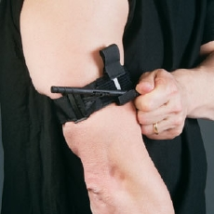
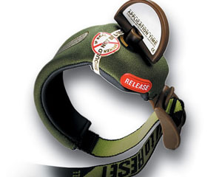
Two Commercial Types
SOF Tactical (CAT) Tourniquet
MAT

Slide 17
How to apply

Slide 18
Indications for use
Life threatening limb hemorrhage or amputation/mangling to allow other management
Life threatening limb hemorrhage not controlled by simple methods
Point of significant hemorrhage from limb not peripherally accessible due to entrapment
Mass Casualty Incident with limited resources

Slide 19
So easy a kid can use it ….. Well if that kid is from Afghanistan

Slide 20
Principles of Application
Be familiar with your particular equipment
The pressure required to occlude blood flow in the limb increases exponentially with the circumference of the limb
There is an inverse relationship between tourniquet width and the minimal pressure required to occlude arterial flow
However as width increases so does the amount of tissue that needs to be compressed

Slide 21
Cross Section of the Thigh

Slide 22
Effectiveness
Will be determined by cessation of external hemorrhage
If ineffective, it should be tightened or repositioned
If still ineffective, you may consider a second tourniquet proximal to the first
Hypothermia seems to decrease the damage due to ischemia

Slide 23
Effectiveness

Slide 24
Removal of the Tourniquet
Should be done as soon as possible
If transport time is <1 hour, it should ONLY be done in the OR where direct surgical control of hemorrhage can be undertaken
If >1 hour a trial of Tourniquet conversion may be attempted
Before release should have wound packing to include hemostatic agents and direct pressure over the bleeding point

Slide 25
Don’t Let Smart People do Dumb Stuff

Slide 26
Transportation and Handover
Go to closest appropriate facility
Note time of application
Discourage hospital staff from removing tourniquet until in the OR
Any amputated limb should be ideally transported with the patient to the hospital even it appears unsalvageable as tissue may be used for reconstruction

Slide 27
Conclusion
It is a rare situation where tourniquets will be necessary to use in the civilian pre-hospital setting
They are no longer a “last resort” device
Be familiar with whatever piece of equipment you have available to you

Slide 28
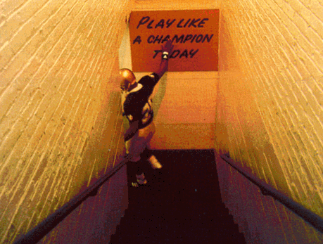
Thank YOU!!
Thanks for everyone’s hard work and willingness to improve patient care
Thanks to Dr. Tyroch for the invitation to speak

