Slide 1
The Dirty Bomb: Community and Medical Response to Radiological and Nuclear Events
13th Annual Rio Grande Trauma Conference and Pediatric Update
December 7, 2012, 2:15 PM
El Paso, Texas
Charles R. Bauer, MD, CPE
Chief Medical Officer
Colonel, Texas State Guard Medical Brigade (MRC)
Adjunct Professor, Surgery and Emergency Medicine,
University of Texas Health Science Center, San Antonio

Slide 2
Objectives:
Provide information regarding the development of a regional disaster preparedness and response program to deal with all –hazards, natural and man-made including terrorist activities.
Review: For This Discussion as it Applies to Nuclear and Radiation Events.
Local triage, training and techniques,
Identification screening capabilities
Decontamination capabilities and training
Facilities and personal protection
Community Reception Center
Psychological First Aid for Radiation Disasters
Laboratory Capabilities and Response

Slide 3
How It Started
1982 – “We don’t have to worry about disasters, the military will take care of us”
No local HazMat Response Teams - started 1980s
Bexar County Medical Society
Emergency preparedness Committee
EMS Committee
Greater San Antonio Hospital Council –1996-2010
Texas Trauma System developed – 1989-1990
STRAC (Trauma Service Area –P) - 1993
9-11
EHDG

Slide 4
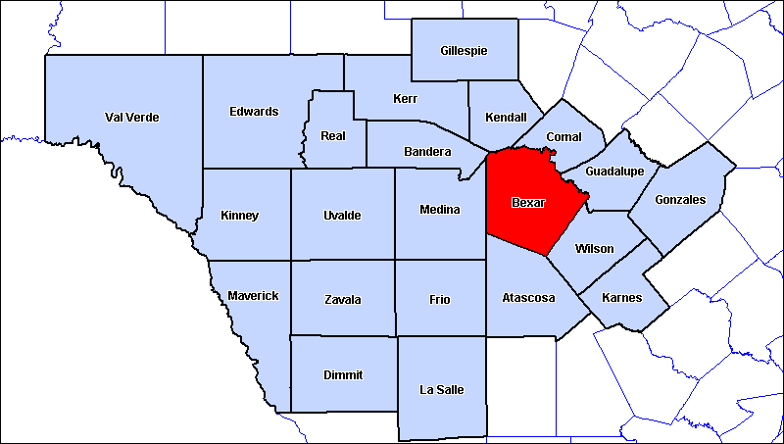
Trauma Service Area P
Trauma Service Area P
Trauma Service Area P
Trauma Service Area P
Trauma Service Area P
Trauma Service Area P
Trauma Service Area P
Trauma Service Area P
Trauma Service Area P
- 26,000 Sq Miles - 71 EMS Agencies - 53 hospitals (35 General, 18 Specialty) - 2 Level I Trauma Centers
200 miles

Slide 5
Emergency/Hospital Disaster Group Committees (EHDG)
Hospital Plans/Advisory Group
Regional Medical Operations Center (RMOC)
Decon-RSO
Exercise Committee
Security Directors
Pharmacy
Infection Control
Materiel and Facilities Managers
MIR3 Users Group – (EverBridge)
Mental Health
Education Committee (STRAC) STRAC.ORG

Slide 6
Hazard Assessment Analysis
Hurricane
Earthquake
Flood
Wildfire
Tsunami
Volcanic Eruption
Space Weather
Human Pandemic
Animal Disease
Avalanche
Drought
Heat
Severe Thunderstorm
Tornado
Winter Storm/Ice Storm
Chemical Substance Release
Civil Unrest
Nuclear Accident
Transportation System Failure
Dam Failure
RDD/Nuclear Attack
Biological Attack (non-food)
Bio/Chem Food Contamination
Chem Attack (non-food)
Armed Assault
Aircraft as a Weapon
Explosive Devices (DIRTY BOMB)
Cyber Attack
a

Slide 7
Decon-RSO Group
Goal: Plan, Prepare, and Respond to Biological, Chemical, and Radiological threats.
Objectives:
Plan collaboratively for all hazards/risks threats within TSA-P
Work with the EHDG IC (infection control) to appropriately prepare for biological threats
Collaborate with EHDG RSOs (Radiation Safety Officers) to appropriately prepare for threats associated with radioactive materials
Establish decontamination and radiation safety standards and assess their compliance within TSA-P
Cooperate as regional partners in ASPR funded equipment acquisition, training, and exercises
Improve decontamination and radiation safety processes based on directives and lessons learned
Facilitate training of TSA-P personnel through exercises
Respond effectively with radiation detection resources in disaster events
STRAC.ORG

Slide 8
Dirty Bomb – Improvised Explosive Device (IED)
Cause Injury through multiple mechanisms:
Primary
Secondary
Tertiary
Quaternary
Quinary

Slide 9
Primary Effect:
Due to over/under pressurization – Rapid expansion of gasses.
Direct tissue damage with complex stress and shear waves
Gas filled organ more prone to injury
Ear – tympanic membrane rupture
Lungs
Hollow viscus organs – Colon (more gas) > Small bowel

Slide 10
Secondary Effects
Caused by projectiles propelled by the explosion
May be embedded in wounds, cause deep penetrating injuries
Terrorists frequently place foreign objects (nuts, bolts, ball bearings, nails, glass, etc.) in bombs
Environmental objects may be propelled – rocks, stones, gravel, manure waste,
Bone fragments and tissue from suicide bombers – may be infected with HIV, other organisms

Slide 11
Tertiary Effects
Due to propulsion of the body against hard surfaces or objects
Blunt, Penetrating and crush injuries
Head injuries
Splenic, Liver rupture
Fractures

Slide 12
Quaternary Effects
Relate to Heat and combustion fumes with toxic injuries from fuels, metals, and environmental contaminants
Burns
Inhalation Injuries
Asphyxiation
Exacerbation of medical conditions

Slide 13
Quinary Effects
Effects due to additives:
Chemicals
Biologicals
Radioactive materials
May be a mixture of several
THIS NOW HAS BECOME A “DIRTY BOMB”
Cannot ignore or assume anything
Proper Protection (PPE)
Time
Distance
Dose
Shielding

Slide 14
Radiation and Nuclear Disasters
IED – Improvised Explosive Device
RDD – Radiological Dispersal Device
May be noticeable (“Dirty Bomb” or “Silent”)
RED – Radiation Emission/Exposure Device
IND – Improvised Nuclear Device
Chernobyl, Ukraine, 1986
Three Mile Island - 1979
Goiania, Brazil - 1987
Japan – 2011
“Misplaced” radioactive testing equipment -

Slide 15
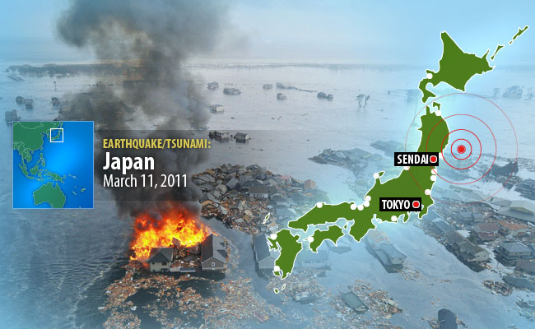
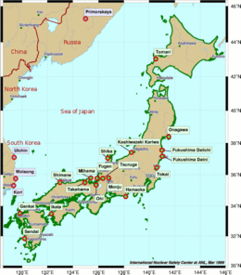
Earthquake/Tsunami, Sendai, Japan. Fukushima Daiichi Nuclear Disaster

Slide 16
Ionizing Radiation
Any Radiation Consisting of Directly or
Indirectly Ionizing Particles or Photons
Alpha
Beta
Gamma
Neutron
1 m Concrete
Notes:
6
Medical personnel have training in radiation, in relation to its use in medical intervention strategies and diagnosis. Environmental radioactivity is very heterogeneous, including alpha radioactivity, which is high energy, but low penetration radiation such as that by plutonium. If I had a solid piece of plutonium on my sleeve, the radioactivity would not be able to even penetrate my coat, or even a sheet of paper. However, if plutonium is inhaled or ingested into the lung or intestinal system, then the high energy radiation can be extremely hazardous. Beta radiation, such as that produced by radioactive iodine, is medium penetration radioactivity that can result in significant health effects, such as the thousands of thyroid cancers that resulted from the Chernobyl accident. Finally, there are the highly penetrating radiations of gamma radioactivity and high speed neutron particles. These will penetrate solid walls, even many multiple walls. There is a burst of gamma radioactivity at nuclear detonation, and then there is a lot of gamma radiation that comes out of the highly dangerous early fallout that falls near ground zero. There has been a lot of speculation about neutron bombs, the devices that would be expected to kill living things, but not significantly affect buildings or inanimate objects. The real concern there, from a medical treatment point of view, would be the effects around the periphery of the fatality area, where patients haven’t received a lethal dose, but enough neutron radiation to create potentially very unpleasant neurological and gastrointestinal effects.

Slide 17
What is a gray (Gy) ?
New international system (SI) unit of radiation dose, expressed as absorbed energy per unit mass of tissue.
1 Gy = 1 Joule/kilogram = 100 rad.
Gy can be used for any type of radiation (e.g., alpha, beta, neutron, gamma).
BUT – It does not describe the biological effects of the different radiations
Biological effects are measured in units of “sievert” or the older designation “rem”.
Sievert is calculated as follows: gray X the”radiation weighting factor” (AKA “quality factor”) associated with a specific type of radiation.

Slide 18
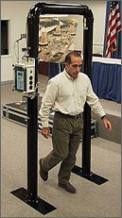
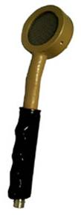
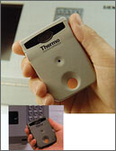
Methods of detection: RADIOLOGICAL
Alpha particles (common) - most harmful if inhaled or ingested. These can be stopped by a sheet of paper
Beta particles - smaller than alpha and stopped by regular PPE
Personal Pocket Dosimeter
Detects Beta and
X-ray Radiation
Ludlum detects Alpha, Beta and Gamma radiation
STRAC.ORG
Notes:
You’ve also been provided several devices to check for radiological exposure. Portals can identify radiation on an individual or an 18-wheeler. Pocket dosimeters detect beta and x-ray with a pager-like device. The Ludlum detects alpha, bet and gamma. If any of these devices register radiation, always ask if the person has had a nuclear medication study and verify that information. If no study has been done, have the person remove their clothing and use the Ludlum to determine if the clothes or the patient is radioactive. Notify security and your RSO.

Slide 19
Need to know your back-ground level. We don’t start from ZERO

Slide 20
Portal Alarm Flowchart for FPCONs
Threat Level
Low or Alpha
Threat Level
Guarded/Bravo/Explosion, Elevated/Charlie, High/Delta, Severe
Alarm
Activated ?
Alarm
Activated ?
YES
NO
YES
NO
Notify RSO
Above 250,000 CPM
Continue PT Care
Contacts:
RSO pgr #
Radiation Safety Officer (RSO):
Radiation Safety Element Chief:
Dosimetry Manager:
Radiation Safety Technician:
Radiological Contamination Control (RCC)
STRAC.ORG
YES
NO
Notify RSO
Continue PT Care

Slide 21
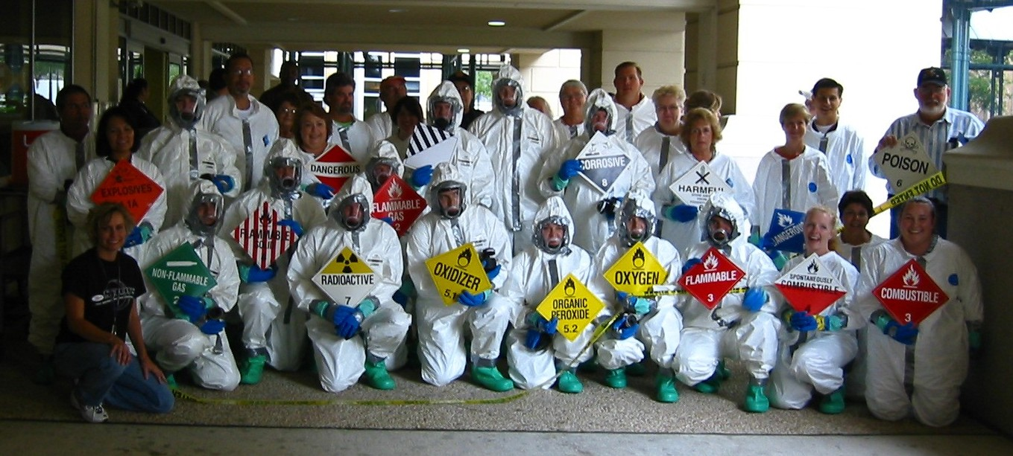
Hospital Decontamination Response Annual Review
STRAC.ORG
Notes:
Welcome to the Regional Decontamination Response Team Course sponsored by the EMS-Hospital Disaster Group or EHDG. This curriculum was developed by the health care providers within Trauma Service Area-P as a way to provide specific training on healthcare facility decontamination response. This training course is based on the HazMat for Healthcare curriculum and was developed on a regional level to ensure a consistent and coordinated response to any incident that results in contaminated patients, as well as, to reduce facility-training costs.

Slide 22
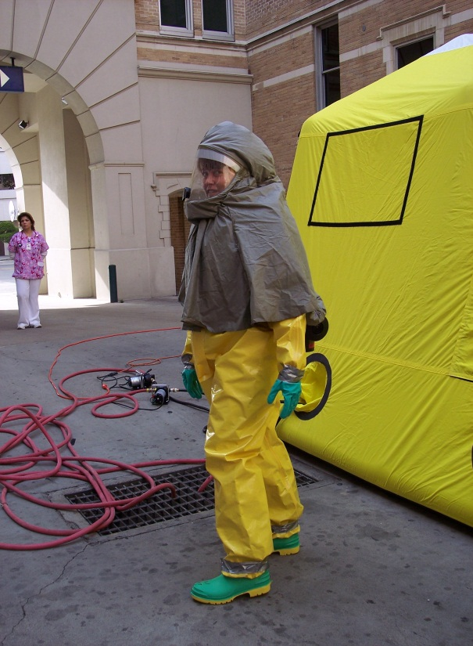
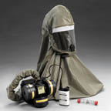
Level C PPE
Provides a lower level of skin and respiratory protection:
Liquid splash protection suit with or without a hood (chemical resistant)
Air-Purifying Respirator (filters vary)
Chemical resistant gloves and boots
Weakness: bulky, heavy, increased potential for heat stress and slip, trip or fall injuries and may not reduce exposure to all agents
STRAC.ORG
Notes:
Level C PPE provides for liquid splash protection and a lower level of respiratory protection through the use of air-purifying respirators.

Slide 23
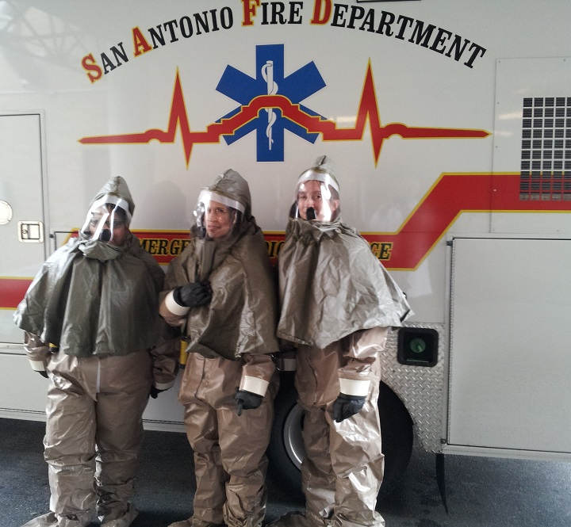

Slide 24
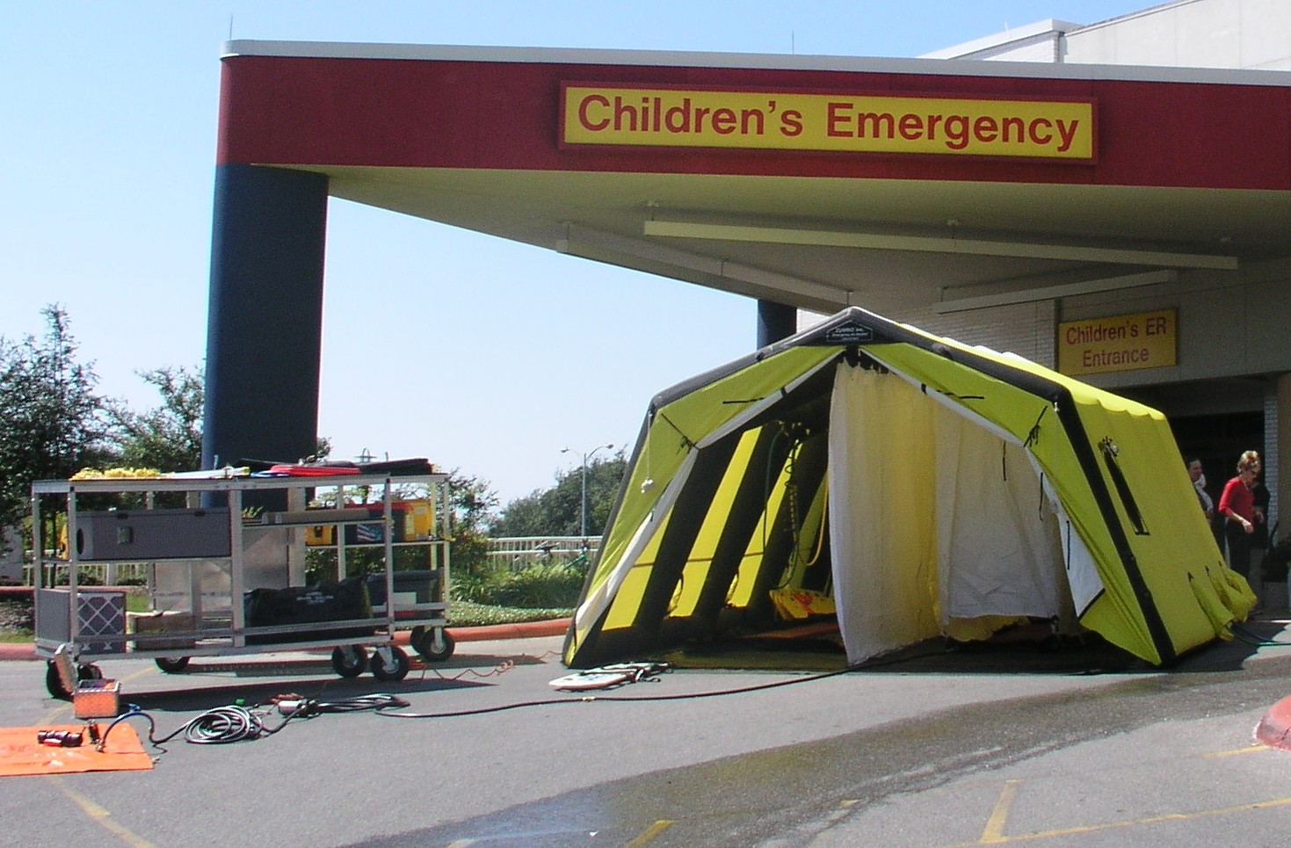
Hospital Decontamination Zone
STRAC.ORG
Notes:
Blank

Slide 25
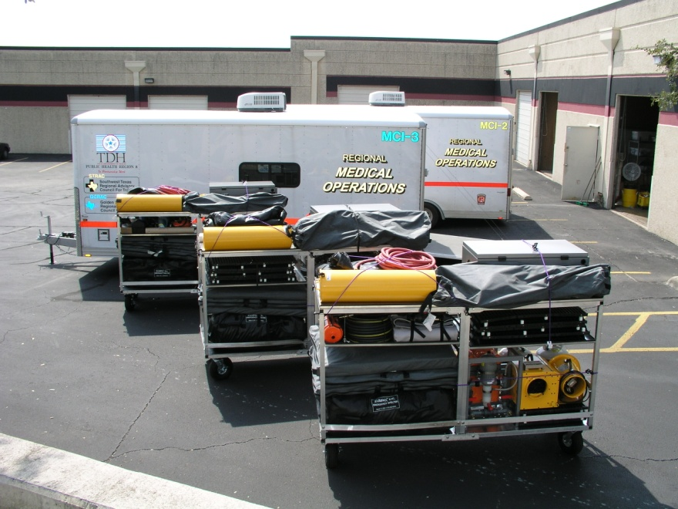
Regional Mass Casualty/Decon Trailers
STRAC.ORG

Slide 26
Ionizing Radiation
Any Radiation Consisting of Directly or
Indirectly Ionizing Particles or Photons
Alpha
Beta
Gamma
Neutron
1 m Concrete
Notes:
6
Medical personnel have training in radiation, in relation to its use in medical intervention strategies and diagnosis. Environmental radioactivity is very heterogeneous, including alpha radioactivity, which is high energy, but low penetration radiation such as that by plutonium. If I had a solid piece of plutonium on my sleeve, the radioactivity would not be able to even penetrate my coat, or even a sheet of paper. However, if plutonium is inhaled or ingested into the lung or intestinal system, then the high energy radiation can be extremely hazardous. Beta radiation, such as that produced by radioactive iodine, is medium penetration radioactivity that can result in significant health effects, such as the thousands of thyroid cancers that resulted from the Chernobyl accident. Finally, there are the highly penetrating radiations of gamma radioactivity and high speed neutron particles. These will penetrate solid walls, even many multiple walls. There is a burst of gamma radioactivity at nuclear detonation, and then there is a lot of gamma radiation that comes out of the highly dangerous early fallout that falls near ground zero. There has been a lot of speculation about neutron bombs, the devices that would be expected to kill living things, but not significantly affect buildings or inanimate objects. The real concern there, from a medical treatment point of view, would be the effects around the periphery of the fatality area, where patients haven’t received a lethal dose, but enough neutron radiation to create potentially very unpleasant neurological and gastrointestinal effects.

Slide 27
What is a gray (Gy) ?
New international system (SI) unit of radiation dose,
expressed as absorbed energy per unit mass of tissue.
1 Gy = 1 Joule/kilogram = 100 rad.
Gy can be used for any type of radiation (e.g., alpha, beta, neutron, gamma).
BUT – It does not describe the biological effects of the different radiations
Biological effects are measured in units of “sievert” or the older designation “rem”.
Sievert is calculated as follows: gray X the”radiation weighting factor” (AKA “quality factor”) associated with a specific type of radiation.

Slide 28
Triage in Acute Radiation Syndrome (ARS)
Time, Distance, Shielding affect signs and symptoms of ARS
Increased mortality with combined injuries
Don’t delay life-saving care by decon
Do Surgery early (within first 48-72 hours) or after 6 weeks
Radiation effects G-I and Hematopoietic system
Berger ME, Leonard RB, Ricks RC, Wiley AL, Lowry PC, Flynn DF (See Ref. List)

Slide 29
Priorities in Combined-Injury Triage- Radiation Doses
Conventional Triage Changes in Expected Triage
(No Radiation Exists) Following Radiation Exposure
<1.5Gy 1.5 – 4.5Gy >4.5Gy
>3 hr 1 – 3 hr < 1 hr
onset onset onset
Immediate Immediate Immediate Expectant
Delayed Delayed Expectant Expectant
Minimal Minimal Expectant Expectant
Expectant Expectant Expectant Expectant
Modified from Medical Consequences of Nuclear Warfare, 1989, p. 39
Notes:
The triage priorities, then, for radiation induced combined injuries would be as follows: when the dose is known, less than 1.5 Grays, or 150 Rads, would result in a full range of triage responses – immediate, delayed, minimal, and expectant. Higher doses than 1.5 Grays would mean there would be primarily expectant patients, with only immediate patients otherwise. Greater than 4.5 Grays of radiation would result in patients only in the expectant category. It is quite likely that many of you will be conducting triage without dose estimations or even blood workups, and you will then be relying on this data set from the Chernobyl experience. One simple question by a pre-hospital provider could be used to commit patients to a triage category, if you are placed in this extreme circumstance: How much time elapsed from the time of radiation exposure until the appearance of nausea, vomiting, and/or other prodromal symptoms? If the time elapsed between exposure and prodromal symptoms was less than half an hour, these individuals did not survive following the Chernobyl exposures. From that data experience, which is the most complete data set we have, we are led to assume that a less than 30 minute latent period will put these patients in the expectant category. Likewise, a one to three hour latent period would mean that most of the patients would be expectant, with some of them in the immediate group. A latent period of more than 4.5 hours would result in a full range of triage responses.

Slide 30
G-I Tract, ARS Vomiting
Less than 10% vomit if 1 Gray or less radiation dose
Most will vomit with more than 2 Gray
Time of onset indicates degree of radiation dose
< 10 minutes > 8 Gy
10-30 minutes 6-8 Gy
Less than one hour 4-6 Gy
1-2 hours 2-4 GY
More than 2 hours < than 2 Gy
Berger ME, Et Al (See Ref. List)

Slide 31
ARS, Diarrhea
Early onset is associated with radiation doses > 9 Gy.
May have significant fluid loss with vomiting and diarrhea.
Not all vomiting is due to radiation, think psychological, but rule out ARS.
Berger ME, Et AL, (See ref. List)

Slide 32
ARS, Hematopoietic
Obtain Baseline CBC with differential and absolute lymphocyte count (total white count x % lymphocytes on the differential) -repeat at 6, 12, and 24 hours
Initial lymphocyte count <1000 consider significant radiation exposure
Affects Bone Marrow
Neutrophiles may initially go up
Andrew’s Nomogram for severity estimates
Berger ME, Et Al (See Ref. List)

Slide 33
Andrew’s Lymphocyte Nomogram
Absolute Lymphocyte Count over 48 hours
Confirms significant radiation exposure
Andrews GA, Et Al (See Ref. List)

Slide 34
Hemogram (300 cGy TBI Exposure)

Slide 35
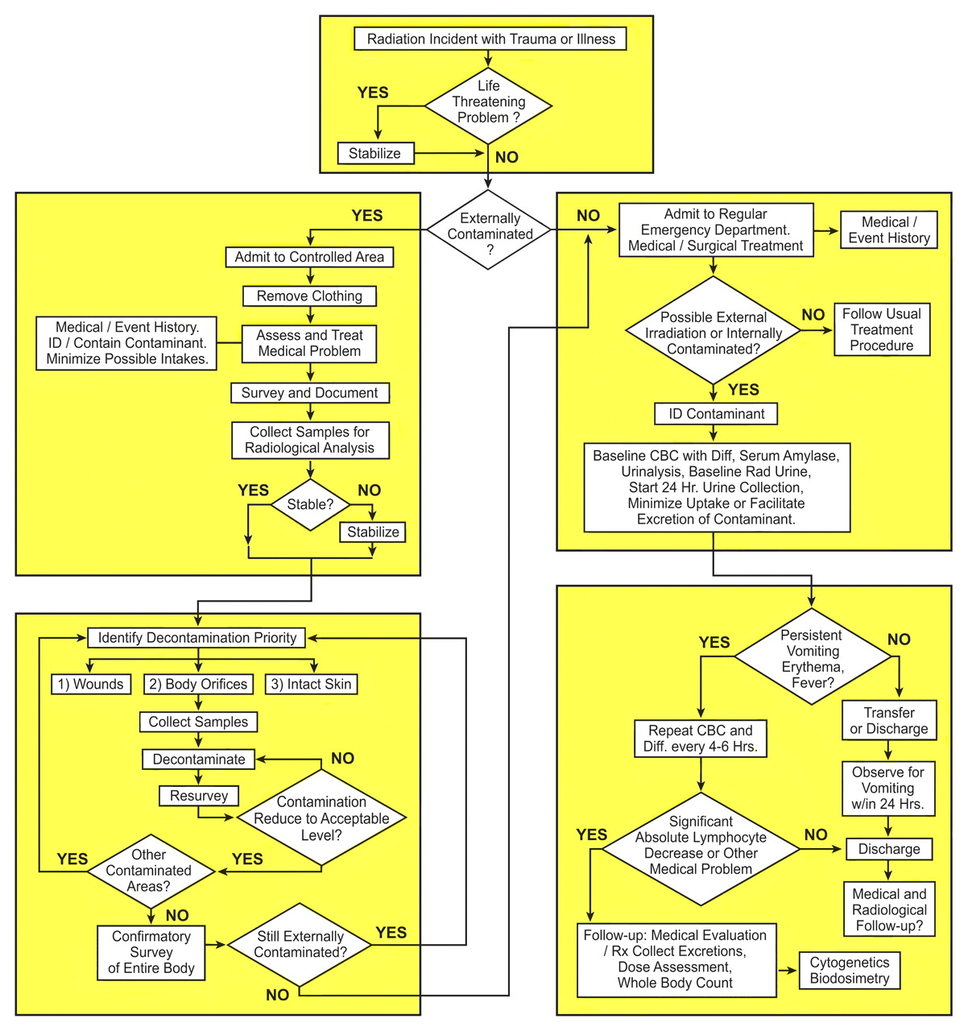
Medical treatment prioritization fl ow diagram for those exposed to ionizing radiation and/or contaminatedM withradioactivity.
Wolbarst A B et al. Radiology 2010;254:660-677
©2010 by Radiological Society of North America
Notes:
Medical treatment prioritization fl ow diagram for those exposed to ionizing radiation and/or contaminated withradioactivity. (Diagram courtesy of REAC/TS, Oak Ridge, Tenn.).

Slide 36
Surgical Procedures
Do Not Delay Surgical Care due to Contamination
Time, Distance, Shielding
Complete within 48-72 post injury or wait > 6 weeks
Remove Foreign Bodies, Radio-active material

Slide 37
Inverse Square Rule for Decreasing Radiation with Increasing Distance
DRB = DRA (A/B)2
Dose Rate 5 mR/hr at A
A – Initial Distance B – New Distance
2” 6”
DRB = 5 mR/hr X (2/6)2
DRB = 5 X (1/3)2 = 5/9 = 0.5556 mR/hr at 6”
Double the distance, Decrease by 4
Four times distance, Decrease times 16

Slide 38
Therapeutic Interventions
Plutonium / Transuranics - DTPA
Cesium - Insoluble Prussian Blue
Uranium - Alkalinization of Urine
Radioiodine - Radiostable Iodine
Tritium - Radiostable Water
Notes:
For plutonium and the transuranics, the major components of nuclear weapons, DTPA has been proven effective. For Cesium, insoluble Prussian Blue has recently been approved by the FDA. Alkalinizing the urine has been shown to be useful in the elimination of uranium from the body. We will talk in some detail in a moment about the high degree of utility, and also lack of success, with the use of iodine tablets in the prevention of radiation-induced thyroid cancer. The rather simple expedient of increasing fluid intake is used to encourage increased tritium clearance.

Slide 39
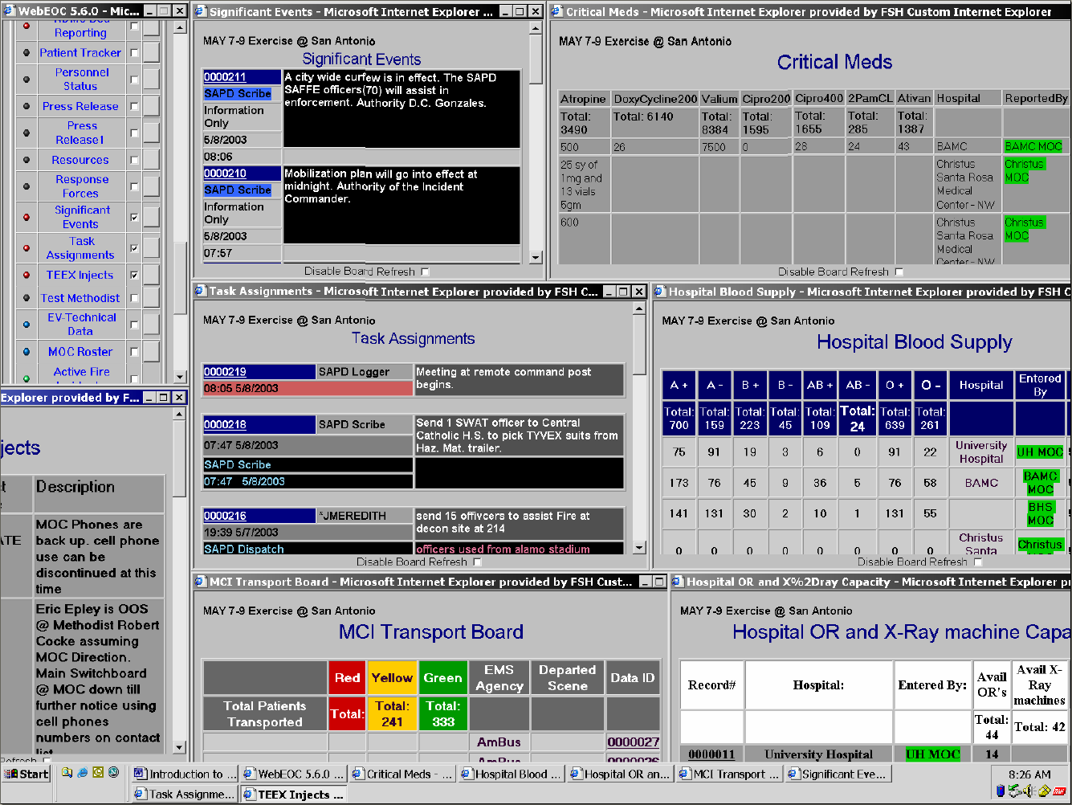
RMOC Display (WebEOC)

Slide 40
Laboratory Response
Routine base-line
Hemograms
Amylase
If Feasible
Blood FLT-3 ligand levels
Blood Citrulline levels
Interlikin-6
Quantitative G-CSF
C-Reactive Protien
Metrohealth
State lab
REAC/TS – Cytogenetic Biodosimetry (Nuclear DNA Damage - Dicentrics)

Slide 41
Peripheral Blood Lymphocytes as a Biodosimeter
Isolated lymphocytes stimulated by phytohaemagglutin (PHA) into mitosis
Arrest of metaphase mitotics using colchicine
Scoring of dicentric chromosome aberrations in metaphase spreads
Notes:
In an ideal world, we would use peripheral blood dosimetry on our exposed patients, where the actual radiation dose record could be accurately reconstructed. Unfortunately, it is highly unlikely that any of you will see this kind of data or have access to it.

Slide 42
Training
Lectures for Physicians and residents – Civilian, Military
Nuclear Medicine/Radiology, Emergency Medicine, Surgery
National Disaster Life Support Courses
Decontamination “train the trainer” courses
In-facility Decontamination training
REAC/TS courses
National Courses
Armed Forces Radiobiology Research Institute
Medical Effects of Ionizing Radiation (MEIR) – Feb 2011, Ft Sam Houston

Slide 43
Radiological Event Preparedness Registry, (REPR) Health Physics Society, South Texas Chapter, Radiation Safety Specialists
The Billet, Dec 22, 2005
Martin L. Meltz, PhD, UTHSCSA
J. Stanley Bravenec III, MS, CHMM, VA Medical Center, Houston, Texas
Web Site Down, Will be Re-established

Slide 44
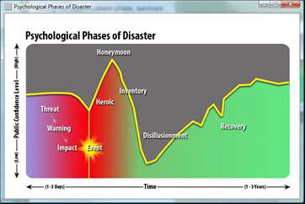

Slide 45
Psychological Phases of Disaster
Threat – Time before impact, includes potential hazards
Warning – Receive notice of a disaster
If short or no warning survivors feel more vulnerable and fearful of the future
Impact – The greater the scope of community losses, the greater the psychological effects on affected people
Heroic – Altruism prominent in survivors and responders
Rescue others, provide safety frequently with disregard for self safety.
NEED to monitor Safety

Slide 46
Psychological Phases of Disaster (Cont.)
Honeymoon – Help arrives – governmental, volunteers
Survivors experience short-lived optimism
Inventory – Survivors recognize that disaster resources are limited.
Multiple stressors cause physical and emotional exhaustion
Gives way to discouragement and fatigue
Disillusionment – Survivors feel abandoned, resentful of disaster assistance and volunteer groups as they leave
Many gate-keeping regulations and red-tape
Recovery (Reconstruction) – Physical, emotional, property
May take years

Slide 47
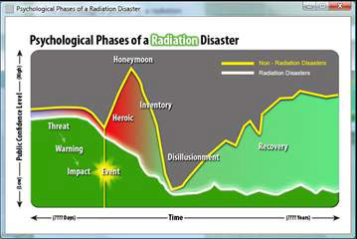
Psychological First Aid in Radiation Disasters

Slide 48
Psychological Phases of Radiation Disaster
Low public awareness of radiation threats
Warning - may be sudden or prolonged and difficult to detect
Heroic and Honeymoon – May have extreme fear and lack of familiarity about protection from radiation – includes medical and responders
Inventory, Disillusionment, and Reconstruction – May be long term contamination leading to permanent dislocation.
Stigma attached to contaminated survivors leads to isolation and prolongs recovery
Worry about delayed, long term effects

Slide 49
At Risk Groups
Children
Pregnant Women
Mothers with young children
Emergency Workers
First responders
Clean up crews
Mortuary teams handling contaminate remains
Evacuees
Displaced, elderly, those with mental illnesses

Slide 50
Principles of Psychological First Aid - Promote
Safety
Calm
Connectedness
Self-efficacy
Help

Slide 51
What can you do to Help?
Be a good listener – Don’ t make people tell their story
Have patience
Present a caring attitude
Demonstrate trustworthiness
Be approachable
Open hands (no crossed arms or legs), lean forward
Have cultural sensitivity

Slide 52
Summary
All Hazards Assessment
Organized preparedness and response plans
RSO Leadership
Centralized, cost effective purchase of equipment for detection, personal protection, and decontamination
Recurrent Training
Exercises
Detection
Decontamination
Triage
Treatment

Slide 53
Questions? Thank You!
Charles R. Bauer, MD, CPE
crbauermd@prodigy.net,
bauerc@uthscsa.edu.
(210) 859 4568

