Slide 1
Emergency Preparedness and Response: Yesterday, Today, and Tomorrow
13th Annual Rio Grande Trauma Conference and Pediatric Update
December 7, 2012, 12:30 PM
El Paso, Texas
Charles R. Bauer, MD, CPE, FACS, FACEP
Adjunct Professor, UTHSCSA,
Surgery & Emergency Medicine

Slide 2
History and Disaster Preparedness
Wikipedia
Contributed by Pete Farmer, RN, EMT
Degrees in Research Biology and History
October 24, 2010

Slide 3
What can History Teach us about Being Prepared for Natural or Man-Made Disasters?
Human History has been one of hardship and privation
A Struggle against other Humans, competing for resources and against nature
Life was rather Darwinian
Before the 19th Century – large families, diseases, famine (Irish Potato Famine), Weather,
Earthquakes

Slide 4
Lesson One
The Prosperity Which We Enjoy Today is an Anomaly, Not the Norm
Modern Societies are the 1st to defeat scarcity on a wide-spread, sustained basis
The poorest among us enjoy conveniences/comforts unimaginable to the wealthy aristocracy of the 18th, 19th centuries
Implications, Fortunate to live now
  Be Grateful – Won the Historical Lottery
  Since never had real hard-ship, can’t imagine the “Great Depression” or the “Dust Bowl”
Psychologists – “Change Blindness” – gradual change
The Black Swan, by Nassim Taleb – Unforeseen event that which profoundly alters our reality. Good, Bad – Computer, Internet, WWI, 1918 flu, 9-11
Often misunderstood, leading to wrong lessons from them.

Slide 5
Lesson Two
No Matter how Hard or Thoroughly One Prepares for the Future, Reality Probably Isn’t Going to Unfold in the Way One Planned
Expect the Unexpected, Probably Will Happen
See Reality as it is, Not as You Wish it to be
Stay Flexible and Adaptive
Work Hard, BUT can Cross your Fingers for Luck
Temper “Can-Do” Attitude with a bit of Realism
Nobody gets to Cheat Death Forever – Carried Out – “Feet 1st”
Fear of the Unknown is often Worse than what Finally Happens

Slide 6
Lesson Three
Sometimes the Worst-Case Scenario is Accurate; Black Swans can be every bit as bad as our Nightmares
Flip-side of Lesson Two, Important for Planners
Motivation to Prepare for the Crises-Yet-to-Occur
1880-1910 – Modern Medicine developed – Flexner, Welch, Oswald, John-Hopkins
Helped with WW I, Flu Epidemic, etc
Bad, but would have been worse
“1918 Flu, Most Deadly Plague in History, could have brought down Western Civilization
More recent closest parallel HIV/AIDS in modern Africa

Slide 7

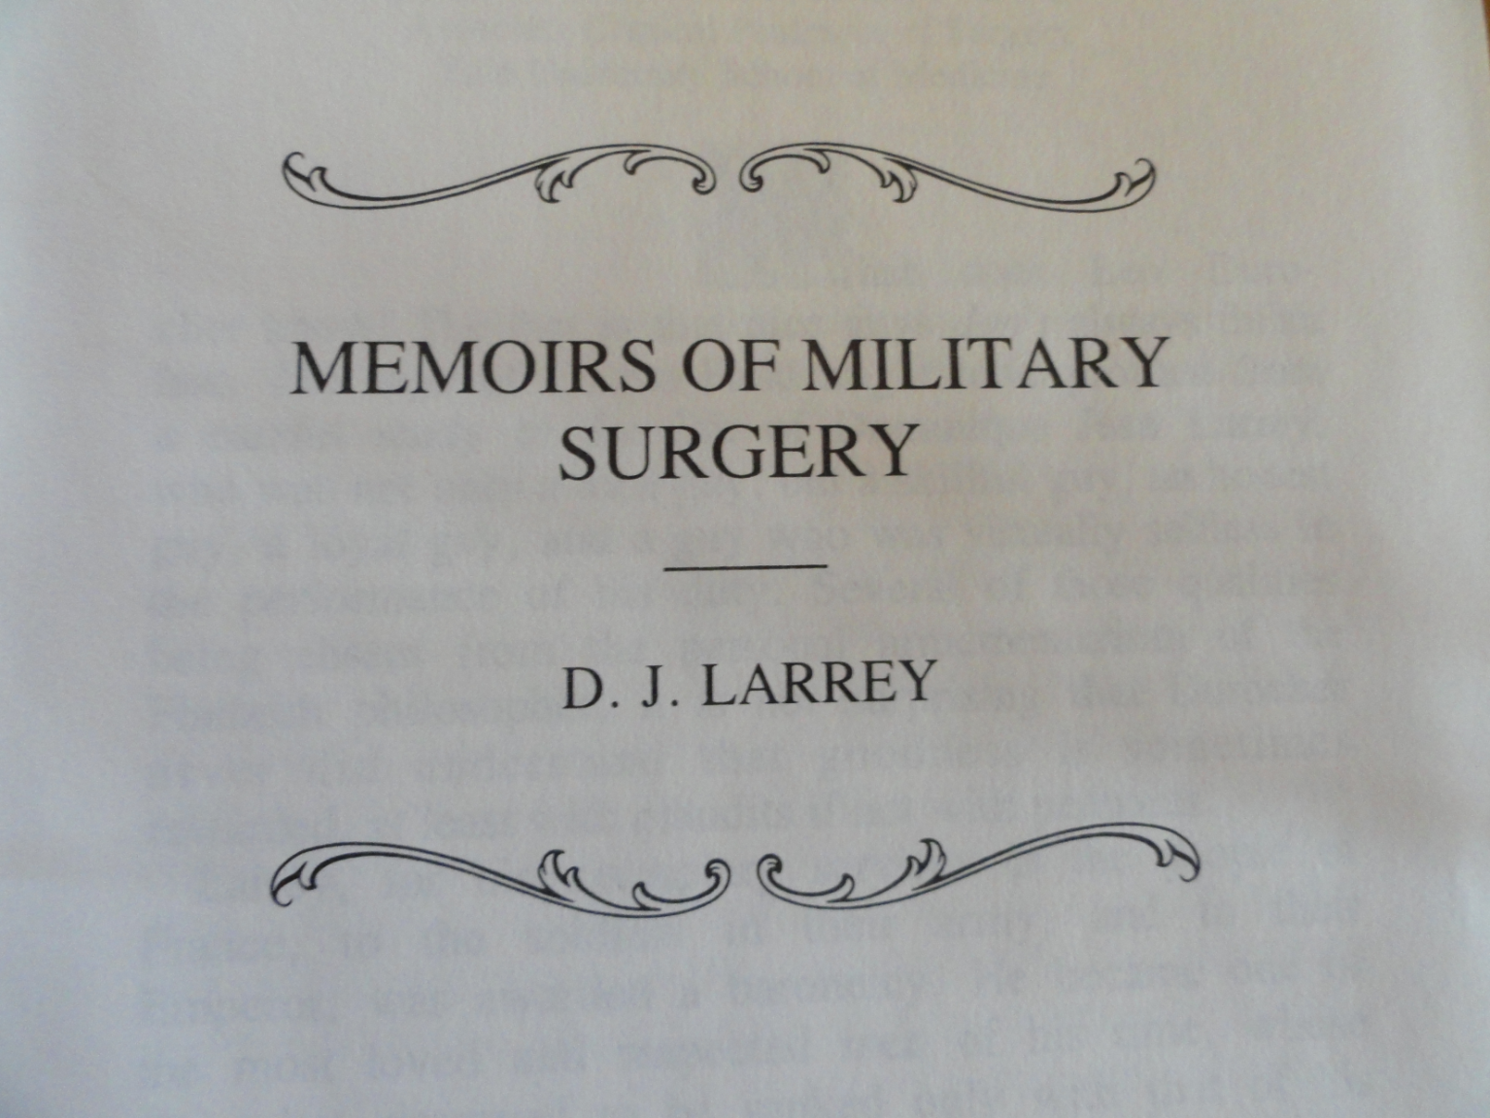

War Surgery

Slide 8
Dominique Jean Larrey
Surgeon-in-Chief, Napoleonic Armies from Italy, 1797 to Waterloo, 1815
Developed
  “Flying Ambulances”
  Triage system caring for the most seriously injured first, regardless of rank
Organized Field Hospitals

Slide 9

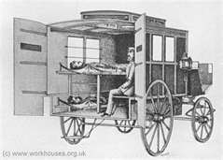
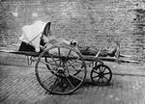
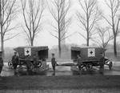

From The Civil War to WW I

Slide 10
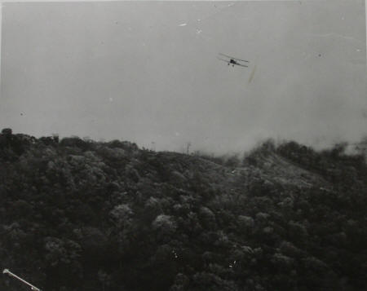
Nicaragua, 1927-28
US Marines used Aircraft to evacuate injured
Photo Marine Corps Biplane over El Chipote, early January, 1928.
From US National
Archives

Slide 11
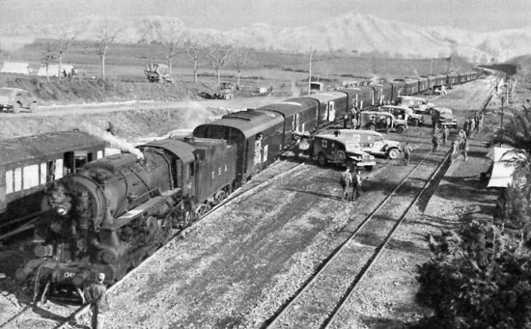
WW II Hospital Train
Loading patients near Riardo for run to Naples, Italy, Feb, 1944
No cars in
1939 to
320 cars by
End of War
32 berths
3 tiers high

Slide 12
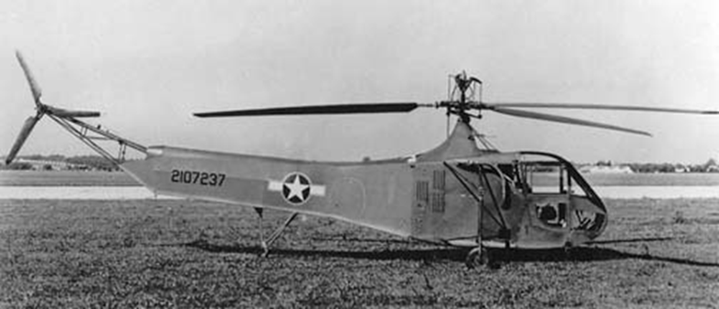
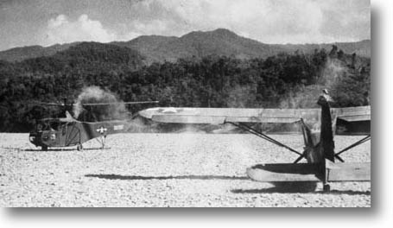
MedEvac – WW II – Burma
Chindwin River
CAPT Peterson,
flying the YR-4
Sikorsky with
escorting L-5 Bird Dog. 1/26/1945
Refueling en-route to
mountain-top weather
station rescue, 250’
strip for the L-5.
GSW of Hand. National Air and Space Museum Archives

Slide 13
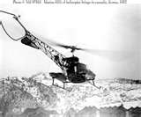
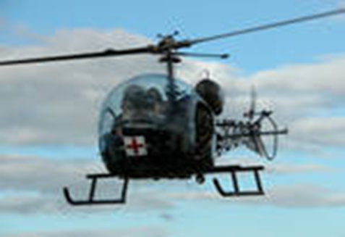



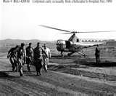
MedEvac - Korea
Concept developed
in Korea
Accepted by the
Office of the Surgeon General
53rd Med Detachment activated
at Brooke Army Med Center,
Ft. Sam Houston, Texas, Oct 15, 1952
    www.truthhunter.info/military
Notes:
H-13, Souix,

Slide 14
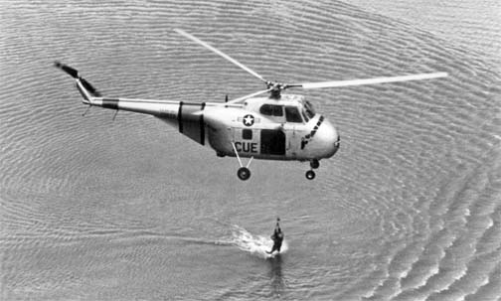
Korea
3rd Air Rescue USAF
USAF H-19 Chickasaw, 1953 rescue in Far East Waters
  Could carry one
medic and 6 litter
patients
– first time internal
patient transport.

Slide 15
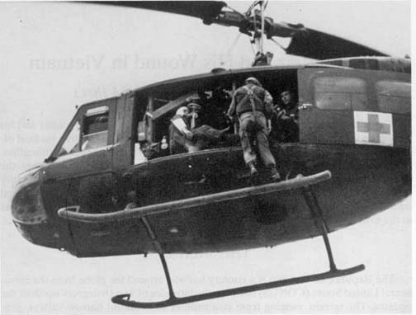
RVN
UH-1 “Huey” - Iroquois
“Dustoff” – Call sign 57th Med Detachment
15% of RVN patients
treated in med facilities
were WIA,
  30-35% med evaced,
  (120,000) WIA adm,
  (90% med evac)
  1/3 of the 390,000 pts air evac to med facilities for treatment. Olive-Drab

Slide 16
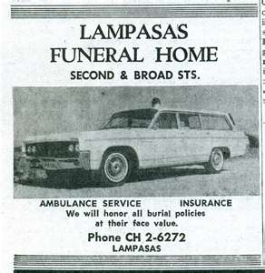
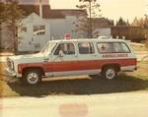
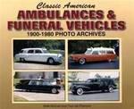
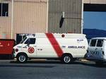
Hearse to Mobile ICU
San Antonio – 1960s, hearses
still used as ambulances

Slide 17
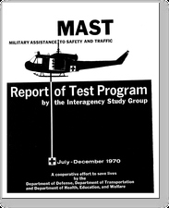
Military Assistance to Safety and Traffic
MAST
Established 1970
EMS, MAST Task Force,
AACOG, 1982
Church Bus Rescue, July 17,
1987, on Guadalupe River
near Comfort, Texas
Rescue 911,
  1st “pilot” episode

Slide 18
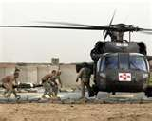
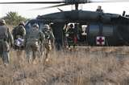
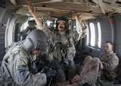
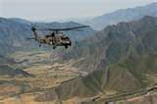
Iraq & Afghanistan
UH-60 Blackhawk www.strategypage.
        www.flyambu.com www.flickr.com

Slide 19
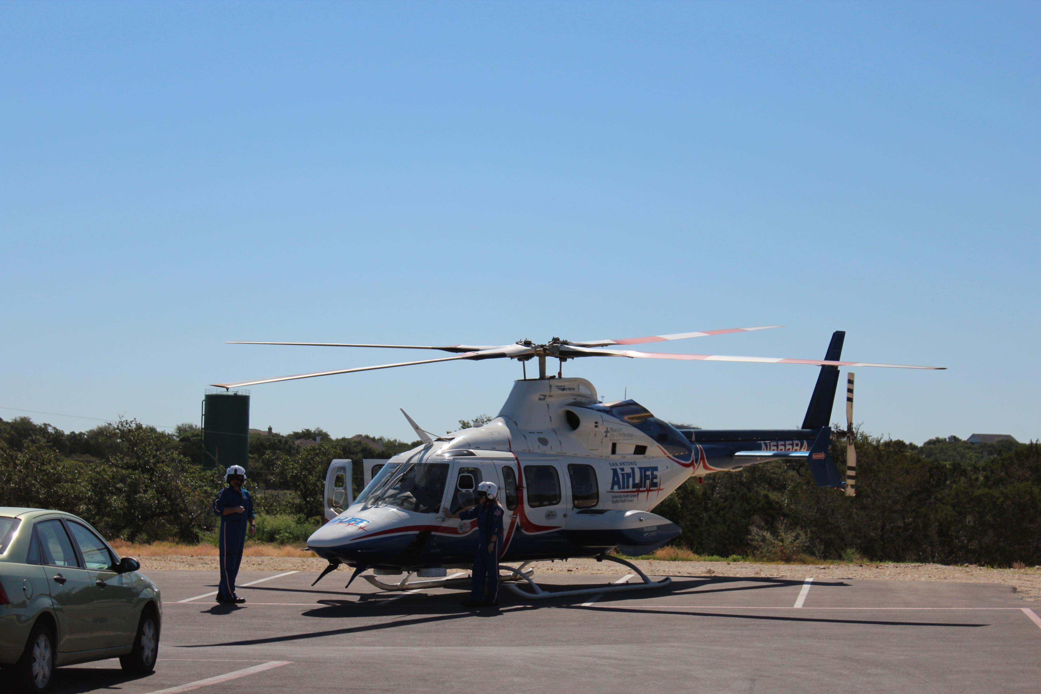
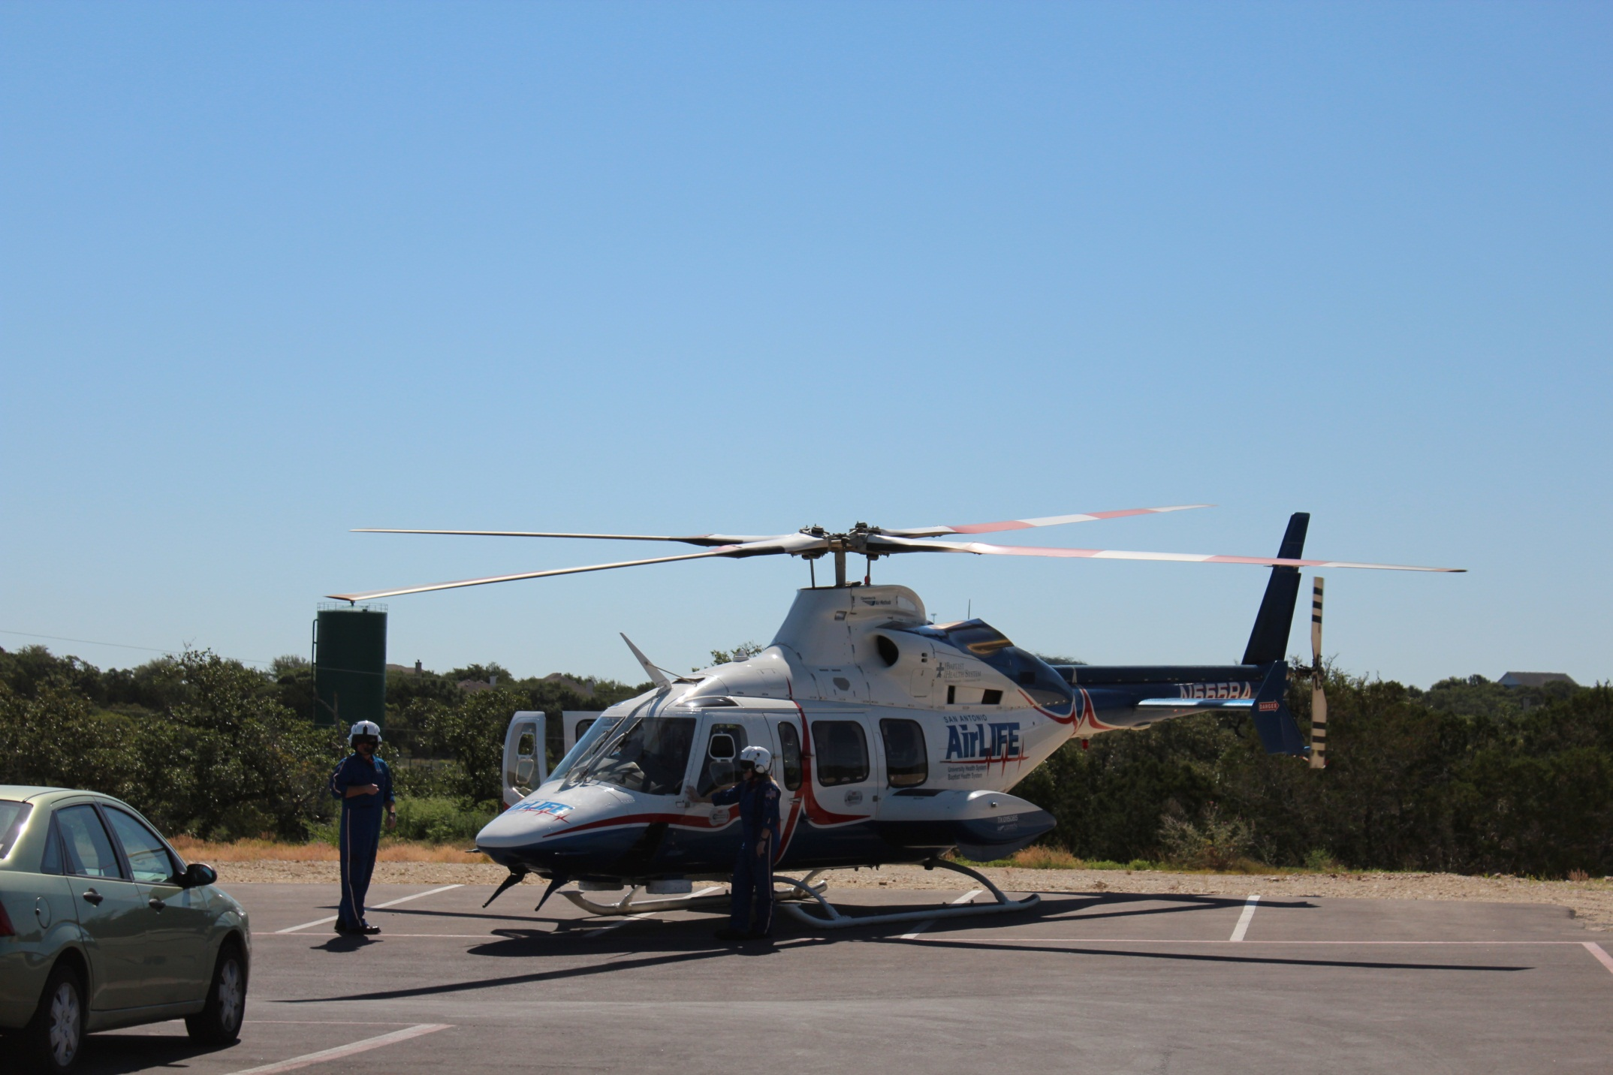


San Antonio AirLife

Slide 20
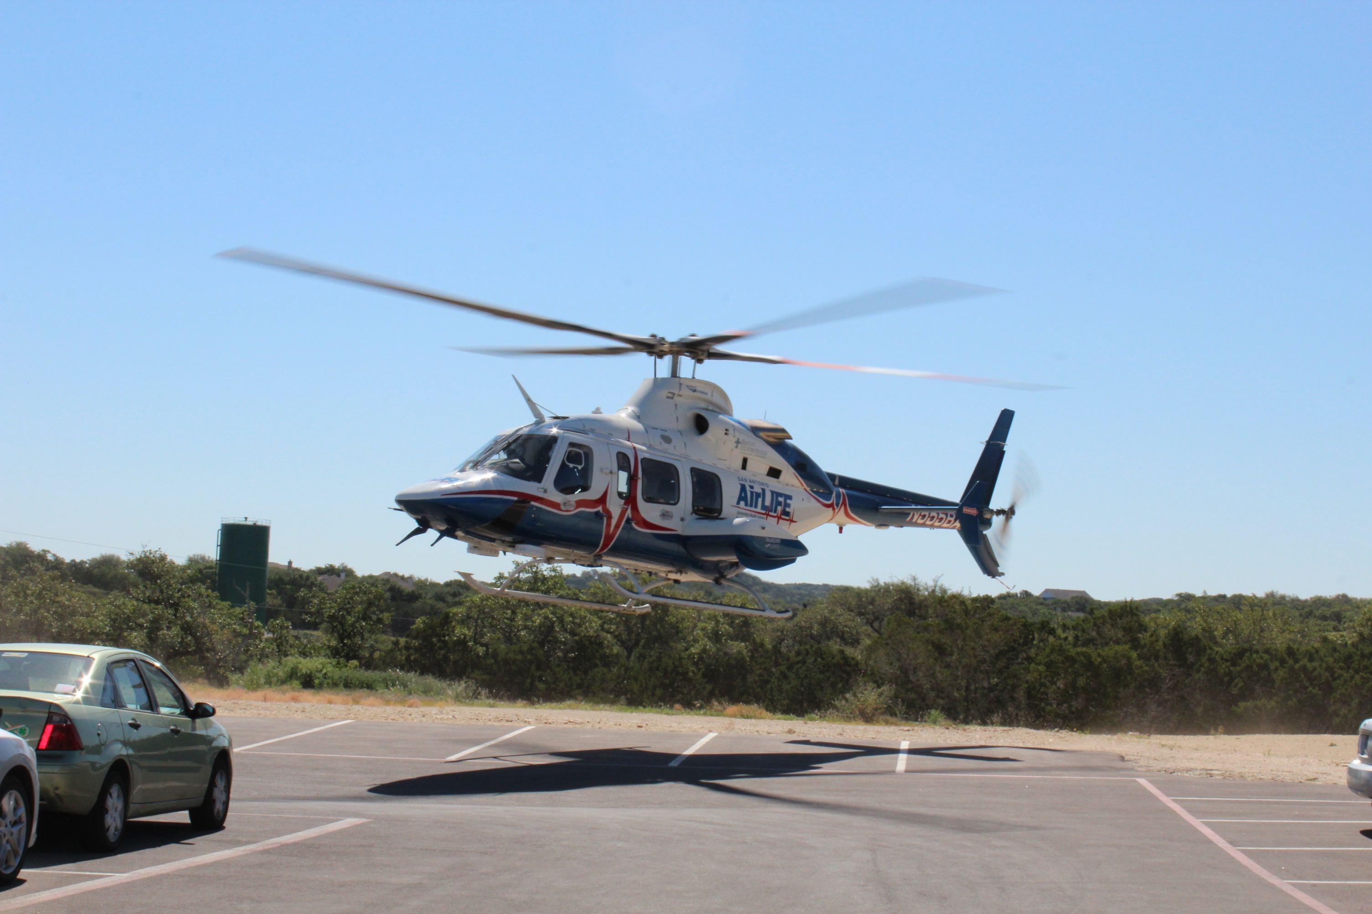

Slide 21
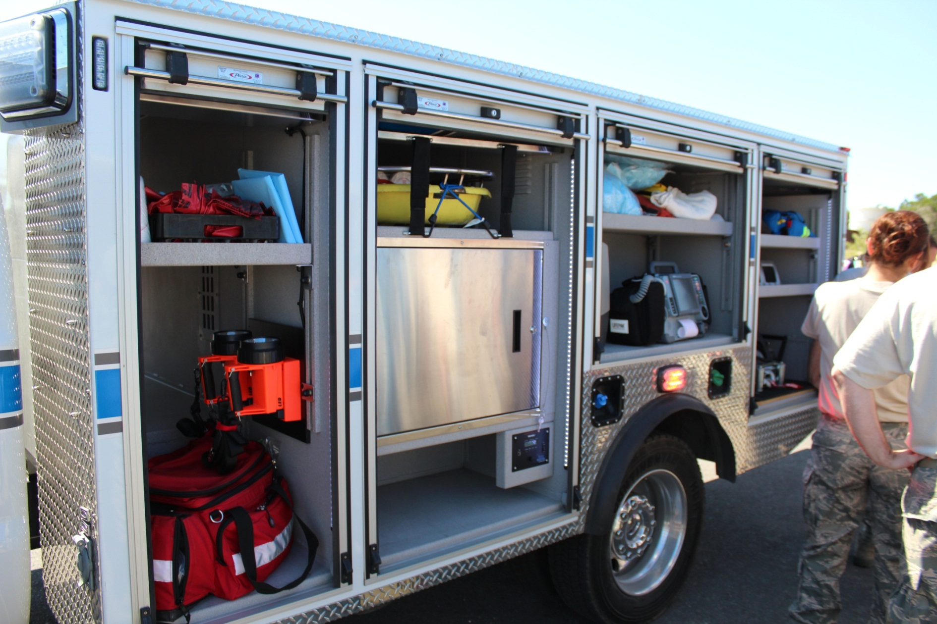
Modern EMS Back-up Trailer
Bulverde Spring Branch EMS

Slide 22

The Civilian Response
The American Red Cross
American Red Cross
  Clara Barton, aids servicemen in
  Civil War, 1861
  Aids in Michigan forest fires, 1881
  30,000 Hurricane victims, South Carolina Sea Islands, 1893
  Johnstown Flood, 1889 kills 2000
  Galveston, Hurricane, Tidal wave 1900 with 8,000 -14,000 deaths

Slide 23

Civil Defense
1692 – Bedford, NY – drummer to sound alarm for Native American attacks
WW I – Great Britain, US – Council of National Defense (CND) August, 1916
WW II – CND re-activated, became
Office of Civilian Defense within
Office of Emergency Planning
– May 20, 1941 – Mayor La Guardia
Cold War – “Duck & Cover”, Evac plans – Portland, Oregon – 19 minutes City Center

Slide 24


Civil Air Patrol
Created days before Pearl Harbor Attack
Commissioned civilian pilots to patrol the
coast & borders, engage in search and rescue missions
Coastal Patrol - Reported 173
U-Boats, Attacked 57, sank 2
Border Patrol
Target Towing
Search and Rescue
Pilot training, Cadet programs

Slide 25
6th WMD Civil Support Team
National Guard, Bergstrom International Air-port, 22 active duty soldiers and airmen,
15 maintain active 24/7 alert posture
Deploys within 4 hours
Assess CBRNE events supporting local incident commanders
Decontamination capabilities
Mobile Analytical Lab System (MALS)

Slide 26

Texas Forestry Service
Lone Star State Incident Management Team (LSSIMT) – Uses All-hazard approach same as for Wildfires.
All Hazard Incident Management Team (AHIMT) – Cooperates with TDEM to support incident management
Texas Intrastate Fire Mutual Aid System (TIFMAS) – 1st used during Hurricane IKE; then Presidio Flooding, N. Texas wildfire (April ‘09), Hurricane Alex

Slide 27
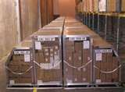
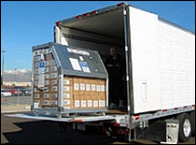
Strategic National Stockpile
Pharmaceutical Supplies
Twelve located around US
Any place in 12 hours
One 747 aircraft or 18-wheelers
Medical equipment and
Medications
When it arrives, handed off
To local DSHS staff for
Distribution – need lots of
Volunteers!! - MRCs

Slide 28
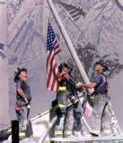

Terrorism
World Trade Center
  Bombing 1993 – included cyanide
  9/11
Anthrax
Tokyo Subway – Sarin Gas

Slide 29
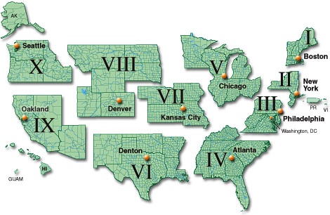
FEMA Regions

Slide 30

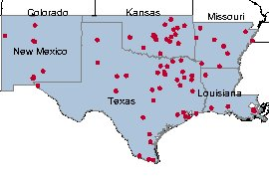
FEMA REGION VI MRCs (TALON)

Slide 31
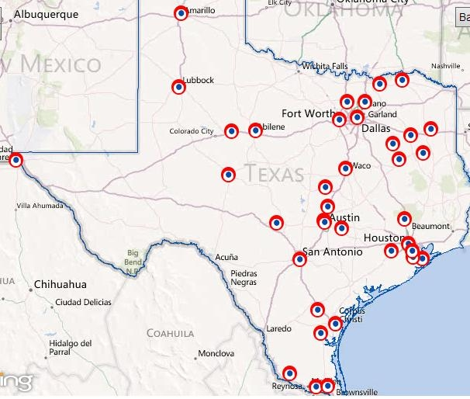
Texas Medical Reserve Corps Units

Slide 32
MEDICAL RESERVE CORPS (MRC)
983 MRC organizations across the US
  Approximately 206,093 members
Texas – 37 MRC organizations
  15,486 members, MD – 1,532, PA – 88, Vet – 31, Pharmacists - 81
  Nurse – 2,106, NP – 135, Mental Health Professional – 339
  EMS – 498, Dentists – 36, Other Med – 1,009,
  Resp. therapist - 57
  Other Public Health, Medical – 1,045
  Non-Public Health, Non Medical – 9,517
TSG MED BDE – 450 active members
  Only uniformed/military affiliated MRC in US.
Notes:
32
32

Slide 33




Texas Military Forces
Texas Army National Guard (TxARNG)
Texas Air National Guard (TxANG)
Texas State Guard (TSG)
  Army
  Air
  Maritime
  Medical
Notes:
33
33

Slide 34
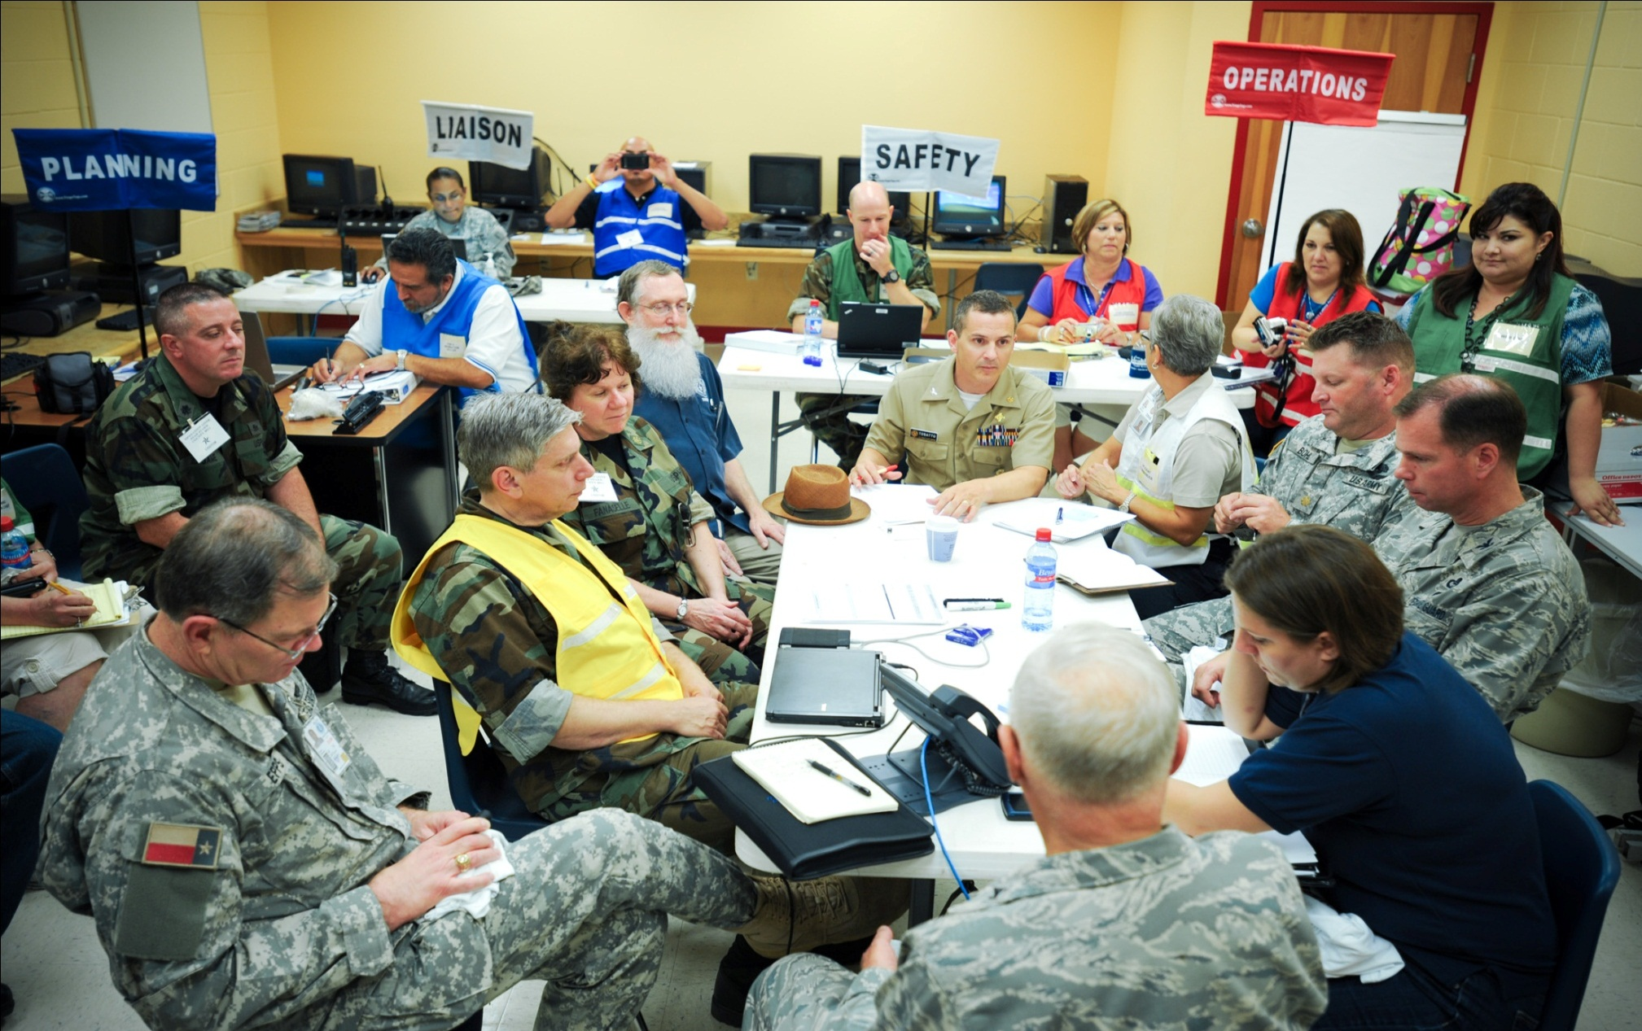
Meeting with CAPT Robert J. Tosatto
Rio Grande City MPOD Operations Center

Slide 35

Epidemics
The American Plague, Yellow Fever,
“The epidemic that shaped our history”
  Memphis, 1878, Crosby, 2006
  Walter Reed research, Havana, Cuba, 1900
The Great Influenza, Barry, 2004
  “Spanish Flu”, Started in 1918,
Haskell County, Kansas (?)
The Coming Plague, Garrett, 1994
  H1N1 – Novel Strain Influenza A, 2009
  SARS – Severe Acute Respiratory Syndrome, 2002

Slide 36

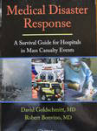
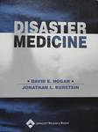
Disaster Response
Ken Alibek, PhD, microbiology and epidemiology; DSc (Physician)
A.K.A., Kanatzhan Alibekov, Colonel,
Soviet Army
Joined Biopreparat, 1975, Soviet Union
First Deputy Chief 1988-1992,
oversaw bio-warfare agents,
defected to US, 1992

Slide 37
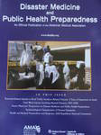

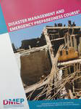
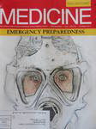
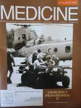
Disaster Response Publications

Slide 38
EMS in Texas
1943 – 48th Legislature, Ambulance permitting legislation. Required attendant to have 8 hours unspecified First Aid Training. Vehicle equipped with a First Aid Kit.
1966 – Division of Disaster Health and Emergency Services established within Texas Health Department.
1970 – Registry of EMS personnel established. Moved from Civil Defense and Traffic Safety to Division of Emergency Medical Services.

Slide 39
1973 – The EMS Act
  - 1st Advisory Council (TEMSAC)
  Coordinated EMS Division to:
    Develop a state plan
    Divide the state into EMS delivery areas and designate at least one hospital in each area a “Trauma Center”.
    ID all public and private agencies that may be utilized for EMS
    Plan for an interagency communications system
    Include use of DPS, National Guard or armed forces helicopters in the state EMS plan (MAST)
    The division to serve as the single state agency to develop plans for federal EMS program participation (grants)

Slide 40
The ‘70s & ‘80s
1975 – The Texas Disaster Act – DSHS assigned primary responsibility for disaster health services to the EMS Division.
  Medical care and treatment
  Disaster health services – primarily preventative aspects of public health in disaster situations
1983 – EMS Act – Requires 2 certified EMS personnel aboard ambulances.
  Regulates personnel and vehicle certification
  Established Bureau of Emergency Management

Slide 41
1989 - HB 18
Under Health and Safety Code established:
  Statewide EMS/Trauma System
  Trauma Technical Advisory Committee (TTAC) with 12 members including hospital, physician specialties, nurses, rural, urban, state trial lawyer association nominee
Bureau of Emergency Management to develop rules for:
  Advanced Life Support, Mobile ICUs, Air Ambulance licensing,
  Certification of instructors, examiners, and course coordinators.

Slide 42
1990 - TTAC
Meets for first time. – January 11, 1990
Charges from Texas Board of Health:
  Develop a trauma registry
  Recommend rules and regs on trauma systems,
  Comment on the operations of hospitals as they function in the trauma system
  Focus on the medical and technical aspects of the system development.

Slide 43
PROGRESS
1991 – EMS/Trauma rules allow access to criminal history, disciplinary actions,
  Defines standard for handling confidential communications
1992 – Tx Dept of Health adopts 1st trauma system rules.
  First 2 Regional Advisory Councils (RACs) recognized by TDH

Slide 44
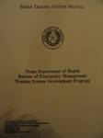
Texas Trauma System Manual
Texas Department of Health,
Bureau of Emergency Management
Trauma System Development Program
Establishing a Regional Advisory
Council (RAC)
Could apply to represent a
Trauma Service Area (TSA)

Slide 45
GETTING THERE
1993 – March, Ms. Kathy Perkins appointed to head Bureau of Emergency Management Trauma Program.
Trauma Registry moves to TDH Epidemiology Division,
11 RACs recognized by TDH
1994 – 4 RACs Recognized by TDH
1995 - Statewide Coverage achieved with 4 RACs recognized by TDH.
DNR incorporated into Health and Safety Code

Slide 46
Southwest Texas Regional Advisory Council (STRAC)
Mission Statement: “To reduce Death/Disability Related To Acute Illness, Injury, and Disaster Through Implementation of Well-Planned and Coordinated Disaster and Emergency Response Systems”
Vision: “We will be the Model Regional Trauma, Disaster and Emergency Healthcare System in the United States that Results in the Lowest Risk-adjusted Mortality for Emergency Healthcare Conditions”
STRAC.ORG

Slide 47
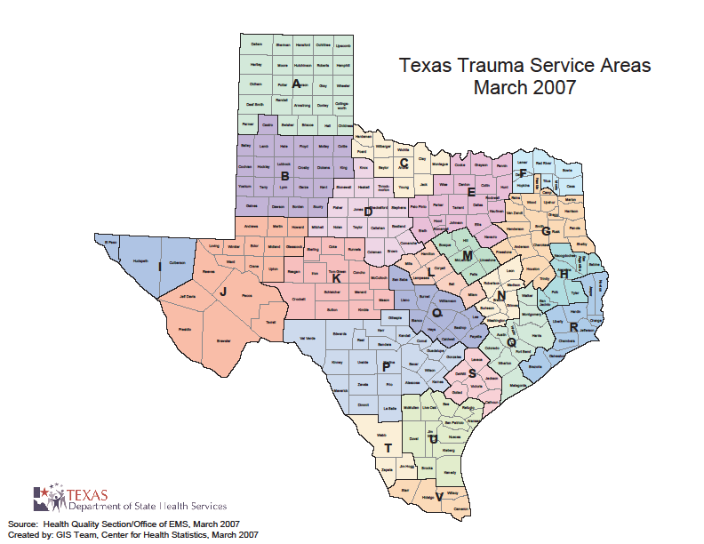

Slide 48
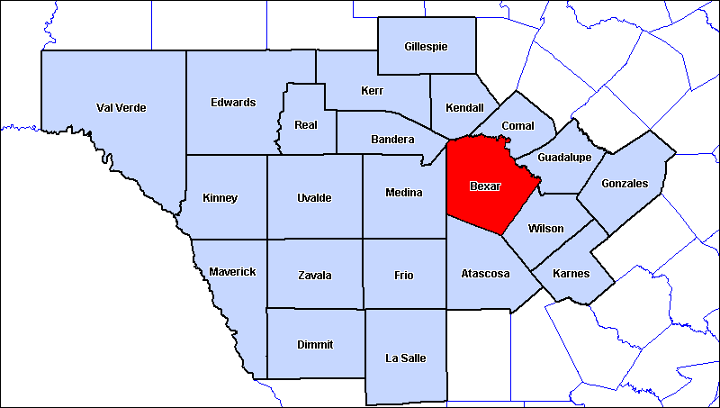
Trauma Service Area P
Trauma Service Area P
Trauma Service Area P
Trauma Service Area P
Trauma Service Area P
Trauma Service Area P
Trauma Service Area P
Trauma Service Area P
Trauma Service Area P
- 26,000 Sq Miles
- 71 EMS Agencies
- 53 hospitals
(35 General, 18 Specialty)
- 3 Level I Trauma Centers
200 miles
Notes:
48

Slide 49
GETAC Arrives
1997 – Licensed Paramedic credential established
1999 – 76th Legislature enacted Health and Safety Code – Chapter 779
  Automated External Defibrillators – rules, purchase, training, notification and use of AEDs by non-professionals
  Chapter 773 – Created governor appointed Governor’s EMS/Trauma Advisory Council (GETAC)

Slide 50



About TWIRP
The State of Texas' Department of State Health Services (DSHS) and the Southwest Texas Regional Advisory Council for Trauma (STRAC, Trauma Service Area P) recognized that WebEOC would be a crucial component to successful management of problems on a regional and state level. To that end they created the Texas WebEOC Interoperability Project (TWIRP) whose task was to ensure that WebEOC was integrated statewide to the fullest extent possible.
Training Videos: Texas ETN Training Videos
Files: STAR Form Pg 1 STAR Form Pg 2 STAR Pocket Guide
2011 TxETN Statewide Tracking
Texas ETN Enrollment Form - English Texas ETN Enrollment Form - Spanish
Links: Training Schedule WebEOC Account Request SOC Clock TDEM Visit us on Twitter support@strac.org phone : 210-233-5888

Slide 51
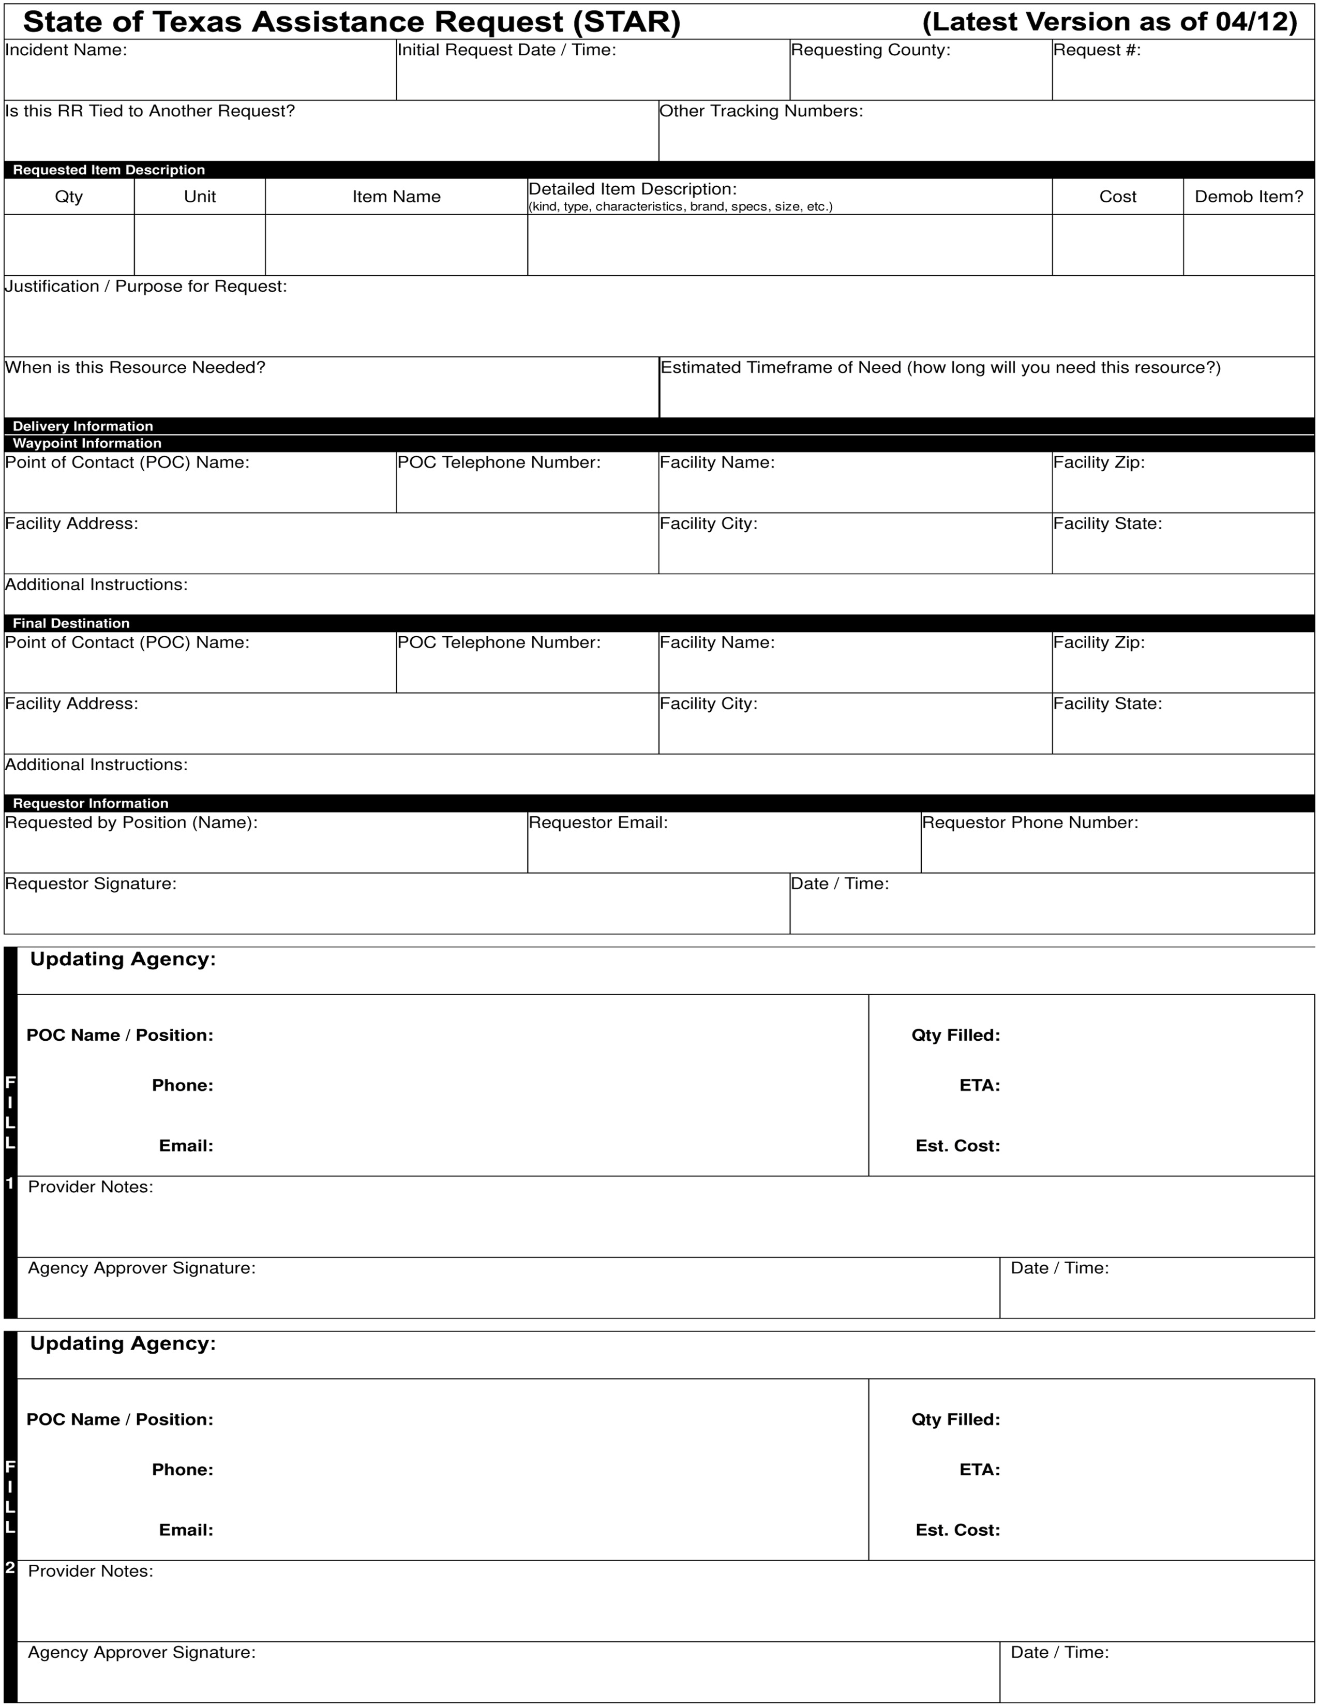

Slide 52
Notes:
52

Slide 53
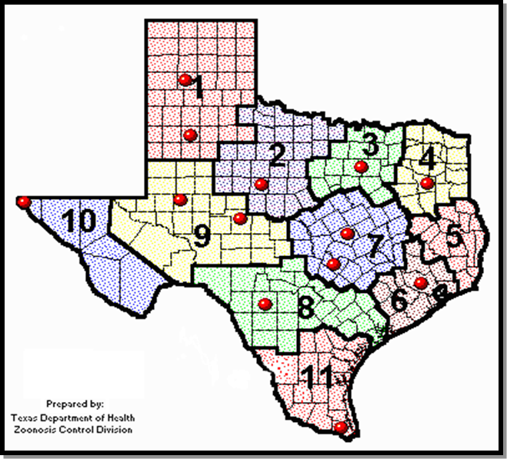
TDHS Regions

Slide 54
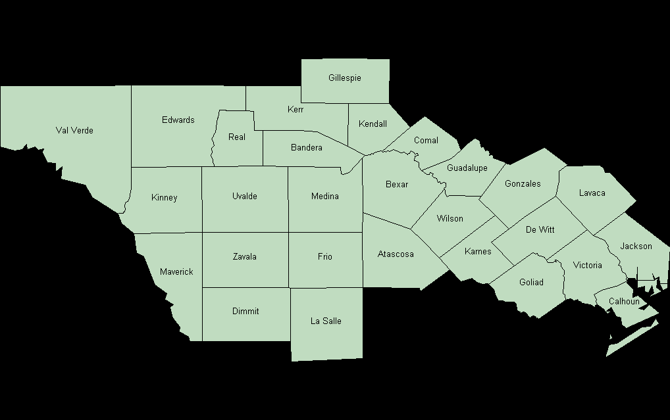
Health Services Region 8
Notes:
54

Slide 55
DSHS Rapid Response Force (RRF)
“All Hazards” Approach
Scalable depending on the situation
  Provide diverse human resources with expertise in various areas to complement local public health departments
Overall Goal – Quickly provide public health resources anywhere in the state
  Uniform, timely Public Health assessment and appropriate response. (RATs, CATs & DOGs)

Slide 56
Rapid Deployment Team
(RAT)
Provides extensive but quick assessment of health and medical capabilities
2-4 people, medical and health backgrounds
Trained to evaluate State’s responsibility of Emergency Support function 8 (ESF-8)
Close coordination with: local emergency officials, local public health, Regional Liaison Officers, and Trauma Regional Advisory Councils to determine needs.

Slide 57
Command Assistance Team
(CAT)
A deployable Incident Management Team
Can respond within 24 hours to assist or supplement regional or local response
Four teams pre-identified with one specialized for austere conditions
18 members per team with various ICS skills

Slide 58
Diversified Occupation Group
(DOG)
A Strike Team based on PH specialty field
  Epidemiologists, nurses, sanitarians, etc
May be organized for a special purpose
  Logistics for field operation support
  Medical strike team,
  Medical special (functional) needs to support shelter operations
Some teams pre-identified – DSHS staff and private contractors, Baptist Child/Family Srvcs.

Slide 59
Today
Advanced Trauma System
MEDCOM for Rapid Patient Acceptance
Air/Land Transport
  Medical Incident Support Teams (MIST)
  Ambulance Staging Manager (ASM)
  Regional Flight Services
Burn Units – US Army Institute of Surgical Research (ISR) located at SAMMC
Damage Control Resuscitation and Surgery

Slide 60
More
Expanded WebEOC
DSHS - RAT, CAT, & DOG teams
Poison Center Network
  National number 1-800-222-1222
Cardiac and Stroke Centers
Strategic National Stockpile
  ChemPack

Slide 61
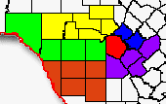

STRAC Ambulance Strike Teams, Dec 06
Gillespie
Edwards
Kerr
Kendall
Val Verde
Real
Bandera
Comal
Guad
Kinney
Uvalde
Bexar
Gonzales
- SAFD-1
Medina
Maverick
Wilson
- STRAC-1
- STRAC-2
Zavala
Frio
Karnes
Atascosa
- STRAC-3
- STRAC-4
Dimmit
LaSalle
- STRAC-5
- STRAC-6
Notes:
61

Slide 62
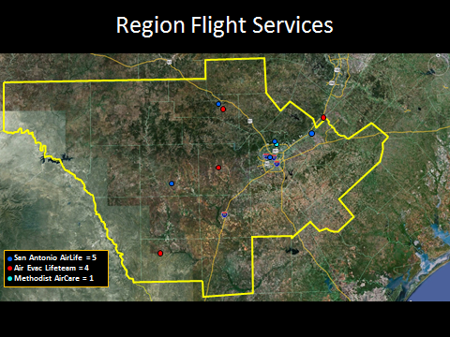
STRAC Flight Services, 2012

Slide 63
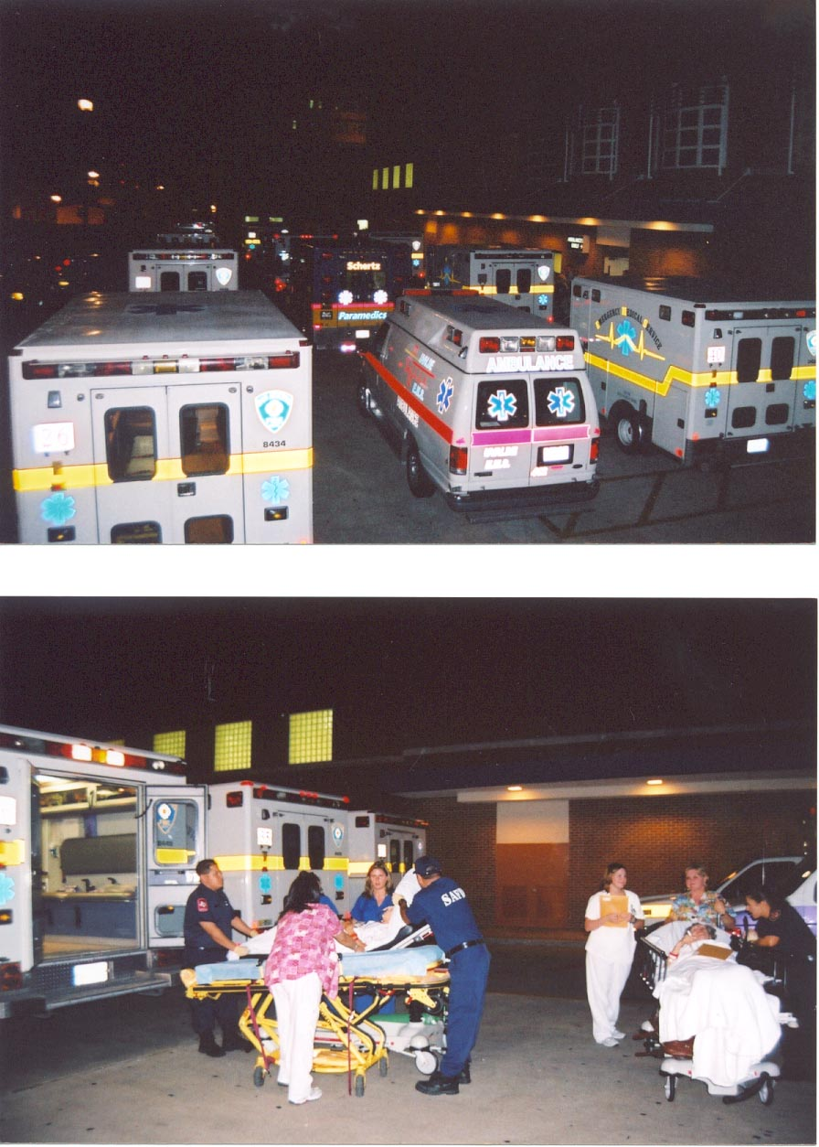
Role of the Evacuating Facility
DUDLEY WAIT - STRAC
Notes:
63

Slide 64
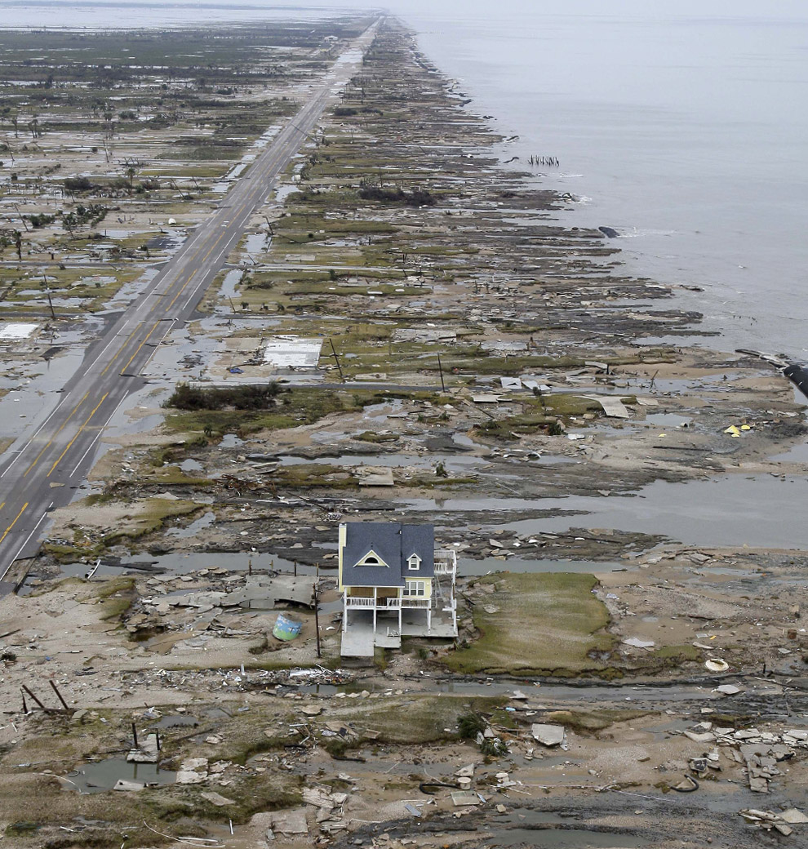
Biggest Lesson Learned
If you want to survive a hurricane you have to PREPARE the RIGHT way!!!

Slide 65
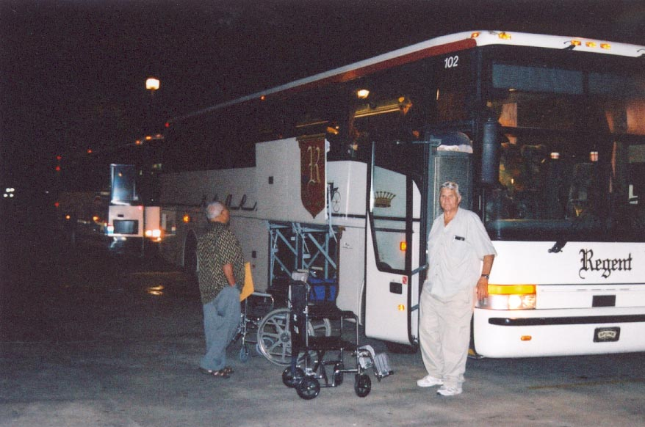

Role of the Evacuating Facility
DUDLEY WAIT - STRAC
Notes:
65

Slide 66

Role of EMS
If no one else is present, Ambulance Strike Team Leader takes command
  Utilizes State criteria
  Works with Staff to solve problems
  Makes decisions to get people moved as safely and efficiently as possible
  DUDLEY WAIT -STRAC
Notes:
66

Slide 67

We have patients to move
DUDLEY WAIT - STRAC
Notes:
67

Slide 68

We have patients to move
DUDLEY WAIT - STRAC
Notes:
68

Slide 69
Texas Regional EMS/Medical Task Force
EMS/Medical Incident Management Team (Type III IMT)
Command/General Staff (from EMS agencies/Hospitals in local jurisdictions)
ICS 100, 200, 300, 400 and AHIMT certs, with position-specific certs as well
Must have EMS/ER/IMT management experience
Full Comms package to communicate with all Groups and Local EOC/DDC/MACC/DSHS/GDEM-SOC
Logistics package to support all Groups
5 Ambulance Strike Teams
5 Ambulances in each Strike Team (25 total ambulances)
5 RN Strike Teams
5 RN’s in each Strike Team (25 total RN’s)
6 hour launch time for minimum of 72 hr deployment
2 Ambuses
Ambuses are capable of transporting up to 24 litter patients at one time.
10 min launch time for 12 hour deployment
Teams are Pre-rostered
10 min launch time for <12 hr deployment
1 ICU Strike Team
Each Strike Team has pre-assigned Strike Team Leader
Each Team has pre-assigned Strike Team Leader
3 ER Strike Teams
1 Specialty area (Burn, OB, Pedi, NICU, etc)
Pre-plumbed for O2, Suction, medical gases, etc
Assigned to EMS agencies that will deploy 5-6 paramedics
4 hour launch time for minimum for 72 hr deployment with additional gear as needed.
4 hour launch time for 72 hour deployment
Field Deployable Medical Station
25-40 bed capacity
Limited treatment, but able to provide stablizing care
Fully staffed with EM physicians, ER nurses, techs, pharmacy, logistics, clerical and other support
6 hour launch time for 72 hr deployment
Notes:
69

Slide 70

EMSystem
Notes:
70

Slide 71
Tomorrow
Hurricanes
Tornadoes
Floods
Terrorism – Domestic and International
  Agro-terrorism, Bioterrorism, Chemical, Radiological/Nuclear, Explosion (CBRNE)
  Cyber-terrorism
  Seaports vulnerable – Houston, Galveston, Corpus Christi
Mexican Drug Cartel activity
Earthquakes – New Madrid Fault
Wild Fires
Droughts

Slide 72

Problems
Funds for training and equipment renovation
Communications – Always a problem
Complacency
Failure to exercise realistically
  People, Supplies, Equipment
  Hospital evacuation
Fatigue, Behavioral Health
Mass Fatality Management. Hauling Bodies to Barges for Burial at Sea, Galveston, 1900

Slide 73
What Can We (You) Do??
Prepare Self and Family; Office and Practice
Stay healthy and physically fit
Meet your neighbors – Who might need help?
Get a weather radio; Consider Ham radio training
Join an MRC/CERT
Take ICS 100, 200, 700, 300; maybe 800, 400
REAC/TS courses in Oak Ridge, TN

Slide 74
AND
Know your Disaster Response Plans
  Review, exercise realistically, re-write based on ARR from exercises and actual events
  Review Hazard Assessment and Analysis
Learn about “Social Media” and how it can be used during disasters to assist with communications
“Train the way you fight” – Typically not done in Civilian training/exercises.
  Think TRIAGE, “Decon”

Slide 75

ICS 300
The “Planning P”
1) Initial Response
2) Set Incident Objectives
3) Tactics Meeting
4) Preparing for the Planning Mtg
5) Planning Meeting
6) Initial Action Plan (IAP) Preparation
and Approval
7) Operational Period Briefing
8) Execute Plan and Assess Programs

Slide 76
THE END
Questions??
Thank You!
        crbauermd@prodigy.net
        210 859 4568

