Slide 1
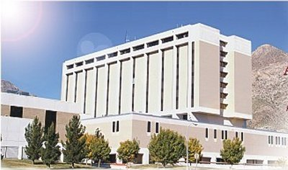
Use of indocyanine green fluorescent dye video angiography in orthopaedic lower extremity trauma: a pilot study
CPT Andrew Cleveland, MD*
Amr Abdelgawad, MD #
Jonathan Cook, MD #
Miguel Pirela-Cruz, MD #
*William Beaumont Army Medical Center, El Paso, TX
♯Texas Tech University Health Sciences Center, El Paso, TX

Slide 2
Methods
Retrospective observational case series
4 patient series of level 1 trauma patients brought to facility for primary evaluation and treatment
Inclusion criteria:
Adult
lower extremity orthopaedic trauma requiring surgery
evaluated intraoperatively with laser-assisted indocyanine green angiography (LA-ICGA)
Administration of 2.5mg/mL ICG-aqueous solvent mixture
Retrospective review of patient outcomes after surgery had taken place

Slide 3
Background
Indocyanine green (ICG)
dye that binds to plasma proteins in the vascular system
half life ~ 180 seconds
removed by liver, excreted harmlessly in bile
Fluorescence at 800nm viewed by laser camera shows signal indicating perfusion
Safety in human use is well established: contraindicated for iodine allergy

Slide 4
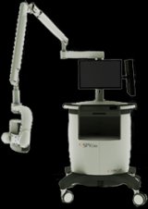
Background
laser-assisted ICG dye angiography (LA-ICGA)
LifeCell SPY Elite camera

Slide 5
background
FDA approved in 2005: intraoperative assessment of coronary vasculature in CABG
Desai et al. J Am Coll Cardiol. 2005: detects additional 4.2% of coronary graft revisions that would have gone unrecognized
FDA approved in 2007: for plastic, micro-, and reconstructive surgery
Rapid expansion of literature for ICG use in plastic surgery
Breast reconstruction: Newman & Samson. J Reconstr Microsurg. 2009
Free tissue transfer: Pestana et al. Plast Reconstr Surg. 2009
TRAM flap evaluation: Newman et al. Can J Plast Surg. 2011
Lit review, ultimately improves outcomes: Liu et al. J Reconstr Microsurg. 2011

Slide 6
background
Minimal literature for use of ICG angiography in the trauma setting
NO literature for use of ICG angiography in orthopaedics
Hypothesis: Real-time perfusion evaluation provided by ICG angiography is predictive for tissue prognosis which can aid surgical decision making.

Slide 7
Case 1
32 year old male
Impact from ruptured fire extinguisher
Open ankle fracture-dislocation
Treatment
I&D
ORIF of medial malleolus
Repair of gastrocnemius fascia
Wound left open
Wound vac placed

Slide 8
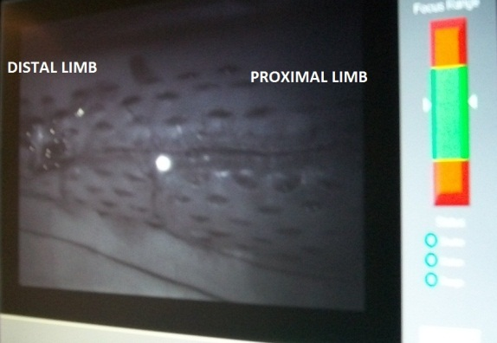
CASE 1
Lateral malleolus ORIF and delayed wound closure performed 5 days later
Wound fenestrated to relieve tension
SPY machine used to evaluate after closure
Demonstrated perfusion
Went on to heal without wound necrosis or infection

Slide 9
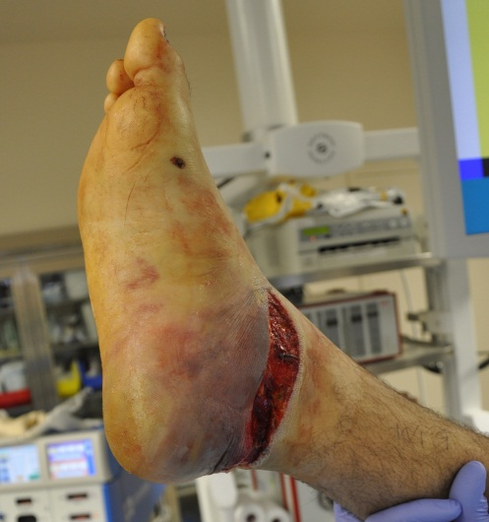
Case 2
15 year old male
MVC
Circumferential open wound to posterior heel with exposed Achilles tendon and calcaneus
Treatment
I&D
wound vac
IV abx

Slide 10
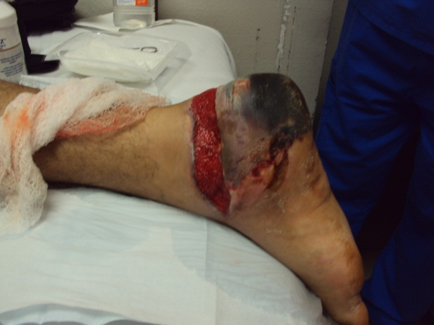
Case 2
SPY showed minimal perfusion of heel
Discharged home with wound vac
Necrotic heel at 1 week
Required heel pad excision and chronic wound vac therapy
Eventual skin grafting

Slide 11
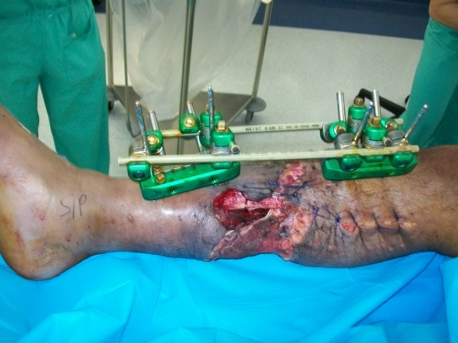
Case 3
35 year old male
Motorcycle crash
Open tibia & fibula fx, vascular injury
Treatment
Ex-fix
Primary vascular repair

Slide 12
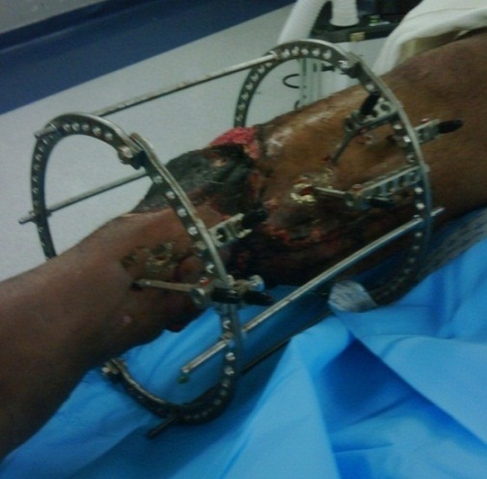
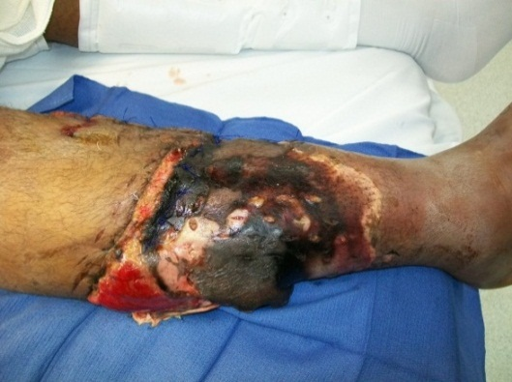
CASE 3
SPY scan showed lack of perfusion in zone of injury
Most of the compartments were necrotic and excised
Placed in ring fixator
Went on to BKA at outside facility

Slide 13
CASE 4
20 year old male
Self-inflicted gunshot
Open tibia & fibula fx, loss of pulses
Treatment
Fasciotomy
Vascular repair
Spanning ex-fix

Slide 14
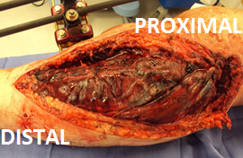
CASE 4
SPY showed no perfusion distal to proximal tibia
Muscle was necrotic throughout zone of injury
Underwent AKA

Slide 15
DISCUSSION
Decreased intraoperative perfusion was associated with worse overall tissue outcomes (i.e. necrosis, progression to amputation)
Could ICG angiography be used to better define the threshold between reconstructive salvage vs. amputation?

Slide 16
DISCUSSION
When to amputate?
Soft tissue traditionally evaluated by macroscopic appearance¹ and 4 C’s
Color, consistency, contractility, capacity to bleed
Development of clinical scoring systems attempted to determine when to amputate
Mangled Extremity Severity Score² – most commonly used
Predictive Salvage Index
Limb Salvage Index
NISSSA score (modification of MESS)³
Hannover Fracture Scale - 97
Scully et al. AMA Arch Surg 1956.
Johansen et al. J Trauma 1990.
McNamara et al. J Orthop Trauma 1994.

Slide 17
DISCUSSION
Recent evidence has shown scoring systems not that effective or predictive
Bosse et al. JBJS 2001
Poor sensitivity for predicting amputation
Found high specificity but not predictive for successful salvage
Ly et al. LEAP study group. JBJS 2008
No scoring system correlated with functional outcome
Definitive criteria remain controversial…
MacKenzie et al. LEAP study group. J Trauma 2002: found soft tissue injury (1st) , plantar sensation (2nd) most significant factors for amputation
Bosse et al. LEAP study group. JBJS 2005: refuted plantar sensation as an indication for amputation

Slide 18
DISCUSSION
Salvage vs. amputation functional long term outcomes are similar^{1,2}
Differences in short term dependent on complications of prolonged reconstruction
Wound infection, nonunion, osteomyelitis, rehospitalization³
1. Bosse MJ et al. N Engl J Med 2002
2. Busse JW et al. J Orthop Trauma 2007
3. Harris et al. LEAP study group. J Orthop Trauma 2009

Slide 19
discussion
ICG angiography holds promise as an additional clinical variable that can be used to avoid the pitfalls of prolonged reconstruction that ultimately go on to amputation.
Limitations
Sample size
Retrospective
No evidence for adverse effects in children
Future considerations
Larger sample sizes
Prospective studies vs. controls
Correlate with clinical outcomes
SPY-Q technology computer-determined gradient of perfusion
Is there a threshold at which point tissue necrosis is inevitable?

