Slide 1
New Cash Receipts Training
Starting September 1, 2015 you will use the new cash receipting system for deposits in the new fiscal year.

Slide 2
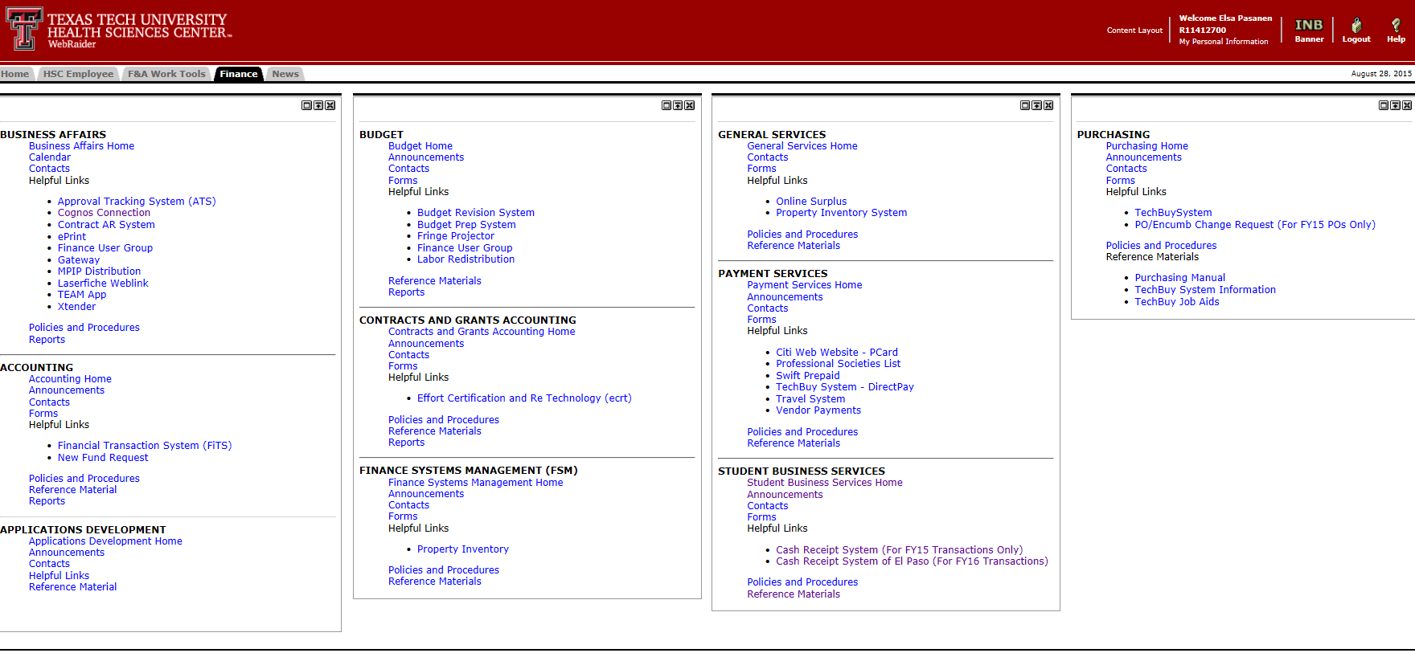
The New Portal
FY16
Access Cash Receipts under Student Business Services.

Slide 3
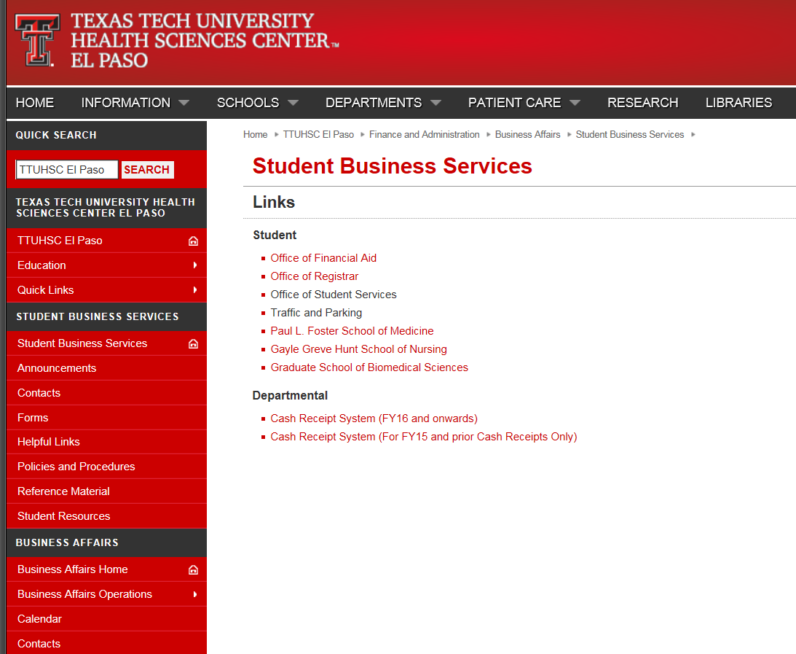
New system link
Or access the Cash Receipt System FY16 link through the Business Affairs>Student Business Services webpage.

Slide 4
Both cash receipts systems are very similar, but there are several differences.
1. The sign-on screen looks a little different.
2. The menu on the left has a couple new items.
3. When entering $ amounts, do not use commas.
4. Message “DEPOSIT AMOUNT DOES NOT EQUAL LINE AMOUNTS” appears as soon as you enter a deposit amount and will remain until added lines total the deposit amount.
5. Merchant IDs can be chosen by clicking.
6. When documents are to be added, use the Firefox browser. Documents will not scan/upload on IE.
7. There is no $ total below the line amounts. (The feature might be added at a later date.)
8. SBS El Paso performs all final approvals. Lubbock no longer will be involved in approvals.
9. Only MPIP Cash Receipts have an Intermediate Approver.

Slide 5
You will enter all required fields – same as the old system. However, there are several differences you will see on the new system.
Here are examples of differences….

Slide 6
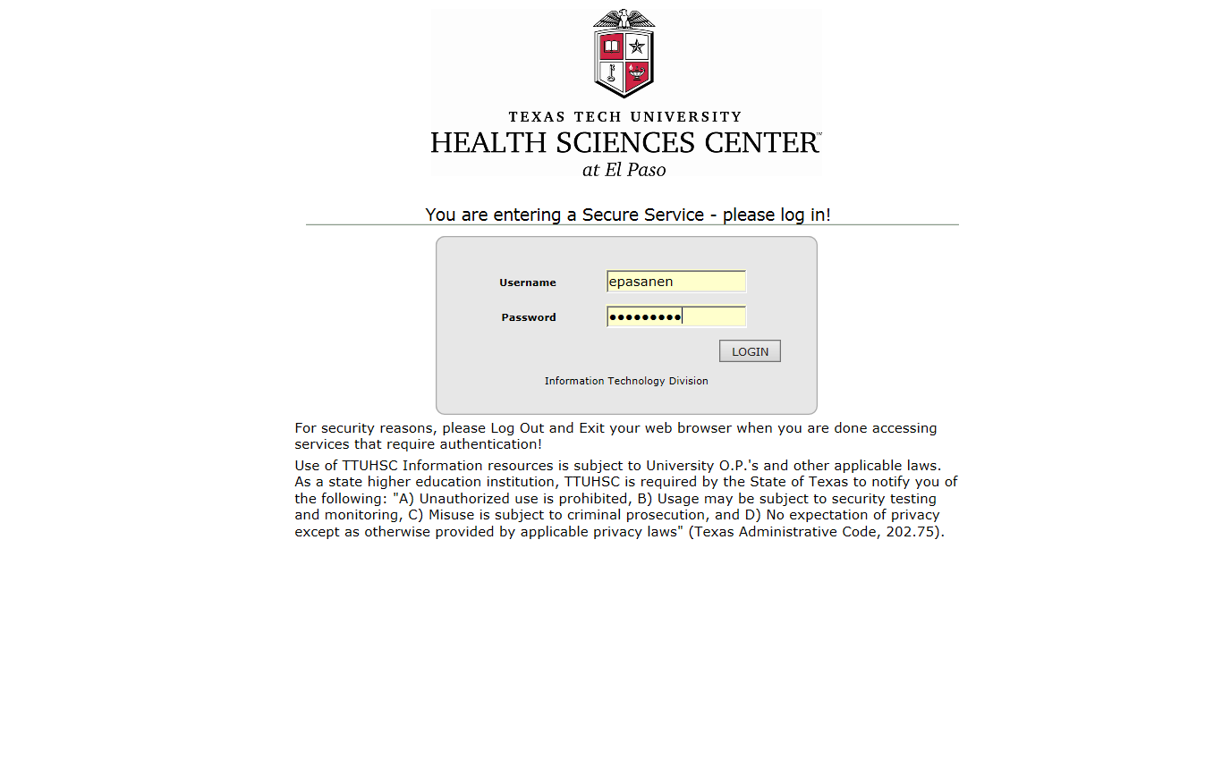
The sign-on screen looks a little different.

Slide 7
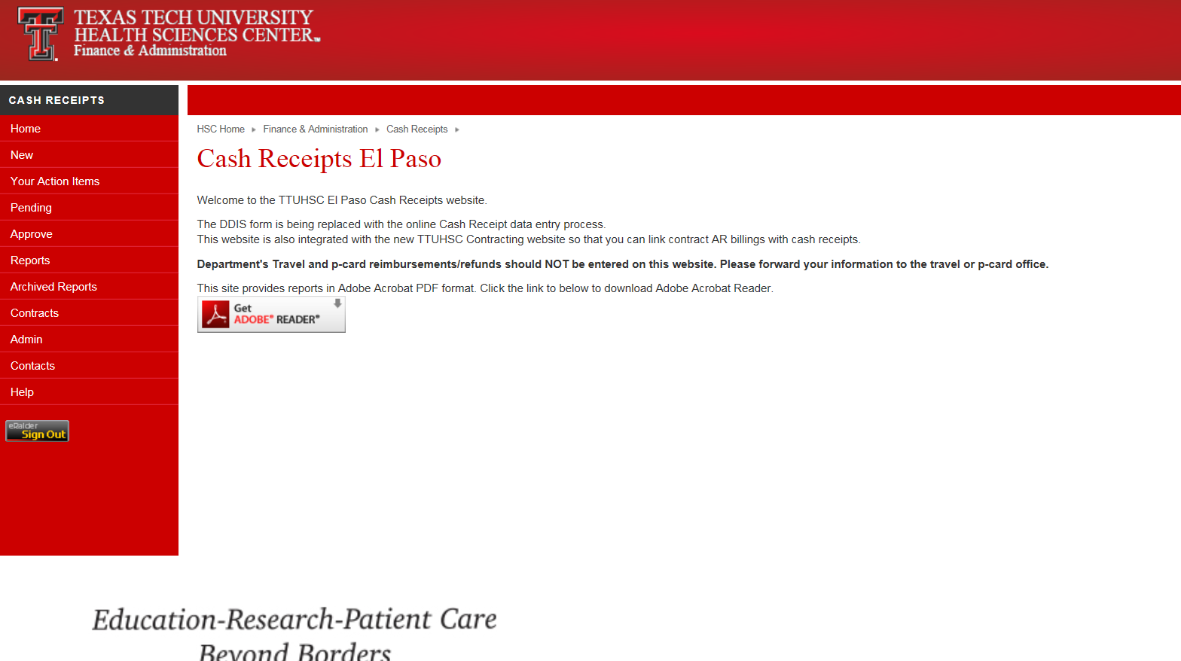
Home page has a few new menu items.

Slide 8
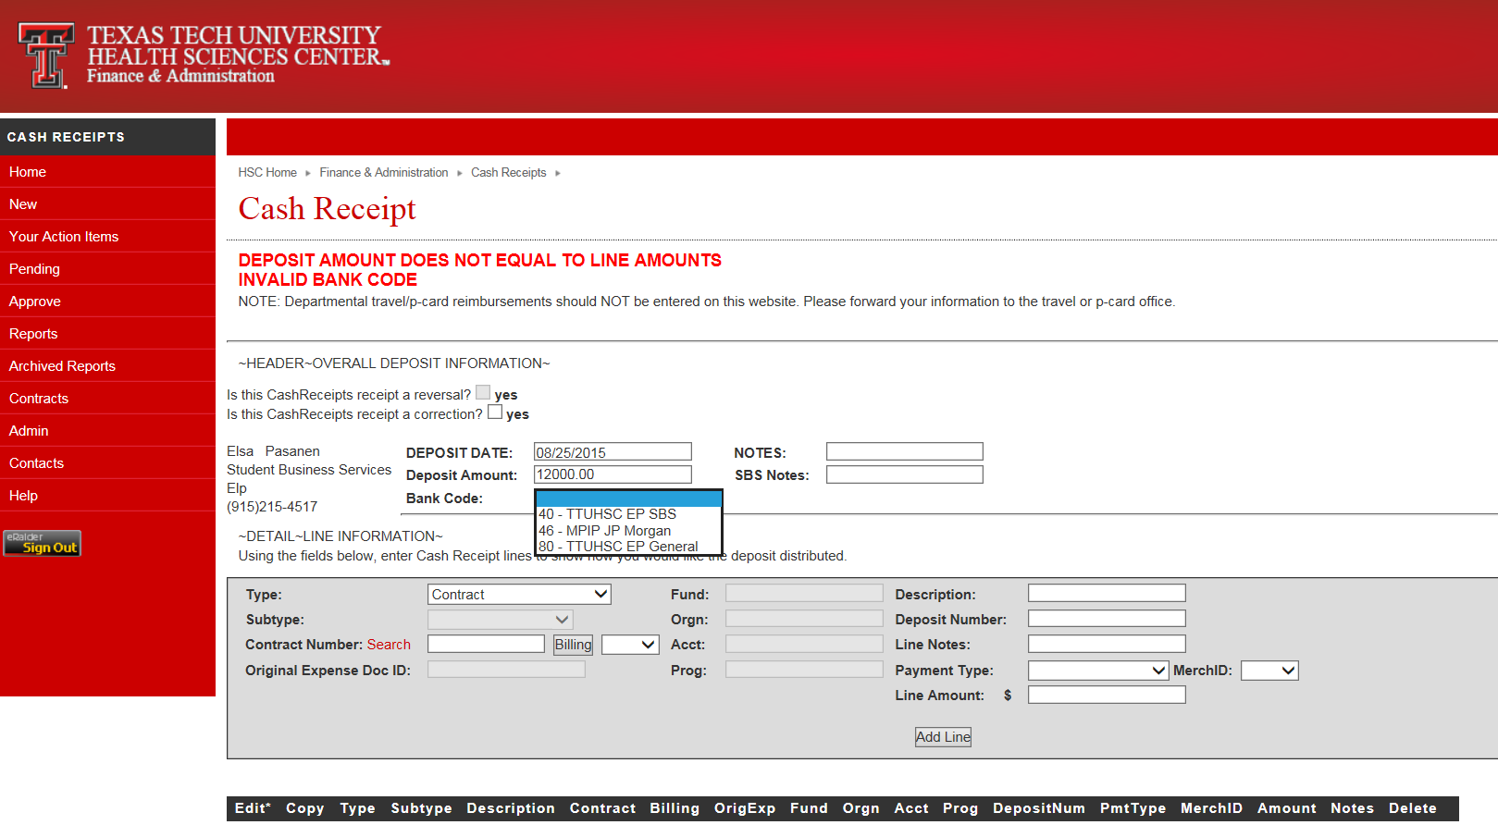
This remains until lines equal deposit.
Only three bank codes.

Slide 9
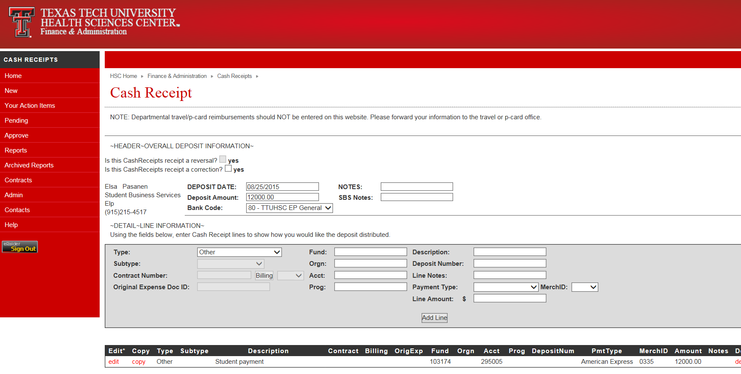
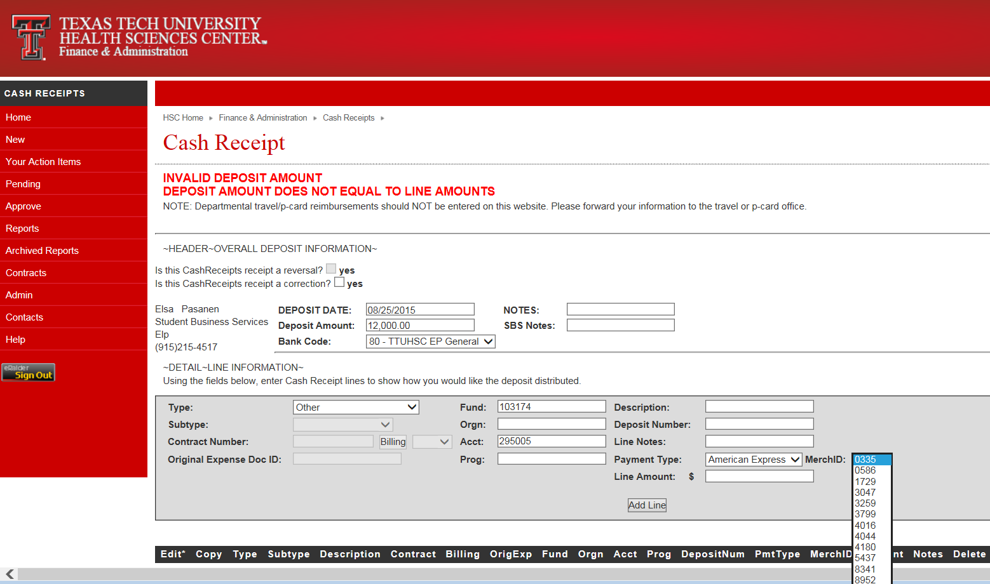
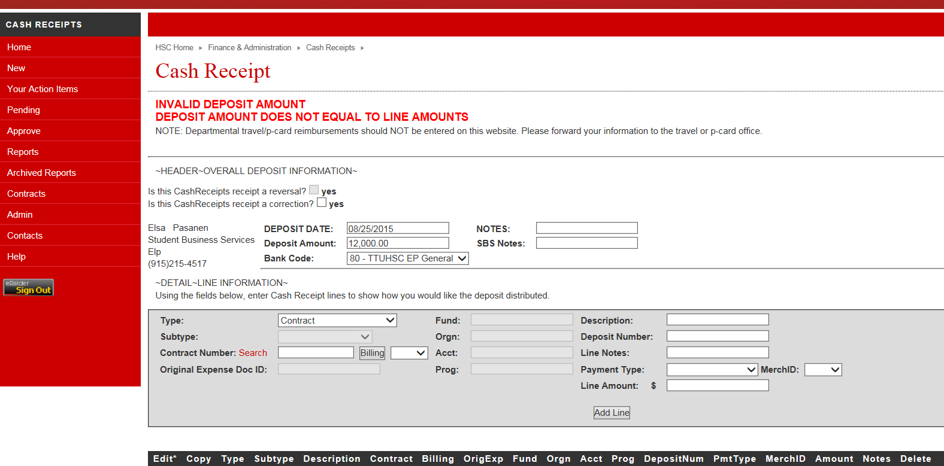
Do not use commas on amounts—invalid.
No Lubbock merchant IDs listed.

Slide 10
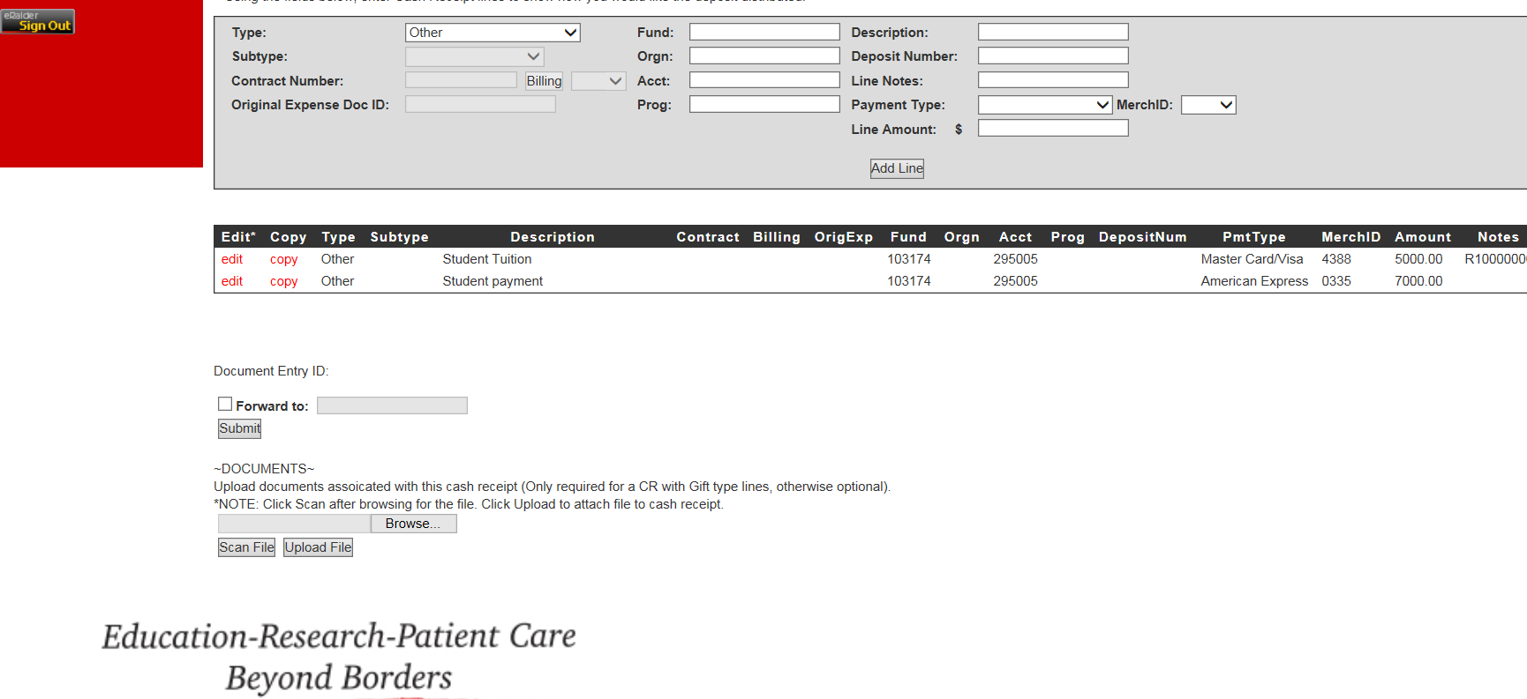
Can forward, but must use recipient’s R#.
To attach a document file:
1. Browse and select, 2. click Scan, 3. click Upload.
Suggest use of Firefox when entering a cash receipt with a document attachment.
We currently only require attached documents for Gift type cash receipts.

Slide 11
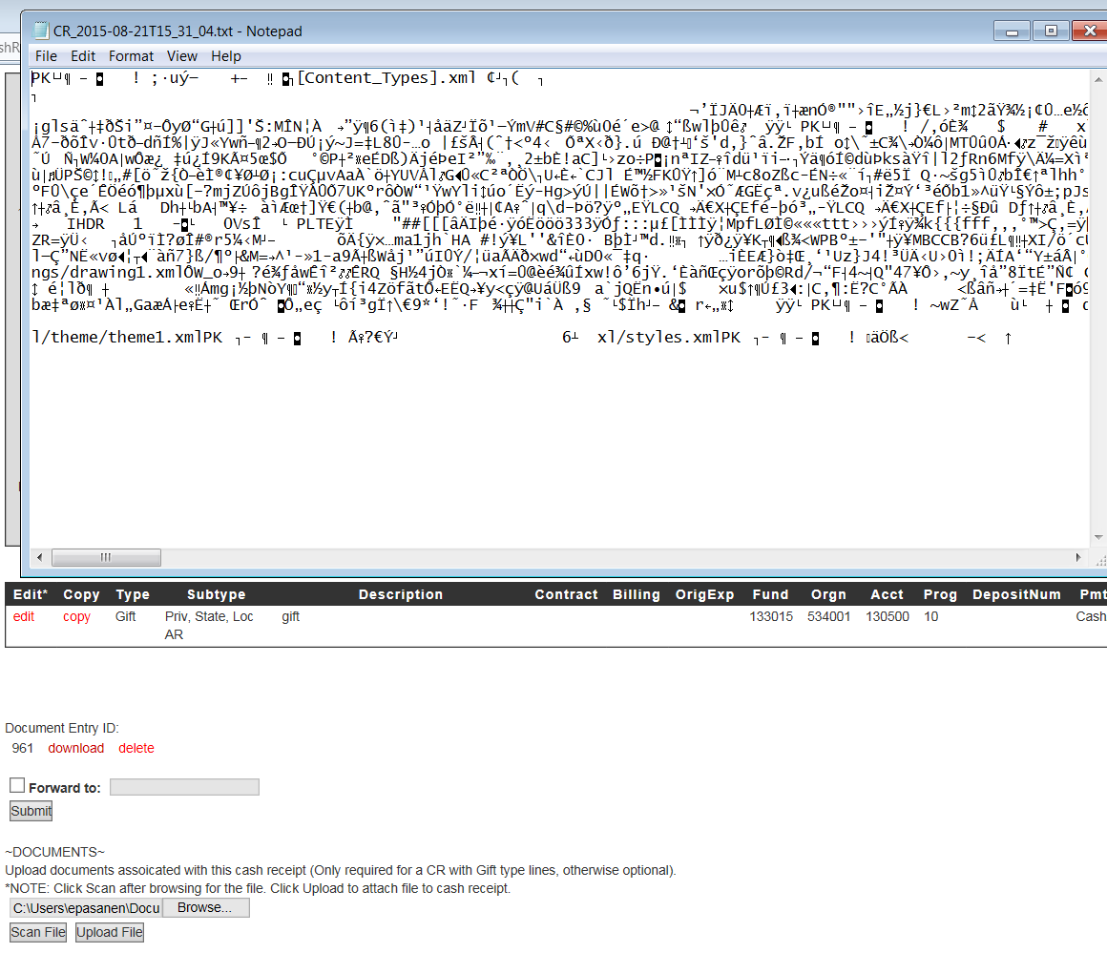
You might get this as your document if your browser doesn’t accept the document upload. Try Firefox.

Slide 12
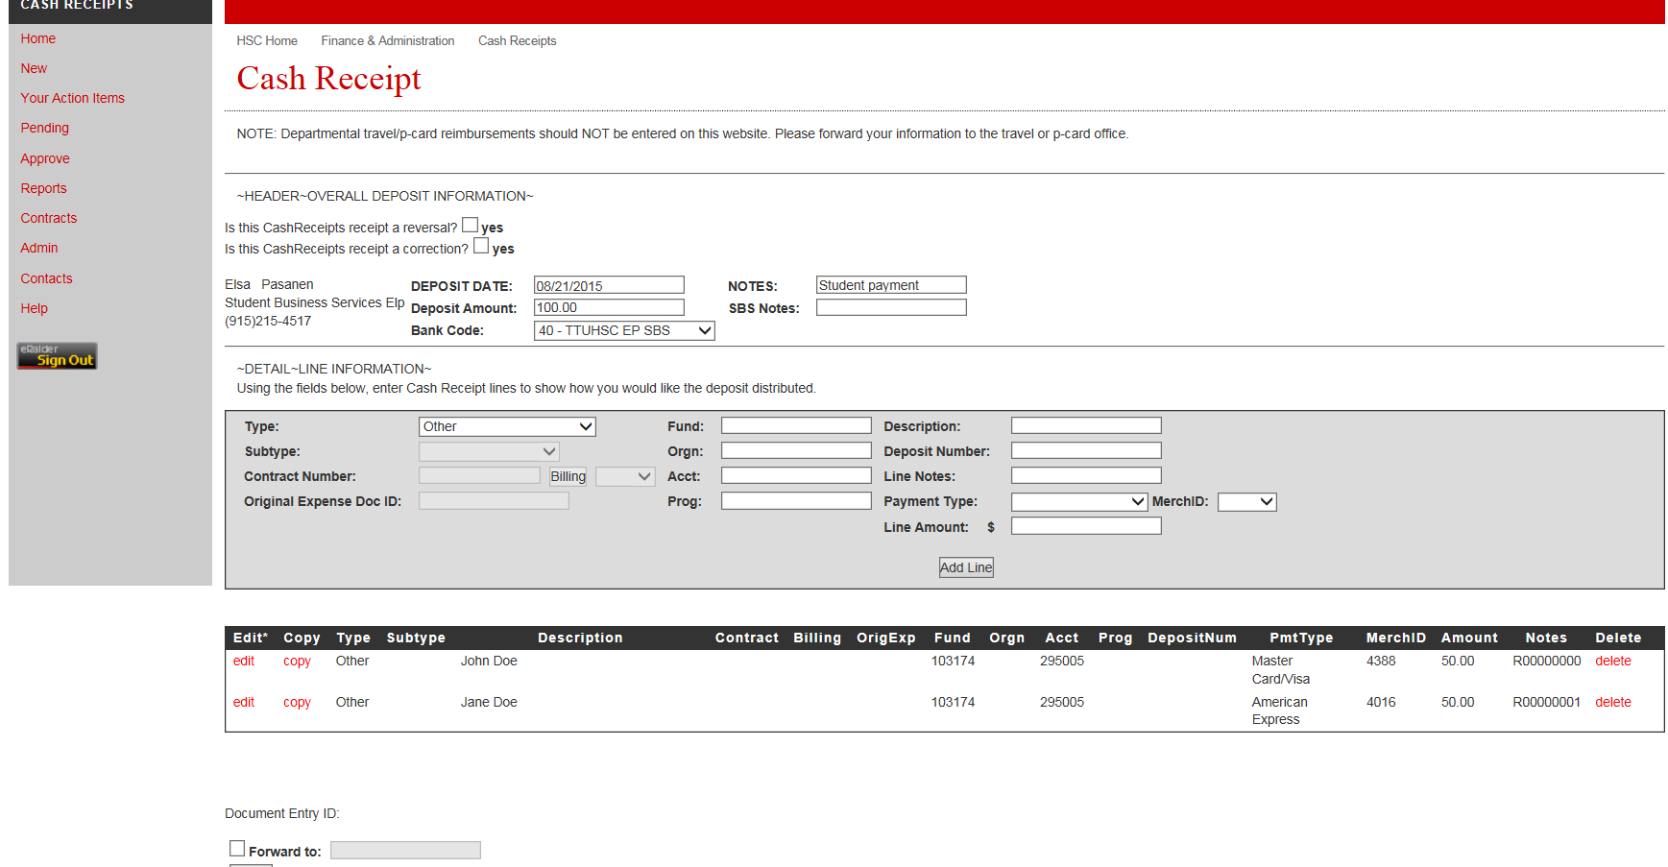
There is no total under the line amounts.

Slide 13
Contracts AR
Contract AR data will be linked to Cash Receipts starting 9/11/15. Contract type requires a couple different clicks, but the same information needs to be on the new cash receipts:
1. Click Search.
2. Locate your Contract # on the list.
3. Copy & paste # into the Contract Number field.
4. Click on AR Billing link on list to see AR amounts and details.
5. Click “Billing” on your Cash Receipt.
6. Click the drop down arrow in the adjacent field, and AR numbers for that contract will appear for you to click.

Slide 14
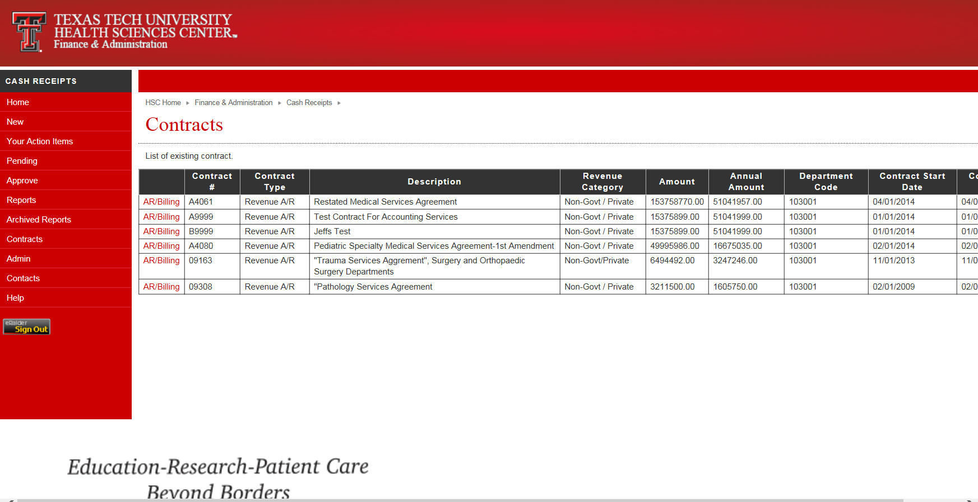
After clicking Search next to Contract, you will get a list of available contracts like this. You can copy/paste the contract # into the cash receipt contract field or type it in.

Slide 15
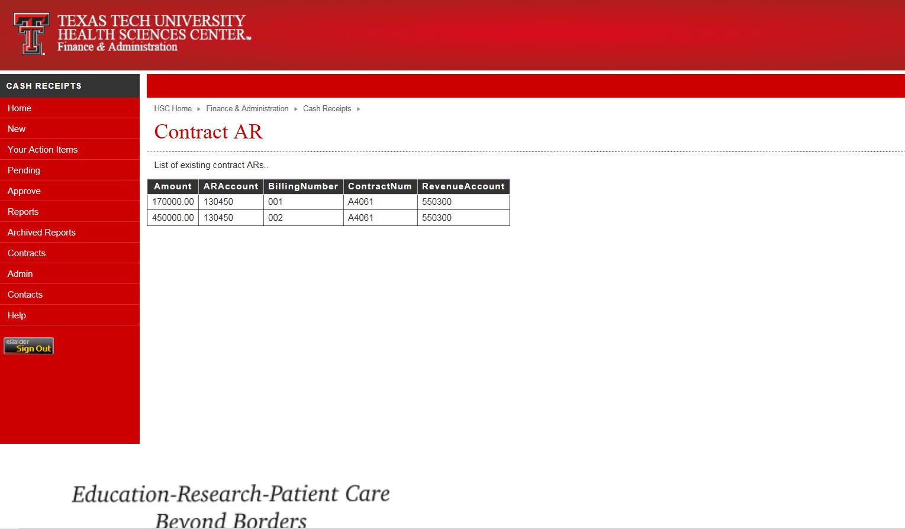
If you clicked the AR/Billing link on the list of contracts (see previous screen), it will let you view some AR billing detail. There are no links on this screen.

Slide 16
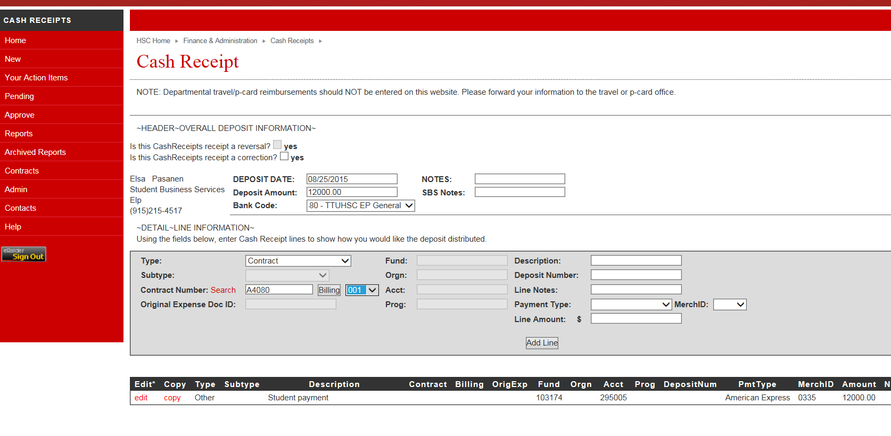
After you copy and paste your contract #, click Billing, click the down arrow, and choose the correct billing #.

Slide 17
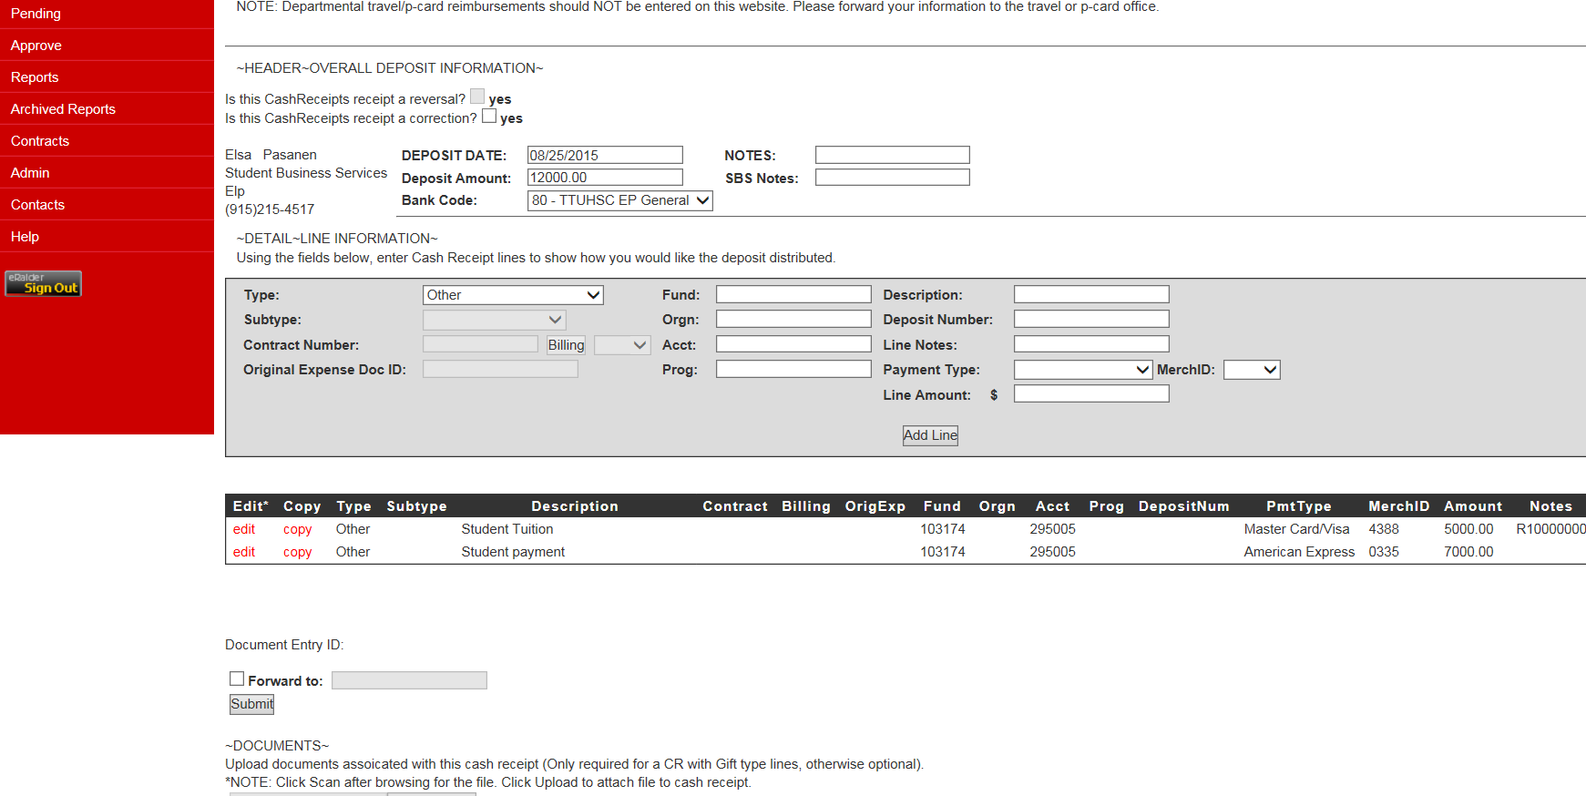
Submit as usual.

Slide 18
Differences for Approvers
1. There is no “use on all lines” box option next to the Deposit # field when editing a cash receipt.
2. Edits requiring identical changes to multiple lines need to be done line by line.

Slide 19
Reports Menu
There are no changes to Reports.

Slide 20
Contracts
You can use the Contracts menu item to view contract and AR/Billing without creating a new cash receipt.
This is a convenient feature.

Slide 21
Admin
The Admin menu item will be for system administrators only. It is used for adding new users and assigning roles.

Slide 22
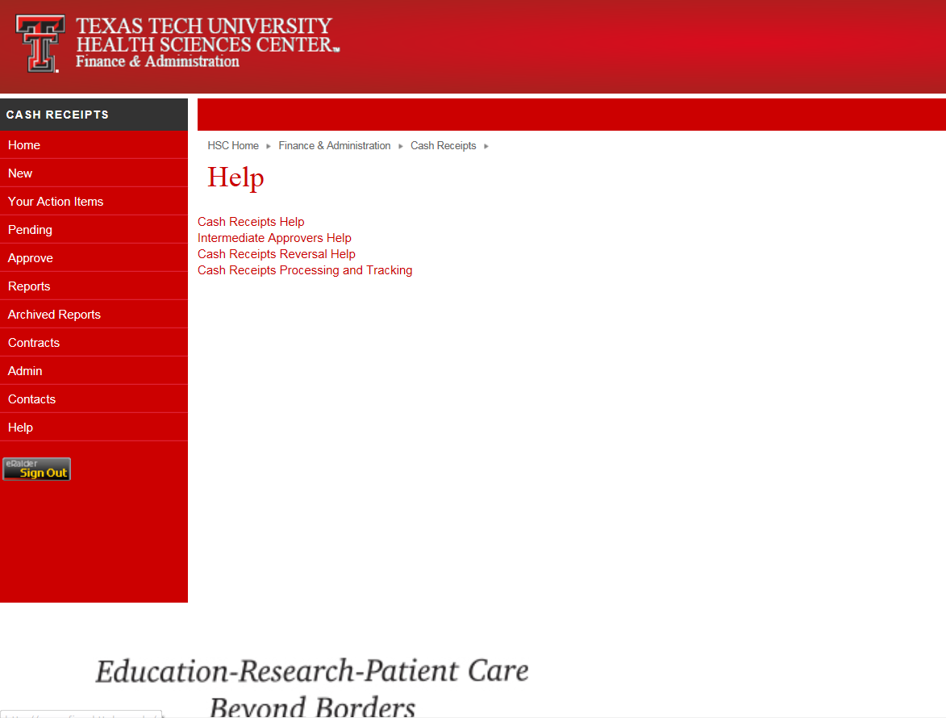
Use the Cash Receipts Help for reminders on how to create various kinds of cash receipts.
Intermediate Approvers Help reminds approvers how to edit, return and approve.
Reversal Help reminds users that reversals are done by Accounting or with Accounting’s assistance.
Processing and Tracking reminds us about timelines and the need for prompt deposits.

Slide 23
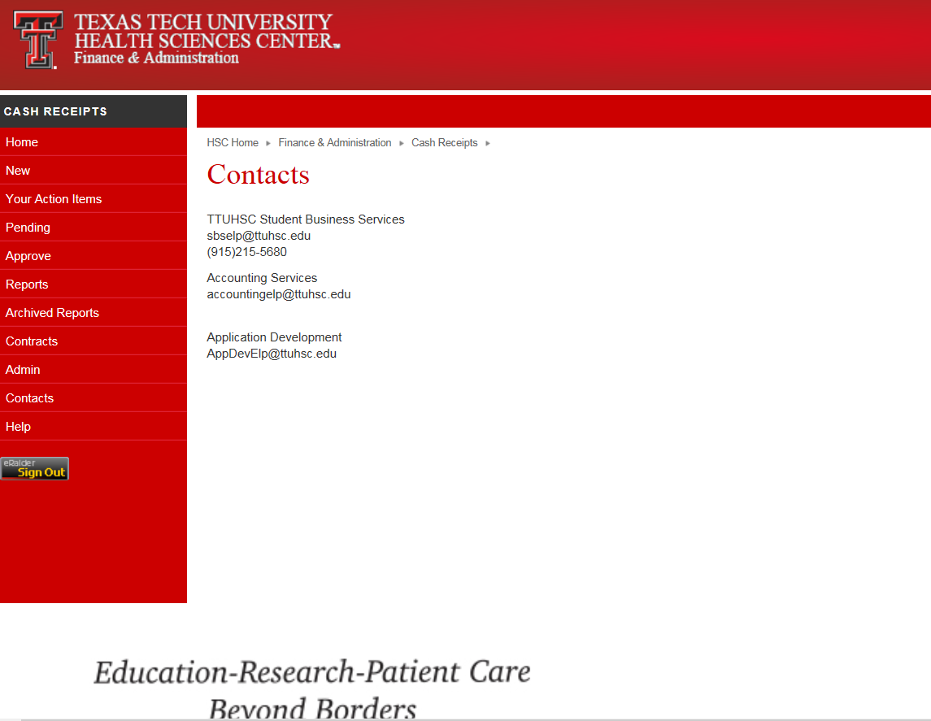
Contact for returns, report deposits, general help
Contact for FOAP and AR help
Contact to report system issues

Slide 24
Year End/ Transition Cash Receipt Handling
Processing of FY15 cash receipts / FY 16 Cash receipts (All FY15 Cash receipts need to be submitted by Sept. 3rd)
Cash receipts for contract AR will be available after September 11th
Cash receipts for contract AR should be entered separate from other cash receipts.
Which account should you use
  Revenue vs. Expense account codes
  Miscellaneous revenue account code 570004
FOP corrections should be processed through FiTS
  Email account code corrections to Accounting Services at accountingelp@ttuhsc.edu

