Slide 2
Student Business Services (SBS)
Physical Location: 130 Val Verde, 1 block South of the MSB II
Business Hours: Monday – Friday
8 a.m. to 5 p.m.
Phone: 915-215-5680
Email: sbselp@ttuhsc.edu
Mailing Address: TTUHSC El Paso
130 Rick Francis St.
MSC 51011
Attn: Student Business Services
El Paso, TX 79905
Visit us on the web under the Department of Business Affairs:
http://elpaso.ttuhsc.edu/fiscal/businessaffairs/studentbusserv/

Slide 3
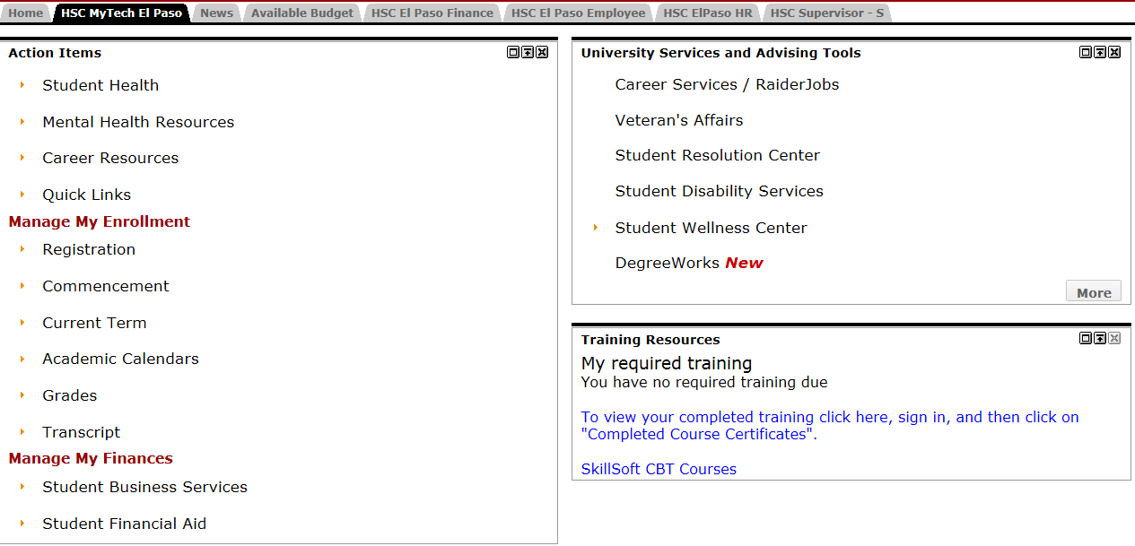
WebRaider Portal
Expand

Slide 4
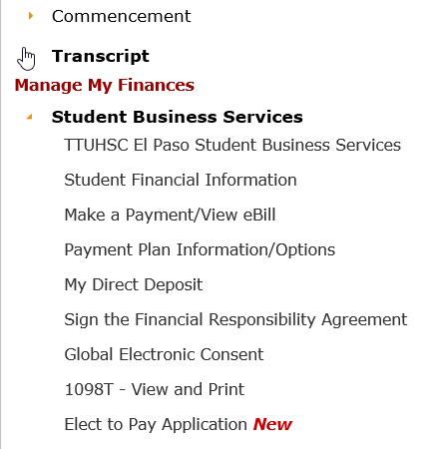
WebRaider Portal
Expanded View

Slide 5
Payment Policy
Payment must be received by the established due date.
Failure to make payment in full
  May result in a registration and transcript hold, or
  Denial of credit for course work completed.
  Diploma will not be released until account is paid in full.
All students must have a Financial Responsibility Agreement on file with SBS.

Slide 6
Payment Options
Payment in full
  Cash or Check
  Debit Card
  Credit Card (online only; is subject to a 2.95% processing fee)
  100% Financial Aid
Payments may be made in person, by mail, or online (credit/debit card or web-check)
Installment payment plan
Emergency tuition loan (processed through the Financial Aid Office)

Slide 7
Billing Statements
Billing statements are emailed
  To the student’s assigned TTUHSC email address, and
  Electronically approximately three weeks prior to the due date
Only students registered at the time of the initial billing will receive a billing statement.
Students who register after the initial billing need to check their account balances via the eBill site accessible through WebRaider Portal.

Slide 8
Credit Refunds
Financial aid will disburse to your student tuition and fee account.
  Any amount in excess of tuition and fees or any other credits will be refunded to the student.
Refunds are processed weekly
  Monday, Wednesday and Friday.
Students may elect to receive refunds via direct deposit or by mailed check.
It is the student’s responsibility to maintain a current address or a current/valid bank account number in the student information system.

Slide 9
Refund Policy for Tuition and Fees
Students who withdraw from the institution are required to pay tuition and fees according to the following schedule:
Fall, Spring or Summer terms (10 weeks or longer)
  Before 1st day of class – 0%
  1st – 5th day of class – 20%
  6th – 10th day of class – 30%
  11th – 15th day of class – 50%
  16th – 20th day of class – 75%
  After the 20th class day – 100%

Slide 10
Refund Policy for Tuition and Fees
Fall, Spring or Summer terms
(more than five weeks but less than 10 weeks)
  Before 1st day of class – 0%
  1st – 3rd day of class – 20%
  4th – 6th day of class – 50%
  On or After the 7th class day – 100%
  For semesters less than 5 weeks, you must withdraw by the 2nd day of the semester to receive a partial refund.

Slide 11
Title IV Return of Aid
Federal refund and repayment calculations must be performed for students who receive Title IV (Pell, FSEOG, Perkins and/or Stafford Loans) funds and officially withdraw from all courses, drop out of all courses, are expelled, take an unapproved leave of absence, or fail to return from an approved leave of absence .
In order to keep all the financial aid issued in each term, students must be enrolled for at least 60% of the term.

Slide 12
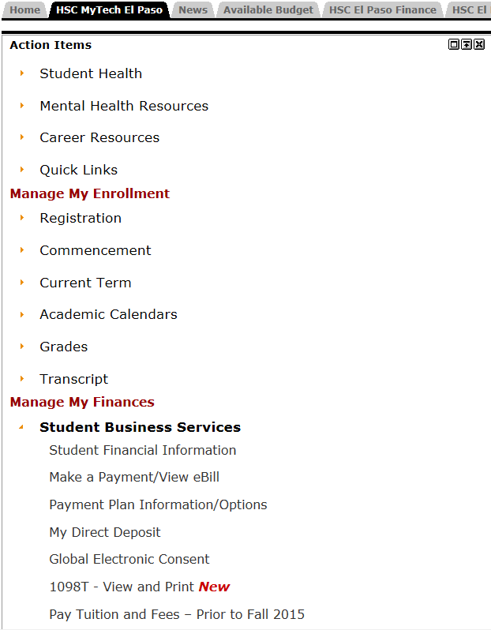
Make a Payment/View eBill
Select this link to view your bill or to make a payment.

Slide 13
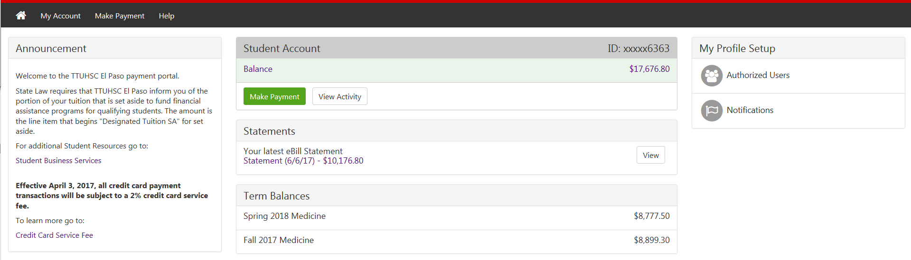
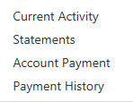
View eBill

Slide 14
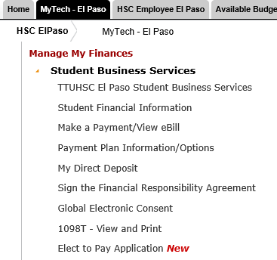
Installment Payment Options
Due Date

Slide 15
Make a Payment

Slide 16
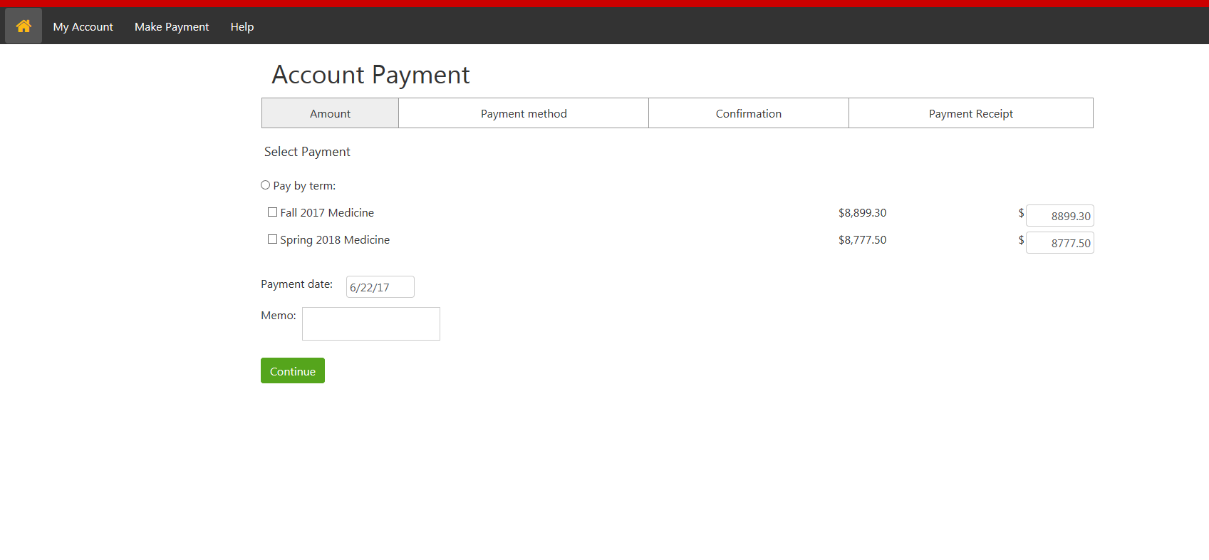
Make a Payment
Edit the payment amount if you wish to pay by installment.
Don’t forget to include the $25 installment fee!

Slide 17
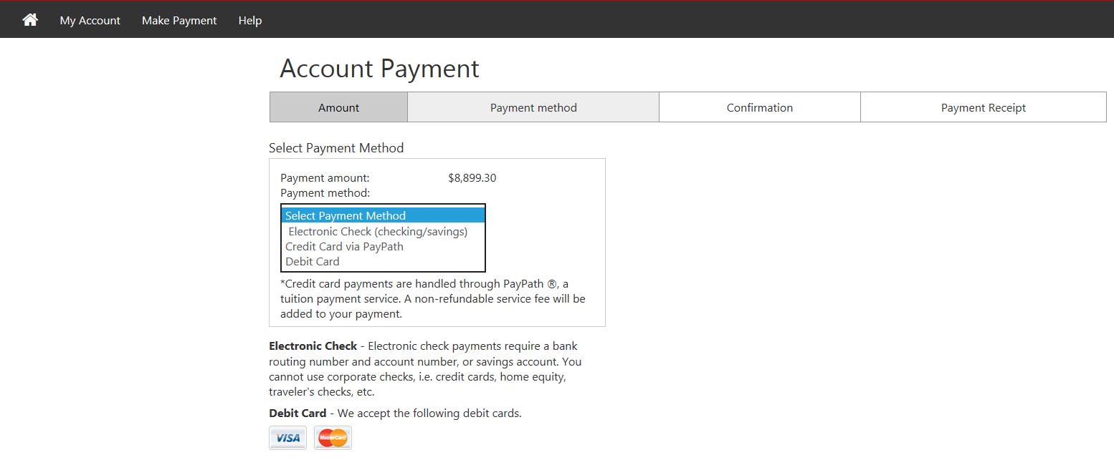
Make a Payment
Payments made via credit card will be assessed a 2.95% fee.
Pay by credit or debit card or you can pay by web check using your bank account.

Slide 18
Expecting a Refund?
Sign up for direct deposit!
Otherwise you will receive a check.
By U.S. mail! To the mailing address associated with your student account.

Slide 19
Expecting a Refund?

Slide 20
Expecting a Refund?
Reminder!
It is the student’s responsibility to maintain a current address or a current/valid bank account number in the student information system.
Failure to do so may result in a delay in receiving your refund!

Slide 21
Authorized User
The Family Education Rights & Privacy Act (FERPA) of 1974 protects the privacy of student education records.
SBS will not provide information regarding your tuition and fees to any unauthorized third parties. Students may consent to release student information through the Registrar’s office.
Visit the eBill site to grant eBill access to an authorized user.

Slide 22
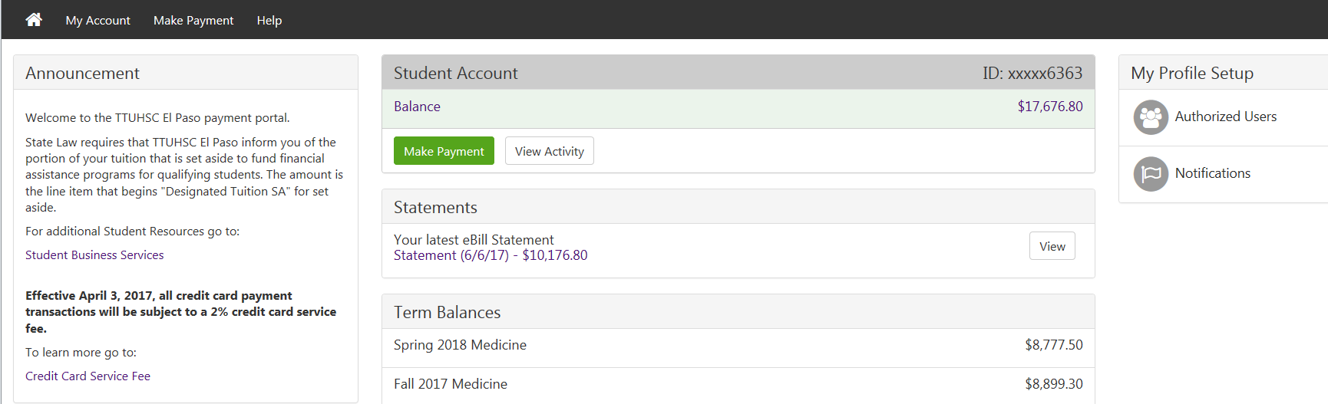
Authorized User

Slide 23
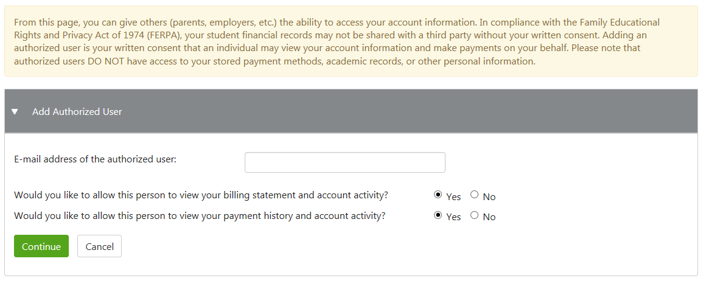
Authorized User

Slide 24
IRS Form 1098-T
1098-T forms are available in late January
TTUHSC El Paso reports payments received during the tax year.
Students who are missing a social security number will not be issued a 1098-T
You must have an electronic consent form on file in order to receive an electronic 1098-T. Students who did not elect to receive electronic communication will have their 1098-T mailed to them.

Slide 25
Student Business Services
welcomes you to TTUHSC El Paso!
We are glad you are here!

