Slide 2
Agenda
Introduction
Why PaymentWorks?
Payee Onboarding Process
Accessing PaymentWorks
Sending Invitations to Vendors/Payees
Invitation Status
Online Help and Troubleshooting

Slide 3
What is PaymentWorks?
PaymentWorks is a cloud-based onboarding application for automating the vendor registration process
TTUHSCEP Departments will have ability to:
Extend invitations to vendors via PaymentWorks
View status of the onboarding process
Vendors will have the ability to:
Register and maintain their own information through an assigned self-service account
Complete their own updates such as address changes and company merger or acquisition, and banking information
View remittances and payment status

Slide 4
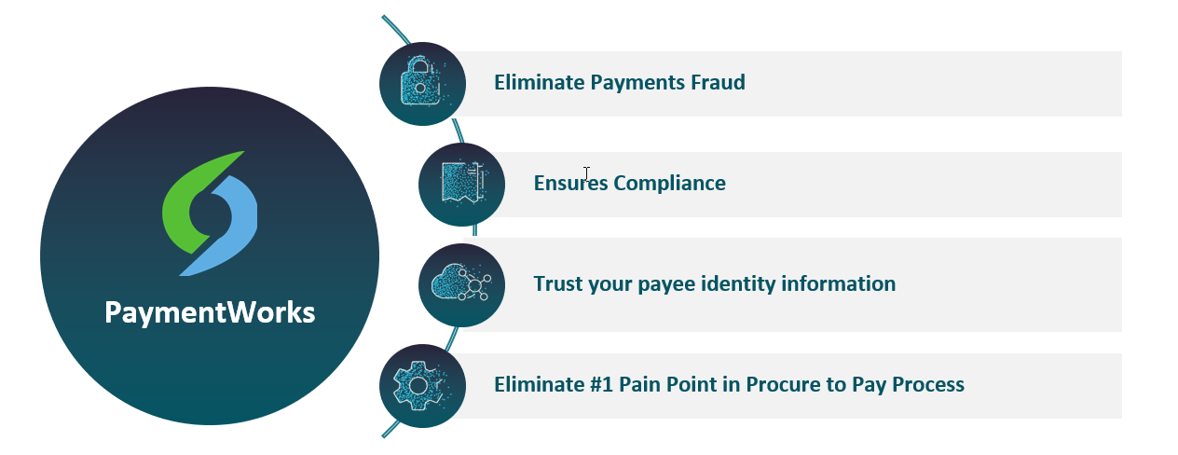
What value does PaymentWorks bring to TTUHSCEP?

Slide 5
Vendor/Payee Onboarding: A Time-Saving Process
TTUHSC ERP
TTUHSCEP Vendor Services
PaymentWorks
Vendor/Payee
1. Initiate Vendor Invite
2. Approve Request
3. Send Invitation
4. Create PaymentWorks Account
8. Create or Update Vendor
7. Approve Workflow
6. Verifications/Screening
5. Complete Registration
9. Notify PaymentWorks
10. Send Notification
11. View Invoices and Remittances
15. Update Record
14. Approve Updates
13. Verifications/Screening
12. Update Profile Information

Slide 6
Who Will Register in PaymentWorks
Any new business, organization, or individual who previously would complete a TTUHSCEP Vendor Form will use PaymentWorks.
US Business or Individuals
Foreign Business or Individuals
Non-Profits or Government Entities

Slide 7
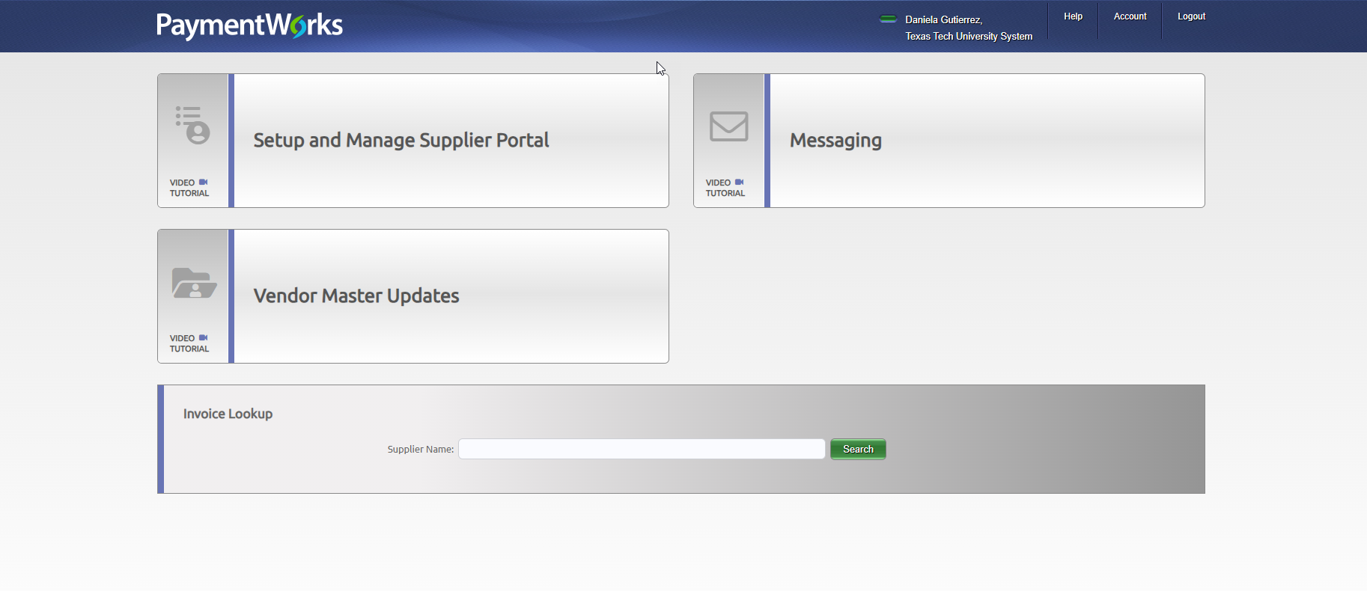
Logging Into Payment Works
https://paymentworks.com/login/saml/?idp=ttu

Slide 8
Inviting a Vendor/Payee –
How to Send Invitations
Step 1:
Once logged into PaymentWorks. Click on the Vendor Master Updates tile.
Step 2:
Click on the New Vendors tab. Initiators will be defaulted to this page.

Slide 9
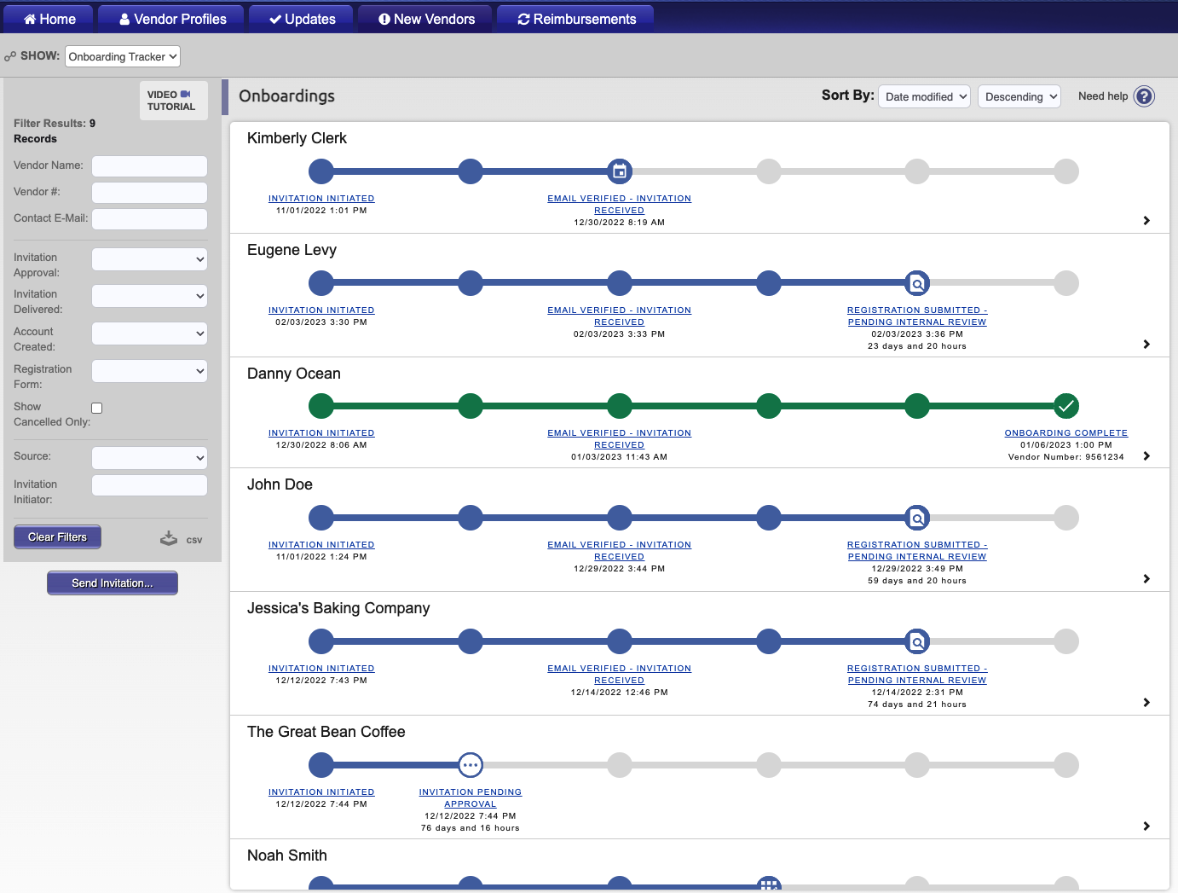
Step 3:
Click the Send Invitation button

Slide 10
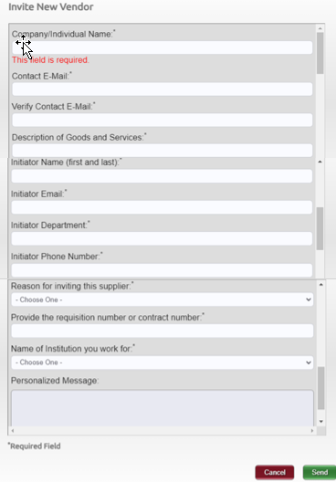
Inviting a Vendor/Payee – How to Send Invitations
Step 4
Complete the required fields in the Invite New Vendor form.
Anything marked with an asterisk is required.
Once complete click send
Select TTUHSCEP
Please select Texas Tech University Health Sciences Center at El Paso as the institution you’re doing business with.

Slide 11
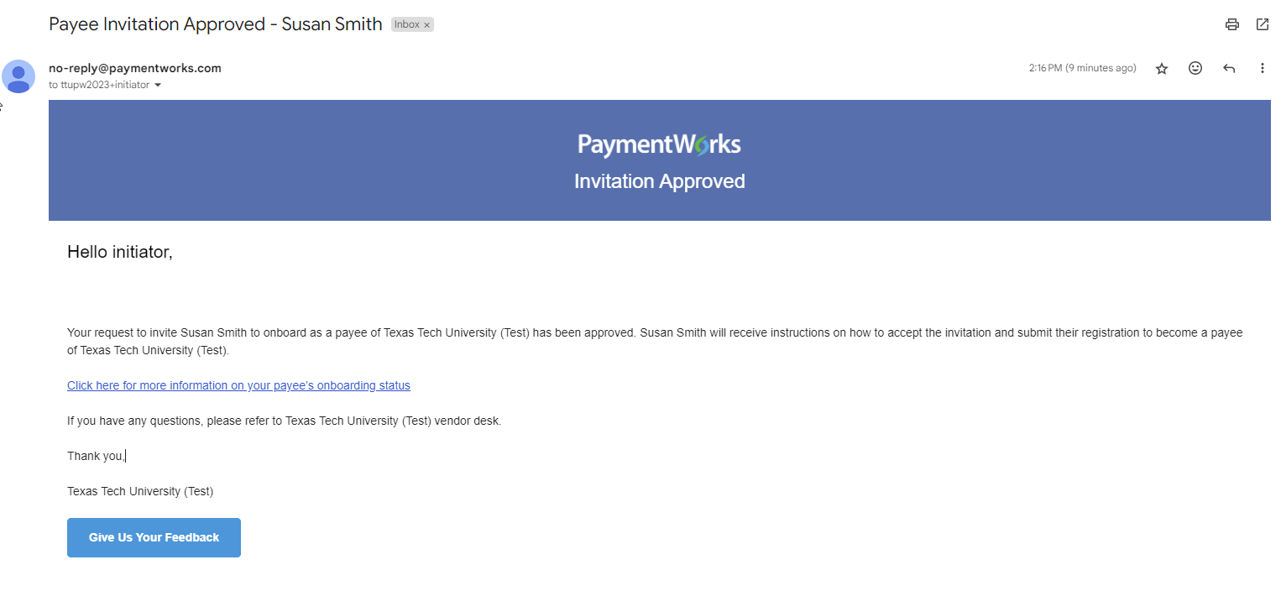
Vendor Onboarding Invitation
Once New Vendor Form is complete a pop up box will appear
The request goes to Vendor Team for approval.
Upon the Vendor Team review and approval, the initiator will receive an email notification

Slide 12
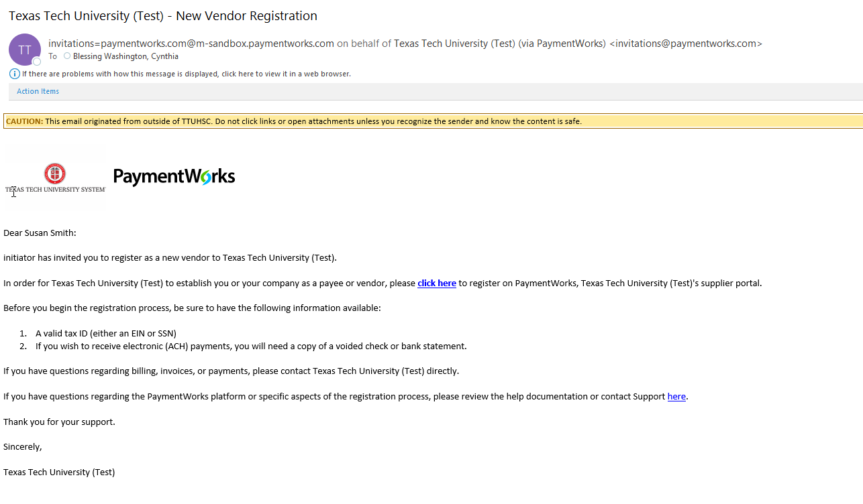
Vendor Receives Email Invitation
The vendor will receive an email invitation with a link to begin the registration process.

Slide 13
Vendor Creates Account
The screen below will appear
If the vendor does not have a PaymentWorks account they will click on
If the vendor has a PaymentWorks account, they click on the Click here to login link

Slide 14
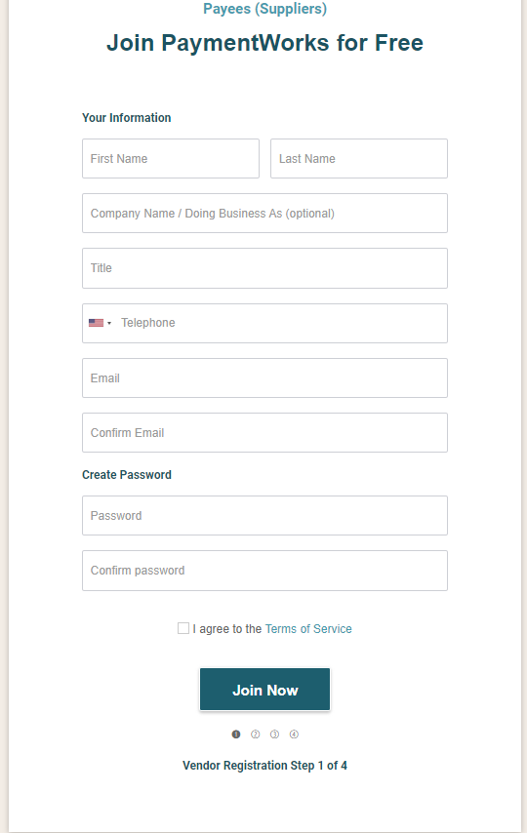
Vendor - Create Account
The vendor can create an account and complete the steps to register.

Slide 15
Searching for a Vendor/Payee
View Status of Onboarding

Slide 16
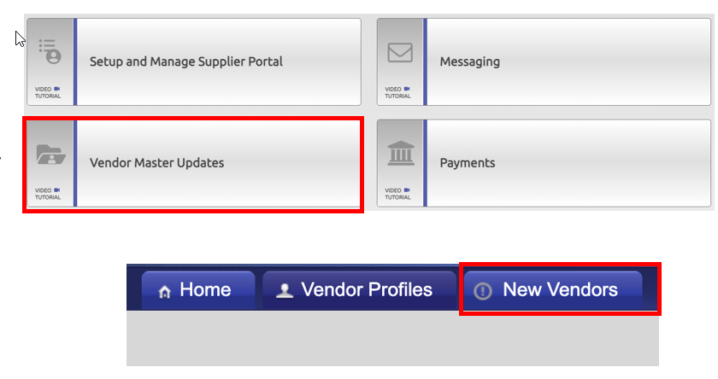
Searching for a Vendor/Payee
How to Search
Step 1:
Once logged into PaymentWorks, click on Vendor Master Updates.
Step 2:
Next click on the New Vendors tab.

Slide 17
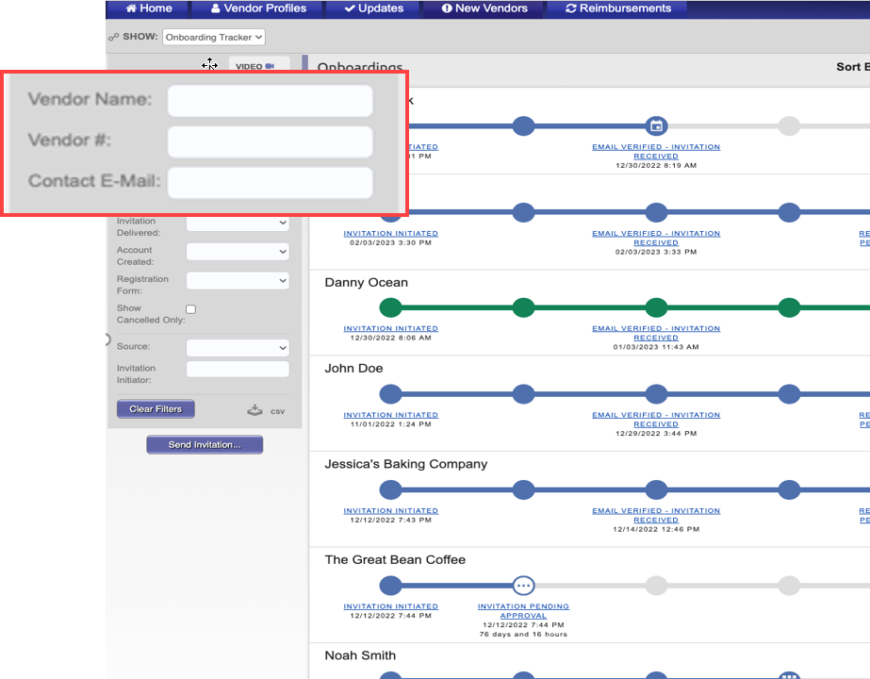
Searching for a Vendor/Payee
How to Search
Step 3:
Under Filter Results, you can now search for the payee via their email address or vendor name.
Next Steps:
This will bring any matching search results along with any corresponding information. If you do not see an invitation or any matches to your search, you will need to invite the Payee.

Slide 18
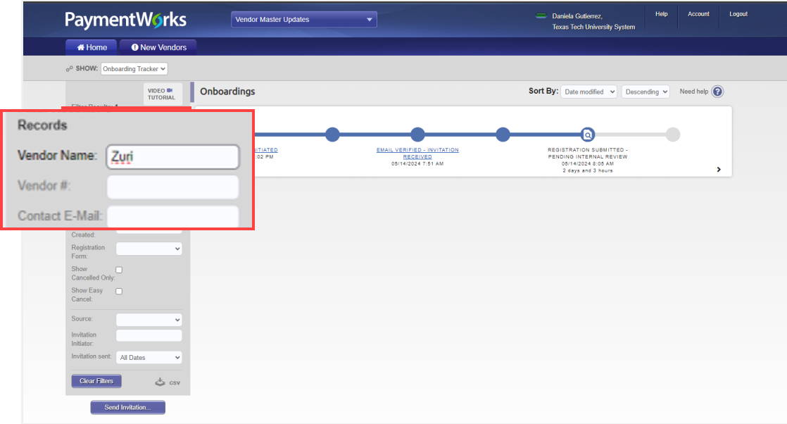
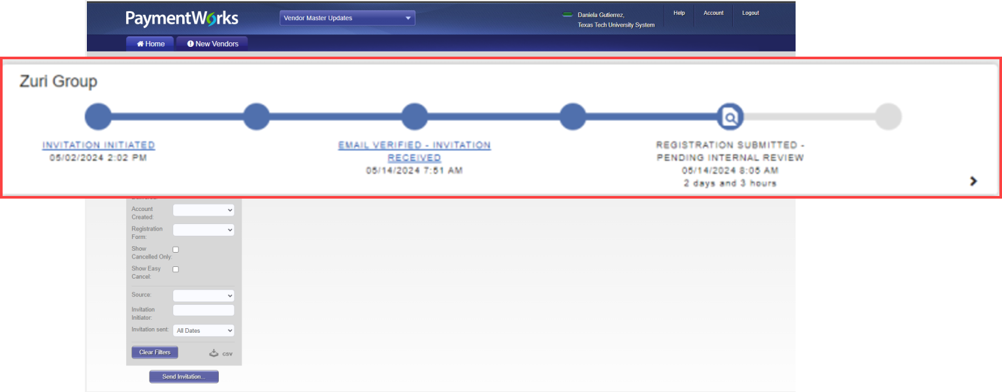
How to View Onboarding Status
As you enter the vendor name the dashboard will display results
The onboarding status will display
Each bubble displays a milestone
Additional information is available by clicking the arrow key
Notes:
You can track the progress of the onboarding status for the vendors that you have invited.
You will not be able to view the onboarding status of vendors that have been invited by others.

Slide 19
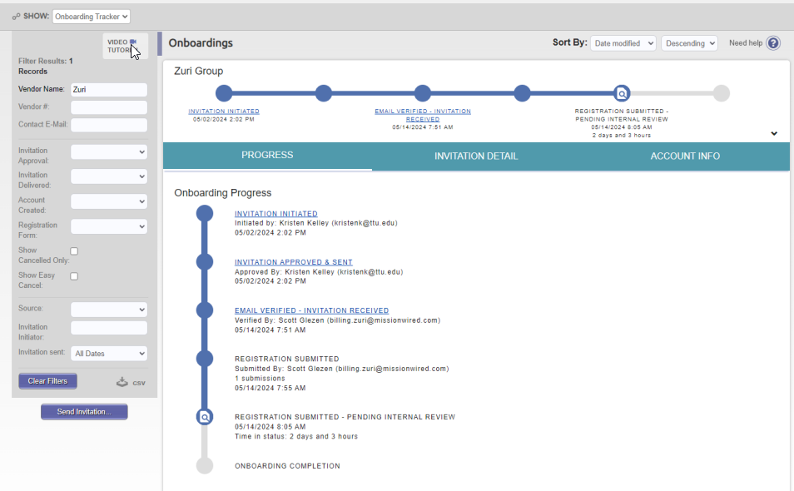
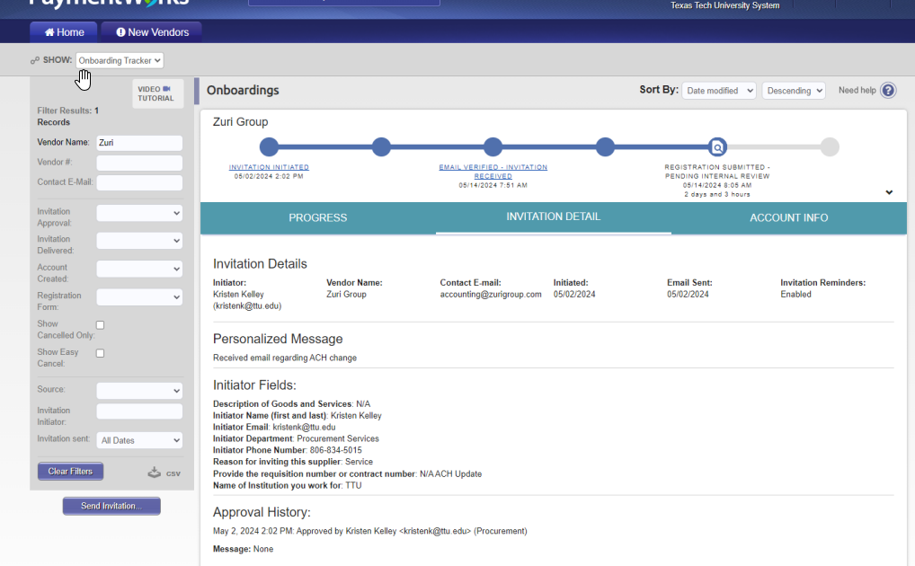
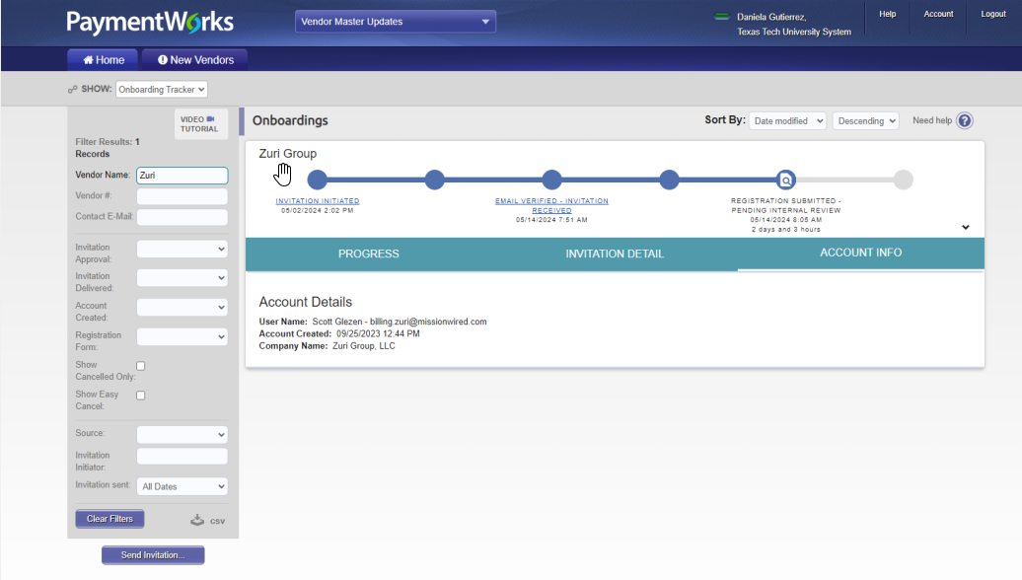
How to View Onboarding Status
Progress
Invitation Detail
Account Info

Slide 20
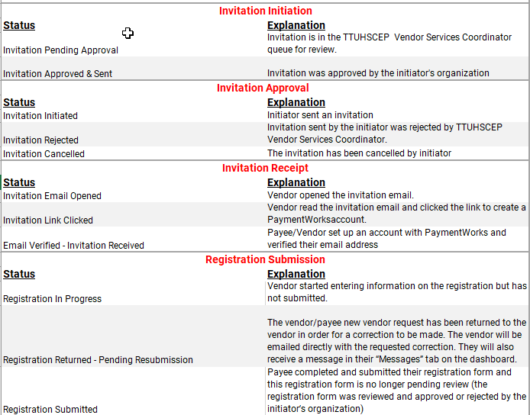
Onboarding Statuses

Slide 21
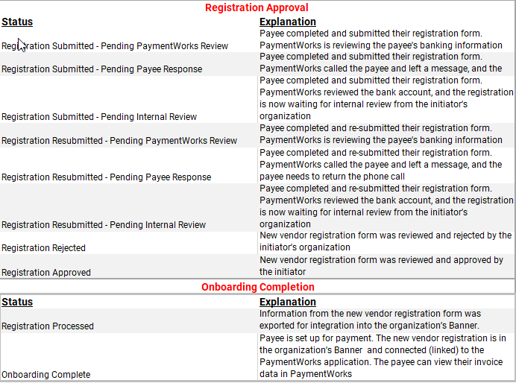
Onboarding Statuses

Slide 22
Trouble Shooting

Slide 23
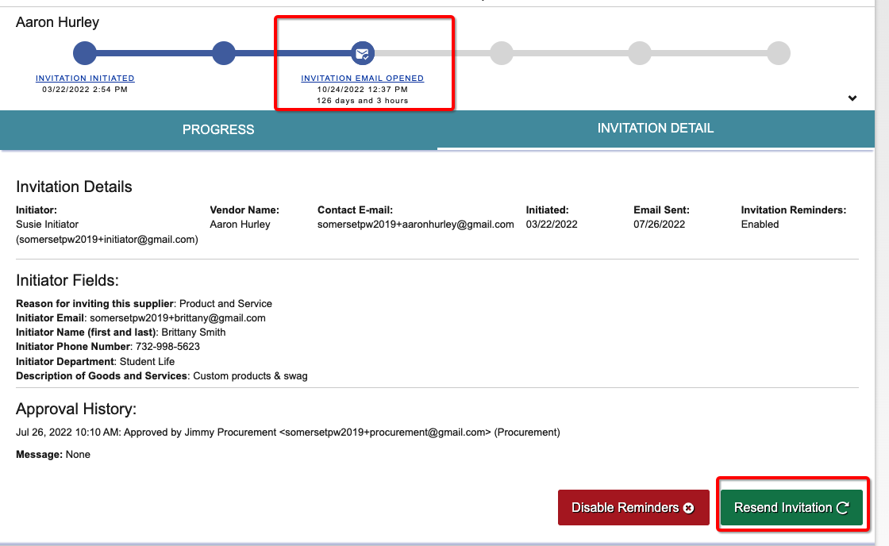
Troubleshooting
My vendor/payee deleted their emailed invitation or did not receive their emailed invite.
First ,verify that they payee has checked their spam or junk folder
Initiators can resend invitations.
To resend:
Click the status in the Invitation Receipt bubble (third bubble)
Click Resend Invitation button

Slide 24
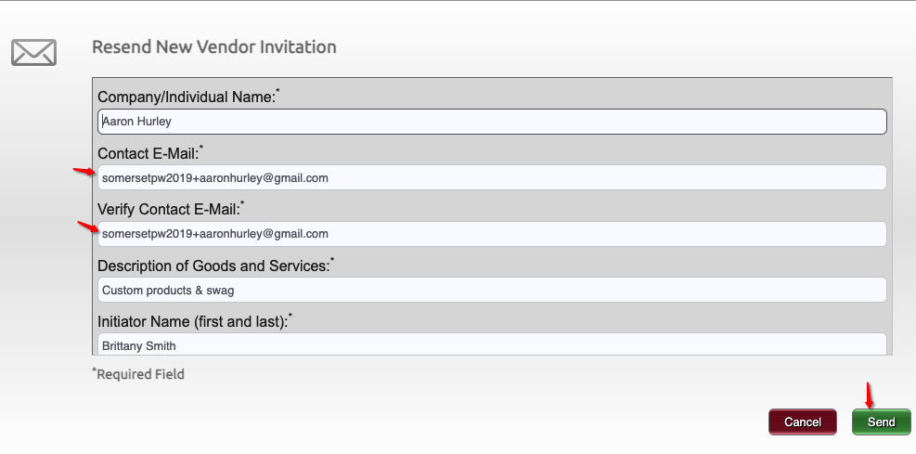
Troubleshooting
I entered the wrong email address or made a typo.
Departments can correct and resend invitations until the Payee creates their account.
To resend invitation with the correct email address:
Click on the invitation status.
Then click on the ”Resend Invitation” button.
Enter correct email address under “Contact E-Mail”
Click on the “Send” button when finished.

Slide 25
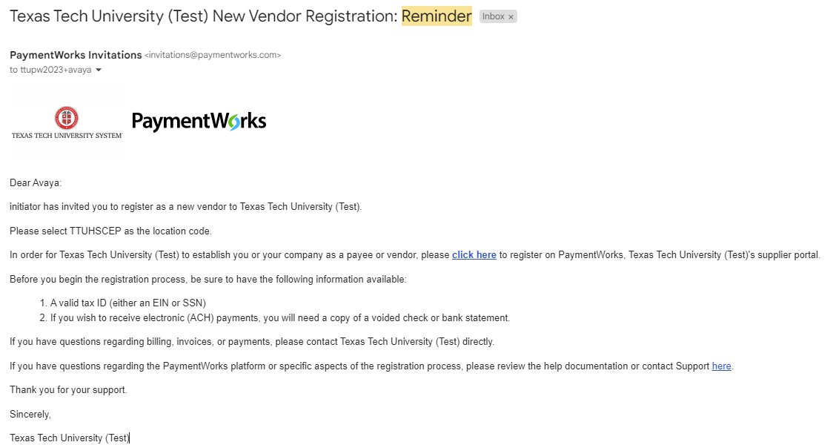
My payee has not completed their form to register.
The payee will receive emails until the registration is completed or the reminders are cancelled.
Reminder email notifications are automatically generated, do not resend invitations unless the payee notifies you that they did not receive the initial email
1st reminder – three days
2nd reminder – seven days
3rd reminder – 14 days
4th reminder – 21 days
5th reminder – 28 days

Slide 26
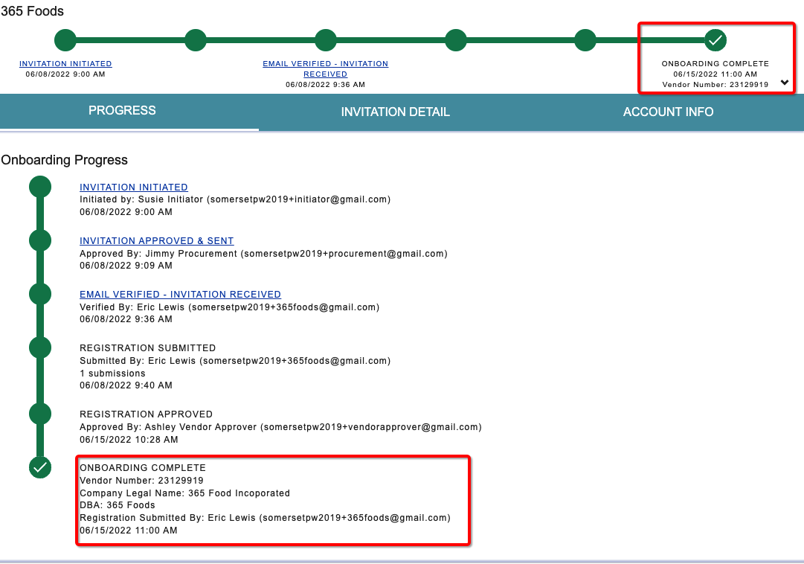
Troubleshooting
I haven’t received my vendor number.
You will receive your Vendor # once the payee has been approved and sent to the ERP

Slide 27
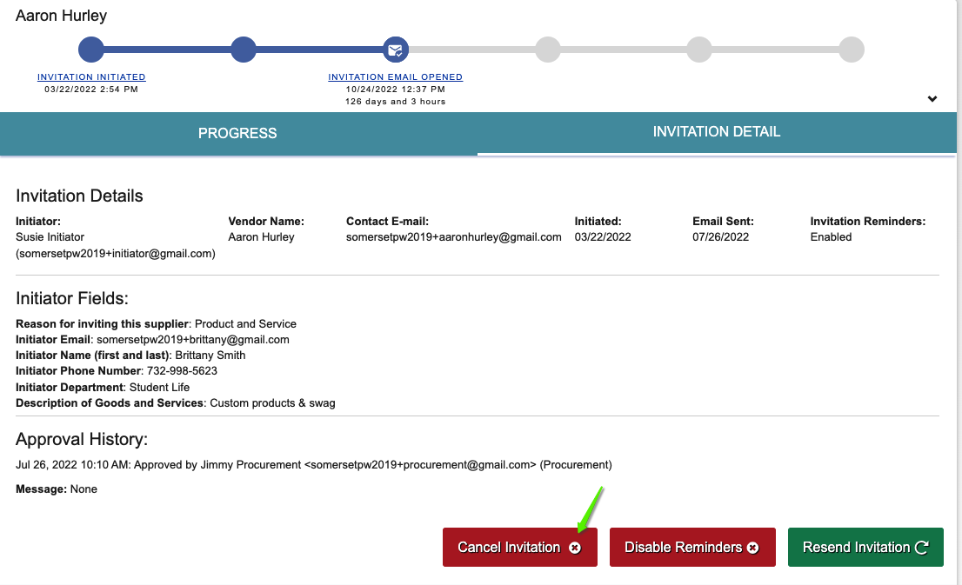
Troubleshooting
I no longer need to invite this payee, OR My payee is no longer needed OR How do I cancel an invitation?
Click on the invitation status.
Then click on the “Cancel Invitation” button.
A confirmation screen will appear, click the “OK” button.
This step can only be done up until the payee creates their account. Once the account is created the invitation cannot be cancelled.

Slide 28
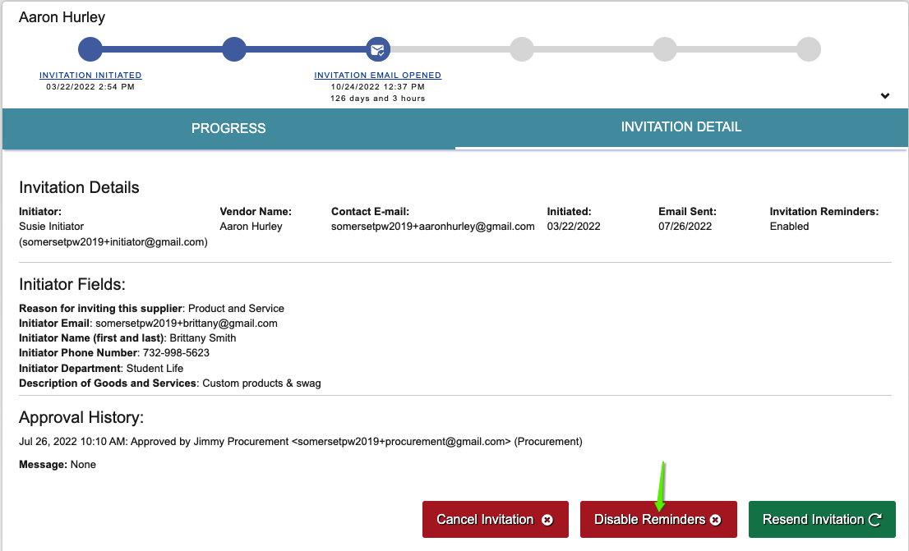
Troubleshooting
I want to stop sending reminders to my payee OR My payee has asked me to stop sending reminders
Click on the invitation status.
Then you will want to click on the “Disable Reminders” button.
A confirmation screen will appear, click on the “OK” button.

Slide 29
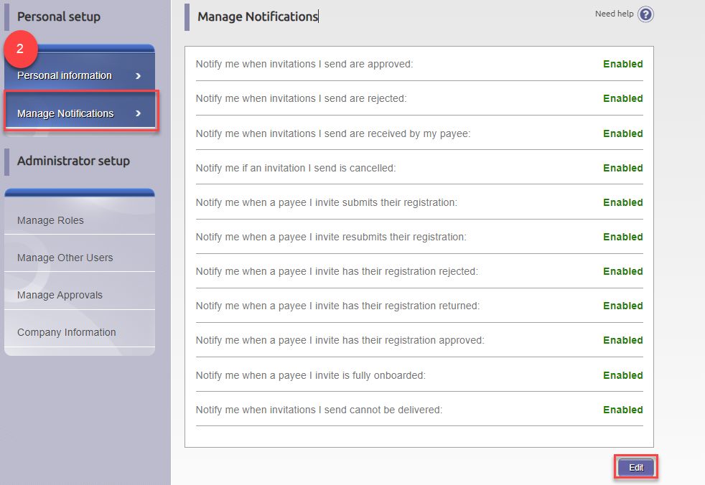
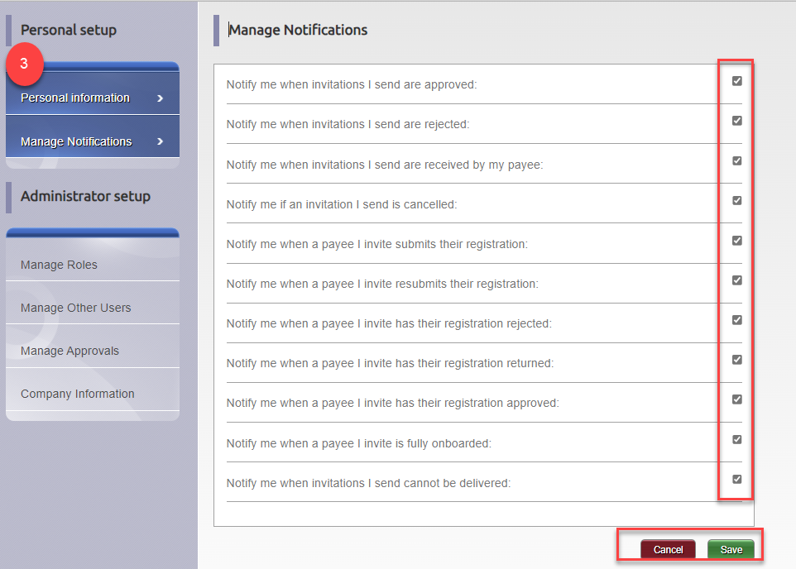
Troubleshooting
I want to stop receiving so many reminders.
Initiators have the ability to limit notifications
Click on Account
Then Click on Manage Notifications
Select the “Edit” button
Finally, you can select notifications you would like to receive
Click the “Save” button or “Cancel” button

Slide 30
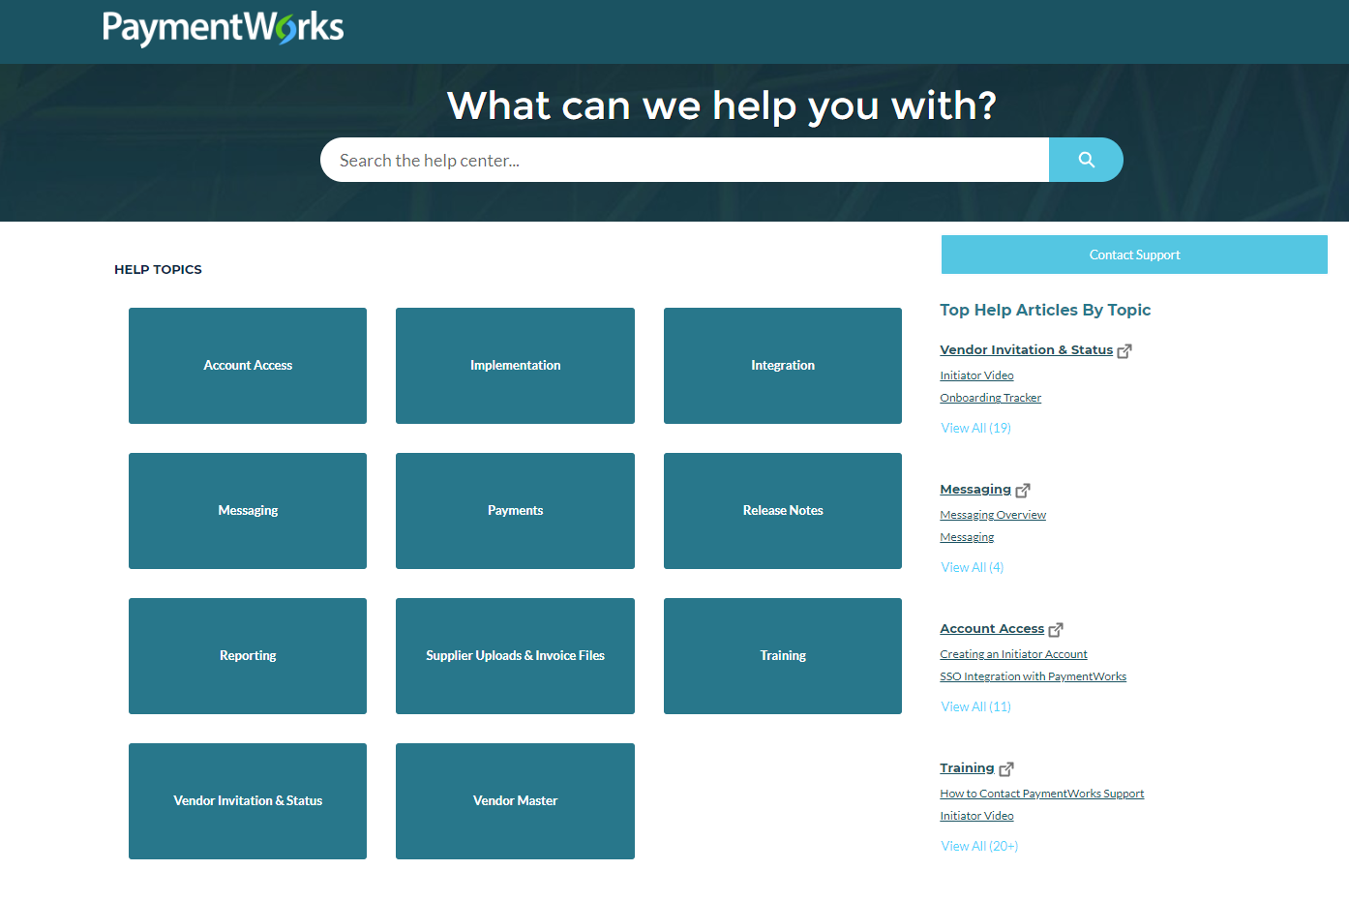
Help Center & Customer Support
Use the Help button in the top right of the screen or click on the Need Help symbols to access the Help Center and to find articles related to Onboarding.
Create a Support ticket using the Contact Support button in the Help Center

Slide 31
Questions?

